Slide 1
Deepening enquiry through planning a coherent learning narrative
Corrine Guntrip and Tatiana Wilson

Slide 2

Bloom’s Misunderstood
KS4
KS3
KS2
KS1
Creating
Evaluating
Analysing
Applying
Understanding
Remembering

Slide 3

Bloom’s Taxonomy for a Unit of Study
Creating
Evaluating
Analysing
Applying
Understanding
Remembering
Notes:
Bloom would have liked this.
The words describing stages of learning are exactly the same but there are 2 huge differences.
This is a picture of horizontal learning. This was how Bloom intended his Taxonomy to be used. This sequence of learning is repeated over and over again - from reception to Y13 and beyond. Bloom and his successors always intended the taxonomy to be used over short periods of time. The idea is that every time you start to teach a new SoW/unit/topic, your pupils start by recalling and remembering factual information. You then introduce -not more facts/content - but more challenging tasks using the same content. You want pupils to understand what they are learning; to analyse the material. Bloom called this deep learning. Deep because you get to understand a limited amount of content from several different angles. He claimed that we retain deep learning - it stays with us -rather than superficial learning which is the result of rushing through a large quantity of content - giving pupils only a few basic tasks to do. Think of all that last minute revision we all did for exams - we remembered it just long enough to write it all down - here today gone tomorrow.
The second big difference between our vertical and horizontal cones is that while the first assumes a constant moving forward, the second signifies that you move through this sequence horizontally thousands of times in a lifetime, as you learn new things. The beauty of it is for the teacher that once you know the sequence and how to use it the system is the same for everything pupils learn -from reception to Y13.

Slide 4
Revisiting Anderson and Krathwohl’s Taxonomy (BRT) 2001 Summary sheet
(Handout)

Slide 5
Key points on Effective Assessment
Use assessment to assess a variety of cognitive processes within a unit of work (not necessarily all)
Assess continuously (and encourage self-assessment) through your teaching unit to reshape planning
Assessment shouldn’t be repeated at the start and end of a unit of work – to be effective you need to offer a new activity or context.

Slide 6
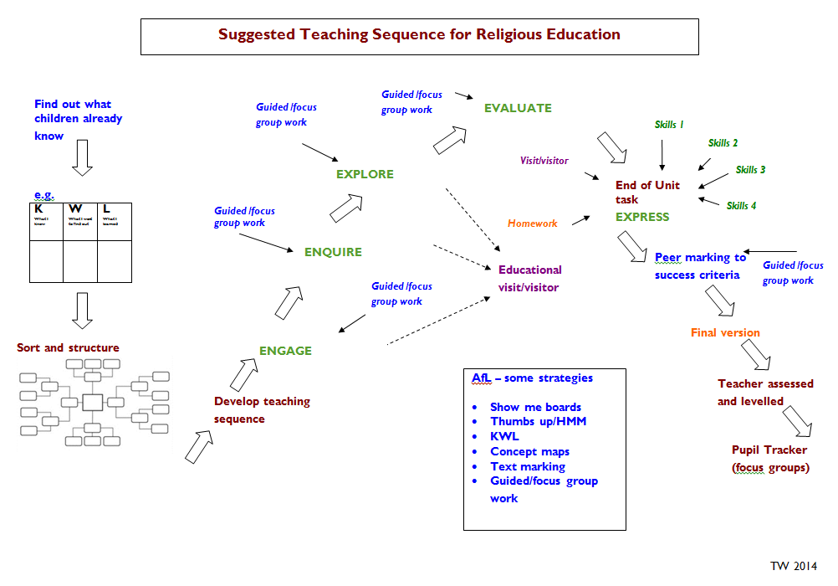

Slide 7
Planning Exemplars with
Corrine Guntrip
(Handouts)

