Slide 1
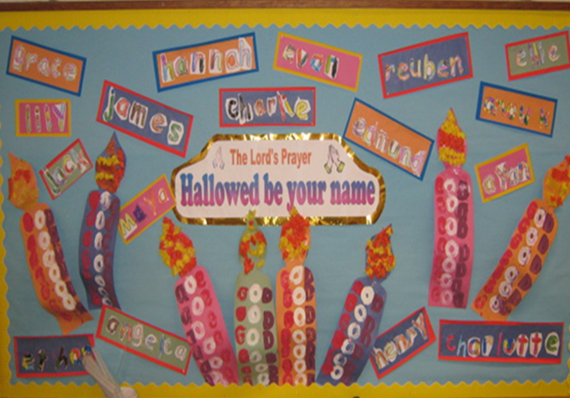
Why is the word ‘God’ so important to Christians?
CREATION 1

Slide 2
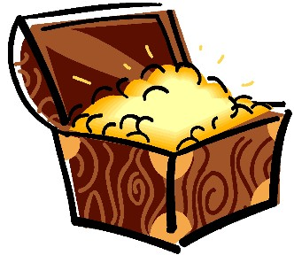
What’s inside the box? Whose box is it?
Open the Treasure Box and look at the teacher’s treasures
Start making your own treasure box and make your own name to label it.
Tom, Tessa and their Treasure Box – unpacking Christian things.
Do we know any Christians?
ENGAGE

Slide 3
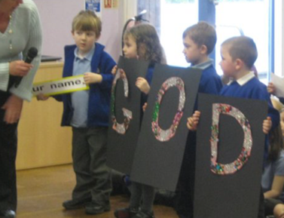
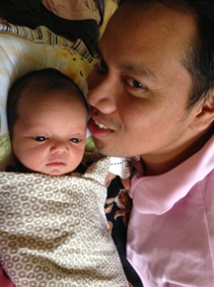
Who is special to you? What are their names? Why is God a VIP in a Christian family?
We talk about VIPs.
We meet the word ‘G-O-D’.
    King of the universe
    Invisible
    Friend
    Everywhere
… and discover it is a ‘name’.
Jesus teaches Christians about God.
Maybe children will meet the word ‘God’ in a new way for the first time in this lesson.
Muslims like a baby to hear the name ‘God’ before any other word.
ENQUIRE

Slide 4

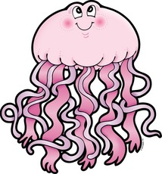
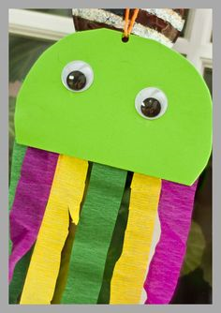
What Bible stories/ words do Tom and Tessa learn about?
Tom and Tessa wonder about jellies and jellyfish.
Grandad reads about God making the world including sea-creatures.
Why did God make jellyfish?
Can we make a jellyfish?
God is the ‘giver of life’.
EXPLORE: BIBLICAL NARRATIVE

Slide 5
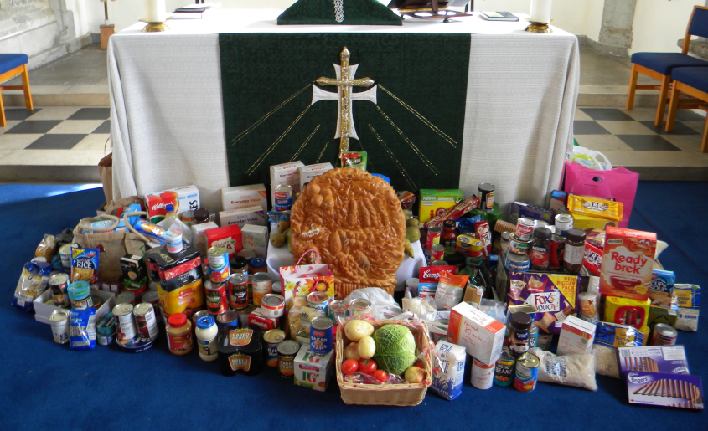
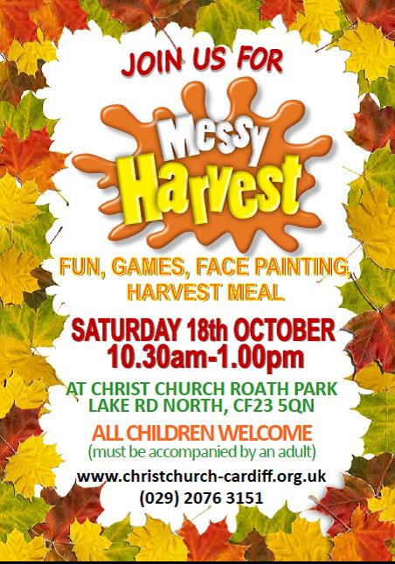
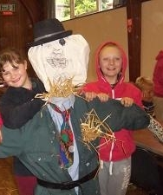
What happens in Tom and Tessa’s church?
Tom and Tessa get ready for a harvest service.
They thank God for their food.
They choose a harvest song.
They go to Harvest Messy Church.
EXPLORE: CHURCH

Slide 6
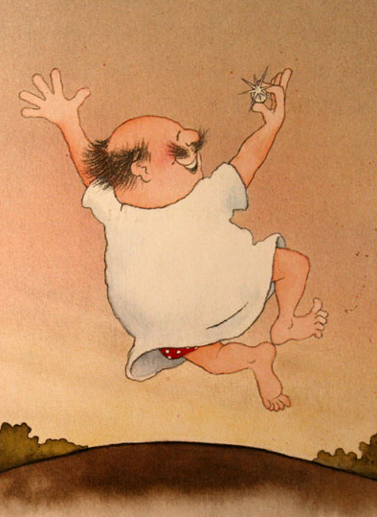
How are Tom and Tessa taught to live their lives?
Tom and Tessa learn to use the name of God with care; it is precious and holy.
Mum’s pearls – and Jesus’ parable of pearls.
Jesus says God’s name is holy in the Lord’s Prayer – Hallowed be your name.
EXPLORE: CHRISTIAN LIVING

Slide 7
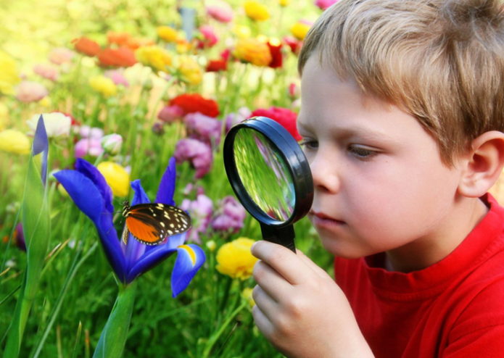
How can we care for our wonderful world?
CREATION 2

Slide 8

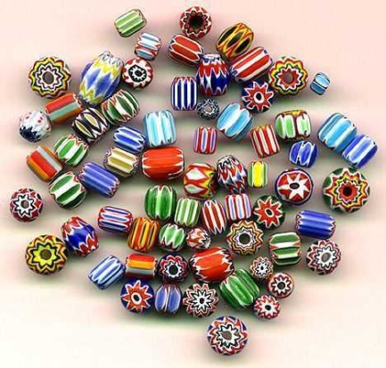
What is so wonderful about the world?
Wonderful Earth – Butterworth and Inkpen
Creation Calls link
Tom, Tessa and the Treasure Box
Revisiting the Creation Story
ENGAGE / ENQUIRE

Slide 9
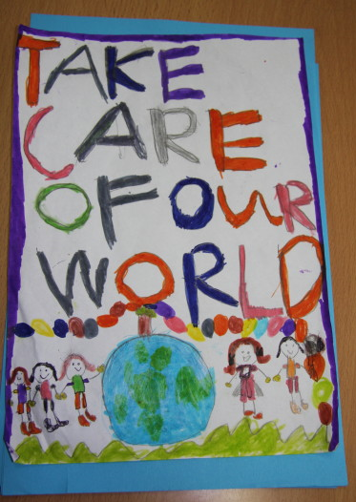
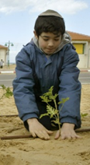
Whose job is it to take care of things?
Clearing up a mess and meeting the school caretaker – can we help put some things right?
How can we take care of the world? Whose job is it to look after the whole world?
Tom and Tessa help in the garden.
We hear about Jewish New Year for Trees.
ENQUIRE

Slide 10
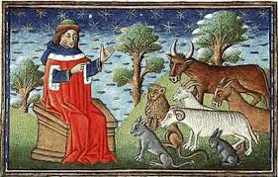
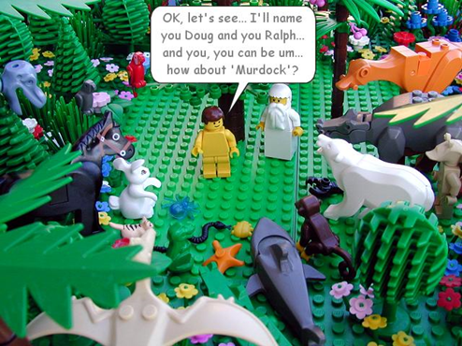
What Bible Stories/ words do Tom and Tessa learn about?
Tom and Tessa look at bugs. They hear about Adam naming the animals.
We sing a bug song from ‘Mini-Beasts’ (Out of the Ark): If I were a mini-beast
http://www.youtube.com/watch?v=n8bKBOhGpcI
EXPLORE: BIBLICAL NARRATIVE

Slide 11
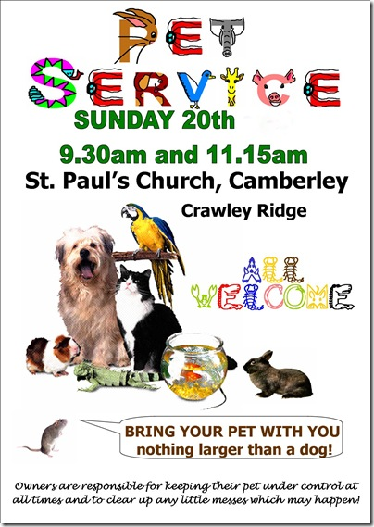
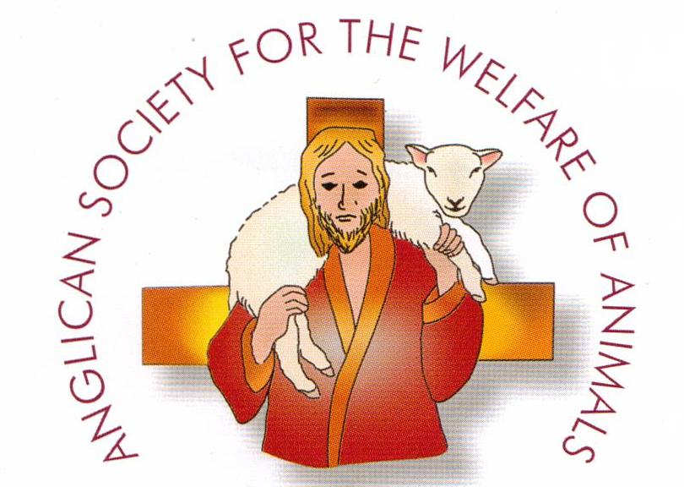
What happens in Tom and Tessa’s church?
Tom and Tessa prepare for a pet service for Animal Welfare Sunday.
They learn ‘From the Tiny Ant’. http://www.youtube.com/watch?v=0sUPK7LqAj8
They make ‘creatures’ to go on a new church banner which says: Lord you have made so many things! How wisely you made them! The earth is filled with your creatures! (Psalm 104 v.24)
EXPLORE: CHURCH
Notes:
From the tiny ant is good because it is a call and copy song – in Come and Praise

Slide 12
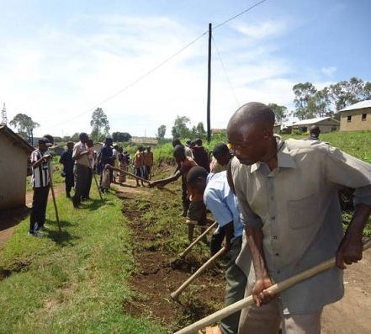
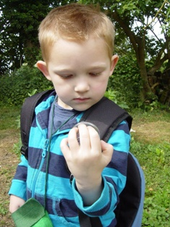

How are Tom and Tessa taught to live their lives?
Classroom tidy time for everyone
Tom and Tessa work in the church yard.
We find out about Umuganda.
Tom and Tessa write a Beasty Bugs Prayer and plan a ‘Wonderful World’ Messy Church
EXPLORE: CHRISTIAN LIVING

Slide 13
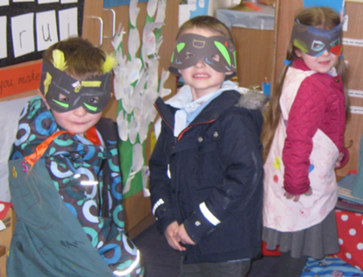
How can we help others when they need it?
SALVATION 1

Slide 14
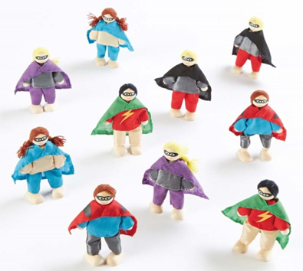
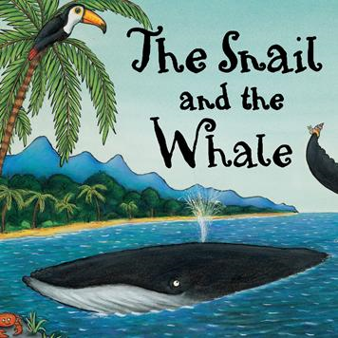

Can you help me?
The superheroes visit our class.
We find out about a snail who is a hero!
We think how we can help.
We offer to be a hero for the day!
ENGAGE

Slide 15
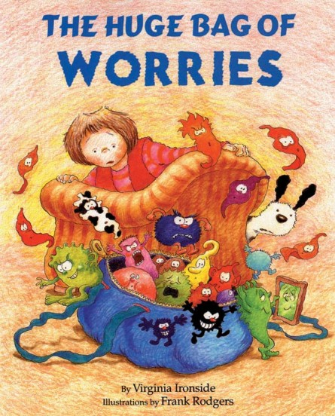


Who do you talk to if you need help? Who do Christians ask for help?
How would we help the girl in ‘The Huge Bag of Worries’?
5 people to help – a helping hand!
Tom and Tessa ask God for help in a prayer.
We look at a prayer book and sing Kumbayah / Talk to him.
ENQUIRE

Slide 16
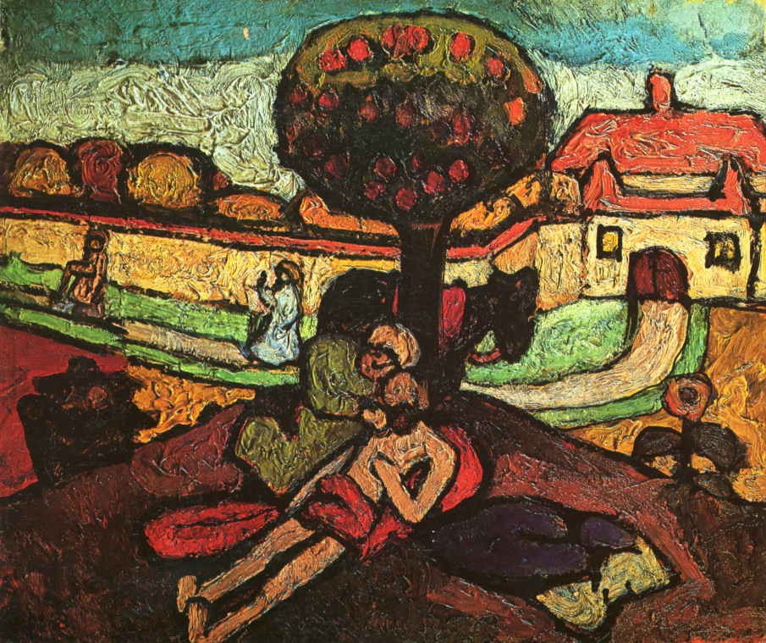
What stories do Tom and Tessa learn from the Bible about Jesus?
We find someone who needs help lying on our floor!
Our teacher mimes a famous story.
We find out about the hero in this Bible story.
EXPLORE: BIBLICAL NARRATIVE

Slide 17
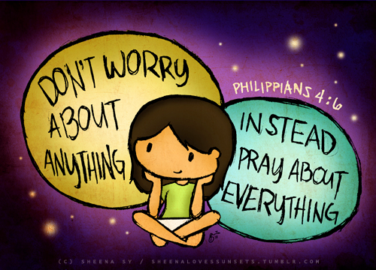
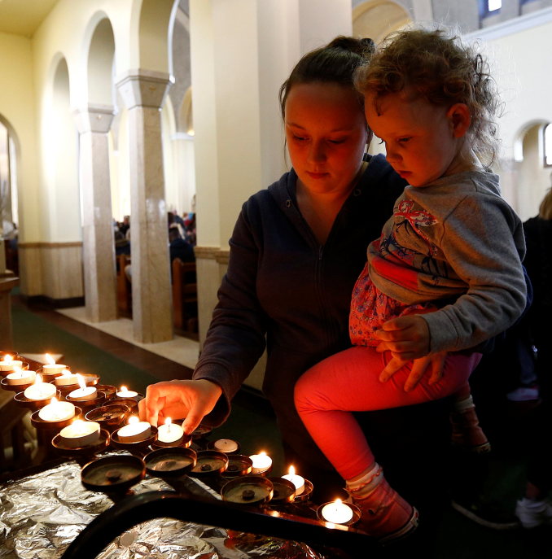
Why do Tom and Tessa light candles at the cathedral?
Tom and Tessa have brought candles to light.
Sometimes the twins worry and need help.
The Bible says: Don’t worry.
Grandad takes them to light candles in the cathedral as a sign of asking for God’s help.
EXPLORE: CHURCH

Slide 18
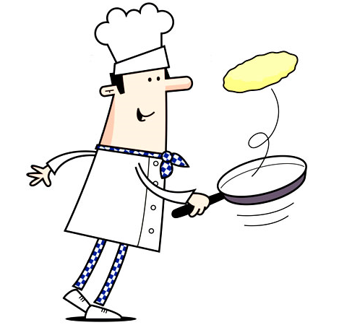


What special things do Tom and Tessa do to help others in Lent?
Tom and Tessa go to a pancake party.
The vicar announces the start of LENT.
40 days of doing good things even if we have to give up things we like.
‘Love Life Live Lent’ project
EXPLORE: CHRISTIAN LIVING

Slide 19
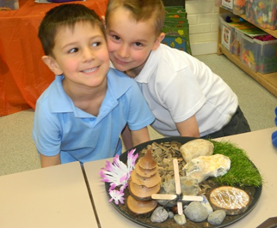
Why do Christians place a cross in an Easter Garden?
SALVATION 2

Slide 20
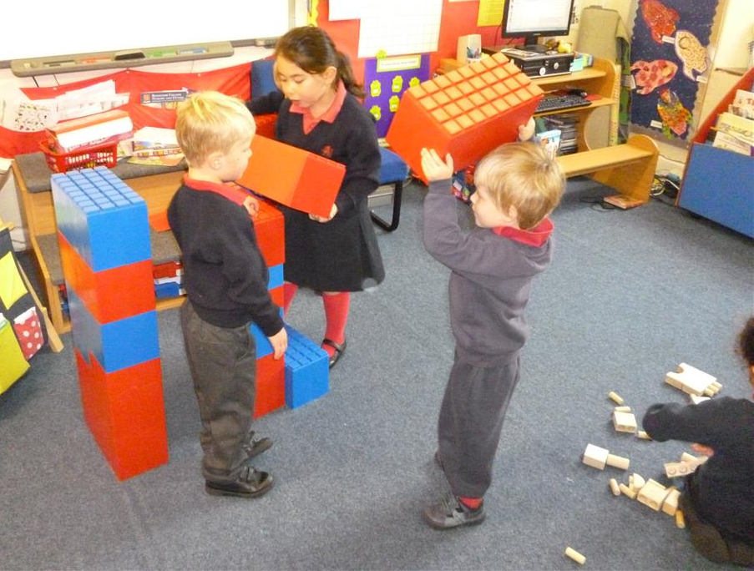
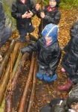
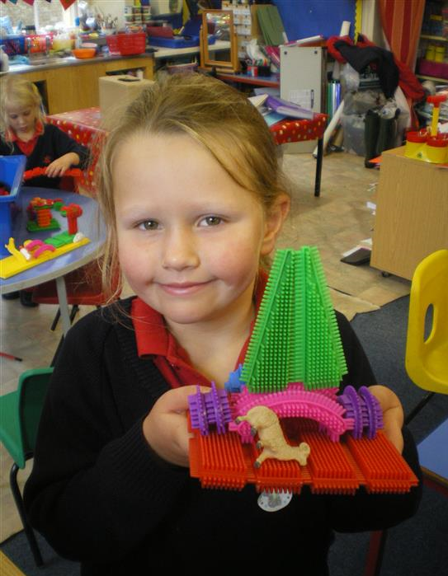
What is a bridge and how can it help?
We think about the bridge in ‘The Three Billy Goats Gruff’.
We build our own bridges.
We use special words: help, rescue and save.
We may hear a Buddhist story about a bridge.
ENGAGE
Notes:
Rendcomb college photos

Slide 21
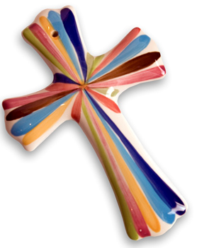
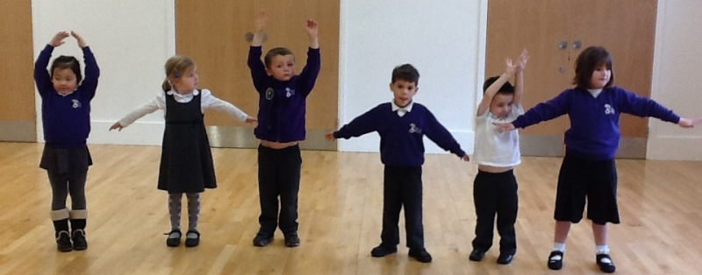
Why is a cross a special symbol for Christians?
We make shapes with our bodies!
We try making a cross shape.
Tom and Tessa show us some crosses
We learn about making the sign of the cross
ENQUIRE
Notes:
Making body shapes – bridges – can you make a bridge?
Can you make other shapes include different cross shape, a kiss, a wrong mark, a Christian cross, a letter X
Tom and Tess argue and have to make up – mum is like a bridge, mum is like a cross, mum is a peace-maker!
Tom and Tessa bring in crosses …. To look at and have to try to make a cross out of two twigs or craft sticks
Making hot cross buns for Easter. Crosses are important to Christians
Mark-making of crosses

Slide 22
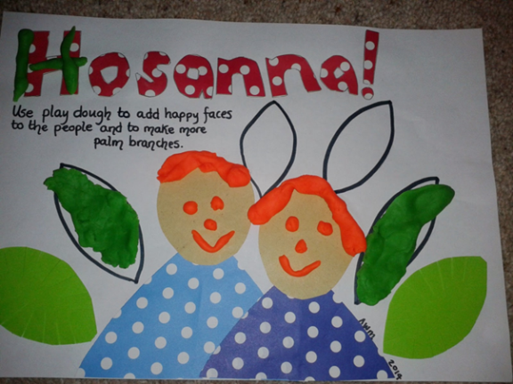
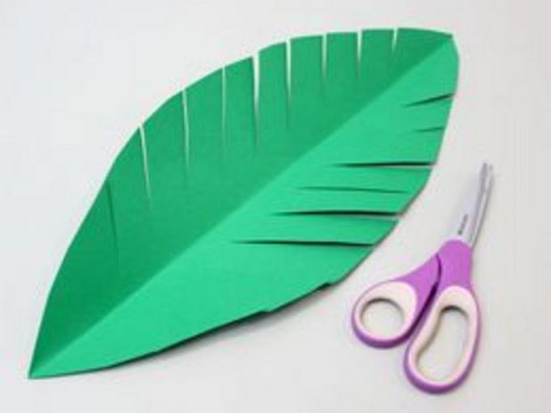
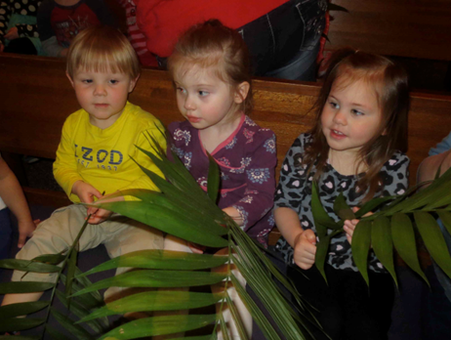
What Bible Stories do Tom and Tessa hear?
Tom and Tessa are given a palm cross at church.
We dress up and re-enact the story of Palm Sunday from the Bible.
We try out a ‘hosanna’ song.
We learn of Jesus’ death and connect it to the cross symbol.
EXPLORE: BIBLICAL NARRATIVE

Slide 23
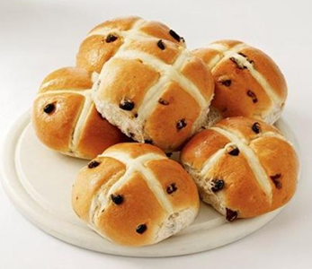
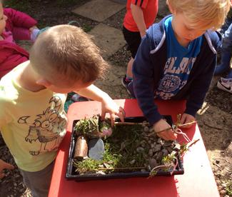
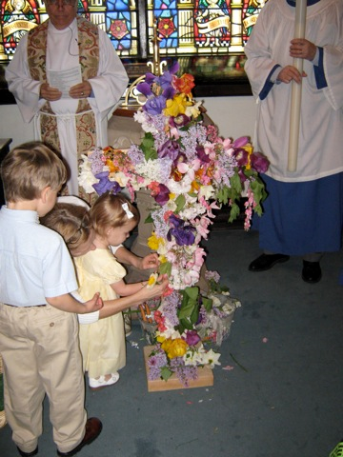
What happens in Tom and Tessa’s church?
Good Friday and eating Hot Cross buns
Easter Saturday and making Easter Gardens
Easter Sunday, the Easter shout and an egg hunt
Organising an Easter photo-shoot
EXPLORE: CHURCH

Slide 24
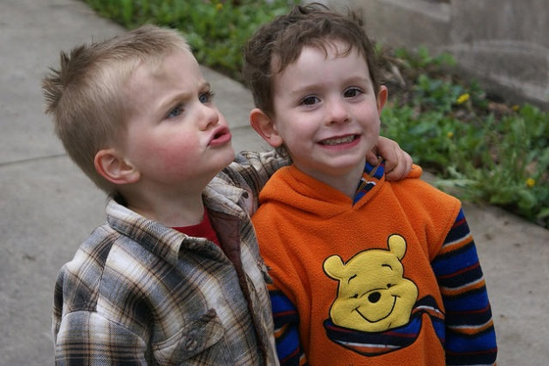
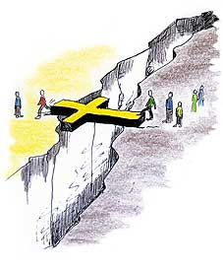
How are Tom and Tessa taught to live their lives?
The Easter Garden is broken
Whose fault is it?
Mum acts as a bridge, like Jesus.
The cross is a symbol of forgiveness and fresh starts
Re-making the Easter Garden
EXPLORE: CHRISTIAN LIVING

Slide 25
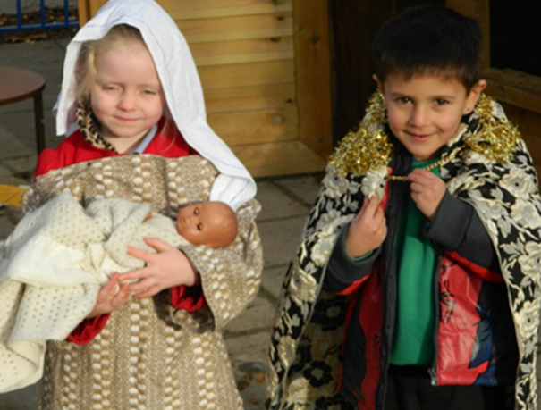
Why do Christians perform Nativity plays at Christmas?
INCARNATION 2

Slide 26
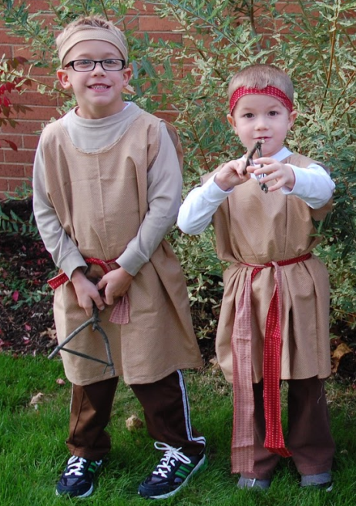
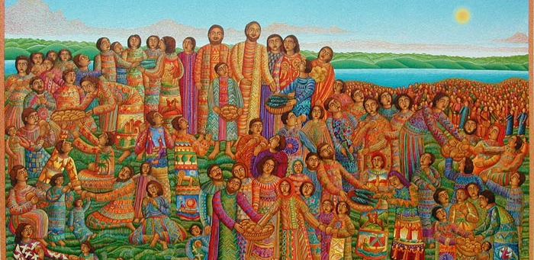
How do we know who someone is?
Costumes and charades
Tom and Tessa bring in dressing up clothes for acting Bible stories.
Playing the part of Jesus – doing and saying amazing things
What is happening here? Feeding of 5000 – John August Swanson
ENGAGE

Slide 27
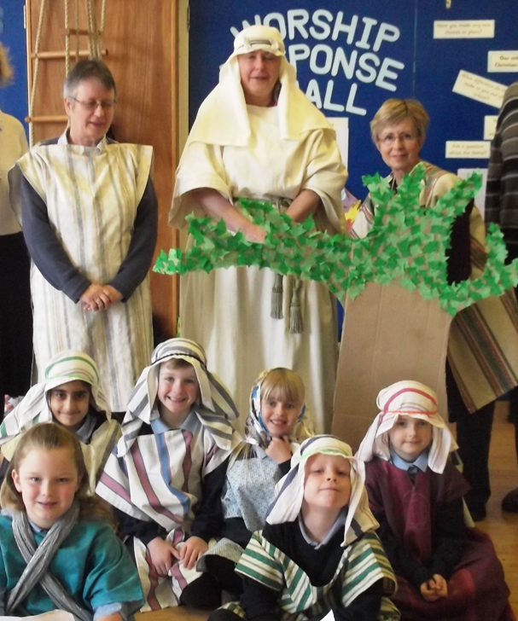
How do Christians find out what Jesus is like? Who do they think he is?
Act the story of the Feeding of the 5000
Look at pictures of Jesus stories in a story-bible.
Jesus is God come to earth.
Interview an Open the Book team.
ENQUIRE

Slide 28
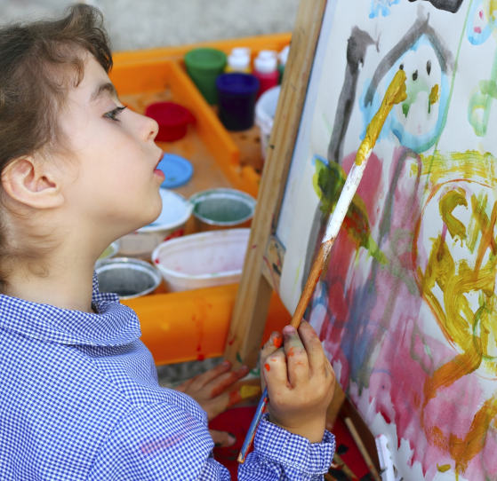
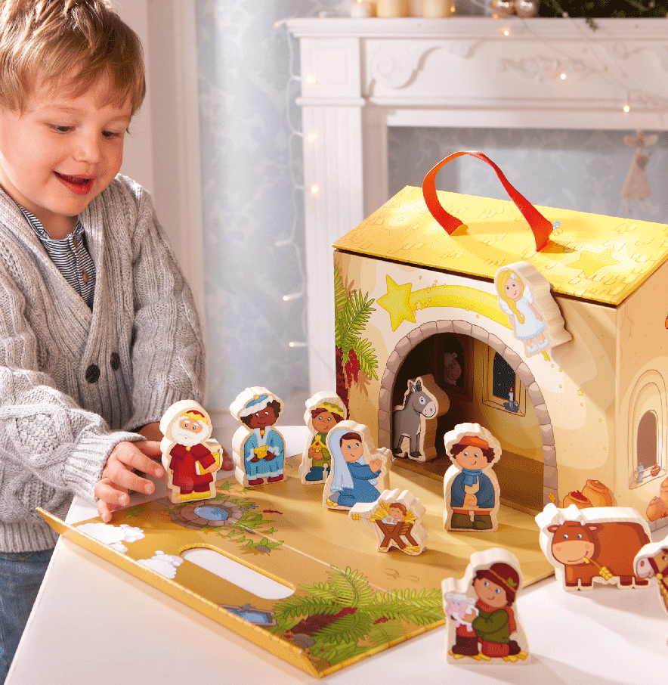
What stories do Tom and Tessa learn from the Bible about Jesus?
What did the teachers look like when they were babies?
Tom and Tessa bring in nativity figures.
We match the figures to the Christmas stories.
Jesus is like a treasure – he is God come to earth as a baby.
EXPLORE: BIBLICAL NARRATIVE

Slide 29
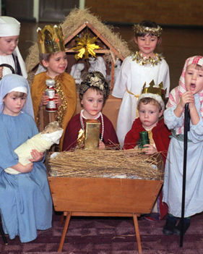
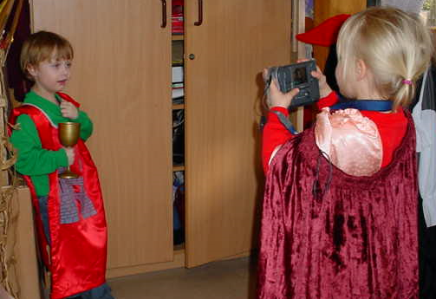

How do Tom and Tessa celebrate at church at Christmas-time?
Sing Happy Birthday to Tom and Tessa.
Lots of people remember Jesus’ birthday at Christmas.
We help Tom and Tessa with their nativity play.
We take photos of ourselves as nativity characters.
EXPLORE: CHURCH
Notes:
From the tiny ant is good because it is a call and copy song – in Come and Praise

Slide 30


What special things do Tom and Tessa do as Christians at Christmas?
We practise wrapping presents.
What is the best present at Christmas?
Tom and Tessa go carol-singing for charity.
We learn a carol too and talk about the words.
EXPLORE: CHRISTIAN LIVING

Slide 31

Why is every single person unique and precious?
INCARNATION 2

Slide 32

What does the word ‘precious’ mean?
I am holding something precious in my hand: what is it?
Tom and Tessa like hunting for things.
What did the woman in Jesus’ story need to find?
ENGAGE

Slide 33



How precious is a baby? Is everyone precious?
Meet a baby; it is precious.
We all grow older; we are still precious… and unique.
People look for us if we are lost.
Mary and Joseph looked for Jesus when he got lost.
ENQUIRE

Slide 34


What stories do Tom and Tessa learn from the Bible about Jesus?
Tom and Tessa need to practise acting a story of Jesus welcoming the children.
We think about how we welcome others.
We learn a welcoming song.
EXPLORE: BIBLICAL NARRATIVE

Slide 35



What happens in Tom and Tessa’s church?
Tom and Tessa go to a
Thanksgiving for their baby cousin at church.
God welcomes everyone.
We make a church and act out a ‘Thanksgiving’.
We make a welcome banner.

Slide 36




How are Tom and Tessa taught to live their lives?
Tom and Tessa invite us to ice cakes.
We find out about ‘Bake and Brew’ for the Children’s Society.
We learn the Golden Rule…. and we remember everyone is precious and unique.

