Slide 1
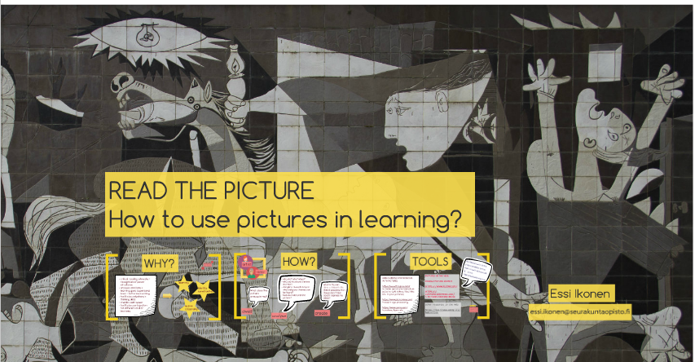

Slide 2
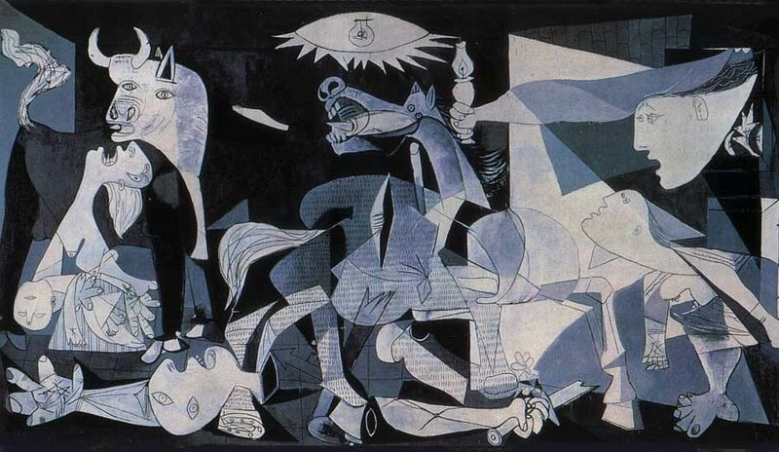
Guernica
is a painting by Pablo Picasso. It was created in response to the bombing of Guernica, a Basque Country village in northern Spain, by German and Italian warplanes at the instruction of the Spanish Nationalist forces on 26 April 1937 during the Spanish Civil War.

Slide 3
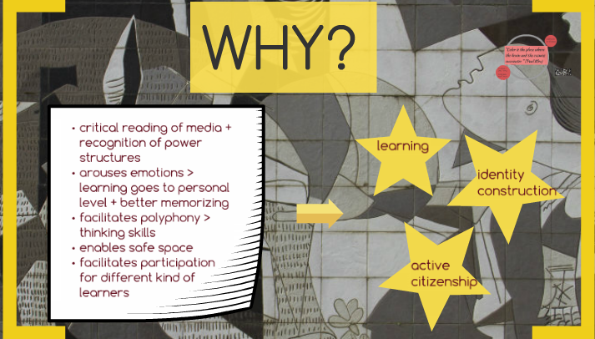

Slide 4
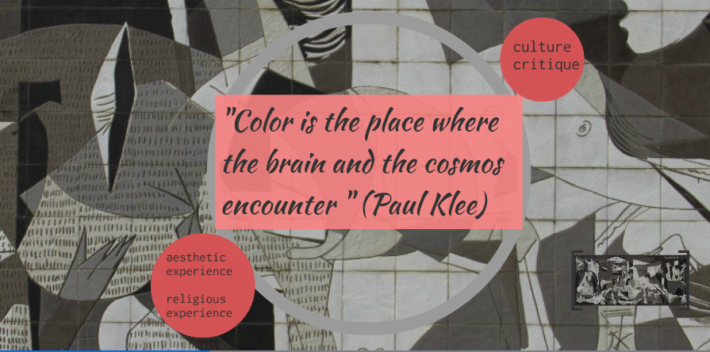

Slide 5
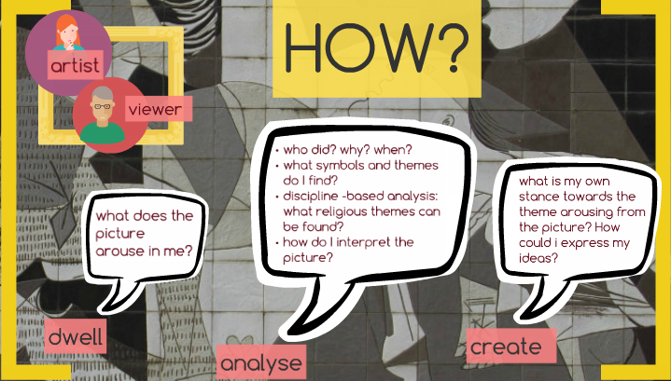

Slide 6
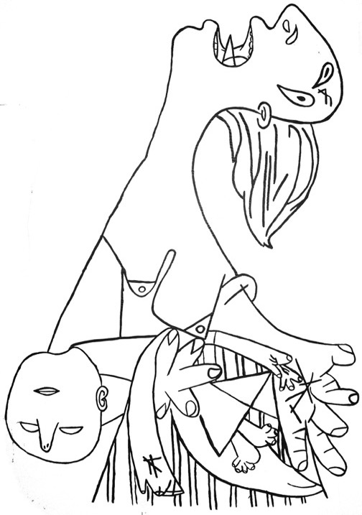

Slide 7


Slide 8
