Slide 1
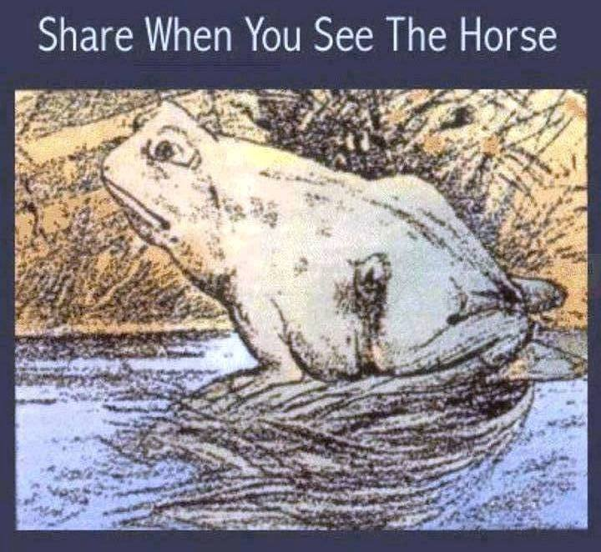

Slide 2
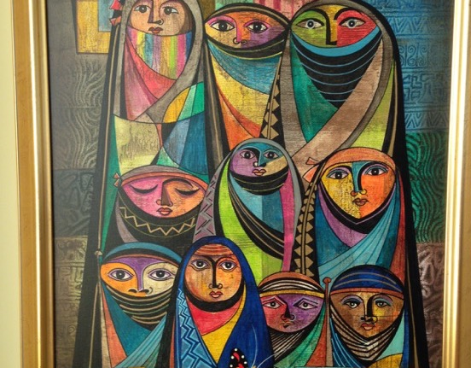
Developing skills in reading the picture
Dwell
What does the picture arouse in me?
Analyse
Who, what, where, when, how?
Observe, describe, explain, evaluate, interpret, critique
Create
What is my response?
How can I express myself?

Slide 3
Class activities using pictures
Using pictures for a silent debate
Print off an A4 copy of a number of pictures
Stick them on an A3 sheet
Pupils circulate the room annotating the images with comments and questions. Encourage a dialogue on the page
Allocate each picture to an individual and feedback to class
Picture share
Print off a selection of 30 pictures (smaller than A4).
Pupils choose one they like.
Talk to a partner and explain why.
All stand up.
Wander around the room talking to others about your picture. Share something on common. Something different.
Feed back

Slide 4


Slide 5
How do you choose pictures for stimulus in enquiry-based learning?
Consider the following criteria:
  A hook or an impact
  An aspect to create engagement
  Something unusual (without being sensational)
  A debating point
  Opens up discussion
  A contrast, similarity, inconsistency
  A surprising or shocking detail
  Links with prior or future learning
  Emphasises a concept or key learning point
  Challenges pre-conceptions and prejudices

Slide 6
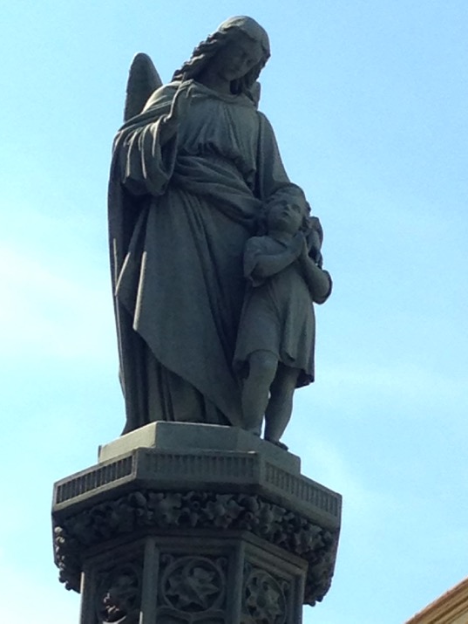

Slide 7
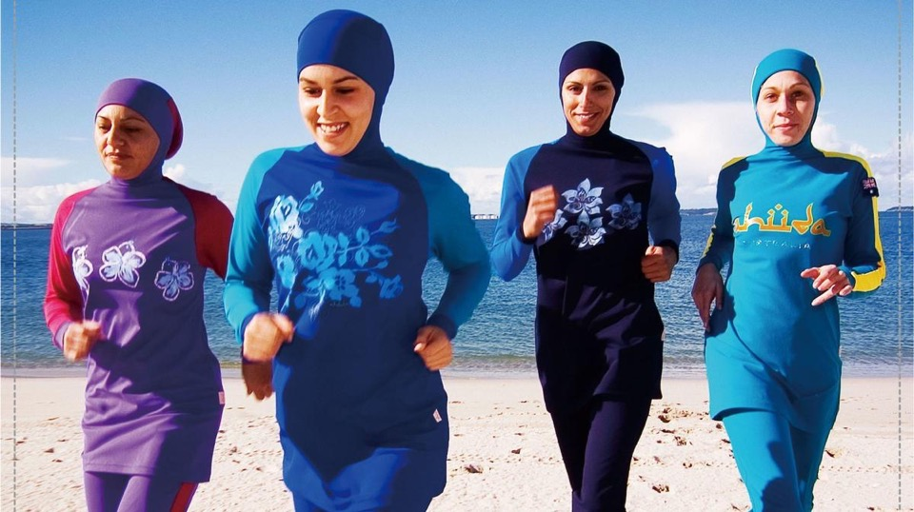

Slide 8
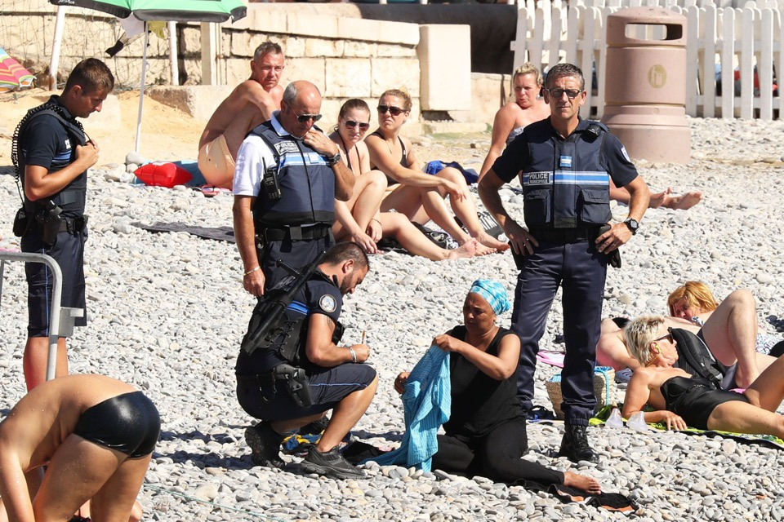

Slide 9
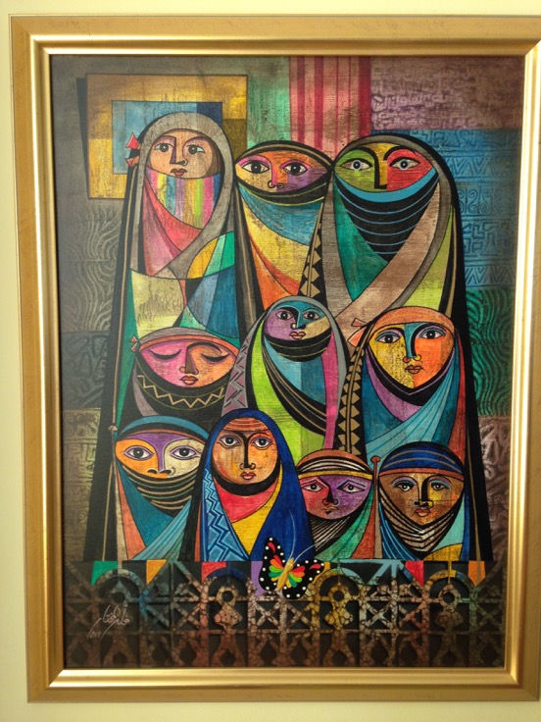

Slide 10
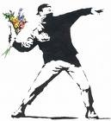

Slide 11
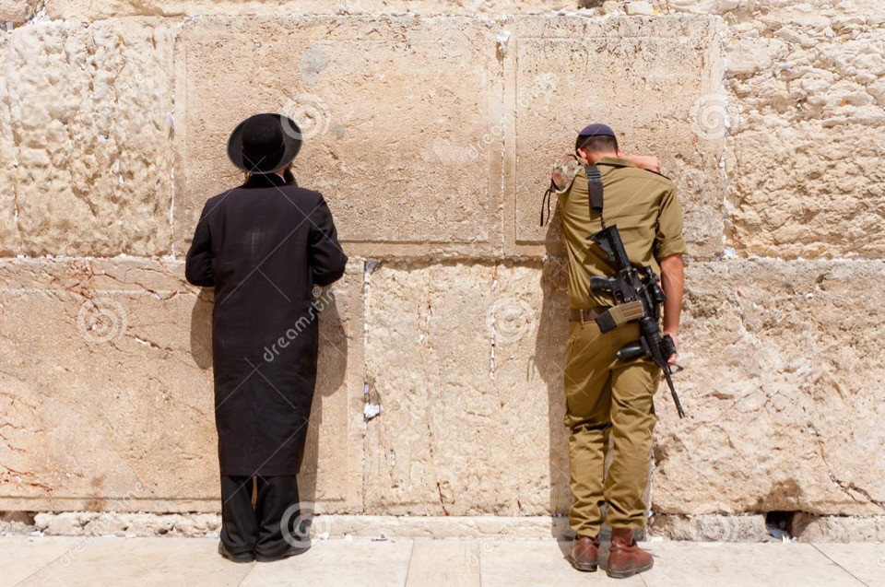

Slide 12
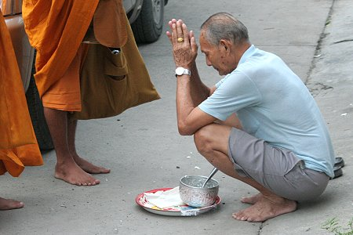

Slide 14
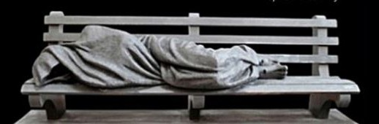

Slide 15
Homeless Jesus
“Sculpture of Jesus as a homeless man sleeping on a bench (that the Pope loved) sparks outrage in North Carolina” Daily Mail, Feb 2014

Slide 16
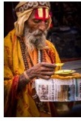

Slide 17
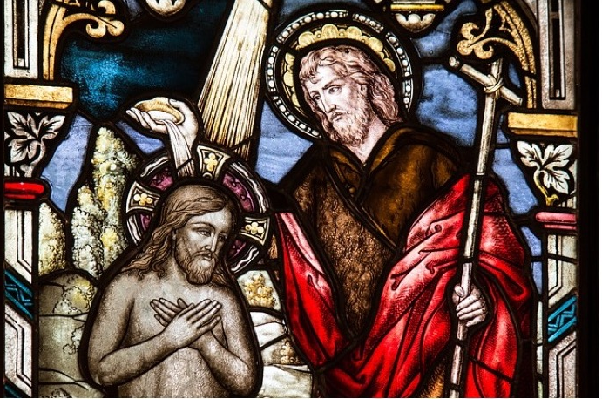

Slide 18
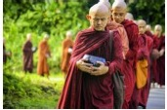

Slide 19
Free download pix:
https://pixabay.com

