Slide 1
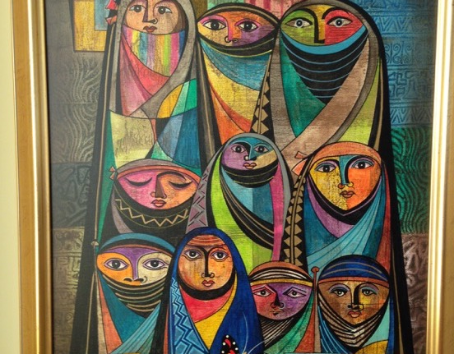
GCSE Subject Knowledge Course
Islam
June 2018
Ed Pawson
efpawson@gmail.com
Call to Prayer: Adhan
Jeremy Bowen: Our man in the Middle East

Slide 2
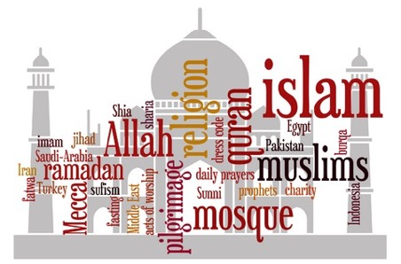
What is Islam?
divine creator
peace
Shari’ah
Muslims
Allah
Prophet Muhammad
God
submission
Qur’an
worship
revelation
Arabic
“There is no god but God”
Choose one word and explain to a partner why it is important
As a pair, discuss which 3 you think are the most important
Talk to another group and explain your decisions to each other
Now write a paragraph, in your own words, using at least 6 of these words
(remember, there’s no absolute answer, it’s about you justifying your choices)

Slide 3
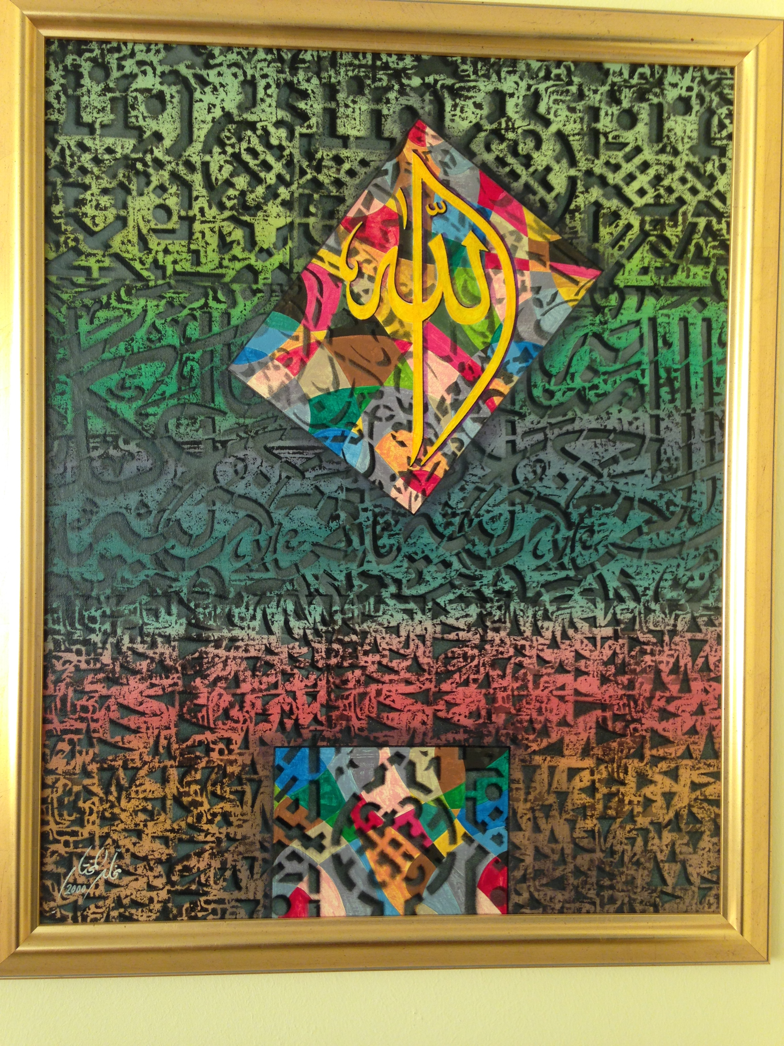
What would you say is the most important date in Islam?
Who, apart from Muhammad, is the most important leader of the Muslim community?

Slide 4
Diagram A
Timeline: Life of Prophet Muhammad
Laylat-ul-Qadr: the first Qur’anic revelation, received from God. Angel Jibril instructs Muhammad to ‘recite’
The year of sorrows: his wife (Khadijah) and his uncle (Abu Talib) both die, leaving him without a protector
Muhammad leads the Muslim army to recapture Makkah. He destroys the 360 idols in the Ka’ba
At the age of six Muhammad’s mother, Amina, dies. He becomes an orphan, to be cared for by his grandfather and later his uncle, Abu Talib
570CE
595CE
613-622CE
622CE
632CE
576CE
610CE
619CE
630CE
Muhammad is born in Makkah
Muhammad marries Khadijah
Muhammad teaches in Makkah, but is met with opposition
The Hijrah: Muhammad and his followers escape from Makkah to the City of Yathrib (later known as Madinah)
Muhammad dies aged 62
Task: can you explain why you think Muslims believe that Allah chose Muhammad to be the Prophet.

Slide 5
Islam after Muhammad (a Sunni perspective)
No clear successor to Muhammad after his death
Using ancient tribal custom, Abu-Bakr was chosen
He was known as the first caliph (deputy)
He promised to uphold all that Muhammad had stood for
Abu-Bakr and his three successors, Umar, Uthman and Ali were known as the ‘rightly guided caliphs’
They ruled over the caliphate
They had all known Muhammad and used the Qur’an and Muhammad’s actions to guide their actions
Under their rule, Muslims would gain control of Arabia, Syria, Egypt, and parts of the Sassanid (Persian) Empire. By 750, the Muslim Empire stretched 6,000 miles

Slide 7
Islam by country
Sunni
Shi’a
Ibadi
Tasks:
Can you describe where in the world most Sunni and Shi’a Muslims live?
Why are there proportionately more Sunni Muslims than Shi’a in the UK?

Slide 8
Islam in the world today
1.6 billion Muslims in the world today
23% of the world’s population
World’s second largest religion after Christianity
Fastest growing religion in the world
Islam originates from the Middle East
The Middle East and North Africa has the highest concentration of Muslim population: 93% of people in this region are Muslims
Nearly two thirds of the world’s Muslims live in the Asia-Pacific region (eg Pakistan, India, Bangladesh and Indonesia)
90% are Sunni, 10% are Shi’a
What’s your favourite statistic or fact about Islam?

Slide 9
Diversity in Islam: Britain
95% are Sunnis
5% are Shi’a
Sunni groups
  Deobandi
  Barelvis
  Salafi
Shi’a groups
  Twelvers
  Zaydis (Fivers)
  Ismailis (Seveners)
Some Muslims describe themselves as Sufis
Sufis try to find the heart of the religion and they practice a more mystical version of Islam
There is a significant Ahmadiyya community in the UK
They believe the long-awaited Messiah (Mahdi) has come in the person of Mirza Ghulam Ahmad
Some Muslims regard the Ahmadiyyas as non-Muslims

Slide 10
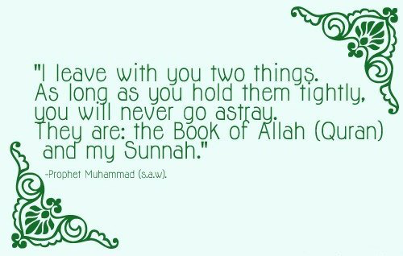
Authority in Islam (Sunni)
Tasks:
Can you explain what this text might mean to a Sunni Muslim
How might a Shi’a Muslim challenge this statement?

Slide 11
Authority in Islam
The Qur’an is the most important authority in Islam; a book of guidance for all human beings
The Sunnah: the way of the Prophet
The Prophet Muhammad is an inspiration to all Muslims
The Sunnah is the second most important source of authority for Muslims
It describes the customs, practices and traditions of Muhammad
It teaches the perfect path or model of how Muslims should live
The Hadith: the sayings of the Prophet
Muslims love and respect the words of Prophet Muhammad
He had deep devotion to God, enormous wisdom and compassion
The Hadith contains his sayings, as recorded by his family and companions
Hadith means to ‘tell’ or ‘report’.
There are different collections of Hadith, accepted by different Muslim groups

Slide 12
The Shari’ah: the straight path
The Shari’ah Law sets out the moral and religious rules for Muslims to follow
It puts into practice the principles set out by the Qur’an, the Sunnah and the Hadith
By following Shari’ah law Muslims can know that they are obeying the will of Allah
Shari’ah lays down laws about what is halal (allowable) and what is haram (forbidden)
It deals with many everyday topics like food, clothing, crime, money, sex and relationships
“I have left among you that which if you hold fast to, then you would never go astray, clear things, the book of Allah and the Sunnah of his prophet” Prophet Muhammad’s last sermon

Slide 13
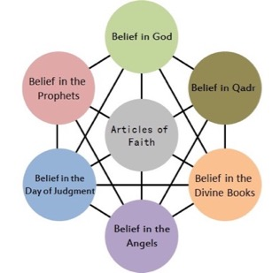
The Six Articles of Faith in Sunni Islam
“You must believe in Allah, his angels, his holy books, his messengers, in the Last Day and in life after death”. Prophet Muhammad
1 Allah (God): the unity and oneness of God is called Tawhid
2 Malaikah (Angels): God created angels to bring His divine message
3 Holy Books: God has revealed his word to humans in the Qur’an.
Other books: Tawrat of Musa (Torah), the Zabur of Dawud (Psalms) and the Injil of Isa (Gospels)
4 Risalah (Prophethood): God has spoken through numerous prophets throughout time
5: Akhirah (Afterlife): Belief in the Final Judgement and life after death
6 Al-Qadr (God’s predestination): God is responsible for everything and has set out a divine destiny for all things

Slide 14
The nature of Allah
Muslims believe that God is:
Oneness (Tawhid): there is one God who has no equals; he is a Divine unity
Immanent: God is always close by. The Qur’an says that God is closer to each one of us than the veins in our necks (50:16)
Transcendent: God is beyond all things, not limited by the rules of nature
Omnipotent: God has all power
Omniscient: God has all knowledge, nothing can be hidden from him
Merciful: God is always fair; He forgives us if we are sorry
Beneficent: God is always kind; He loves us
Justice and fairness: In Shi’a Islam there is an emphasis on Adalat, the Justice of God. This is one of the five roots of religion (Usul ad-Din). God does not wrong anyone and he will not tolerate wrong-doing

Slide 15
Some of the 99 names:
Giver of life
Protector
Just
Generous
Guide
Ever-forgiving
Watchful
Creator
Compassionate
Avenger
Tremendous
Mighty
Finder
Patient
Knower
King
Gentle
The 99 beautiful names of God
Transcendent: beyond all things | Omniscient: all-knowing | Beneficient: always loving | Merciful: kind and forgiving | Judge: decision-making, fair | Creator: maker, designer
Task: Create a table with the headings shown.
Put the ‘names’ of God in the list into the relevant columns

Slide 16
The 99 beautiful names of God
Transcendent: beyond all things | Omniscient: all-knowing | Beneficient: always loving | Merciful: kind and forgiving | Judge: decision-making, fair | Creator: maker, designer
Tremendous | Watchful | Protector | Ever-forgiving | Just | Giver of life
Mighty | Finder | Generous | Compassionate | Avenger | Creator
King | Knower | Guide
 |  | Patient
 |  | Gentle

Slide 17
God the One and Only:
Surah 112 sums up the nature of God
In the name of God, Most Gracious, Most Merciful say “He is God the One and Only, God the Eternal, Absolute. He begetteth not nor is He begotten; and there is none like unto him”
Task: Annotate this text to show understanding of Islamic beliefs about God (Allah)

Slide 18
God is personal, but he is not a person. God cannot be pictured in human form.
Quran 112:1-4. These notes are adapted from Yusuf Ali.
God the One and Only:
Surah 112 sums up the nature of God
He is “eternal”, without beginning or end.
There is only one God (monotheism). Belief in many gods (polytheism) is false.
In the name of God, Most Gracious, Most Merciful say “He is God the One and Only, God the Eternal, Absolute. He begetteth not nor is He begotten; and there is none like unto him”
“He begetteth not” means that he has no children. This challenges the Christian belief that Jesus is the ‘Son of God’
God is perfect and unchanging. There is no greater being
Nothing compares to God;
He is incomparable. He is the creator, everything else is part of His creation
Task: Now create your own mind map
I
- Allah -
I
“nor is He begotten” means he was not born.

Slide 19
Revelation in Islam
Risalah, Prophethood
Prophets are human beings chosen to carry guidance from God to people, but their wisdom does not come from within themselves; it comes from God.
A ‘rasal' is a prophet. ‘Risalah’ means bringing prophecy from God
Divine wisdom and human words
Prophet Muhammad was the channel through which God spoke.
Muslims make a clear distinction between the Divine revelation (recorded in the the Qur’an) and the human words of the Prophet Muhammad (preserved in the Hadith).
God’s message
“For each period is a Book revealed”. (Qur’an 13:38)
Qur’an: every generation has been given its own prophet, bringing God's message in a book.
Prophet Muhammad’s message is the same message as had been preached by all the prophets back to Adam: the need to worship the one, true God, who will be the Judge of all.
“We send the messengers only to give good news and to warn”. Qur’an 6:48

Slide 20
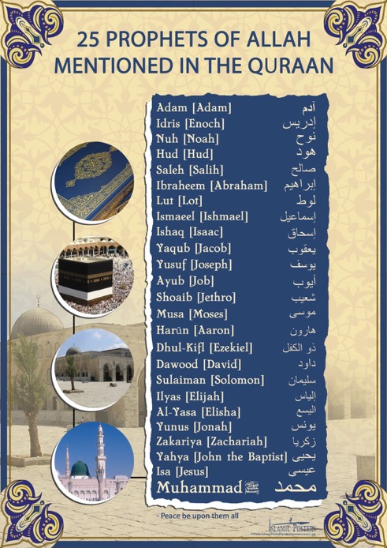
Prophethood
At least one Prophet has been sent at some time in human history to all the
peoples of the earth
Muhammad spoke of 124,000 of such Prophets in total although the identities of the vast majority are unknown to us.
“Allah chooses to Himself those who he pleases, and guides to Himself those who turn to Him.” (Qur’an 42:13)
“People, no prophet or messenger will come after me, and no new faith will emerge.” Muhammad’s last sermon (Hadith)

Slide 21
Mount Arafat/ Mount of Mercy
Plain of Arafat
Mawah
Safa
The Ka’ba
Zamzam well

Slide 22
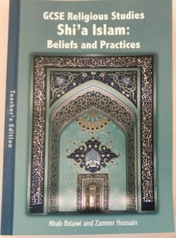
Islam resources
Zameer Hussain video: Crash course in Shi’a Islam
https://sites.google.com/site/londonrehub/video-2016
True Tube resources
https://www.truetube.co.uk/list?content%20types=films&page=1&search=Islam&keystages=key%20stage%204&
Native Deen: Mercy to Mankind
https://www.youtube.com/watch?v=Go71P2UPgkc
The long, short story: Islam
https://www.youtube.com/watch?v=8os1SL-9vRs
Bible or Qur’an? (watch out for the bad language!)
https://www.youtube.com/watch?v=lX0Zt0ODrEA
Dr Chris Hewer
https://www.youtube.com/watch?v=5yzrcdyTBHU
Ashura in Manchester
https://www.youtube.com/watch?v=LaWtr10b1es
GCSE Religious Studies, Shi’a Islam: Beliefs and Practices by Zameer Hussain re@alkhoei.org

