Slide 1
Islam and Ethics
GCSE Religious Studies
Ed Pawson
efpawson@gmail.com

Slide 2
A belief in ‘family’ is central to religious ethics
Christians, Jews and Muslims all regard family as the most important foundation of society
There is a need to create strong nuclear and extended families

Slide 3
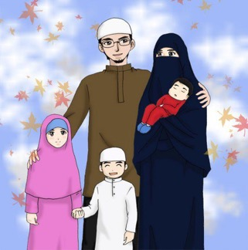
Traditional views
In general, Islam teaches a traditional view of roles
Traditional view of the role of women and men in family life
Father/husband: responsible for providing for the family through work
Mother/wife: responsible for domestic life
Patriarchal: man seen very much as the leader of the family
Binary understanding of gender and sexuality

Slide 4
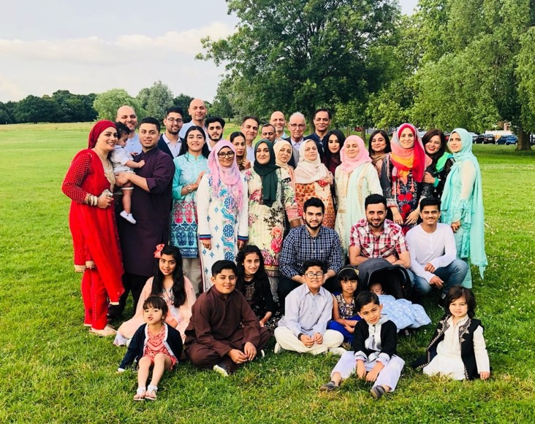
Eid-ul-Fitr 2018
Hussain Family - 4 generations

Slide 5
Traditional views in Islam
The following quotation shows how Islamic teaching holds a very traditional view of family roles. Men are in charge of the family unit; women are referred to as their ‘subjects’. Women are responsible for the home and children:
‘God’s Apostle said, “Surely! Everyone of you is a guardian and is responsible for his charges: The Imam [ruler] of the people is a guardian and is responsible for his subjects; a man is the guardian of his family [household] and is responsible for his subjects; a woman is the guardian of her husband’s home and of his children and is responsible for them; and the slave of a man is a guardian of his master’s property and is responsible for it. Surely, everyone of you is a guardian and responsible for his charges.”’
Hadith Sahih Bukhari 9:89:252
The last sentence could be used to support a more modern view in which both parents are responsible for the children in a family.

Slide 6
Changing views in family life in UK population
In the UK today, women and men are more of a partnership, with shared responsibilities
Increasingly common for:
women to continue to work when they get married and have a family
men to take on more household chores and responsibilities
In 2014 the Office for National Statistics reported that the number of ‘stay at home’ dads has doubled since 1993, with over 229,000 fathers staying at home to look after their children. The law is also changing to reflect this.
In 2015 it became possible for men and women to share parental leave. Parents can decide who takes leave to care for the baby, rather than it automatically being the mother.
To what extent do you think these changes are reflected in the Muslim community?

Slide 7
What have families got to do with religion?
Religion and the family are interlinked
Home: where religious belief is ‘taught’ and ‘caught’.
The family is a domestic arena in which religious belief, practices and teachings are lived out
Family life is where religion is experienced by young children and young adults through the example of their parents
Most religious believers think it is a religious duty for parents to bring up their children to share in their faith and teach the values which are important to them

Slide 8
Muslims are expected to marry
In the Qur’an there are a number of references to the importance of marriage and how it is the basis of family life. All Muslims are encouraged to marry in order to have a companion and, although divorce is permitted, the ideal is that marriage is for life.
Muslims believe marriage is a gift from God and that people should marry. It says that within this relationship the couple are able to show affection towards one another and are able to support each other in their religious faith.
‘And of His signs is that He created for you from yourselves mates that you may find tranquillity in them; and He placed between you affection and mercy. Indeed in that are signs for a people who give thought.’
Qur’an 30:21

Slide 9
Temporary marriage
Some Shi’as (Twelvers) practise Nikah Mut’ah (temporary marriage)
a marriage that lasts only for a limited period of time
a formal arrangement with a contract (nikah) which specifies the terms of the arrangement, including the length of the marriage and any rules of behaviour during the marriage
The man may give the woman a gift (dowry/mahr)
Historically (during the time of Muhammad) the practice was used by men who were travelling away from home for a long period of time to allow them to take a wife while they were away
Today some UK Shi’as engage in temporary unannounced marriages to date and socialise with members of the opposite sex
This wouldn’t otherwise be allowed under Shariah law.
Twelvers point to passages in the Qur’an and hadith that say temporary unannounced marriage is acceptable
Sunnis and other Shi’a groups say that this is completely wrong
They say that having sex before marriage is not permitted in Islam
Sunnis point to the teaching of the Second Caliph who banned temporary unannounced marriage

Slide 10
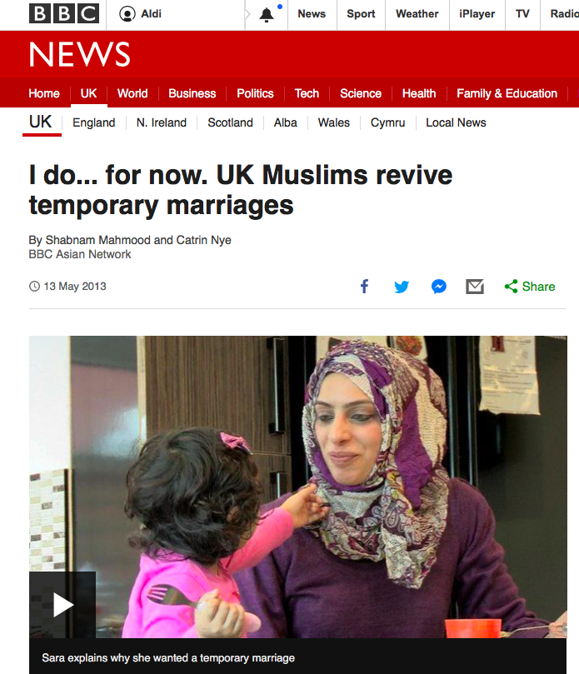
https://www.bbc.co.uk/news/uk-22354201

Slide 11
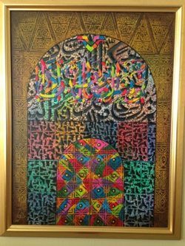
Marriage in Islam
In Islam, marriage is a gift from God
‘He is the One who has created you all from a single person and made its mate of like nature in order that he might dwell with her in love’ Surah 7 v 189
However, marriage is a contract, not a sacrament
It is not seen as an eternal, unbreakable vow before God (as in Christianity)

Slide 12
Adultery
Adultery is seen as a form of theft of the worst possible sort.
• The Qur’an teaches that adultery is wrong:
‘Have nothing to do with adultery for it is a shameful thing and an evil, opening the way to other evils.’
Qur’an 17:32
‘And do not approach unlawful sexual intercourse. Indeed, it is ever an immorality and is evil as a way.’
Qur’an 17:32

Slide 13
Divorce is acceptable in Islam
Muslims reluctantly accept that when a marriage breaks down, reconciliation is not always possible, so they do accept divorce. When divorce does occur Muslims believe each partner should be free to remarry in the future
As well as a civil divorce, which legally ends the marriage, Muslims believe that the marriage must also be ended in the eyes of God. They can apply to a Shari’ah council to obtain an Islamic divorce
Muhammad married a number of wives after the death of Khadijah and some of them were divorced, so this sets a pattern for Muslims.

Slide 14
Divorce is allowable
‘The most detestable act that God has allowed is divorce’ (Hadith)
Divorce should always be the last resort, after attempts to put things right
Talaq
A talaq is a divorce requested by a husband
The intention to divorce must be stated 3 times
A wife can divorce by talaq if it was agreed at the time of their marriage and put into their contract

Slide 15
Divorce in Islam
Mubara’ah
The husband and wife can agree between themselves to terminate their marriage
Khul
If the wife has a genuine grievance against her husband she can obtain a divorce from him by returning his marriage gift in return for the dissolution of the marriage. This is known as khul
Talaq
A talaq is a divorce requested by a husband
The intention to divorce must be stated 3 times
A wife can divorce by talaq if it was agreed at the time of their marriage and put into their contract, but this is not common

Slide 16
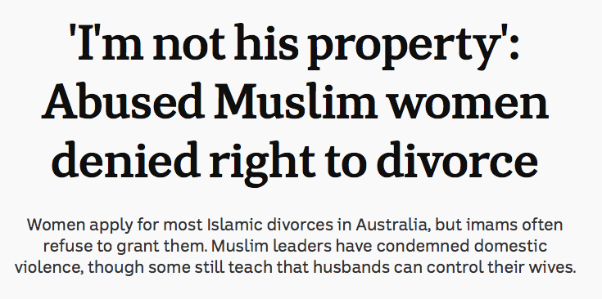
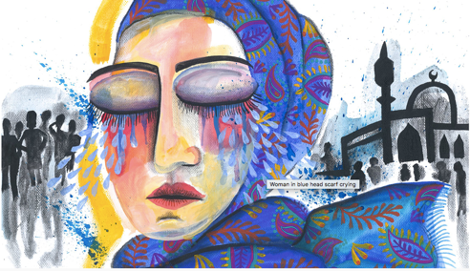
http://www.abc.net.au/news/2018-04-18/abused-muslim-women-denied-right-to-divorce/9632772

Slide 17
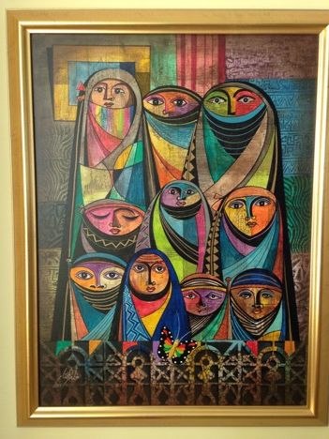
Same sex relationships
Islam forbids same-sex marriages and homosexual and lesbian relationships, believing that sex should only take place between a husband and wife.
Muslims regard marriage as the only place where sexual relationships should take place and regard marriage as a sacred contract between only a man and a woman.
Muslims interpret this to mean that same-sex relationships are wrong.

Slide 18
Punishment
Forgiveness is very important in Islam
So is the need to protect society (ummah) and keep law and order
Punishment is central to justice and essential in keeping people from straying from what is good and just
Shari’ah Law (straight path) outlines the rules to live by and the punishments if these laws are broken
Many Shari’ah punishments are designed to deter as well as protect society from further wrongdoing
Eg cutting off a hand for theft, or a receiving a beating in full view of the local community.
For Muslims, punishment has nothing to do with removing sin as only God can forgive
Punishment is a way of keeping law and order.
Muslims hope that offenders will repent, reform and seek forgiveness both from God and their victims.
‘Indeed, God orders justice and good conduct and giving [help] to relatives and forbids immorality and bad conduct and oppression. He admonishes you that perhaps you will be reminded.’ Qur’an 16:90

Slide 19

Halal and Haram
‘The halal is that which Allah has made lawful in His Book, and the haram is that which He has forbidden, and that concerning which He is silent, He has permitted as a favour to you’ (Hadith)
Everything Allah has created is halal unless it has been declared haram
Five ‘Provisions’ in Islam for a Muslim:
Compulsory (Fard)
Recommended (Sunnah)
Permissible (Halal)
Disliked (Makruh)
Forbidden (Haram)

Slide 20
Five ‘Provisions’ in Islam for a Muslim
Compulsory (Fard)
eg obligatory duties like salah, zakah, fasting
Recommended (Sunnah)
eg how to pray, what to wear. Muslims often look to the example of Muhammad
Permissible (Halal)
These actions permitted by the fact that nothing is said about them, eg reading a book, paying a fair price
Disliked (Makruh)
These actions are not approved of, but are not punishable, eg divorce, materialism
Forbidden (Haram)
Forbidden actions which will be punished by Shari’ah Law and God, eg eating haram food, murder, theft, and beating women, disrespecting Islamic Laws

Slide 21
Is this a helpful image?

Slide 22
Shari’ah Law
Islam teaches that God will judge all humans after death
But God is also Just
This means He must have set out the law that shows people how they should behave

Slide 23
Shari’ah
Simply: Islamic law is revealed in the Qur’an
However, the Qur’an is not principally a law book and only 260 verses refer to laws
So Muslims need to look to secondary sources to establish Shari’ah
First and foremost they look to the Sunnah and the Hadith
Muhammad is the seen as the most perfect man, so Muslims look to his example
Beyond this, many Islamic schools of law also take into consideration:
  Customs and practices in Muslim communities
  Consensus and opinions of Muslim scholars
  Interpretation and analogy
Sharia Law - Islamic Law Myths and Realities
https://www.youtube.com/watch?v=FO2LYke16hY

Slide 26
Shari’ah Law closes off actions that could lead to harm
Many people criticise Shari’ah law, labelling it as a set of unnecessary and unacceptable limitations and restrictions.
However, Muslims say these laws are designed to keep people away from harm
‘When Islam prohibits something, it closes all avenues of approach to it. This is achieved by prohibiting every step and every means leading to haram. Accordingly, whatever excites passions, opens ways for illicit sexual relations between a man and a woman and promotes indecency and obscenity is haram.’
Yusuf al’Qaradawi

