Slide 1
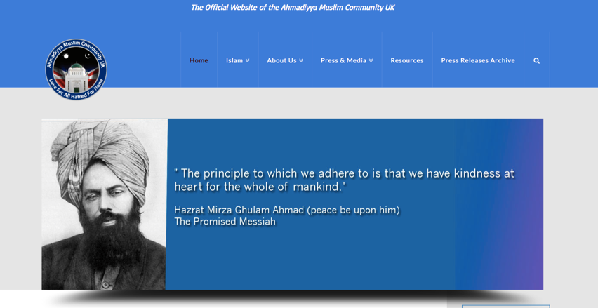
Ahmadiyya Islam
Screenshot of the Ahmadiyya website ‘Love for all, hatred for none’
Featuring an image of Ghulam Ahmad, the ‘Promised Messiah’
http://www.loveforallhatredfornone.org

Slide 2
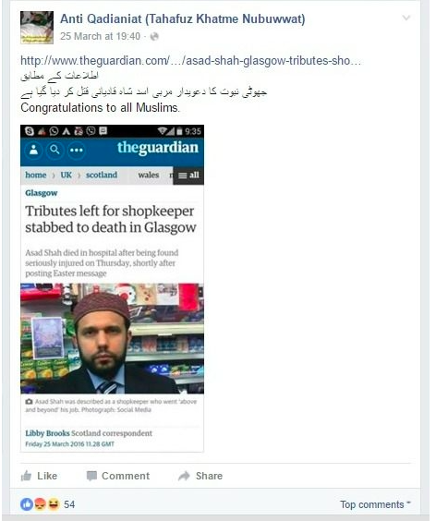
Persecution of Ahmadis in UK
The murder of Asad Shah, a 32-year old Glasgow shopkeeper, in late March shocked Scotland and the local community who had long known him as a friendly face.
But whereas previous anti-Muslim attacks in the UK have often been the work of far-right activists, the main suspect in Shah’s killing is in fact another Muslim - raising fears that the attack may have been sectarian, motivated by Shah’s Ahmadiyya faith.
Shortly after the attack, a Facebook group called Tahafuz Khatme Nubuwwat posted a link to the article saying “congratulations to all Muslims”
http://www.middleeasteye.net/news/ahmadi-muslims-1002773646
6 April 2016

Slide 3


Slide 4
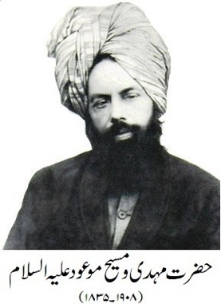
Who are the Ahmadi?
Origins in British-controlled northern India, late 19th Century
Identifies itself as a Muslim movement
Follows the teachings of the Koran
10 million followers worldwide
Founded by Ghulam Ahmad (b 1835), who saw himself as a renewer of Islam and claimed to have been chosen by Allah.
Regarded by his followers as the messiah and a prophet
Ghulam Ahmad "based his convictions on the belief that Muslim religion and society had deteriorated to the point where divinely inspired reforms were needed.”
The movement stresses non-violence and tolerance of other faiths.
http://news.bbc.co.uk/1/hi/world/south_asia/8711026.stm
Mirza Ghulam Ahmad (peace be upon him).
Ahmadis say: he was not a "law-giving" prophet. His job was only to propagate the laws enunciated by Islam's Prophet Muhammad

Slide 5

Ghulam Ahmad to be the promised Messiah and Mahdi
The Ahmadiyya community believes Mirza Ghulam Ahmad to be the promised Messiah and Mahdi, who claimed a certain kind of prophethood, but never claimed to have brought any new divine laws or change the law of Muhammad
Amadis believe Ghulam was Divinely appointed to revive and universally establish the law/religion of Muhammad.
The Ahmadiyya community draws upon various opinions of Islamic scholars throughout the history of Islam to show the possibility of non-law bearing prophethood within Islam.

Slide 6

Ahmadi beliefs
Ahmadi Muslims accept the same beliefs as the majority of Muslims, but with a difference of opinion on the meaning of Seal of the Prophets (Khatam an-Nabiyyin).
They follow the six articles of faith, based on the Quran and the traditions of Muhammad, in exactly the same way as Sunni Muslims
Ahmadi Muslims accept Muhammad as the 'Seal of the Prophets' and the last prophet to have brought a complete and comprehensive universal law for humanity (last law-bearing Prophet)
They believe that Muhammad brought prophethood to perfection
He was the last law-bearing prophet, the apex of man's spiritual evolution
However, Ahmadis believe that new prophets can come
They believe that prophethood ‘subordinate to Muhammad’ is still open so long as they do not exceed him in excellence, nor alter his teaching or bring any new law or religion

Slide 7
Criticisms of Ahmadiyya Islam
Many orthodox Muslims regard Ahmadiyya as heretical because it does not believe that Mohammad was the final prophet sent to guide mankind, as orthodox Muslims believe is laid out in the Koran
Ahmadis: Persecuted
In 1974, the Pakistani Government introduced a constitutional amendment - known as the second amendment - which declared Ahmadiyya non-Muslims.
Ahmadiyya is described by rights organisations as one of the most relentlessly persecuted communities in Pakistan

Slide 8
