Slide 1
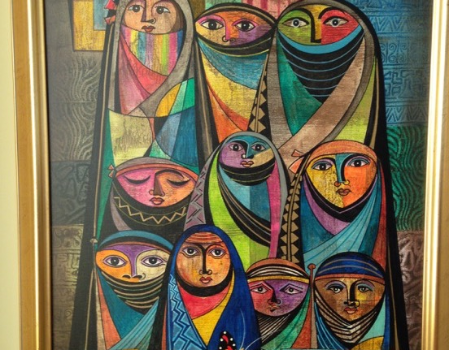
GCSE Subject Knowledge Course
Islam
June 2018
Ed Pawson
efpawson@gmail.com
Call to Prayer: Adhan
Jeremy Bowen, Fire and smoke: Our man in the Middle East
Mercy to Mankind

Slide 2
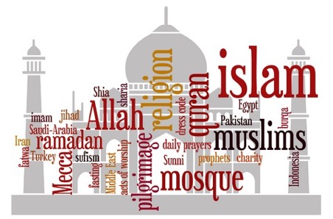
What is Islam?
divine creator
peace
Shari’ah
Muslims
Allah
Prophet Muhammad
God
submission
Qur’an
worship
revelation
Arabic
“There is no god but God”
Choose one word and explain to a partner why it is important
As a pair, discuss which 3 you think are the most important
Talk to another group and explain your decisions to each other
Now write a paragraph, in your own words, using at least 6 of these words
(remember, there’s no absolute answer, it’s about you justifying your choices)

Slide 3
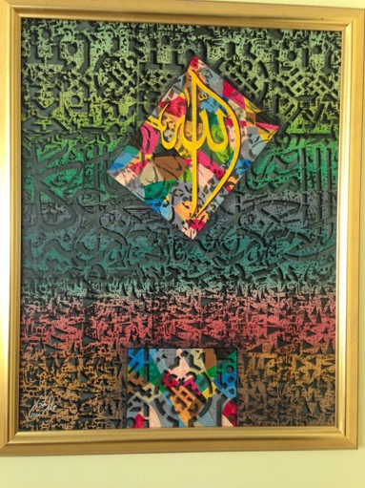
What would you say is the most important date in Islam?
Who, apart from Muhammad, is the most important leader of the Muslim community?

Slide 4
Diagram A
Timeline: Life of Prophet Muhammad
Laylat-ul-Qadr: the first Qur’anic revelation, received from God. Angel Jibril instructs Muhammad to ‘recite’
The year of sorrows: his wife (Khadijah) and his uncle (Abu Talib) both die, leaving him without a protector
Muhammad leads the Muslim army to recapture Makkah. He destroys the 360 idols in the Ka’ba
At the age of six Muhammad’s mother, Amina, dies. He becomes an orphan, to be cared for by his grandfather and later his uncle, Abu Talib
570CE
595CE
613-622CE
622CE
632CE
576CE
610CE
619CE
630CE
Muhammad is born in Makkah
Muhammad marries Khadijah
Muhammad teaches in Makkah, but is met with opposition
The Hijrah: Muhammad and his followers escape from Makkah to the City of Yathrib (later known as Madinah)
Muhammad dies aged 62
Task: can you explain why you think Muslims believe that Allah chose Muhammad to be the Prophet.

Slide 6
Islam by country
Sunni
Shi’a
Ibadi
Tasks:
Can you describe where in the world most Sunni and Shi’a Muslims live?
Why are there proportionately more Sunni Muslims than Shi’a in the UK?

Slide 7
Islam in the world today
1.6 billion Muslims in the world today
23% of the world’s population
World’s second largest religion after Christianity
Fastest growing religion in the world
Islam originates from the Middle East
The Middle East and North Africa has the highest concentration of Muslim population: 93% of people in this region are Muslims
Nearly two thirds of the world’s Muslims live in the Asia-Pacific region (eg Pakistan, India, Bangladesh and Indonesia)
90% are Sunni, 10% are Shi’a
What’s your favourite statistic or fact about Islam?

Slide 8
Diversity in Islam: Britain
95% are Sunnis
5% are Shi’a
Sunni groups
  Deobandi
  Barelvis
  Salafi
Shi’a groups
  Twelvers
  Zaydis (Fivers)
  Ismailis (Seveners)
Some Muslims describe themselves as Sufis
Sufis try to find the heart of the religion and they practice a more mystical version of Islam
There is a significant Ahmadiyya community in the UK
They believe the long-awaited Messiah (Mahdi) has come in the person of Mirza Ghulam Ahmad
Some Muslims regard the Ahmadiyyas (Ahmadis) as non-Muslims

Slide 9
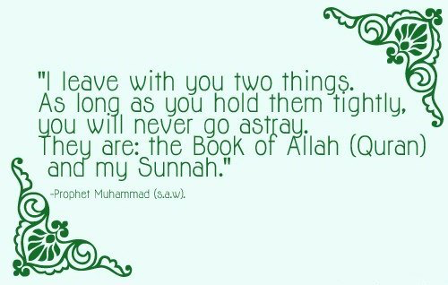
Authority in Islam (Sunni)
Tasks:
Can you explain what this text might mean to a Sunni Muslim
How might a Shi’a Muslim challenge this statement?

Slide 10
Some of the 99 names:
Giver of life
Protector
Just
Generous
Guide
Ever-forgiving
Watchful
Creator
Compassionate
Avenger
Tremendous
Mighty
Finder
Patient
Knower
King
Gentle
The 99 beautiful names of God
Transcendent: beyond all things | Omniscient: all-knowing | Beneficient: always loving | Merciful: kind and forgiving | Judge: decision-making, fair | Creator: maker, designer
Task: Create a table with the headings shown.
Put the ‘names’ of God in the list into the relevant columns

Slide 11
The 99 beautiful names of God
Transcendent: beyond all things | Omniscient: all-knowing | Beneficient: always loving | Merciful: kind and forgiving | Judge: decision-making, fair | Creator: maker, designer
Tremendous | Watchful | Protector | Ever-forgiving | Just | Giver of life
Mighty | Finder | Generous | Compassionate | Avenger | Creator
King | Knower | Guide
 |  | Patient
 |  | Gentle

Slide 12
God the One and Only:
Surah 112 sums up the nature of God
In the name of God, Most Gracious, Most Merciful say “He is God the One and Only, God the Eternal, Absolute. He begetteth not nor is He begotten; and there is none like unto him”
Task: Annotate this text to show understanding of Islamic beliefs about God (Allah)

Slide 13
God is personal, but he is not a person. God cannot be pictured in human form.
Quran 112:1-4. These notes are adapted from Yusuf Ali.
God the One and Only:
Surah 112 sums up the nature of God
He is “eternal”, without beginning or end.
There is only one God (monotheism). Belief in many gods (polytheism) is false.
In the name of God, Most Gracious, Most Merciful say “He is God the One and Only, God the Eternal, Absolute. He begetteth not nor is He begotten; and there is none like unto him”
“He begetteth not” means that he has no children. This challenges the Christian belief that Jesus is the ‘Son of God’
God is perfect and unchanging. There is no greater being
Nothing compares to God;
He is incomparable. He is the creator, everything else is part of His creation
Task: Now create your own mind map
I
- Allah -
I
“nor is He begotten” means he was not born.

Slide 14
Revelation in Islam
Risalah, Prophethood
Prophets are human beings chosen to carry guidance from God to people, but their wisdom does not come from within themselves; it comes from God.
A ‘rasal' is a prophet. ‘Risalah’ means bringing prophecy from God
Divine wisdom and human words
Prophet Muhammad was the channel through which God spoke.
Muslims make a clear distinction between the Divine revelation (recorded in the the Qur’an) and the human words of the Prophet Muhammad (preserved in the Hadith).
God’s message
“For each period is a Book revealed”. (Qur’an 13:38)
Qur’an: every generation has been given its own prophet, bringing God's message in a book.
Prophet Muhammad’s message is the same message as had been preached by all the prophets back to Adam: the need to worship the one, true God, who will be the Judge of all.
“We send the messengers only to give good news and to warn”. Qur’an 6:48

Slide 15
Prophet Muhammad’s Family Tree (Ahl al-Bayt: the Family of the House)
Abdul Mutalib
(M’s Grandfather)
Abu Tallib
(M’s Uncle)
Abdullah
(M’s Father)
Amina
(M’s mother)
=
Abu Bakr
(M’s closest companion)
Khadijah
(M’s first wife)
=
Muhammad
=
Aisha
(one of M’s later wives)
Ali
(M’s cousin and son-in-law)
(First Imam)
Fatima
(M’s daughter)
=
Hassan
(M’s grandson)
(Second Imam)
Hussain
(M’s grandson)
(Third Imam)
= Shi’a beliefs

Slide 16
Key similarities and differences between Sunni and Shi’a beliefs and practices
 | Sunni | Shi’a
Qur’an | The Qur’an is an earthly copy of a heavenly original. They usually interpret the Qur’an literally, as it is read. | The Qur’an is not eternal, but was created by God as a guide for human beings. Everything in it has a hidden meaning to be interpreted by special religious leaders (Imams)
Shahadah (statement of belief) | “I bear witness that there is no god but God, and Muhammad is the Prophet of God” | Shi’as say the same Shahadah as Sunnis, but they add the phrase: “and I bear witness that Ali was the friend of God”
Salah (prayer) | Five prayer times every day | Often pray three times a day
Zakah (giving) | Often pay zakah to the State (government) | Pay zakat to religious leaders and also pay an additional khums tax
Sawm (fasting) | Fasting during Ramadan | Shi’as fast the same way, but they also spend three days during Ramadan mourning the death of Ali
Hajj (pilgrimage) | Pilgrimage to Makkah | Shi’as are expected to go on Hajj, but they also go on pilgrimage to other sites sacred to the Shi’a tradition (eg Karbala)
Prophethood | Risalah: Sunnis believe that Muhammad was the final prophet. | Nubuwwah: Like Sunnis, Shi’as believe that Muhammad was the last prophet, but they also believe that there have been 12 infallible Imams since Muhammad’s death.

Slide 17
 | Sunni | Shi’a
The appearance of the Mahdi | The Mahdi is the “guided one” who will come on the Day of Judgement with Isa (Jesus), to rid the world of evil. | Shi’as too are awaiting the Mahdi, who will come on the Last Day, but they believe his identity will be revealed as the Hidden (or 12th) Imam.
Festivals | Id-ul-Adha and Id-ul-Fitr | In addition, Shi’as celebrate Ashura
Al Qadr (predestination) | God has set out a plan or destiny for all things. | Many reject predestination, saying that God cannot be responsible for evil. Humans have free will.
Required lineage for ruler | Can be any practising Muslim chosen by the ummah | Must be male child from lineage of Ali and Fatimah
Imam (leadership) | An imam is a leader chosen by the community. He is an ordinary man with strong faith in Qur’an and Sunnah | An Imam is a holy figure, a divine guide, the only legitimate interpreters of the Qur’an, the political and spiritual successors of Prophet Muhammad.
View on the personality of Imam Ali | Considered as a 'Lion of God', the first male convert to Islam, and a warrior champion of the faith. | Prophet said: “Exemption from the Hellfire comes with love for Ali (A.S).”; “Of whomever I was master, Ali (A.S) is his master.”
Continuation of authoritative revelation | No, authoritative revelation ended with Prophet Muhammad | Partially true. Imams are considered divinely guided. The purpose is the explain and safeguard the current faith and its esoteric meaning.
Angels | God created angels from light. They do not have their own free will and always obey the commandments of God | Angels obey God’s commandments. They have limited free will, though no drive to sin.

Slide 18
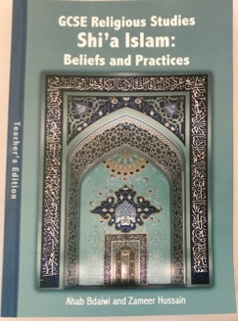
Islam resources
Zameer Hussain video: Crash course in Shi’a Islam
https://sites.google.com/site/londonrehub/video-2016
True Tube resources
https://www.truetube.co.uk/list?content%20types=films&page=1&search=Islam&keystages=key%20stage%204&
Native Deen: Mercy to Mankind
https://www.youtube.com/watch?v=Go71P2UPgkc
The long, short story: Islam
https://www.youtube.com/watch?v=8os1SL-9vRs
Bible or Qur’an? (watch out for the bad language!)
https://www.youtube.com/watch?v=lX0Zt0ODrEA
Dr Chris Hewer
https://www.youtube.com/watch?v=5yzrcdyTBHU
Ashura in Manchester
https://www.youtube.com/watch?v=LaWtr10b1es
GCSE Religious Studies, Shi’a Islam: Beliefs and Practices by Zameer Hussain re@alkhoei.org

