Slide 1
Promoting religious literacy in secondary RE classrooms
Janet Orchard, University of Bristol

Slide 2

Aims of the session?
Why promote religious literacy?
Consider the ‘academic turn’ in RE
Are there ‘Big Ideas’ in RE on which religious literacy could be built?
What can this look like in the secondary RE classroom in your area?

Slide 3

My worry…………
teachers do not perceive researchers as understanding what happens in the daily life of the classroom, therefore what researchers can contribute to practice is viewed with scepticism (Broekkamp & van Hout-Wolters 2007).

Slide 4

Your expectations?

Slide 5

Religious literacy is
Knowledge and understanding of religion, beliefs, practices, spiritual insights and secular world views
Preparing pupils for twenty-first century life in a diverse world that is consciously inter-connected at a global level, 24/7
Communicating with fluency and understanding about religion and belief within that context
  Adapted from the Cambridgeshire, Northants, Peterborough and Rutland Agreed Syllabus for RE 2018

Slide 6

The value of religious literacy
Enables “children and young people to hold balanced and well-informed conversations about religion and belief” Kathryn Wright
Encourages children to live well, sufficiently clear in their own beliefs and those of others

Slide 7
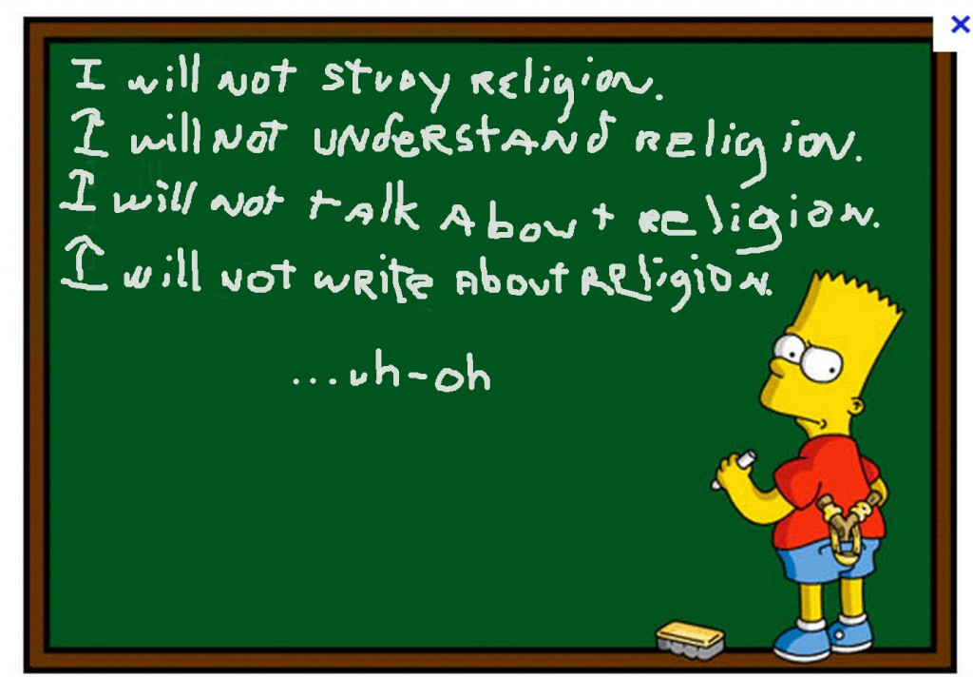
Going beyond the reflexive?
How helpful is the C20 notion of ‘learning about and from’ religion in RE?
Too much RE is poor quality and academically unchallenging (with honourable exceptions)
Learning from religion may be indoctrinatory; not clear how be assessable AT2 is (….. So……)

Slide 8

Academic turn in schooling since 2010
‘Academic literacies’
Powerful knowledge (Michael Young)
About being able to make inferences in order to ‘read’ the world, ‘all that lies therein’ with meaning
Inferentialism: what separates us from other ‘intelligent’ life forms

Slide 9

Academic turn in RE: the challenges
We need to be well-informed to be religiously literate but so what? Who cares, apart from religious people?
As numbers of religiously agnostic people increase, we cannot assume pupils will bring this from home (though some will); highly varied levels of religious literacy create differentiation and motivation issues
Could be argued that removing religion from the public space entirely offers a better alternative response to the diversity problem

Slide 10

Responding to these challenges
Actually quite a lot of people care about religion as a phenomenon, particularly when we think of the world as a whole and its inter-connectedness,
Approached dynamically and taught well, specialist RE teachers can motivate pupils to learn and differentiate properly
Desire to remove religion from the public square is not the panacea hard-line secularists would wish it to be. Better for democracy to include religion

Slide 11

Pause for thought
What strategies do you find effective in promoting religious literacy in your classroom?
Why do you think these strategies work?

Slide 12
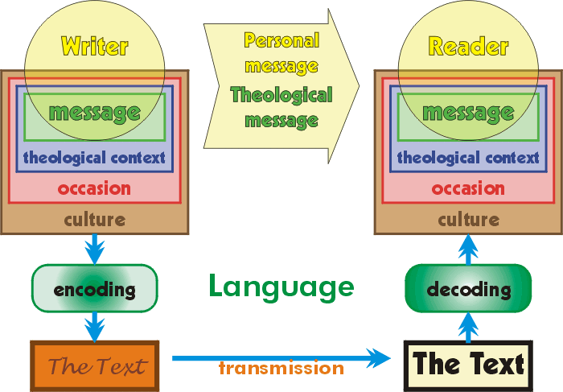
New Pedagogies: Hermeneutics in RE
Better reading of and interpretation of sacred texts, in particular the Bible, in religious education (Bob Bowie).
Understanding Christianity (Cof E)
Appreciating the diversity of interpretations in/of Islam (Farid Panjwani
Transformational application of philosophical hermeneutics to RE (David Aldridge)

Slide 13

Understanding Christianity
To enable pupils to know about and understand Christianity as a living world faith, by exploring core theological concepts
To enable pupils to develop knowledge and skills in making sense of biblical texts and understanding their impact in the lives of Christians
To develop pupils’ abilities to connect, critically reflect upon, evaluate and apply their learning to their own growing understanding of religion and belief (particularly Christianity), of themselves, the world and human experience.

Slide 14

https://socialsciences.exeter.ac.uk/media/universityofexeter/collegeofsocialsciencesandinternationalstudies/education/research/groupsandnetworks/reandspiritualitynetwork/Big_Ideas_for_RE_E-Book.pdf
Centrality of understanding that is ‘deep and sophisticated’
Importance of students’ ability to transfer their learning to situations outside the classroom
Incompatible with a curriculum that tries to cover too much information.

Slide 15

Characteristics of Big Ideas
Provide criteria for selecting and prioritising subject knowledge
Transferable to events outside the classroom.
Memorable.
Capable of being expressed at increasing levels of complexity and sophistication
Of long term relevance
Make sense of what might otherwise be confusing information/experiences and isolated facts.
Act as lenses which, when used to ‘view’ content, help to clarify it: illuminate what is relevant to RE and hide what is not.
Taken together, express the core or central concerns of the subject, not what is peripheral.

Slide 16
Six Big Ideas for RE
1. CONTINUITY, CHANGE AND DIVERSITY
  i.e. the changing nature of religion? (hard one to pin down)
2. WORDS AND BEYOND
  i.e. religious language
3. A GOOD LIFE
  i.e. ethics
4. MAKING SENSE OF LIFE’S EXPERIENCES
  i.e. religion and experience
5. INFLUENCE, COMMUNITY, CULTURE AND POWER
  i.e. religion and community
6. THE BIG PICTURE
  i.e. grand narratives

Slide 17

Big idea 3 under the microscope
Focus on struggle to live a good life by religious and non-religious individuals and communities
Explore characteristics and behaviours a good person will seek to achieve,
What is/ not, acceptable moral behaviour; different ideas about how and why good life should be led.
Lives and characters of ‘exemplary’ members.
Common/ universal values or culturally relative responses
Major disagreements over the interpretation and application of moral principles between members of the same religion or worldview

Slide 18

Benefits of Big Ideas?
Enquiry driven, focused on ‘Big Questions’
Experiential and creative
Using reasoned argument and debate to explore controversial issues
Using investigative and interpretative skills to gather, analyse and present information
Planning sequential enquiries to make sure pupils build effectively on prior learning, appreciate their relevance
Allowing for pupil progress in RE that can be defined and assessed.

Slide 19

Over to you…..

Slide 20

Linking to lesson ideas: 3 examples
Surayah’s story
The Moral Ocean
How do Christians respond to racism?

Slide 21

Links to your schemes of work/ exam specifications?
http://www.awarenessmysteryvalue.org/
https://www.bristol.anglican.org/documents/re-agreed-syllabus-wiltshire/
http://www.amvsomerset.org.uk/

Slide 22

Personal Conclusions
Long standing issue of challenge in RE
Part of the solution lies in making it more academically rigorous
Stimulating thinking in Big Ideas project of practical use
But will not in and of itself improve the status of RE in schools
Must find ways of showing the significance of religious literacy (indeed all kinds of academic literacy) to life in today’s world

