Slide 1
Exploring the importance of using research in RE
Kevin O’Grady
Lead Consultant for Research
Culham St Gabriel’s Trust

Slide 2
Session key questions / overview
Why is it important to use research in RE?
Where can you quickly find it and what can you do with it?
Introducing practical strategies to use research to improve teaching, using the Research for RE website.

Slide 3
Why is it important to use research in RE?
OED definition: “systematic investigation into and study of materials and sources in order to establish facts and reach new conclusions”.
There’s a huge amount of research into areas related to RE: religion, education policy, teacher development, moral education, philosophy and ethics, effective teaching, RE itself.
Religion changes, education changes, RE changes, all the time. We need to keep up to date.
Research literature can give us interesting teaching ideas and help us to improve practice.
Research on schools that use research shows this – “using research evidence can give you new ideas; it helps to stop you getting stale and using the same teaching strategies over and over again . . .”, “engaging with research gets you thinking, it challenges you and makes you evaluate carefully your teaching methods and the reasons behind them . . .” (NFER & United Learning Schools 2014, v).

Slide 4
Where can you quickly find research and what can you do with it?
The same NFER & United Learning Schools report found quick access to be crucial. Teachers should also have support to find research suited to their own specific work. (NFER & United Learning Schools 2014, vi).
But often (not always), the research happens in academia; your school / LA / MAT might not keep you in touch with it and you might not have academic contacts.
Culham St Gabriel’s addressed these issues, in consultation with partners such as NATRE and AULRE, who confirmed that they applied to RE.
The response is the Research for RE website, which went live in September 2017 and now has around 500 registered users.
The website is designed to direct RE teachers to high-quality, relevant research, quickly and easily, with practical teaching ideas.
You should be able to use Research for RE to develop the RE teaching in your school, you can leave feedback and use more and more research over time (there are currently around 70 sources posted).

Slide 5

Research for RE http://researchforre.reonline.org.uk/

Slide 6
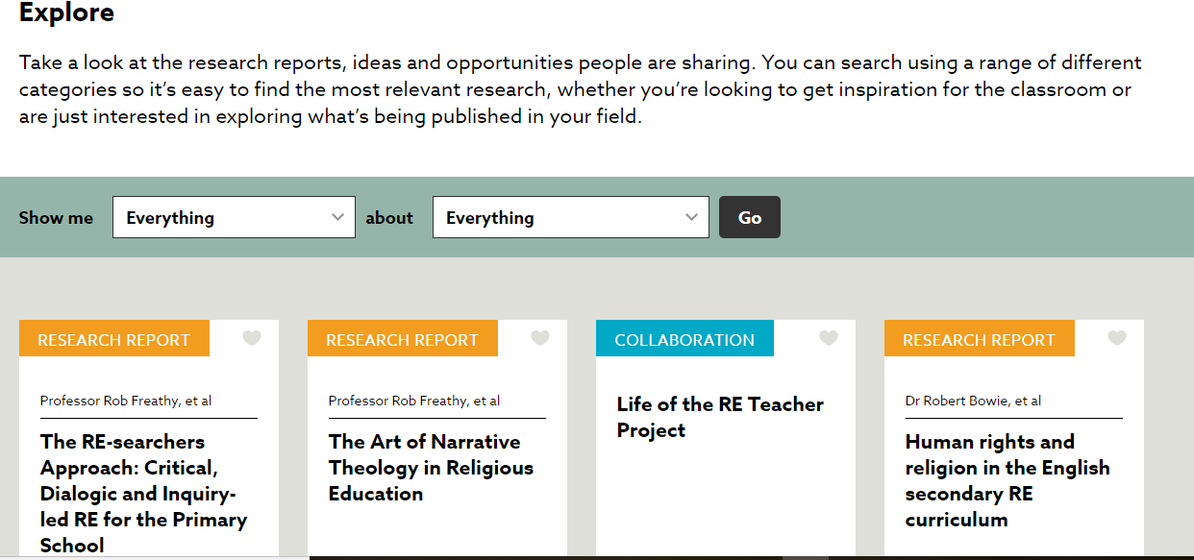

Slide 7
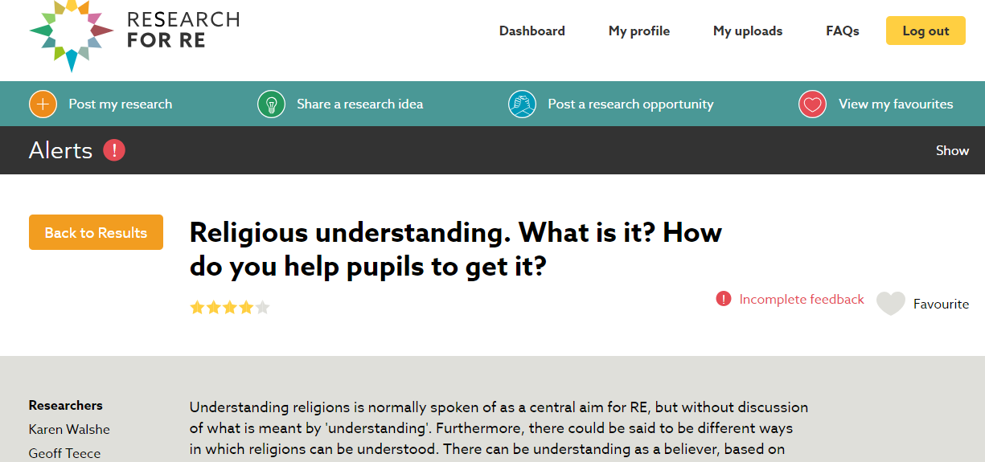
Using research to develop teaching: practical strategies (1) (guided)
Scroll down to this report of research by Karen Walshe and Geoff Teece (May 2018 RE research of the month), then just put it aside for a few moments (we’ll come back to it).

Slide 8
Using research to develop teaching: practical strategies (1) (guided)
Religious understanding. What is it? How do you help pupils to get it? HEADLINE POINTS
Religions are essentially soteriological (concerned with salvation or life’s ultimate meaning or purpose).
If RE focuses on soteriology, pupils will be equipped to gain understanding of what religions mean to believers.
E.g. in Sikhism there are key soteriological beliefs and practices: haumai (self-centredness) is the root of earthly life’s problems, but a life of sewa (selfless service) leads to gurmukh (God-centredness) and a state of mukhti (spiritual liberation.
Serving in the gurdwara expresses these beliefs (during a visit, pupils could ask Sikhs about how it does so).
ACTIVITY
If possible, pair up with somebody teaching in or around the same age range as you.
Read over the research report together.
Discuss how the key ideas might be used to prepare to teach about a different religious tradition and note a skeleton plan.
Finally, if you have time, discuss and note strengths and weaknesses of this approach as you see it.
Be ready to feed back in 15 minutes.

Slide 9
Using research to develop teaching: practical strategies (2) (independent)
ACTIVITY
Working in the same pairs, spend about 5 minutes looking through the various research reports in Research for RE.
Select one report that you think presents some potentially useful or interesting points for your practice in school – it doesn’t matter which one, what its focus is, or how different or unusual the points.
Note 3-4 bullet points on your chosen report and a further 3-4 on how it might influence or affect your practice in school and be ready to feed these back.
You have 15 minutes altogether.

Slide 10
Conclusion, next steps
Do please spread the word about Research for RE.
The Research for RE initiative will work if you use it and feed back to us about it. We need to know what teachers do with it and how to keep improving it.
As well as leaving feedback on the research reports, send us your stories about how you used them in teaching - we’ll publish those.
Nominate a report for RE research of the month.
Use Research for RE as a focus for a local group or hub meeting. Book me to come and help with that.
The Teach RE course will offer a module based on Research for RE from September. Enrol for the course / module if you’d like to take this introductory session further.
Visit Research for RE regularly. The range of research reports will expand, e.g. through the ‘Research 7’ projects.
This session has focused on research reports, but Research for RE also has facilities to post ideas for research and respond to opportunities to carry out research. Doing rather than using research is another session, however . . .

