Slide 1
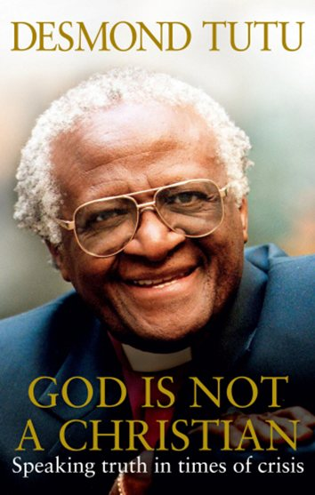
Exploring (beliefs about) the nature of God
Do Christians and Muslims worship the same God?
Franklin Graham: “Islam and Christianity clearly do not worship the same God”
Larycia Hawkins says Christians and Muslims worship the same God
The Qur’an and the Bible have more in common than most believers realise
Desmond Tutu: God is not a Christian
Chris Hewer: Muslims don’t own God

Slide 3
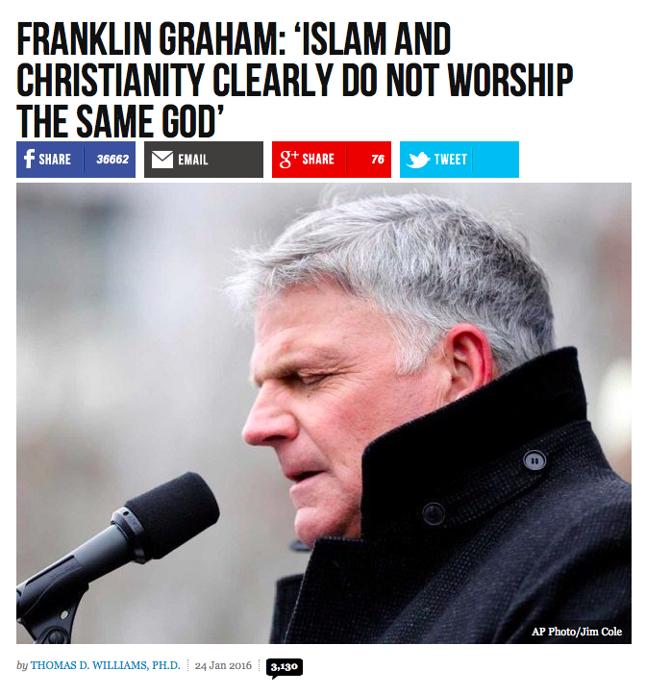

Slide 4
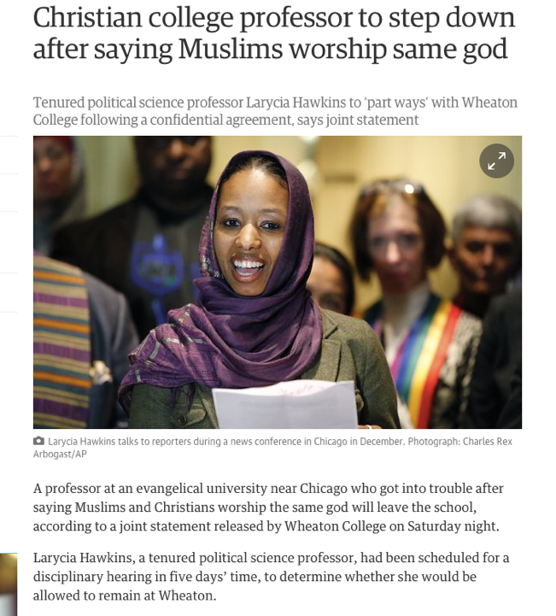
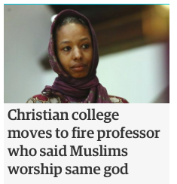

Slide 5
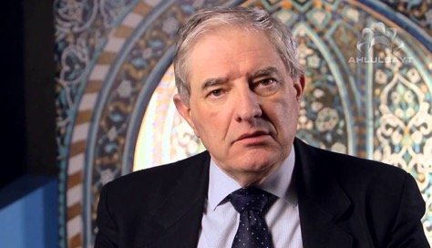
Chris Hewer on Shi’a Islam
Islam not just for Muslims
Don’t tribalise God
Is ‘Allah’ the Muslim God?
Language distorts faith
Muslims don’t own God
Muhammad is not the tribal possession of Muslims
https://www.youtube.com/watch?v=5yzrcdyTBHU

Slide 6
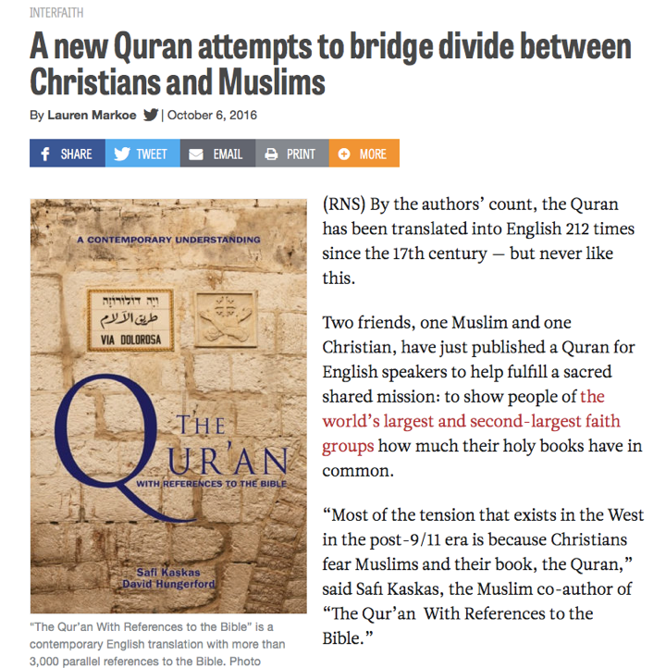

Slide 7
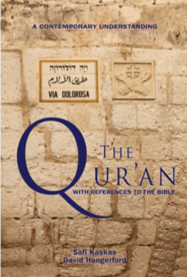
“Our intent is not at all to convert readers from one faith to another, or merge the two religions into one,” Kaskas said. “Rather we seek to build bridges of understanding among people of the three Abrahamic faiths.”
Drs. Kaskas’ and Hungerford’s underlying motivation for the translation and inclusion of the extensive footnotes are not intended to promote a particular school of Islam or Christian apologetics. These exist in abundance. Their goal is to build bridges of better understanding, undermine radicalism and enlighten ignorance. This powerful instrument offers Muslims and Christians a fresh insight on the “straight path” to reconciling with God and man; sorely needed and missing from other translations.

Slide 8
Bible or Qur’an?
Look carefully at the following verses.
Can you identify which ones come from the Qur’an and which from the Bible?
How do you know?
1 “… for in six days the Lord made the heavens and the earth, and on the seventh day He abstained from work and rested.” | 2 “He it is who created the heavens and the earth in six days then established Himself over the throne.”
3 “And your God is One God: There is no god but He.” | 4 “The Lord our God is one.”
5 “The Lord God formed the man from the dust of the ground and breathed into his nostrils the breath of life, and the man became a living being.” | 6 “Then God shaped the man and breathed into him His spirit.”
7 “He is the First and the Last and the Manifest and the Hidden; He is the Knower of all things.” | 8 “The Lord Almighty: I am the First and I am the Last; apart from Me there is no God.”

Slide 9
Bible or Qur’an?
Look carefully at the following verses.
Can you identify which ones come from the Qur’an and which from the Bible?
How do you know?
1 “… for in six days the Lord made the heavens and the earth, and on the seventh day He abstained from work and rested.” Exodus 31:7 | 2 “He it is who created the heavens and the earth in six days then established Himself over the throne.” Qur’an 57:4
3 “And your God is One God: There is no god but He.” Qur’an 2:163 | 4 “The Lord our God is one.” Deuteronomy 6:4
5 “The Lord God formed the man from the dust of the ground and breathed into his nostrils the breath of life, and the man became a living being.” Genesis 2:7 | 6 “Then God shaped the man and breathed into him His spirit.” Qur’an 32:9
7 “He is the First and the Last and the Manifest and the Hidden; He is the Knower of all things.” Qur’an 57:3 | 8 “The Lord Almighty: I am the First and I am the Last; apart from Me there is no God.” Isaiah 44:6

Slide 10
Do Christians and Muslims worship the same God?
Christianity
Islam
Tasks:
Add your own terms onto this Venn diagram to start to answer the question
What is your view? Explain your ideas

Slide 11
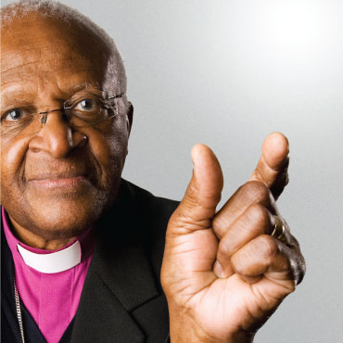
Desmond Tutu
“Where there is injustice I will not keep quiet”

Slide 12
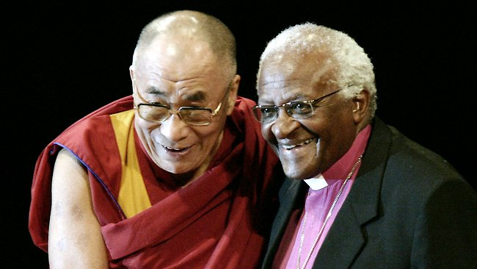
The Dalai Lama and Archbishop Desmond Tutu

