Slide 1
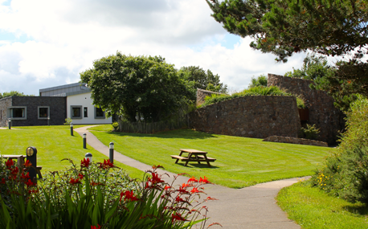
Corrymeela
‘We are Corrymeela and you are always welcome.’
Corrymeela is Northern Ireland’s oldest peace and reconciliation organisation. They began before “The Troubles” and continue on in Northern Ireland’s changing post–conflict society.
Handling disagreement: towards reconciliation
With Emma Ainslie-King and Mary-Anne Willmott

Slide 2
Our trip to Corrymeela…
An exciting opportunity, privileged to be asked to take part.
Monday 29th to Tuesday 30th May 2017.
Party of 30 including Chaplins, teachers, ITT students and lecturers.
Funded by the University of Bristol and Westhill Trust (with a contribution from the attendees).
Led by Dr Norman Richardson MBE, lecturer in RS at Stranmillis University College, Belfast.
The aim was to learn from experience and dialogue about Corrymeela’s ‘Theology of space’.
What has the Corrymeela community and Northen Ireland experience got to teach us about living in a diverse society?
Day 2 ~ a tour of Belfast to visit key sites and an opportunity to discuss the legacy of ‘the troubles’ and their aftermath.

Slide 3
What is Corrymeela?
Corrymeela believes that people can learn to live and work well together.
Corrymeela has a residential centre on the north coast of Ireland that hosts over 11,000 people a year, as well as a lived community of volunteers and staff.
Corrymeela also has a dispersed community of over 150 members who commit to living out Corrymeela’s principles of reconciliation in their own communities.
Corrymeela’s programme staff travel to work with school and community groups throughout Northern Ireland, as well as hosting groups on site.
They work alongside people from youth and school groups, family and community organisations, faith communities and political parties.
https://www.corrymeela.org/about (5 minutes)

Slide 4
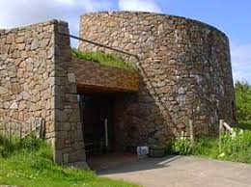
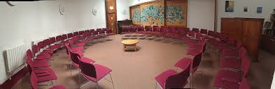
The Croi…
On the site we have a space of worship called The Croí, which is designed in the shape of the human heart. “Croí” is the Irish word for “heart.”
“This place is rightly called An Croí – the heart. Indeed it is heart–shaped. Here we can take time to listen to the great heartbeat – in a society where there are so many violent and destructive beats, here we can take time to listen to the Heartbeat that guides, inspires and unites us all together.”
Ray Davey

Slide 5

https://www.corrymeela.org/
Visit the website to find out more…
Up: Standing – Stories of Courage from Northern Ireland
Primarily designed to support educators and young people to link the lessons of the past to the choices individuals make today, ‘Upstanding: Stories of Courage from Northern Ireland’ is a 45 minute DVD exploring 10 diverse case studies from all over Northern Ireland showing how people stood up to violence, discrimination or prejudice.

Slide 6
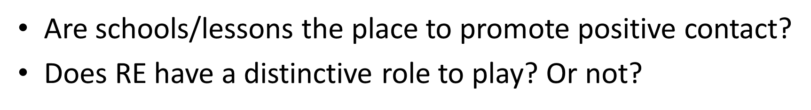

Contact Theory, RS and Corrymeela…
Learning about religion/ communities/ ethnic backgrounds thus raising awareness.
Teachers modelling good interactions with ‘others’, creating classroom/school environment promoting positive contact/ setting a good example.
Discussion/debate/dialogue therefore thinking/ awareness.
Engaging with authoritative reasoning and argument for overcoming prejudice?

Slide 7
Dr Derick Wilson, Corrymeela Community ~ Using the principles of contact theory to enable structured and meaningful interactions to take place…
Contact principles are useful, although understanding the context and roots of conflict is as important as interpersonal contact.
Wilson suggests that to move beyond prejudice born of conflict people must stop having ‘polite’ conversations.
People must be prepared to explore painful territory.
This requires trust. Corrymeela attempts to create a space where people can meet as unique individuals.
Wilson argues that understanding the process of ‘scapegoating’ is essential. Understanding and identifying scapegoating also helps people move beyond prejudice.
People must be prepared to critique aspects their own culture or context if necessary in order to understand the roots of conflict and begin to overcome them.
‘the need to both be aware of levels of trust and relationships of power in a learning environment, but also the need for honesty and courage in teaching difficult and sensitive information accurately, for deep understanding to be gained.’

Slide 8
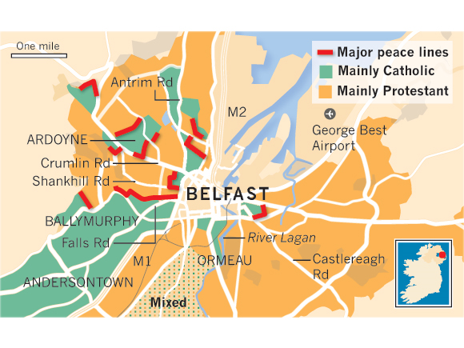

Slide 9
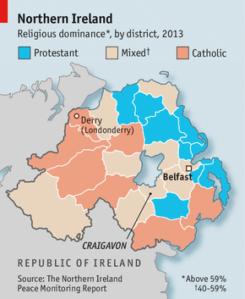

Slide 10
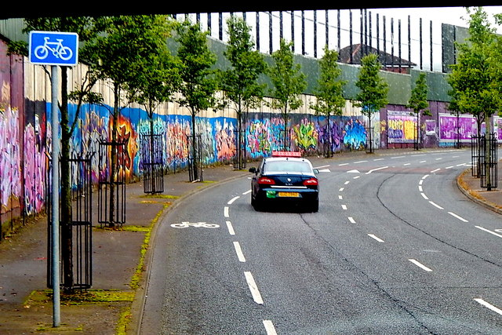

Slide 11
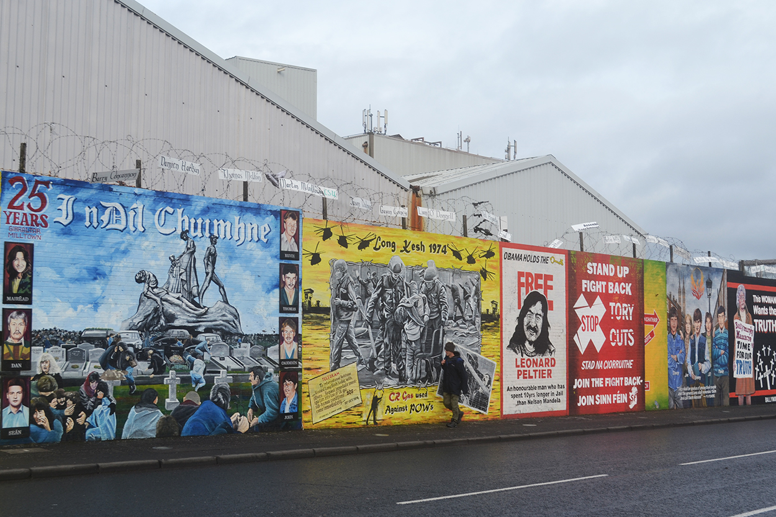

Slide 12
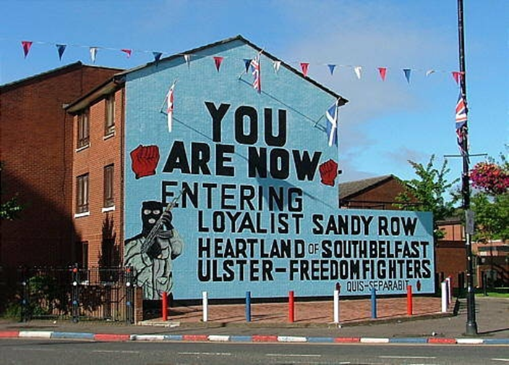

Slide 13
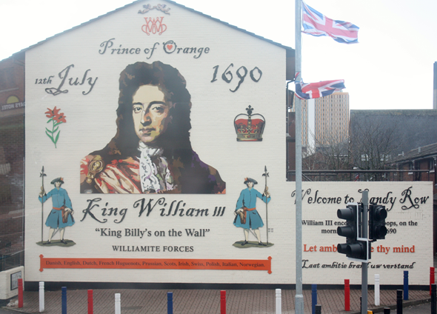

Slide 14
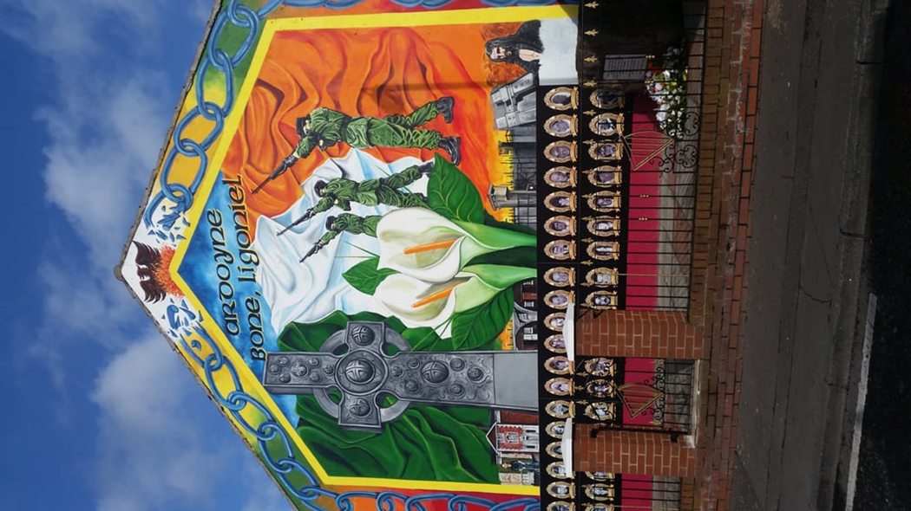

Slide 15




Slide 16
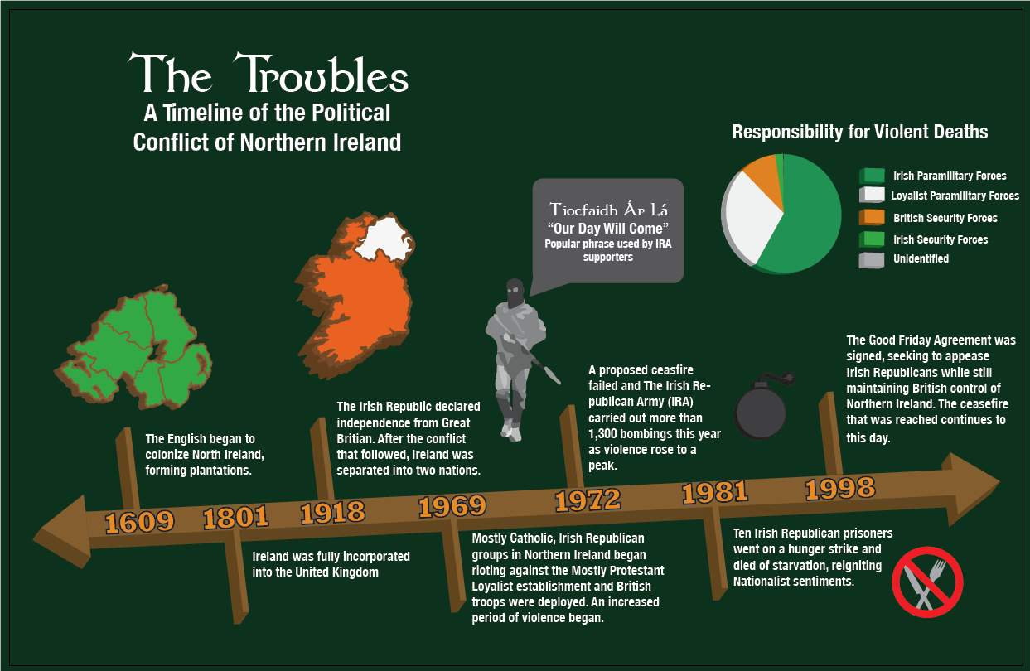

Slide 17
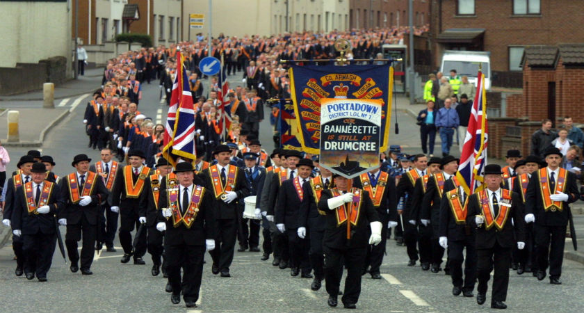
The annual ‘marching season’ parades in Northern Ireland which run over the summer months mainly mark the anniversary of Protestant Dutch King William III’s victory over Catholic English King James II at the Battle of the Boyne in July 1690.

Slide 18
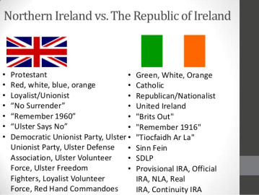

Slide 19
The education system in Northern Ireland.
Most Protestants and Catholics have been educated apart from each other and have had few opportunities to meet and learn to trust each other.
There exists two parallel separate school systems. Government figures indicate that 90% of children still attend the schools of “their own community”.

Slide 20
Integrated schools.
1981 saw the first integrated school being established in Northern Ireland. Since then, there are 62 such schools, some primary and some secondary. Including some existing schools that have “transformed” to become integrated.
These schools account for 7% of the school population, roughly 22,000 children, although their influence is growing slowly. It is now receiving more government led funding to increase collaboration with different school types.

Slide 21
Educational strategies.
Since the 1990’s all schools were required to implement the educational (cross curricular) themes of Education for Mutual Understanding (EMU) and Cultural Heritage(CH). Both of these initiatives were defined as “learning to live with differences in a spirit of acceptance, fairness and mutual respect” (Richardson, 1996).
This approach had mixed success, with criticism being that some work was superficial or tokenism.

Slide 22
Since amendments in 2007, the Department of Education has made changes expressing a strong commitment to citizenship and democratic participation. The Northern Ireland Curriculum now includes specific taught units of work which incorporate the ideas from EMU and CH.
Focus includes:
Diversity and inclusion
Equality and social justice
Democracy and Active Participation
Human Rights and Social Responsibility.

Slide 23
The Holy Cross dispute occurred in 2001 and 2002 in the Ardoyne area of north Belfast, Northern Ireland. During the 30-year conflict known as The Troubles, Ardoyne had become segregated -- Protestants lived in one area and Catholics in another. This left Holy Cross—a Catholic primary school for girls—stuck in the middle of a Protestant area. In June 2001, Protestant loyalists began picketing the school, claiming that Catholics were regularly attacking their homes and denying them access to facilities. For weeks, hundreds of protesters tried to stop the schoolchildren and their parents from walking to school through their area. Some protesters shouted sectarian abuse and threw stones, bricks, fireworks, blast bombs and urine-filled balloons at the schoolchildren and their parents. Hundreds of riot police, backed up by British soldiers, escorted them through the protest each day.

Slide 24

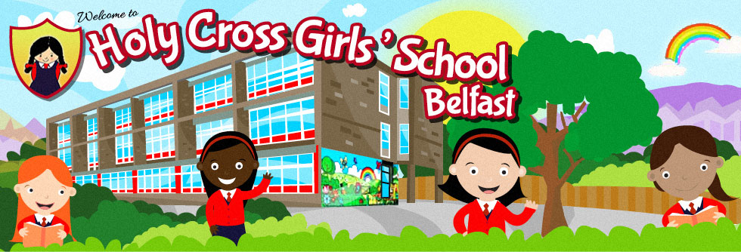
Notes:
https://www.youtube.com/watch?v=IE8h7l6eI7I&oref=https%3A%2F%2Fwww.youtube.com%2Fwatch%3Fv%3DIE8h7l6eI7I&has_verified=1

Slide 26

buddy up
https://www.youtube.com/watch?v=_akjJ3F_oX8

Slide 27
buddy up
HOLY CROSS SCHOOL NEWS REPORT
https://www.youtube.com/watch?v=_akjJ3F_oX8

Slide 28
My Dad, the peace deal and me.

