Slide 1
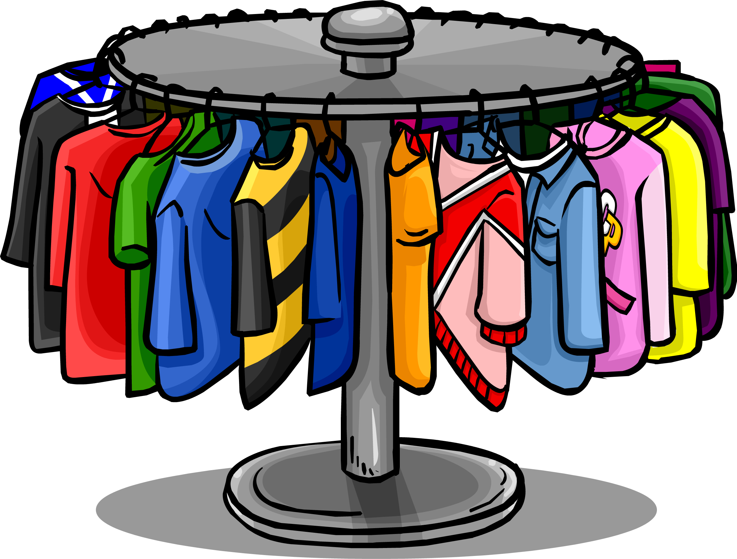
LTLRE June 2018
Why do different voices matter?
Sushma Sahajpal

Slide 2

Encountering ‘different’:
First Gut REACTION…
Unpredictability
Under-qualified
Fear of unpleasantness
RISK

Slide 3

Encountering different:
First Gut REACTION…
Unpredictability
Under-qualified
Fear of unpleasantness
RISK
Increasingly
Comfort-Driven World

Slide 4
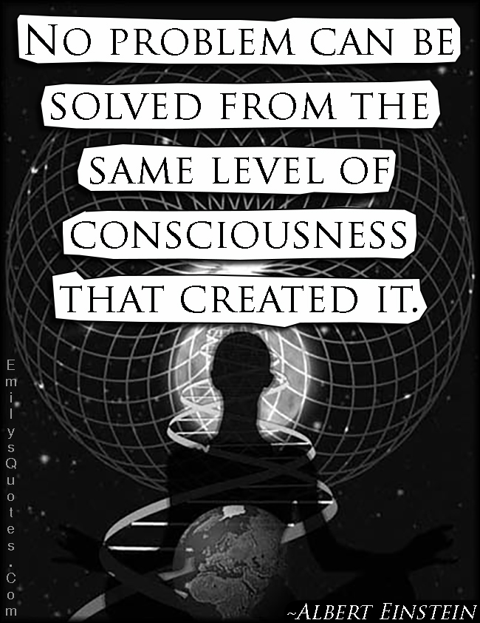
What if we saw these things things that seem separate from another point of view?

Slide 5

A Hindu Perspective:
“Jaisi Dhristi, Vaisi Srishti”
“As your sight,
so appears the world”
Harmonious
Interconnected
Non-violent (Ahimsa)
Dynamic
Unified
Intelligent
Spiritual
Melodic
(at the cellular level: My DNA!)

Slide 6

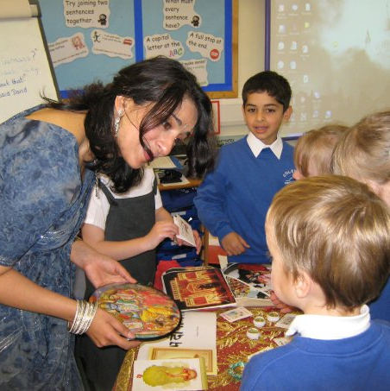
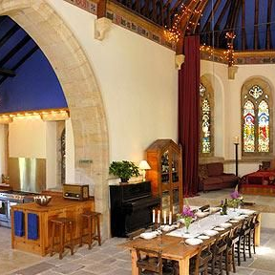
Three Stories
.

Slide 7
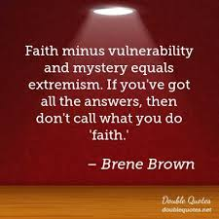
Sushma Sahajpal

Slide 8
3 Stories: It’s not about always about you
Faith can mean trusting there is more going on …

Slide 9
Encountering different:
NORMAL for Hindus!
First Hindu REACTION…
Unpredictable - Curiosity
Underqualified-fascination
Weirdness-Frisson

Slide 10

Encountering different:
NORMAL for Hindus!
First Hindu REACTION…
Unpredictable - Curiosity
Underqualified-fascination
Weirdness-Frisson
Namaste

Slide 11
Encountering different:
NORMAL for Hindus!
First Hindu REACTION…
Unpredictable - Curiosity
Underqualified-fascination
Weirdness-Frisson
Namaste
From competing Football Teams…

Slide 12
If everyone is ‘different’:
First Pluralist REACTION…
Unpredictable - Curiosity
Underqualified-fascination
Weirdness-Frisson
…To a football Academy!

