Slide 1
Unlocking Dharmic concepts
Core Ideas in the Indian Religions
By
Sushma Sahajpal

Slide 2
Understanding Dharmic Religions
“It is crucial…for anyone with a genuine interest in understanding Dharma, to be able to suspend their own frame of religious reference to understand this one. There is otherwise a potential barrier to comprehension that I am naming at the outset. The analogy I suggest to new students …is to assume the mind-set of a horse expert encountering an elephant. Do not assume it is merely a misshapen or inferior type of horse, but see the functionality, beauty and rationale of unfamiliar tusks and trunk for what they are, features on a genetically distinct creature, developed in a fundamentally different climate and environment”

Slide 3

Unlocking Dharmic Traditions
Banyan Tree
Ancient,
multiple root systems,
The Indian/Insider word for ‘religion’ is ‘Dharma’
BUT Unusual Features of Dharmas:
  All Dharmas: No Specific Deity, Doctrine of Faith or
  After-life ‘privileges’ of belonging/chosen people
  Hindu Dharma(s): No Founder, No ‘Commandments’

Slide 4
Unlocking Dharmic Traditions
Banyan Tree
Ancient,
multiple root systems,
The Indian/Insider word for ‘religion’ is ‘Dharma’
Buddhism: Dhamma (Pali Language)
Sikhism: Dharam (Punjabi)
Jainism: Dharma (Sanskrit)
Hinduism: Sanatan Dharma – Umbrella term!

Slide 5
Unlocking Dharmic Traditions
Banyan Tree
Ancient,
multiple root systems,
The Indian/Insider word for ‘religion’ is ‘Dharma’
Rather than a belief system it is a way of Being, Behaving and Becoming
What matters is not what you believe but how you experience & treat life today and evolve.

Slide 6
Unlocking Dharmic Traditions
Banyan Tree
Ancient,
multiple root systems,
The Indian/Insider word for ‘religion’ is ‘Dharma’
Teacher/Guru, Philosophy, Principles & Practices
Examine some key features of a specific Dharma
Key Concepts across Dharmas
Closer look at the word Dharma

Slide 7
Dharma= Philosophy, Principles & Practice (Disciplines-slider)
Divine (Life positive) Truth
Avatars
eg Krishna
Philosophy/Principles
Gurus eg Vivekananda (Deepak Chopra?)
Faith Leaders Swamis
Practice
Community Leaders eg Priests
Immediate Human Needs
Notes:
Spirituality = Connection with Identity, Meaning & Purpose
Environment= Natural World.
For each faith: What is the connection between us and the world?
How does each faith suggest we Identify with our world, its meaning for us (feelings) and purpose (relationship)

Slide 8
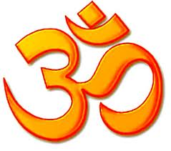
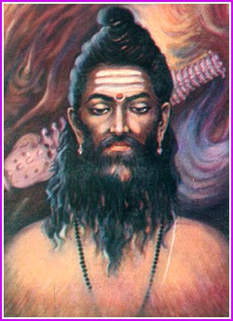
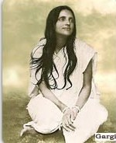
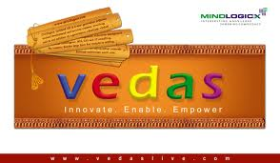
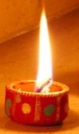
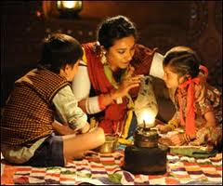
Understanding Dharmas
  Hinduism can be understood on two simultaneous levels:
Philosophy (not Truth Claims) and Self-Development Practices:
Preserved in Sanskrit Books by Ancient
Rishis (Seers)
and Rishikas
Folk Culture: Living the Philosophy (Namaste/Guest Reverance)
Diverse Traditions learnt in family communities through
Stories & Festivals
These two are blended in varying ways across India,
a country over 12 times the size of Britain
Notes:
Folk Culture acts as ‘envelope’ for the philosophy. Emphasis of fHow you behave is what counts.

Slide 9
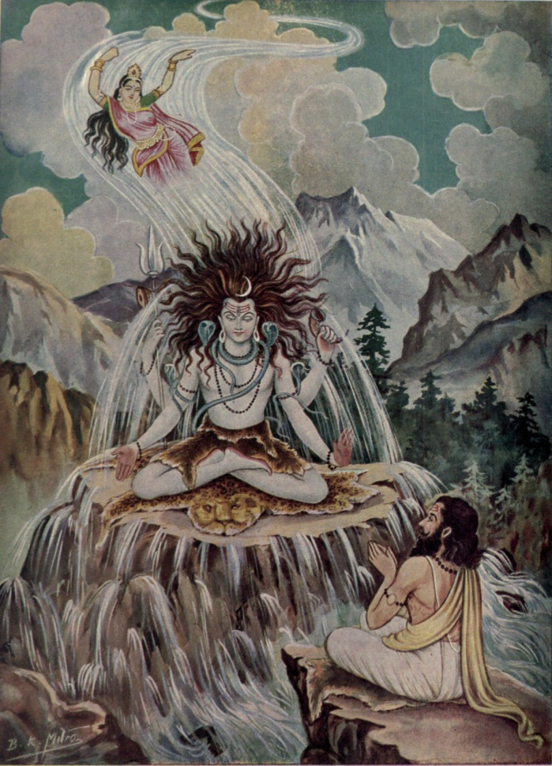
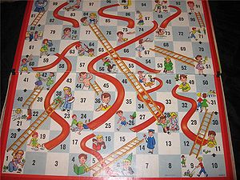
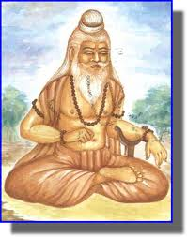
Dharmic Philosophies as Living Traditions
The Rishis used Images, Stories & Games to help explain to lay people (so can we!)

Slide 10
Understanding Hindu ways of ‘Being & Behaving’
Indian Name for ‘Hinduism’ - for this way of Being:
  Sanatan Dharma
Which literally means:
  The Eternal or Ever-flowing Way
  (in harmony with the unfolding Universe)
What matters is not what you believe about the past or the future, but how you experience & live life.

Slide 11
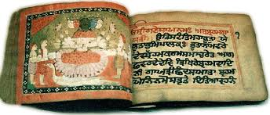
Hindu Philosophy: Brahman
One Ultimate Reality or Absolute Truth
  Infinite & Universal
  Without form or attribute
  before and beyond Time (Sanatan).
self-organising field of intelligence or consciousness, spiritual ‘gloop’,
Spirit. (‘God’??)

Slide 12
Philosophy: MATERIAL WORLDS COME & GO
All Physical Universes emerge and blend back into Brahman in their OWN Time.
Each universe has a finite calculated lifespan
Modern Cosmologists calculate age of this universe (ie since the big bang) to within decimal points of the definition in the Vedas.
One Kalpa= 4.32 billion years
Time is considered to be cyclical not linear
And now a game…

Slide 13
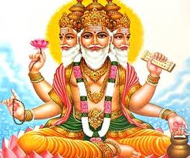
Lord Brahma (Who?)
For help creating NEW ideas

Slide 14
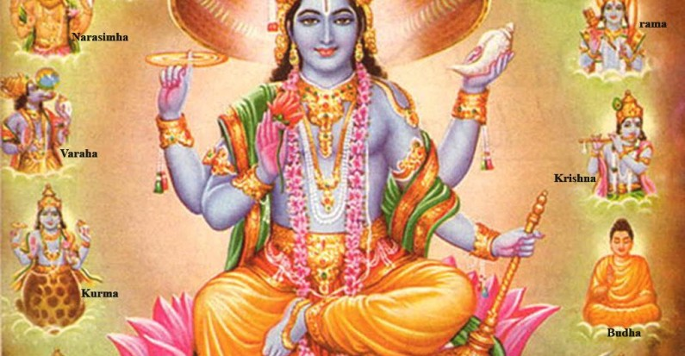
Lord Vishnu(Who?)
For developing/growing WELL

Slide 15
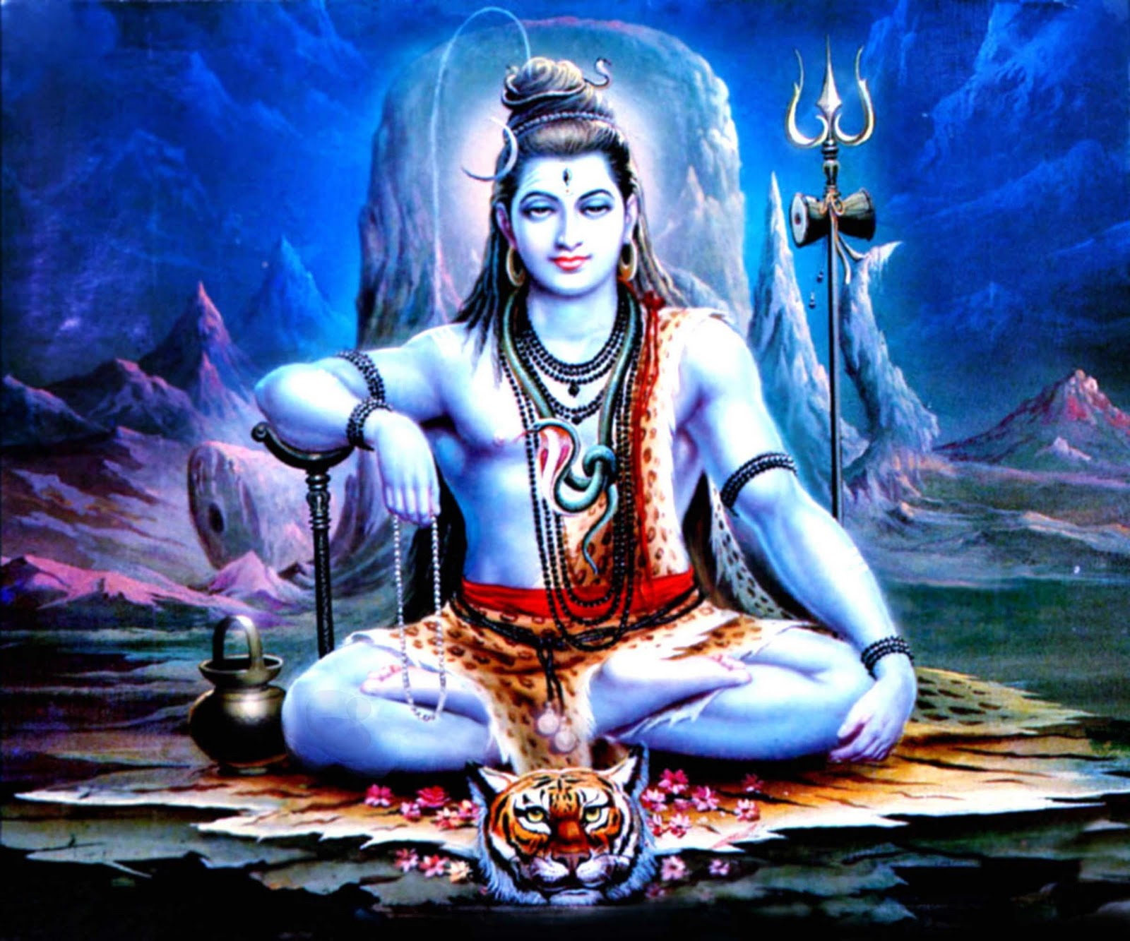
Lord Shiva (Who?)
For wisdom/power to appreciate endings

Slide 16
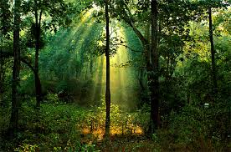
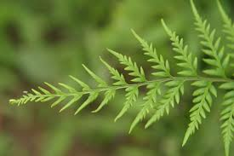
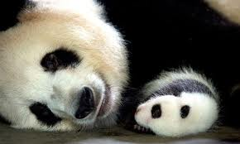
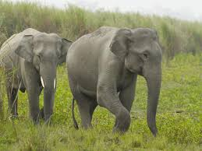
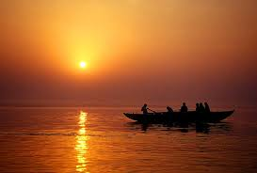
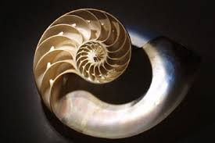
Dharma – Flourishing Blueprint

Slide 17
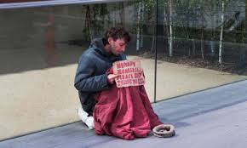

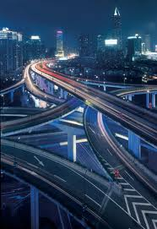
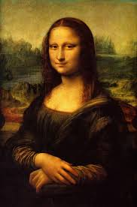
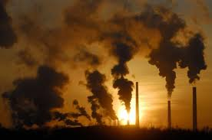
Karma – Choices & Consequences

Slide 18
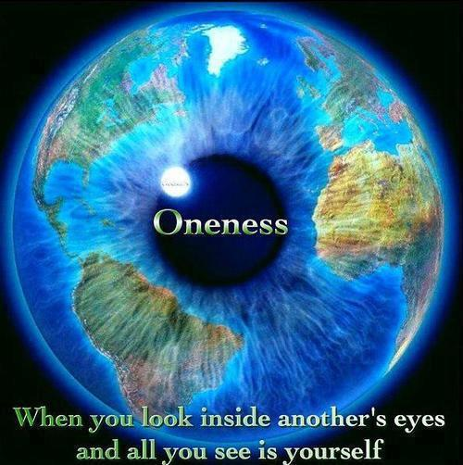




Namaste
First key Concept:
Universal Interconnected Divinity
(Golden Rule Plus+)

Slide 19

...Nourishment, Nurture & Spiritual Health considered as Conscious as we are
(eg. Dancers/my family/Indigenous traditions around the world)
‘Hindu’ Dharma relates to the Natural World as a mother who gives us....

Slide 20
Way of Behaving: Activity
Karma is not good or bad – it generates consequences
it takes us towards dharmic flow (Greater Good)
or away from IT (Personal Desire)
Notes:
A chance to play and create Indian designs and colours. Get the children’s acknowledgement that it is an exciting and busy day ahead. Explain the need to listen.... Observe... Pay good attention... And ask the children to agree to work together to make it a wonderful day with a very special final session that we will tell them more about as the day progresses.

Slide 21
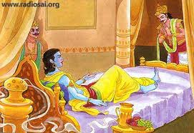
Principles not Rules:
Importance of Wisdom
Stories – Bhagavad Gita
Notes:
A chance to play and create Indian designs and colours. Get the children’s acknowledgement that it is an exciting and busy day ahead. Explain the need to listen.... Observe... Pay good attention... And ask the children to agree to work together to make it a wonderful day with a very special final session that we will tell them more about as the day progresses.

Slide 22

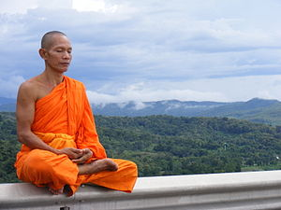
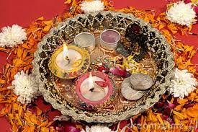
How Dharmics ‘Tune-In’
Meditation– Puja – Whole Being
Is this prayer?
What does Mandir mean?
Notes:
A chance to play and create Indian designs and colours. Get the children’s acknowledgement that it is an exciting and busy day ahead. Explain the need to listen.... Observe... Pay good attention... And ask the children to agree to work together to make it a wonderful day with a very special final session that we will tell them more about as the day progresses.

Slide 23
Dharma= Guru, Philosophy, Principles, Practice (Disciplines-slider)
Being it!
Intuition
/Consciousness
Deity Intervention
Philosopy
Eg Oneness
Principles
Eg Ahimsa
The many meanings of the Word Dharma
Practices
Eg Vegan
Notes:
Spirituality = Connection with Identity, Meaning & Purpose
Environment= Natural World.
For each faith: What is the connection between us and the world?
How does each faith suggest we Identify with our world, its meaning for us (feelings) and purpose (relationship)

Slide 24
Key Concept: Pluralism
  Truth is One, though the sages know it variously
  (Ékam sat vipra bahudā vadanti)
  Rig Veda
  “Whenever & wherever Dharma becomes weak and Adharma becomes strong, I (Spirit) will manifest in every age” - Sri Krishna
  Bhagavad Gita
  Not just in India or Bethlehem or Jerusalem BUT wherever a correcting intervention is needed. What would it look like??
Notes:
A chance to play and create Indian designs and colours. Get the children’s acknowledgement that it is an exciting and busy day ahead. Explain the need to listen.... Observe... Pay good attention... And ask the children to agree to work together to make it a wonderful day with a very special final session that we will tell them more about as the day progresses.

Slide 25
Religious revelation Events:
Prophets, Saints & Avatars
  What would a correcting intervention look like??
Depending on what imbalance was being restored in that time & place
  Those who overturn temples (Jesus)
  Those who build temples (King Solomon)
  Those who denounce ritual (Guru Nanak)
  Those who bring new rituals (Guru Gobind Singh)
  Those who preach peace (Dalai Lama)
  Those who lead conflicts (St Joan of Arc)
  E.g. Rama who brought peace & rule of law
  E.g. Krishna facilitated an epic war & the dismantling of hypocritical laws
  Dharmic intervention is benign, fluid, responsive,
  fit for purpose and brings much-needed societal change.
Notes:
A chance to play and create Indian designs and colours. Get the children’s acknowledgement that it is an exciting and busy day ahead. Explain the need to listen.... Observe... Pay good attention... And ask the children to agree to work together to make it a wonderful day with a very special final session that we will tell them more about as the day progresses.

Slide 26
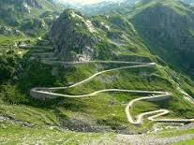
Many Paths up the Mountain
The Mountain is for all not only ‘Hindus’
Notes:
A chance to play and create Indian designs and colours. Get the children’s acknowledgement that it is an exciting and busy day ahead. Explain the need to listen.... Observe... Pay good attention... And ask the children to agree to work together to make it a wonderful day with a very special final session that we will tell them more about as the day progresses.

