Slide 1
Understanding Hinduism
Core Teachings in the Hindu Tradition
By
Sushma Sahajpal

Slide 2

Understanding Hinduism
Banyan Tree
Ancient,
multiple root systems,
Unusual Features:
  No Founder, No Commandments,
  No Specified Book or Deity, No Truth Claim/Doctrine of Faith
Rather than any specific practice or belief system it is a way of Being and Behaving and Becoming
What matters is not what you believe but how you experience & treat life today.

Slide 3

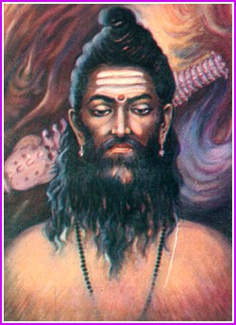
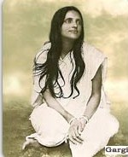
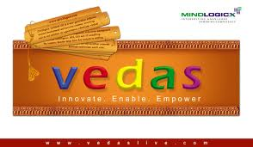
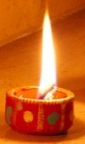
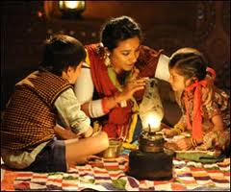
Understanding Hinduism
  Hinduism can be understood on two simultaneous levels:
Philosophy (not Truth Claims) and Self-Development Practices:
Preserved in Sanskrit Books by Ancient
Rishis (Seers)
and Rishikas
Folk Culture: Living the Philosophy (Namaste/Guest Reverance)
Diverse Traditions learnt in family communities through
Stories & Festivals
These two are blended in varying ways across India,
a country over 12 times the size of Britain
Notes:
Folk Culture acts as ‘envelope’ for the philosophy. Emphasis of fHow you behave is what counts.

Slide 4





Namaste
First key Concept:
Universal Interconnected Divinity
(Golden Rule -> Platinum Rule)

Slide 5
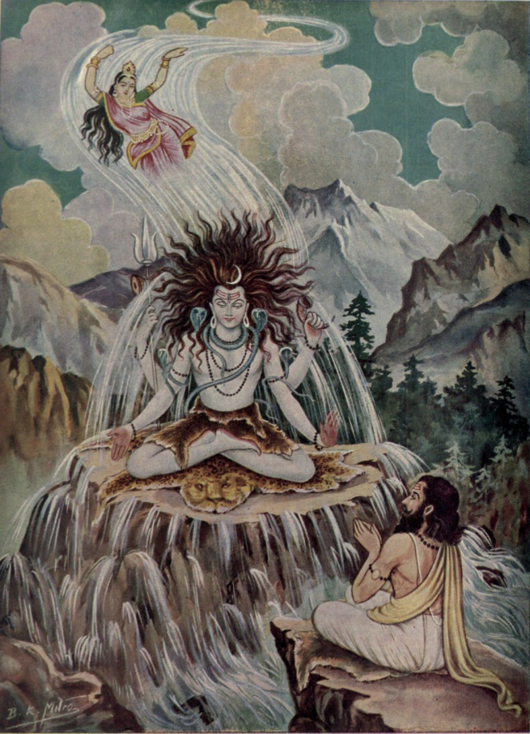
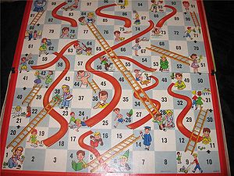
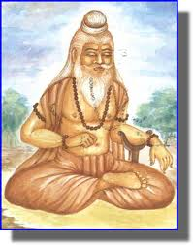
Hindu Philosophy as Living Traditions
The Rishis used Images, Stories & Games to help explain to lay people (so can we!)

Slide 6
Understanding Hindu ways of ‘Being & Behaving’
Indian Name for ‘Hinduism’ - for this way of Being:
  Sanatan Dharma
Which literally means:
  The Eternal or Ever-flowing Way
  (in harmony with the unfolding Universe)
What matters is not what you believe about the past or the future, but how you experience & live life.

Slide 7
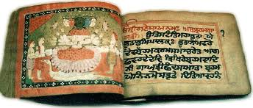
Hindu Philosophy: Brahman
One Ultimate Reality or Absolute Truth
  Infinite & Universal
  Without form or attribute
  before and beyond Time.
self-organising field of intelligence or consciousness, spiritual ‘gloop’,
Spirit. (‘God’??)

Slide 8
Philosophy: MATERIAL WORLDS COME & GO
All Physical Universes emerge and blend back into Brahman in their OWN Time.
Each universe has a finite calculated lifespan
Modern Cosmologists calculate age of this universe (ie since the big bang) to within decimal points of the definition in the Vedas.
One Kalpa= 4.32 billion years
Time is considered to be cyclical not linear
Visual Demonstration…

Slide 9
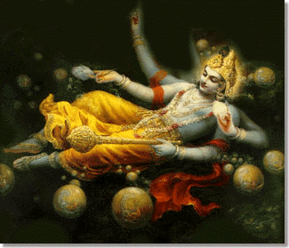
Cosmos
Multiple Universes

Slide 10
Philosophy: MATERIAL WORLDS COME & GO
All Physical Universes emerge and blend back into Brahman in their OWN Time.
Each universe has a finite calculated lifespan
Modern Cosmologists calculate age of this universe (ie since the big bang) to within decimal points of the definition in the Vedas.
One Kalpa= 4.32 billion years
Time is considered to be cyclical not linear
And now a game…

Slide 11
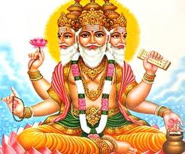
Lord Brahma (Who?)
For help creating NEW ideas

Slide 12
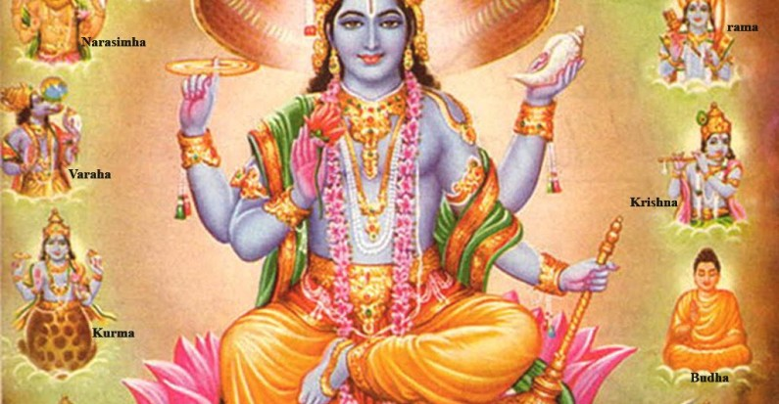
Lord Vishnu(Who?)
For developing/growing WELL

Slide 13
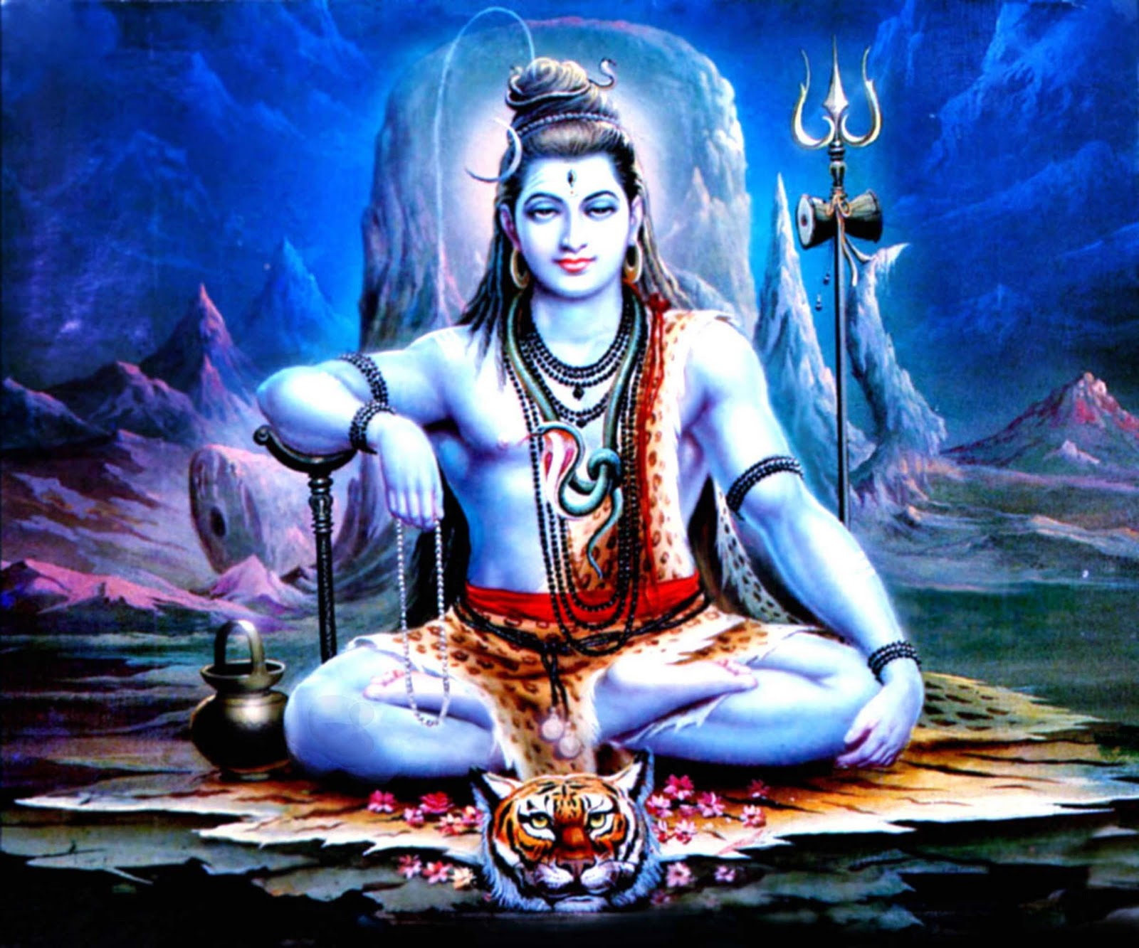
Lord Shiva (Who?)
For wisdom/power to appreciate endings

Slide 14
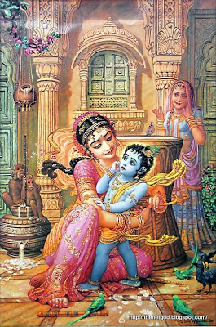
Story: Lord Krishna’s Proof

Slide 15
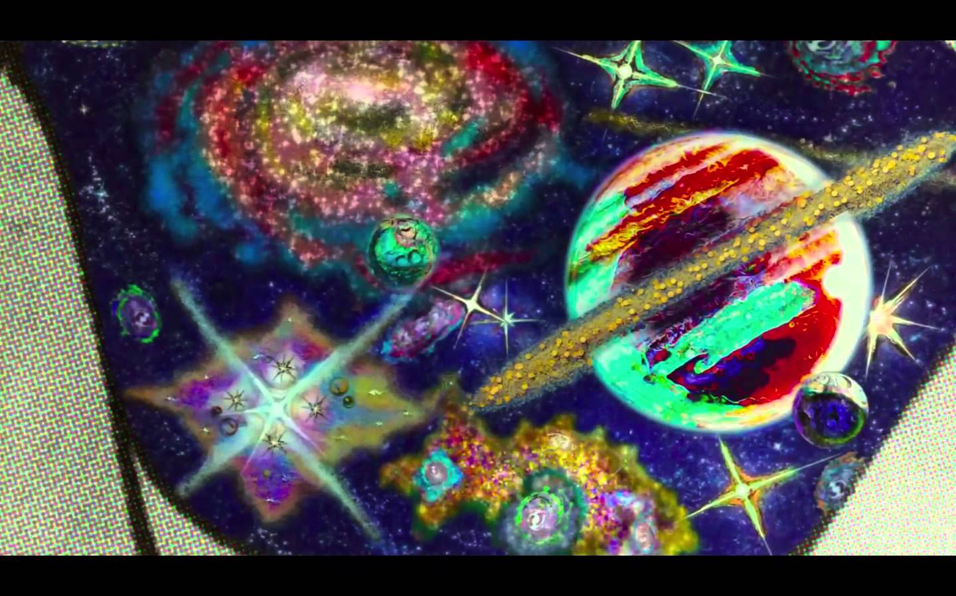
Lord Krishna’s proof

Slide 16

...Nourishment, Nurture & Spiritual Health considered as Conscious as we are (eg. Dancers/my family)
Hindu Dharma relates to the Natural World as a mother who gives us....

Slide 17
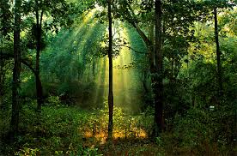
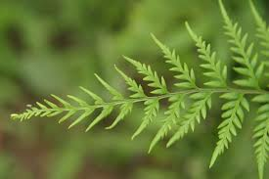
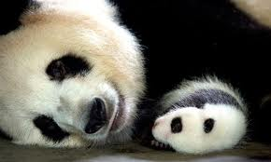
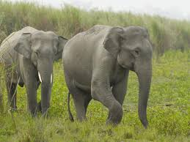
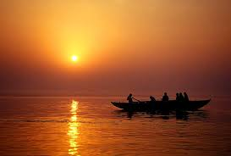
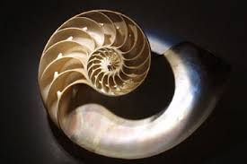
Dharma – Flourishing Blueprint

Slide 18
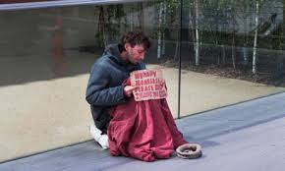

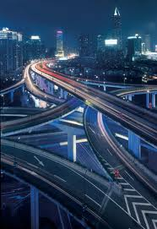
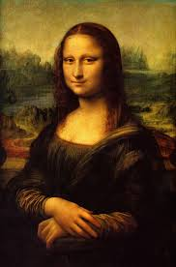
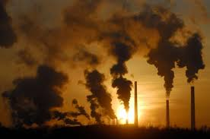
Karma – Choices & Consequences

Slide 19
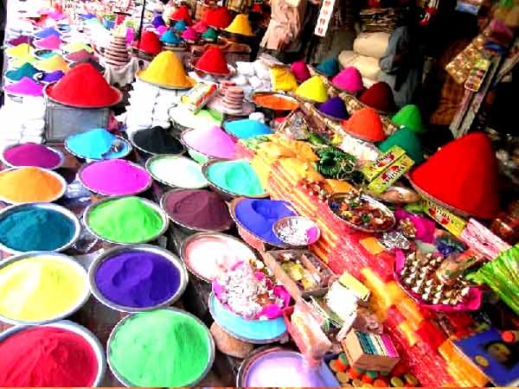
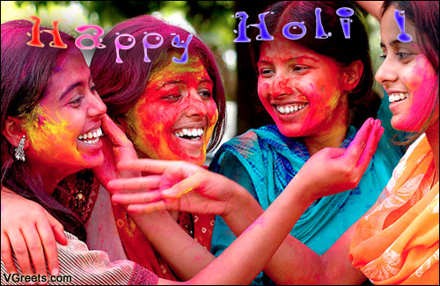
Teaching through the festivals: eg Dharma:
Actual Festival: Holi: Festival of Colour
Harmonising with the Natural World:
Flourishing together
Not just celebrating Spring and thanksgiving.

Slide 20
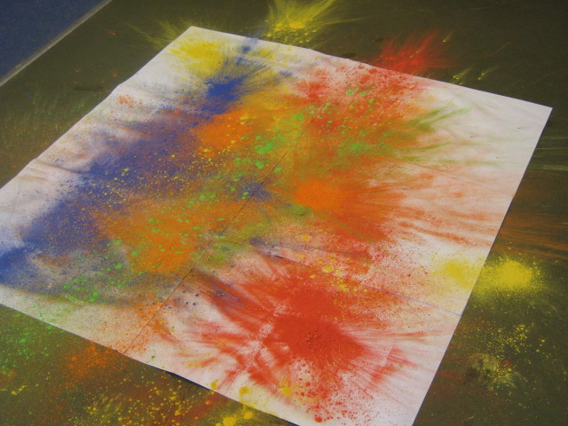
Creatively Exploring In the Classroom
Festivals: Holi Workshop, Story, Images and
Visual/Tactile Experience– colour &craftwork (Splash Art to celebrate Holi), way of being
“ I will never forget Holi Day. We’ve never laughed so much in all the years of working at this school as we did with the children that day” .

Slide 21
Way of Behaving: Activity
Karma is not good or bad – it generates consequences
it takes us towards dharmic flow (Greater Good)
or away from IT (Personal Desire)
Notes:
A chance to play and create Indian designs and colours. Get the children’s acknowledgement that it is an exciting and busy day ahead. Explain the need to listen.... Observe... Pay good attention... And ask the children to agree to work together to make it a wonderful day with a very special final session that we will tell them more about as the day progresses.

Slide 22
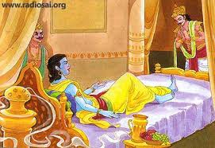
Principles not Rules:
Importance of Wisdom
Stories – Bhagavad Gita
Notes:
A chance to play and create Indian designs and colours. Get the children’s acknowledgement that it is an exciting and busy day ahead. Explain the need to listen.... Observe... Pay good attention... And ask the children to agree to work together to make it a wonderful day with a very special final session that we will tell them more about as the day progresses.

Slide 23
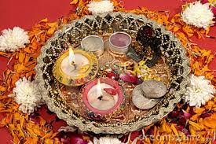
How Hindus ‘Tune-In’
Reflection– Puja – Whole Being
Is this prayer?
Notes:
A chance to play and create Indian designs and colours. Get the children’s acknowledgement that it is an exciting and busy day ahead. Explain the need to listen.... Observe... Pay good attention... And ask the children to agree to work together to make it a wonderful day with a very special final session that we will tell them more about as the day progresses.

Slide 24
Key Concept: Pluralism
  Truth is One, though the sages know it variously
  (Ékam sat vipra bahudā vadanti)
  Rig Veda
  “Whenever & wherever Dharma becomes weak and Adharma becomes strong, I (Spirit) will manifest in every age” - Sri Krishna
  Bhagavad Gita
  Not just in India or Bethlehem or Jerusalem BUT wherever a correcting intervention is needed. What would it look like??
Notes:
A chance to play and create Indian designs and colours. Get the children’s acknowledgement that it is an exciting and busy day ahead. Explain the need to listen.... Observe... Pay good attention... And ask the children to agree to work together to make it a wonderful day with a very special final session that we will tell them more about as the day progresses.

Slide 25
Religious revelation Events:
Prophets, Saints & Avatars
  What would a correcting intervention look like??
Depending on what imbalance was being restored in that time & place
  Those who overturn temples (Jesus)
  Those who build temples (King Solomon)
  Those who denounce ritual (Guru Nanak)
  Those who bring new rituals (Guru Gobind Singh)
  Those who preach peace (Dalai Lama)
  Those who lead conflicts (St Joan of Arc)
  E.g. Rama who brought peace & rule of law
  E.g. Krishna facilitated an epic war & the dismantling of hypocritical laws
  Dharmic intervention is benign, fluid, responsive,
  fit for purpose and brings much-needed societal change.
Notes:
A chance to play and create Indian designs and colours. Get the children’s acknowledgement that it is an exciting and busy day ahead. Explain the need to listen.... Observe... Pay good attention... And ask the children to agree to work together to make it a wonderful day with a very special final session that we will tell them more about as the day progresses.

Slide 26
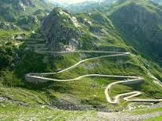
Many Paths up the Mountain
The Mountain is for all not only ‘Hindus’
Notes:
A chance to play and create Indian designs and colours. Get the children’s acknowledgement that it is an exciting and busy day ahead. Explain the need to listen.... Observe... Pay good attention... And ask the children to agree to work together to make it a wonderful day with a very special final session that we will tell them more about as the day progresses.

