Slide 1
Exploring Religious and Non-religious Worldviews with Foundation and Key Stage 1
Katie Freeman
St Matthew’s C of E Primary and Nursery Academy
SLE, PLRE with LTLRE area 1 and NATRE Primary Vice Chair
@Katie_Kates84
Katie.freeman@stmatthewsstcmat.org

Slide 2

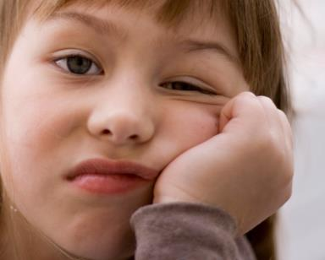
Why do we teach RE in Foundation and Key Stage One?

Slide 3
What do we want to achieve?
Children having a firm understanding of religious and non-religious worldviews.
Children being able to use a range of technical vocabulary when talking about religious and non-religious worldviews.
A sense of fun through learning.

Slide 4
What does it lead to?
Salvation means ‘save us’ (Millie)
Ramadan means fasting, Muslims fast all day during Ramadan (Amelia)
At Easter, Jesus died and they put him in a tomb with a big boulder in front of it. (Charlie)
God’s plan was to make the world good but people made mistakes. (Ruben)
The synagogue is a special place to worship and Jews go there to pray. (Mason)
The Torah is a special text for Jews and it is a scroll. (William)

Slide 5
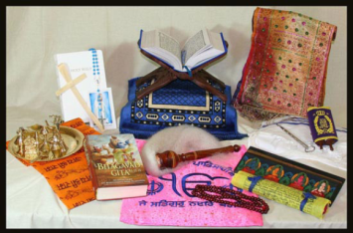

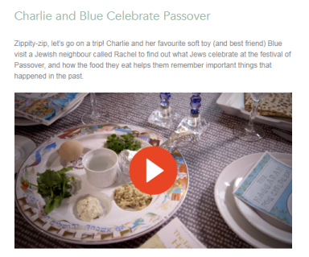
Where do we start?
Resources
Vocabulary
Artefacts
Video clips
Web resources
Visitors

Slide 6
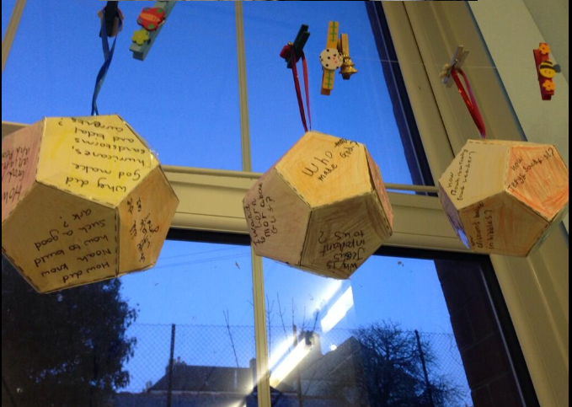
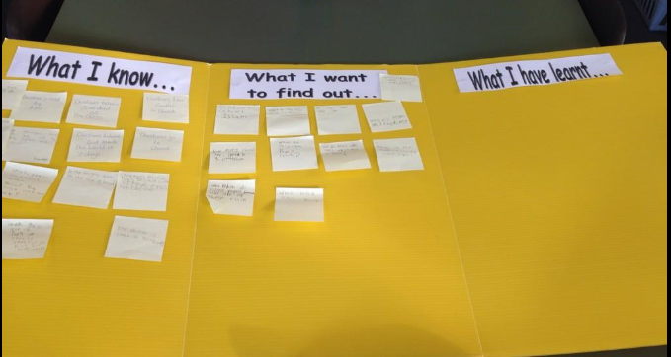
Benchmark Assessment

Slide 7
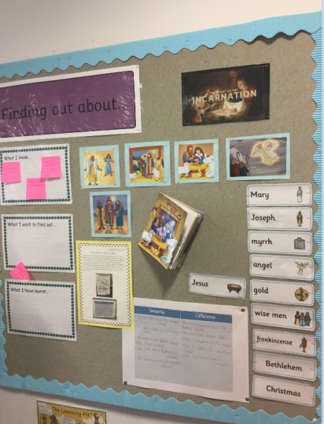
Working Walls
Promoting the use of technical vocabulary.
Helping children to sequence their learning.
Child friendly reference point for future learning.
PHOTOS

Slide 8
RE and Arts Week
What did we want to achieve?
Large school with many children who have BIG questions.
Younger children interested in what the older children are learning about.
A diverse and developing community
Wanting to ensure that our C of E school was focusing on a range of religions and non-religious worldviews.

Slide 9
Buddhism
Enlightenment

Slide 10

Looking at Buddhism with KS1 and Foundation…
How did we do it?
Why did we do it?
What did the children get from it?
How did they share their learning?
Vocabulary
http://www.reonline.org.uk/charlie-and-blue/

Slide 11
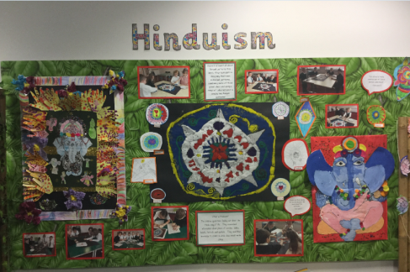
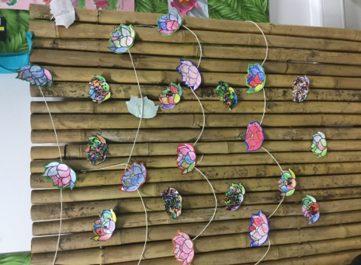
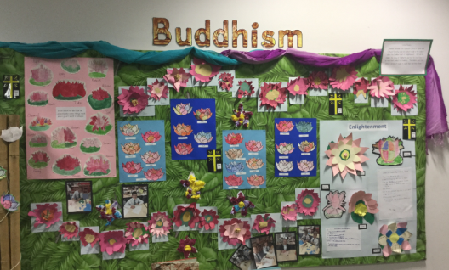
Photos from Arts Week

Slide 12
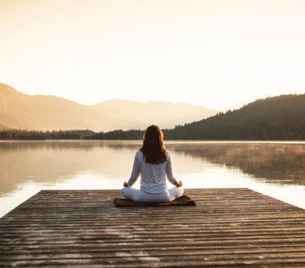
How do we reflect? What is meditation?
Year 5- meditation
Use older children to share their knowledge with younger children
Finding out about meditation with Jonathan Marshall.

Slide 13
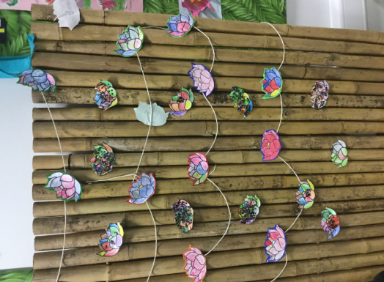
What did we do?

Slide 14
Christianity
Using Scripture

Slide 15
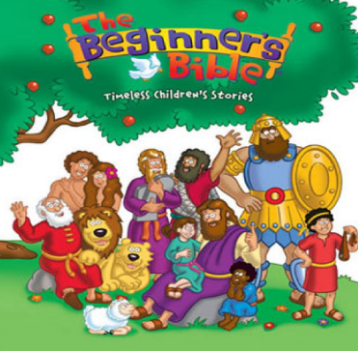

Using Texts with KS1

Slide 16
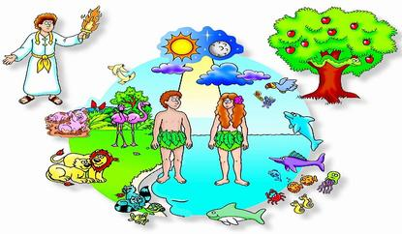
Creation
How do we create awe and wonder?
How do we use scripture and make our lessons engaging?

Slide 17
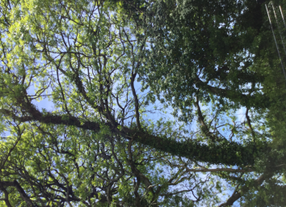
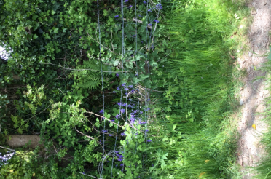
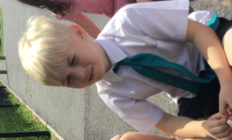
Outside learning
How do children experience being the creator?
How do we make text relevant to them?
Comparing the Beginner’s Bible to the NIV.

Slide 18

Creating awe and wonder…
Big questions, what do they want to know?
Encouraging children to lead their own learning.
Going outside and giving the children time to ‘drink in their surroundings.
How did everything get there?
Den building

Slide 19
Reading…
Genesis 1:26-31New International Version (NIV)
²⁶ Then God said, “Let us make mankind in our image, in our likeness, so that they may rule over the fish in the sea and the birds in the sky, over the livestock and all the wild animals,^{[a]} and over all the creatures that move along the ground.”
²⁷ So God created mankind in his own image,
in the image of God he created them;
male and female he created them.
²⁸ God blessed them and said to them, “Be fruitful and increase in number; fill the earth and subdue it. Rule over the fish in the sea and the birds in the sky and over every living creature that moves on the ground.”
²⁹ Then God said, “I give you every seed-bearing plant on the face of the whole earth and every tree that has fruit with seed in it. They will be yours for food. ³⁰ And to all the beasts of the earth and all the birds in the sky and all the creatures that move along the ground—everything that has the breath of life in it—I give every green plant for food.” And it was so.
³¹ God saw all that he had made, and it was very good. And there was evening, and there was morning—the sixth day.

Slide 20
What does it mean?
Discuss time times God uses ‘good’ or ‘very good’ to describe his creation. Why does he do this?
Children to think about a time when they have created something. How would they have described it?

Slide 21
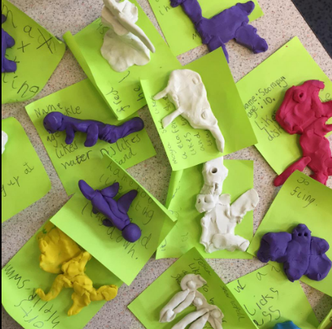
Being the Creator…

Slide 22
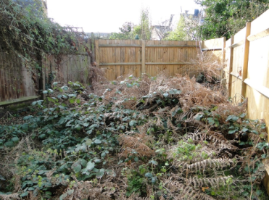
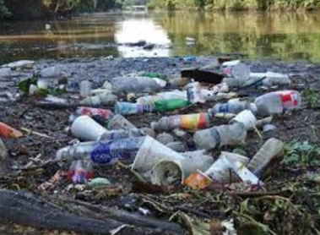
Stewardship
Read the text again, how would a Christian feed about creation looking like this?
Why do they feel that stewardship is important?
What could they do about it?

Slide 23
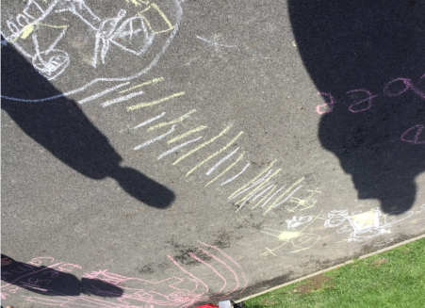
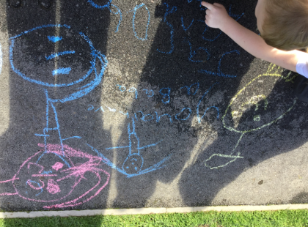
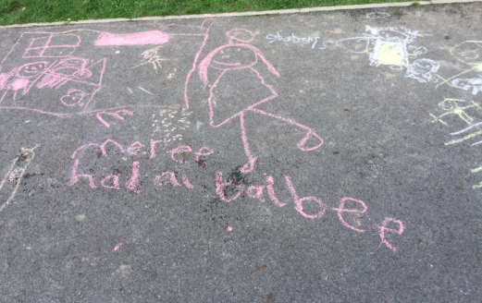
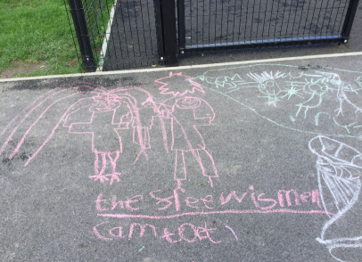
Nativity Storytelling…

Slide 24
The Psalms
A cross-curricular RE project

Slide 25
Looking at AT1 and AT2
Find out how art can express key beliefs (AT1)
Relate key Jewish stories to their feelings and experiences (AT2)

Slide 26
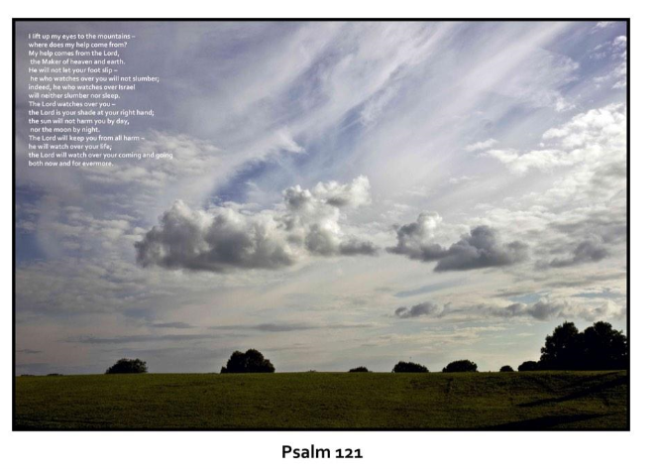
The children spent time looking at the Psalms and reading them in different translations.

Slide 27
Looking at different translations…
Psalm 121
A song of ascents.
1 I lift up my eyes to the mountains—
where does my help come from?
2 My help comes from the Lord,
the Maker of heaven and earth.
3 He will not let your foot slip—
he who watches over you will not slumber;
4 indeed, he who watches over Israel
will neither slumber nor sleep.
5 The Lord watches over you—
the Lord is your shade at your right hand;
6 the sun will not harm you by day,
nor the moon by night.
7 The Lord will keep you from all harm—
he will watch over your life;
8 the Lord will watch over your coming and going
both now and forevermore.
New international Version
God the Help of Those Who Seek Him
A Song of Ascents.
121 I will lift up my eyes to the hills—
From whence comes my help?
2 My help comes from the Lord,
Who made heaven and earth.
3 He will not allow your foot to be moved;
He who keeps you will not slumber.
4 Behold, He who keeps Israel
Shall neither slumber nor sleep.
5 The Lord is your keeper;
The Lord is your shade at your right hand.
6 The sun shall not strike you by day,
Nor the moon by night.
7 The Lord shall preserve you from all evil;
He shall preserve your soul.
8 The Lord shall preserve your going out and your coming in
From this time forth, and even forevermore.
King James Version

Slide 28
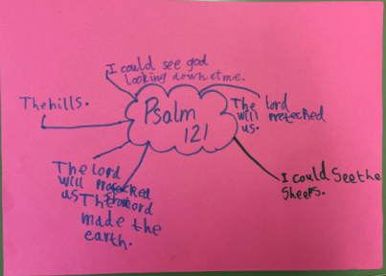
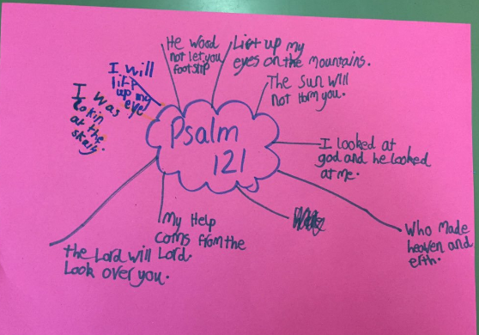
Investigating scripture…

Slide 29

Listening to music based on The Psalms
What does it make you think of?
Why do you think it was written?
Which Parts of the Psalm does it remind you of?

Slide 30
The Museum of The Psalms
http://www.youtube.com/watch?v=gXLr919uBbI

Slide 31
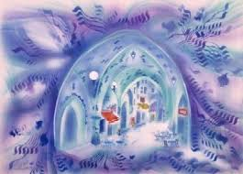
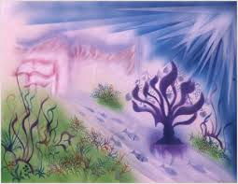
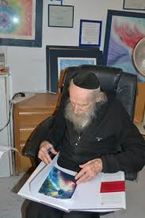
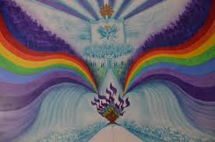
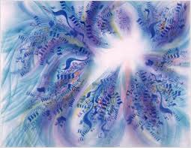

Slide 32
Looking at colours…
Blue – mercy
White – loving kindness
Purple – wisdom
Green - beauty

Slide 33
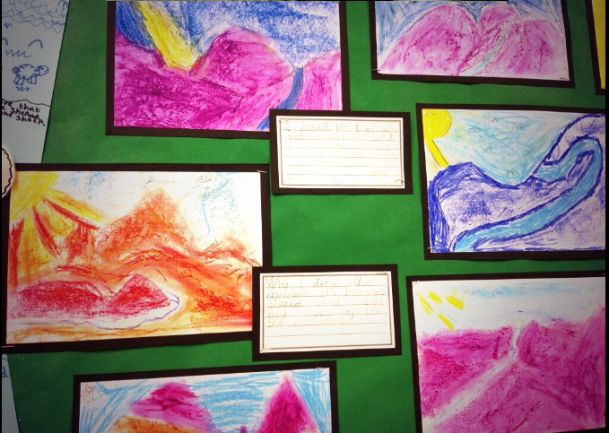

Slide 34
Reflections on The Psalms
I drew the light because God is always looking down on David. I also drew a path because I think David walked with God. I drew the mountains because David said about them in The Psalms.
I drew the mountains because David said ‘when I look up to the mountains’. I drew the light because God is watching over David.
I drew the path because God is walking with David.

Slide 35
What did the children think about the project?
I like learning about The Bible through art.
I enjoyed learning about The Psalms and using oil pastels to draw what it made me think of.
I enjoyed finding out about God and David. We watched a video that told us lots of information.

Slide 36
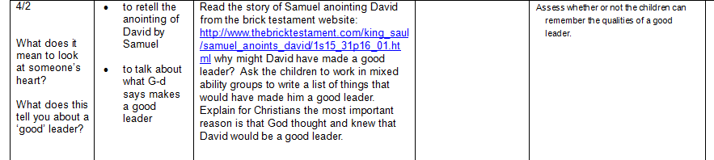
Samuel anoints David

Slide 37
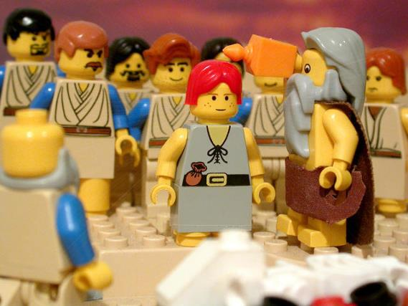
Yes I agree, he doesn’t look like a superhero but I’m sure God has a plan.
David is an unlikely hero!
What are you talking about? Look at his good looks, he could be a film star

Slide 38
No he isn’t, he’s only a child who isn’t strong enough to fight a battle.
David is the right choice to be King of Israel.
I agree,, God knows what he’s doing and we have to trust his decision.

Slide 39
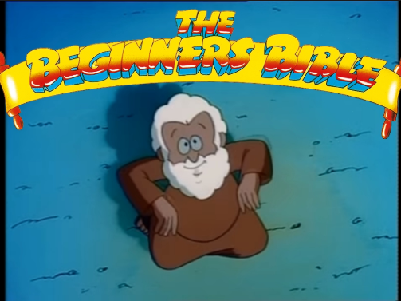
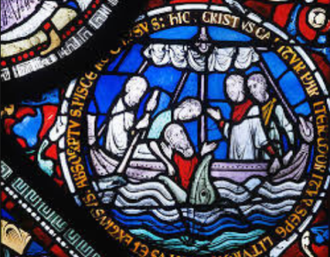
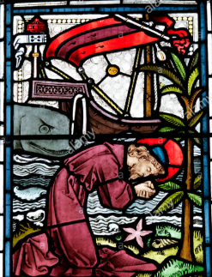
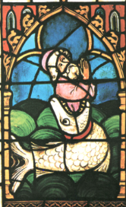
Artwork and text
https://www.youtube.com/watch?v=XYUFq8azCw4

Slide 40
Humanism

Slide 41
What did we do?
We cover Humanism in Year 4,5 and 6.
Most agreed syllabi advice that this worldview is taught in KS2.
We felt it was important that our children knew that not everyone is religious.
We linked this with many of the Understanding Christianity units.

Slide 42
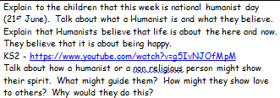
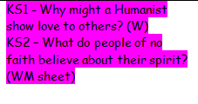
We also linked this with Collective Worship…

Slide 43
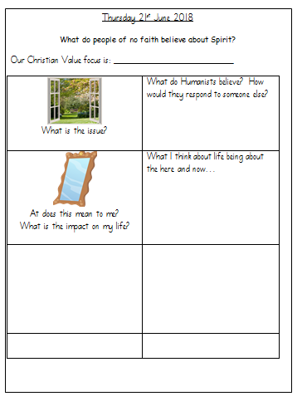
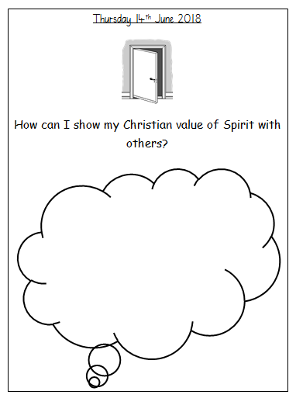

Slide 44
Islam

Slide 45
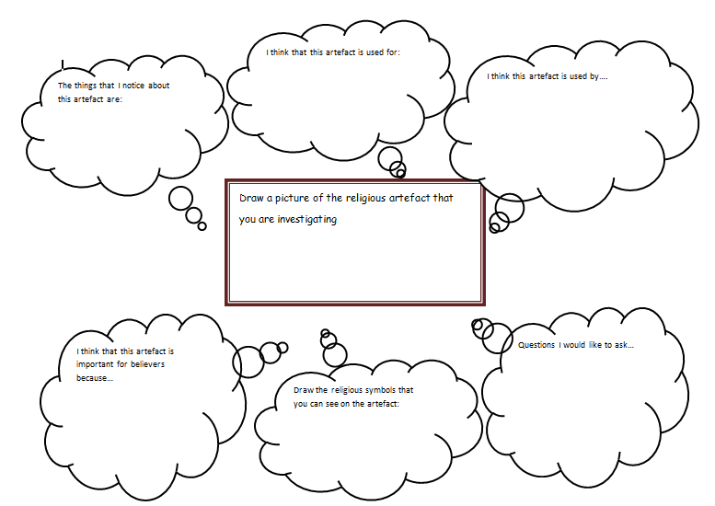
Using artefact sheets…

Slide 46
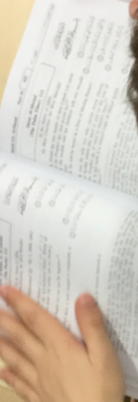
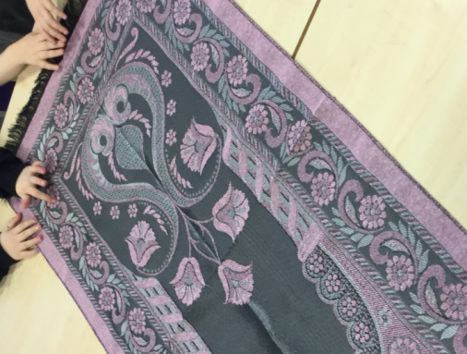
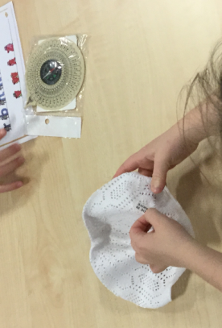
Investigating Artefacts

Slide 47
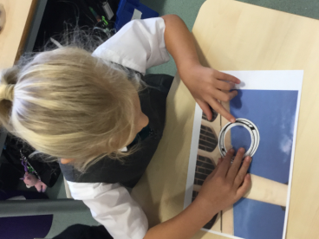
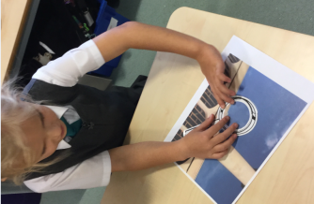
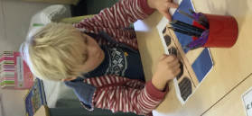
Investigating the mosque…
Thinking of big questions
Looking for signs and symbols
What is interesting? What is exciting? What is confusing? Big questions…
Using REOnline to ask a believer

Slide 48
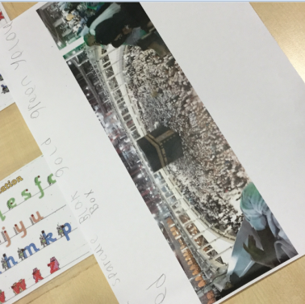





Hajj Matrix

Slide 49
Progression grids…

Slide 50


Slide 51


Slide 52


Slide 53


