Slide 1
My journey into creative RE
Katie Freeman
St Matthew’s C of E Primary and Nursery Academy
SLE, PLRE with LTLRE area 1 and NATRE Primary Vice Chair
@Katie_Kates84
Katie.freeman@stmatthewsstcmat.org

Slide 2
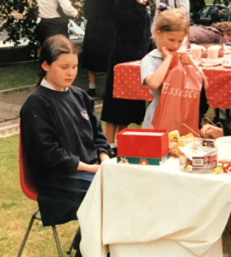
When did my RE journey start?

Slide 3
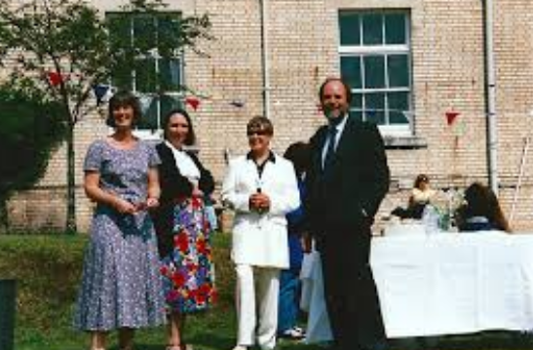
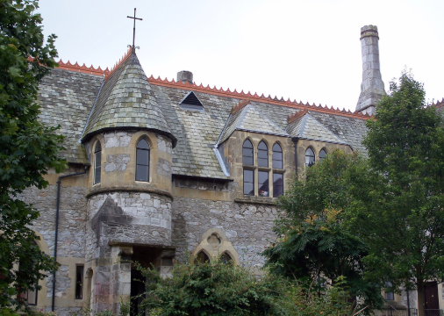
What happened?

Slide 4
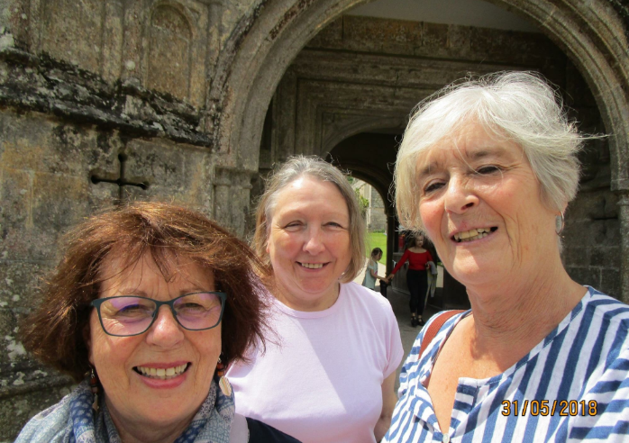
Mrs Clark
Everyone has that one stand out teacher.
What did Mrs Clark do that was so special?
Why I want to be like my A Level RE teacher!

Slide 5
Why RE?
Finding learning challenging
One teacher who believed in me enough to encourage me to take RE GCSE.
Finding RE fascinating
Going on to study A Level

Slide 6
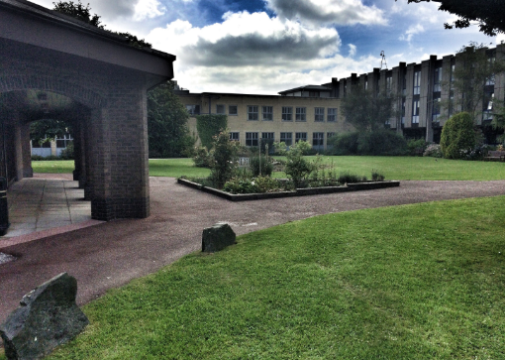

Falling out of Love
A Level
General Primary at Uni

Slide 7
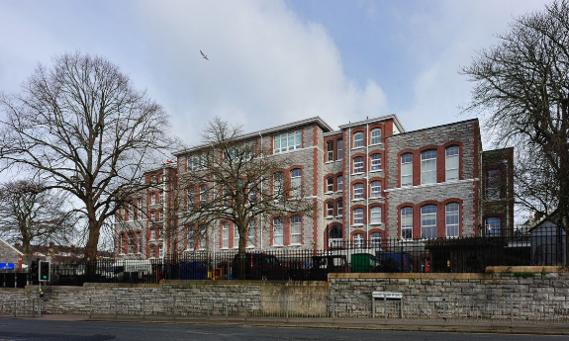
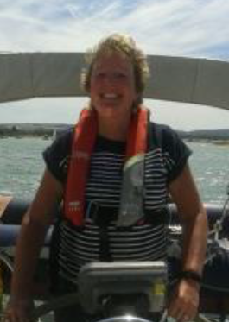
What took me back to RE?
Never walk into a cupboard when you are about to finish your NQT year!
Always accept a challenge even if you don’t think it is for you.
Something new might be just the something that you are looking for.

Slide 8
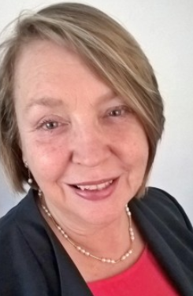

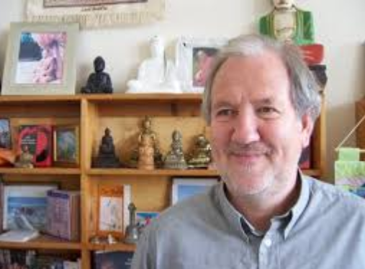
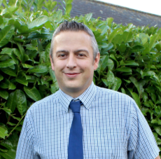
SACRE, LTLRE and Jonathan Marshall

Slide 9
What did our first LTLRE conference inspire me to do?
Hearing amazing speakers
Getting involved with Twitter
Being brave and trying out new things in the classroom.
Recognising that there was more to teaching RE than just reading stories.
Completely rewriting our RE curriculum.

Slide 10
My first creative project…

Slide 11
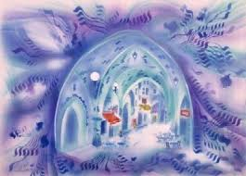
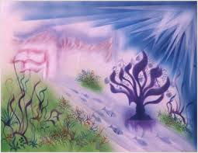
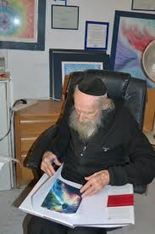
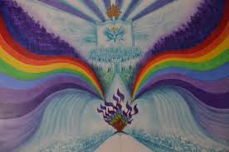


Slide 12
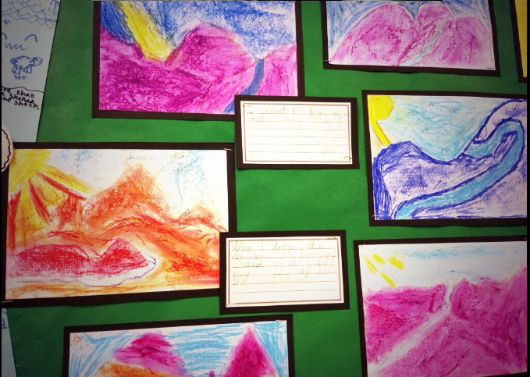

Slide 13
Reflections on The Psalms
I drew the light because God is always looking down on David. I also drew a path because I think David walked with God. I drew the mountains because David said about them in The Psalms.
I drew the mountains because David said ‘when I look up to the mountains’. I drew the light because God is watching over David.
I drew the path because God is walking with David.

Slide 14
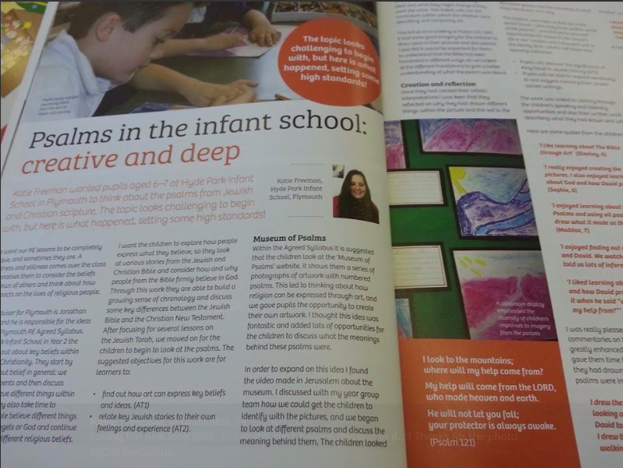
REToday article

Slide 15
What this first project led to…
A desire to see every child go deeper with their learning.
A knowledge that creative RE could do this for our school
Understanding that this wasn’t just my RE journey but one that we needed to go on as a school family.

Slide 16
Developing our curriculum
Pitching to the school
Networking via Twitter
Asking for advice and sharing what we had.
Trying to inspire an established staff to change teaching styles and planning.
Using the REQM criteria to ensure that provision was high quality.
What did this do for our school?

Slide 17
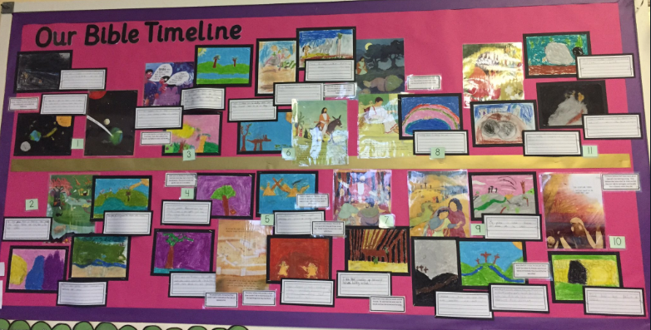
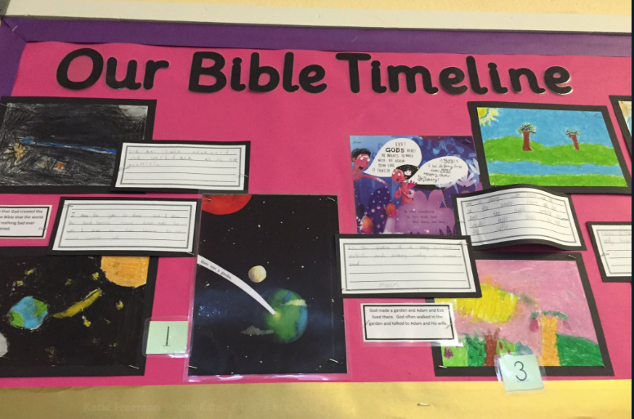

Slide 18
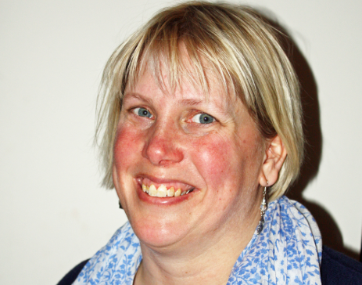

An interesting phone call…
Taking risks
Having the opportunity to take RE to a bigger stage
Talking to people who can make a difference
Never forgetting your place in the classroom.

Slide 19
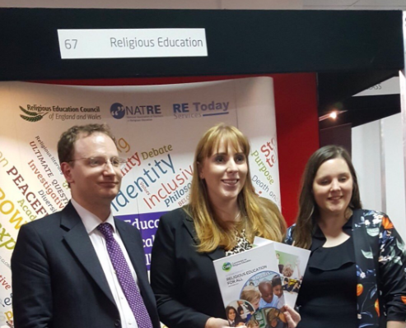

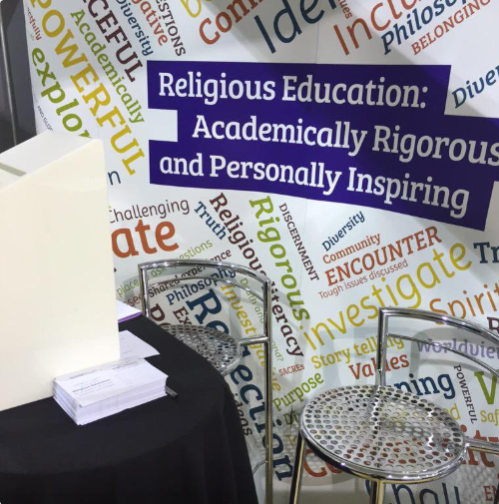
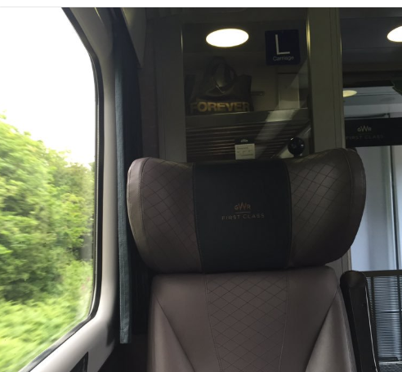

Slide 20
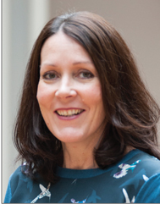
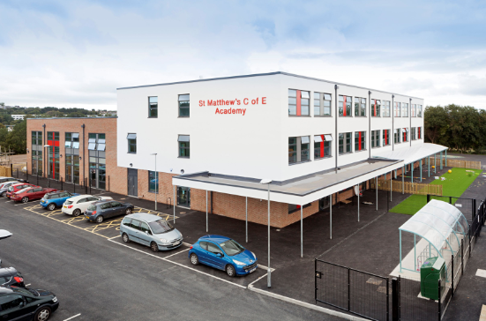

Taking a bigger risk…

Slide 21
The challenges that I faced
KEY STAGE TWO!!!
Moving into a C of E School and wanting people to know that I was learning at the same time as they were.
Thinking about the bigger picture over two schools.
Moving both schools towards inspection and development.
Implementing new ways of working.

Slide 22
What does creative RE look like in our schools?

Slide 23
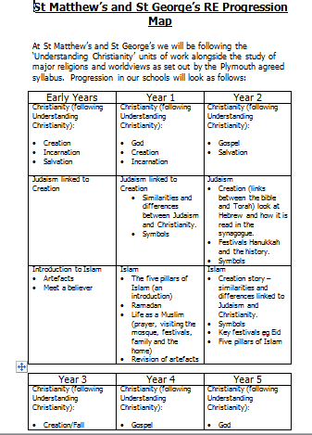

Slide 24
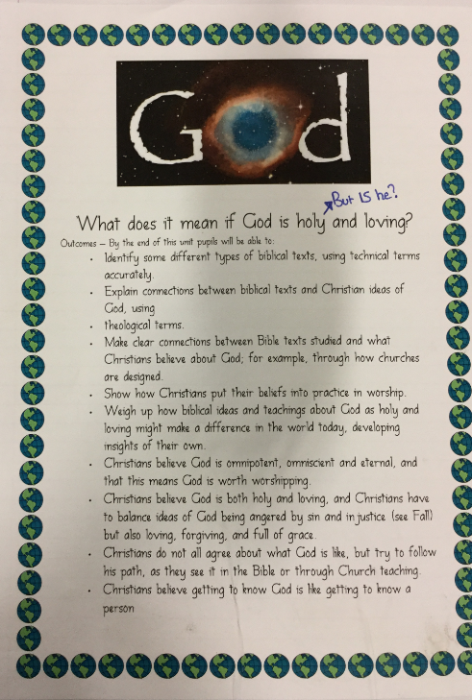

Slide 25
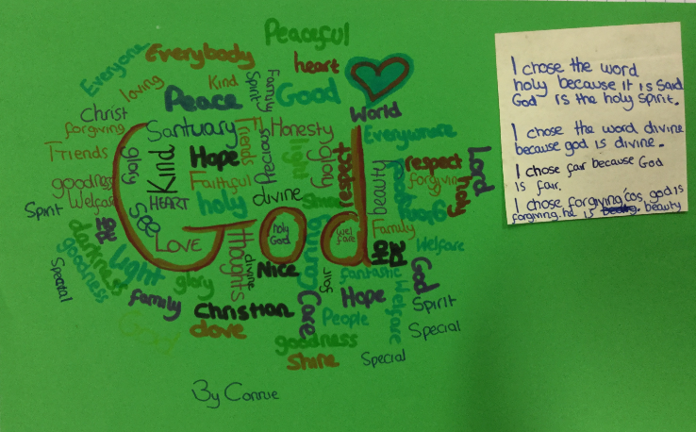

Slide 26
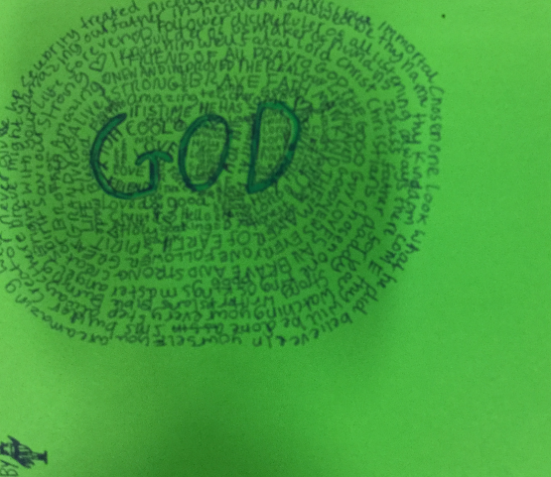
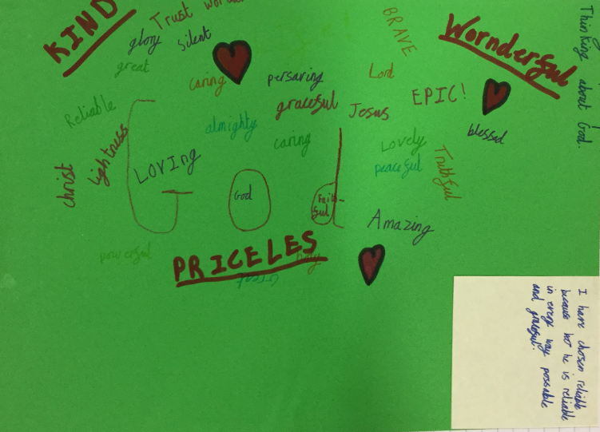

Slide 27
Isaiah 6:1-5
Isaiah’s Commission
6 In the year that King Uzziah died, I saw the Lord, high and exalted, seated on a throne; and the train of his robe filled the temple. ² Above him were seraphim, each with six wings: With two wings they covered their faces, with two they covered their feet, and with two they were flying. ³ And they were calling to one another:
“Holy, holy, holy is the Lord Almighty;
the whole earth is full of his glory.”
⁴ At the sound of their voices the doorposts and thresholds shook and the temple was filled with smoke.
⁵ “Woe to me!” I cried. “I am ruined! For I am a man of unclean lips, and I live among a people of unclean lips, and my eyes have seen the King,the Lord Almighty.

Slide 28
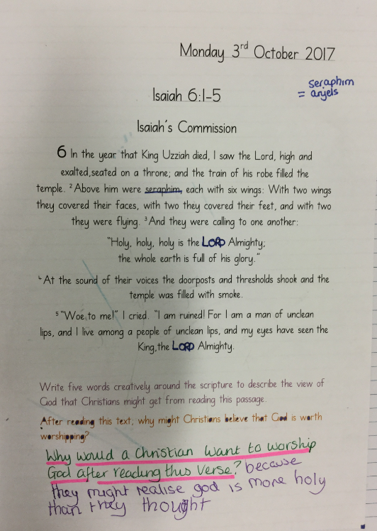
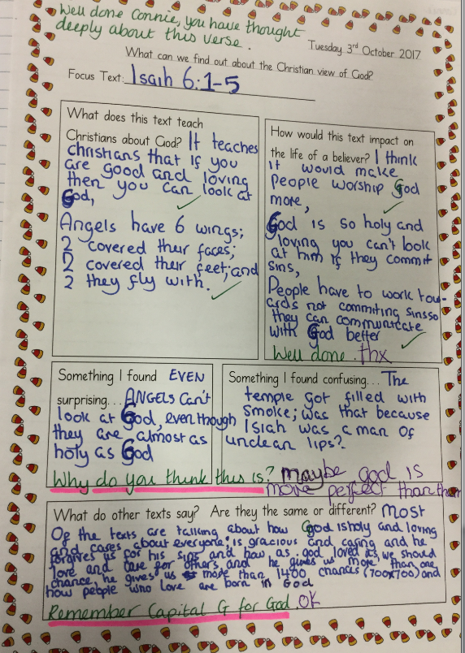

Slide 29
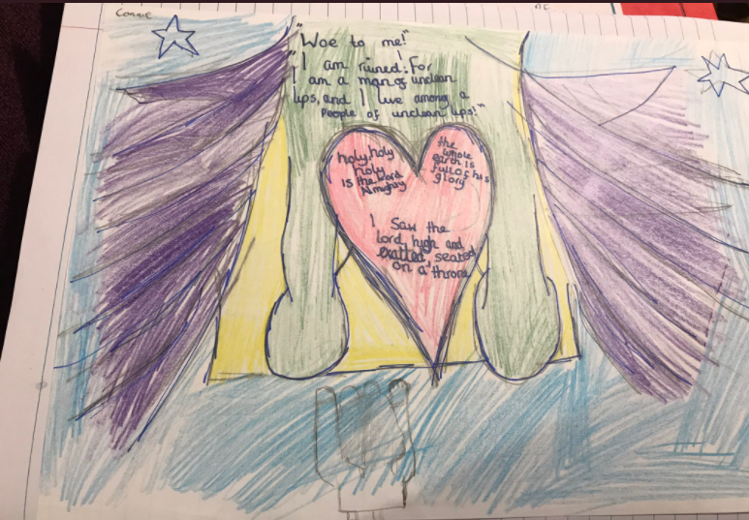

Slide 30
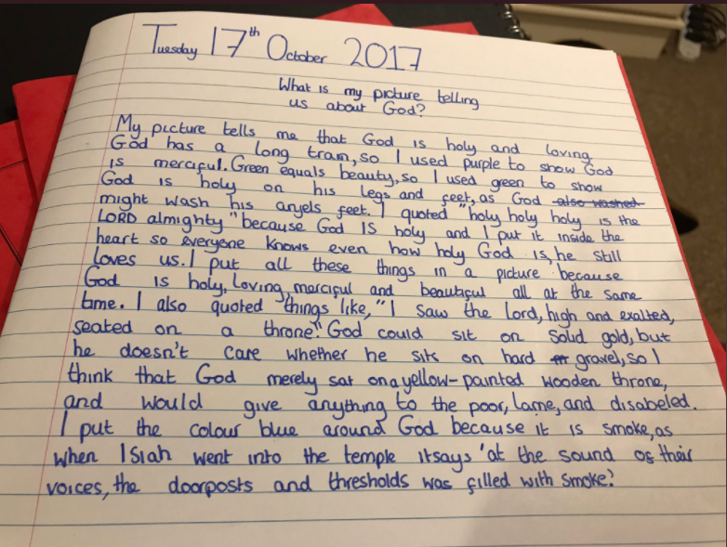

Slide 31
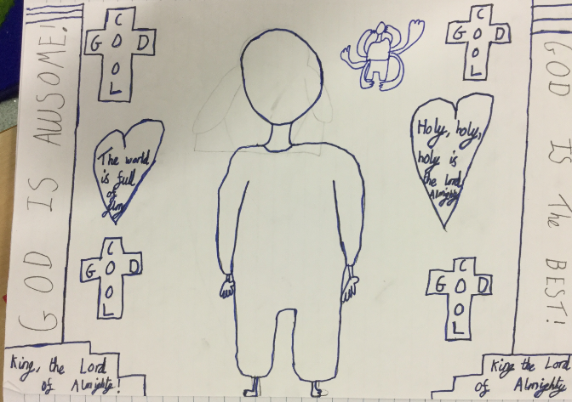

Slide 32
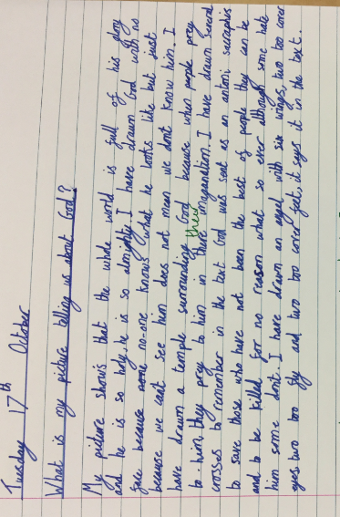

Slide 33
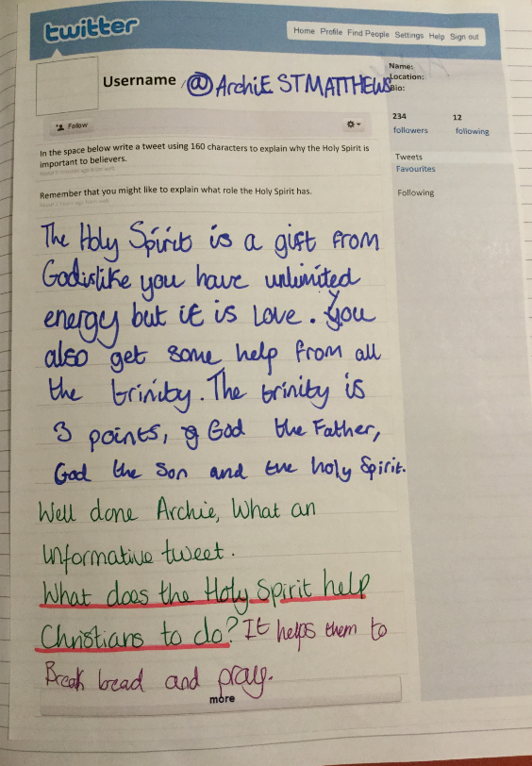
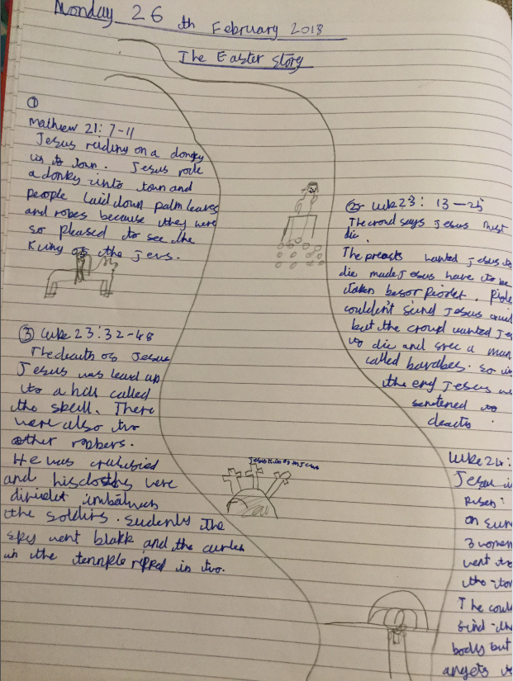
Year 4

Slide 34
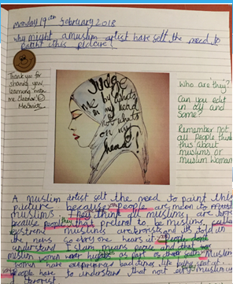
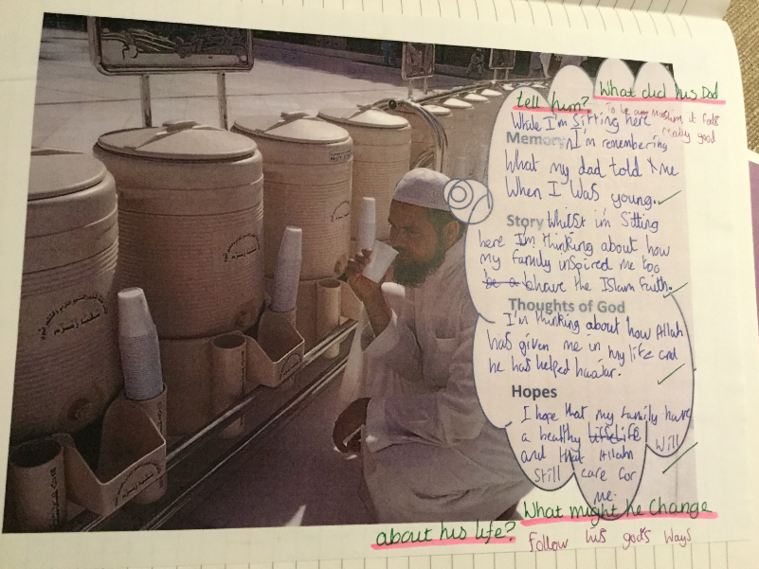

Slide 35
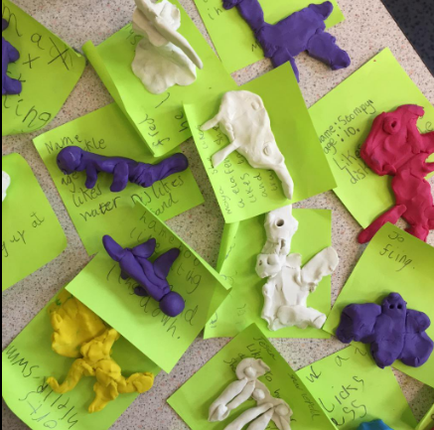
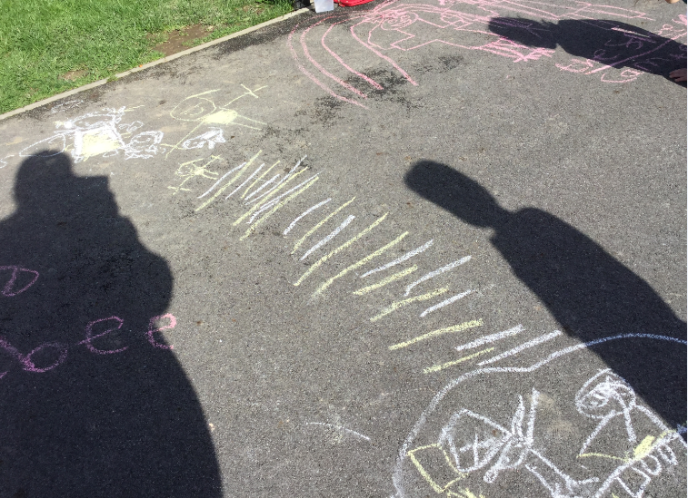
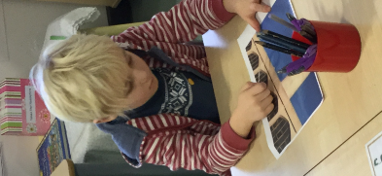
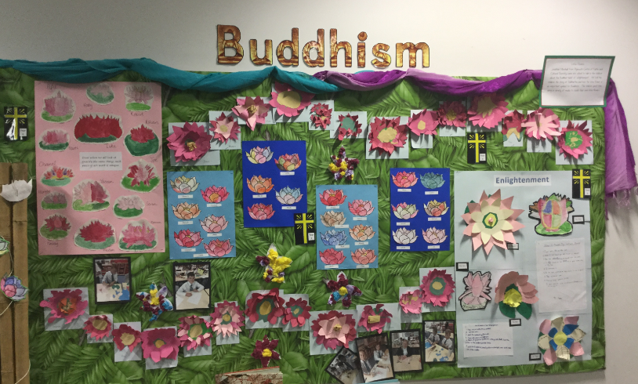
What about our younger children?

Slide 36
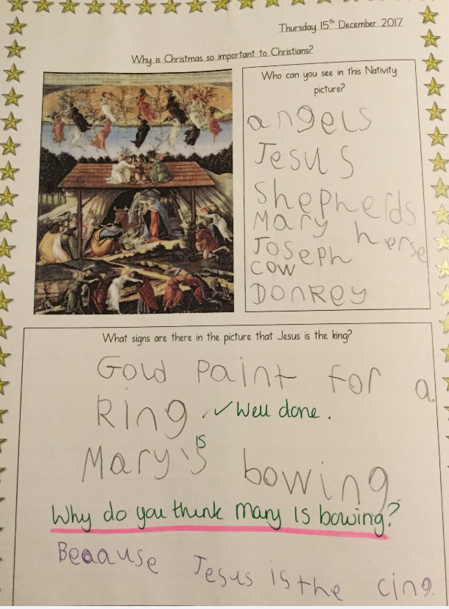
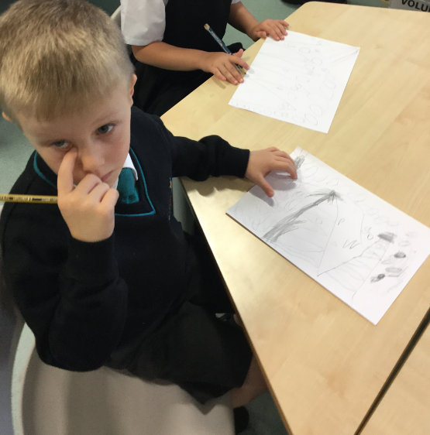

Slide 37
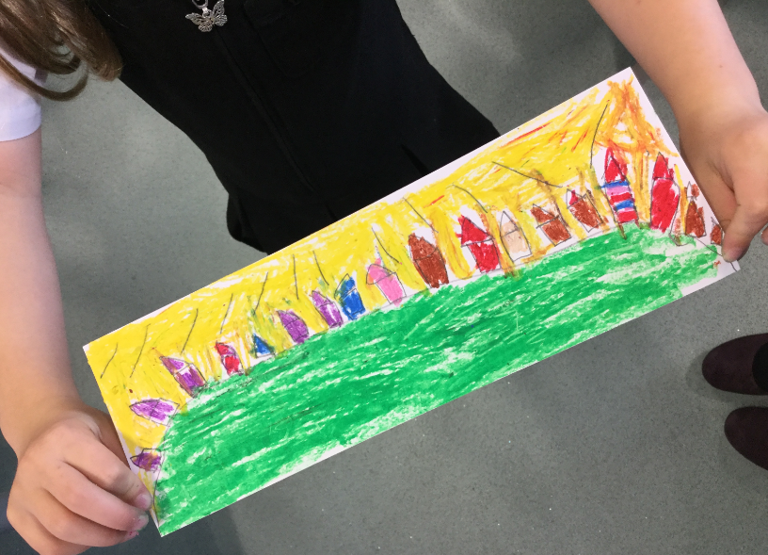
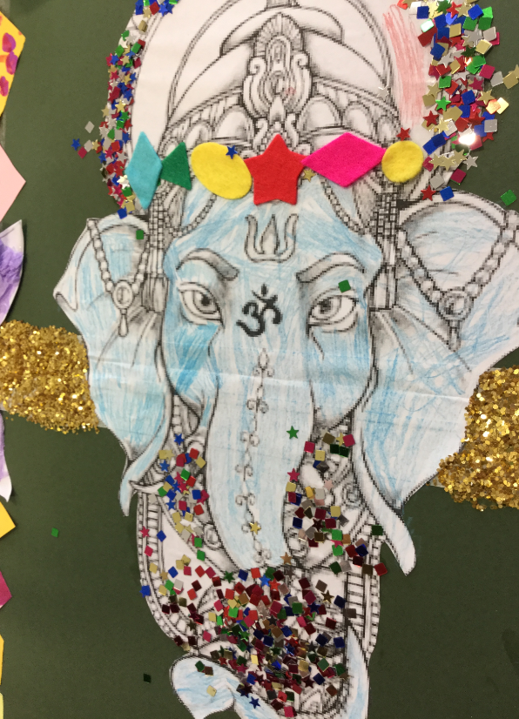
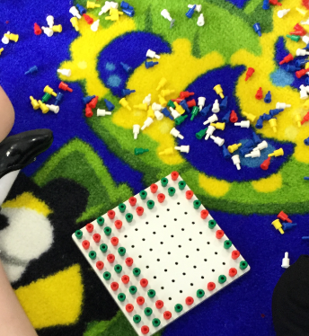
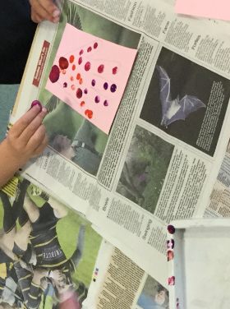

Slide 38
What do our children think about RE in our school?

Slide 39
Bad RE
Bad RE is when you only find out about one religion.
In my old school, I thought that RE was bad because the teacher told me that all Muslims are terrorists!
I think RE is bad when the teacher gives their opinion, its about talking about the views of all people.
Bad RE happens when the teacher doesn’t know about the subject, its boring for us the pupils.
I did RE for the first time when I moved to St Matthew’s.
In my old school, we only had RE once every three weeks and it was always about the same religion.

Slide 40
Good RE
Good RE is about studying a range of religions and digging deeper to find out more.
It is not about being taught to believe something, its about learning how to respect the beliefs of others.
Good RE is focusing on one theme for more than a week so you can dig deeper and find out more.
Good RE is listening to everyone’s opinions.
We are lucky to have a specialist teacher who helps us to go deeper with our learning.
Good RE is about being taught in different ways and not just listening to the teacher talk.
Your teacher needs to have a good understanding of religions and non religious worldviews.

Slide 41
Why do we need RE?
We need RE so that people don’t treat people of faith differently. We need religious understanding so that we can be respectful of one another.
We don’t want to have a country where RE isn’t taught, how would we learn understanding?
So that we don’t see the world one way.
So that we can challenge the media
We need RE so that we can understand why people act in different ways.

Slide 42
Messages from Year 5 and 6 to the Commissioners…
Please make sure that all schools teach RE.
When I go to secondary school, I will choose to study RE because it is inspiring and interesting. Please make sure that RE is like this for everyone.
We need RE so that people don’t just listen to what the media say about religion.
Think about a way of getting more specialist RE teachers into primary schools.
Come and visit our school so that we can talk to you in person.

