Slide 1


How can we use Art to show depth in RE?

Slide 2
Why do we choose to use artwork in RE?
Looking at different interpretations of a concept.
Thinking about why things matter to believers.
Trying to understand the thought process of others.

Slide 3

How can art help to show understanding in RE?
Abstract art gives a freedom to all pupils.
Art can be anything and represent anything.
Less confident pupils have something to base their discussions and explanations on.

Slide 4
Practical Ideas for the primary classroom
Kate Vernon

Slide 5
Secondary focus on Hinduism
Greg

Slide 6
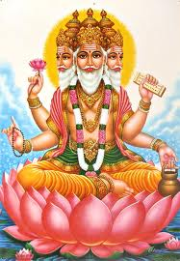

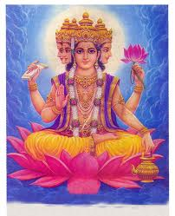
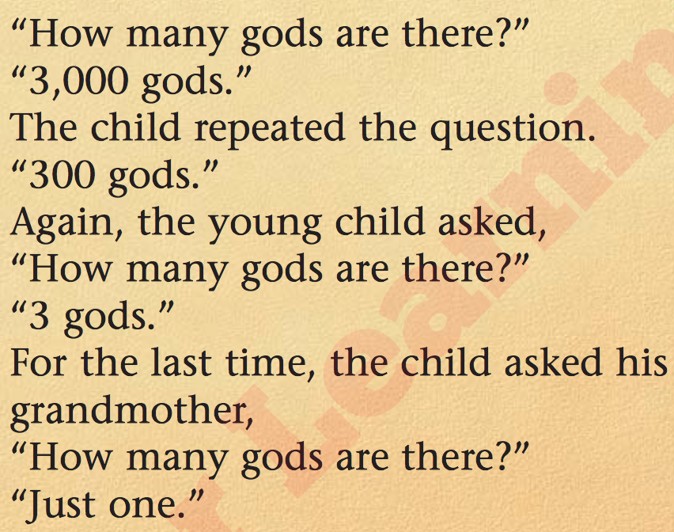
One God or Many?
Read the text below
What does it tell you about Hindu gods?
L/O:
To enquire into the idea of many Gods
To be able to describe the Trimurti
To explain the symbolism of the different parts of the Tri-Murti
Key Question: What do Hindus believe about God?

Slide 7


Draw a flower in your book.
Label each of the petals with a different role you have in your life.
Label the duties that go with these roles. How do you have to act or behave in each of these roles?
Challenge Yourself!
If we have different roles in our lives is it possible to be the same person all of the time?

Slide 8
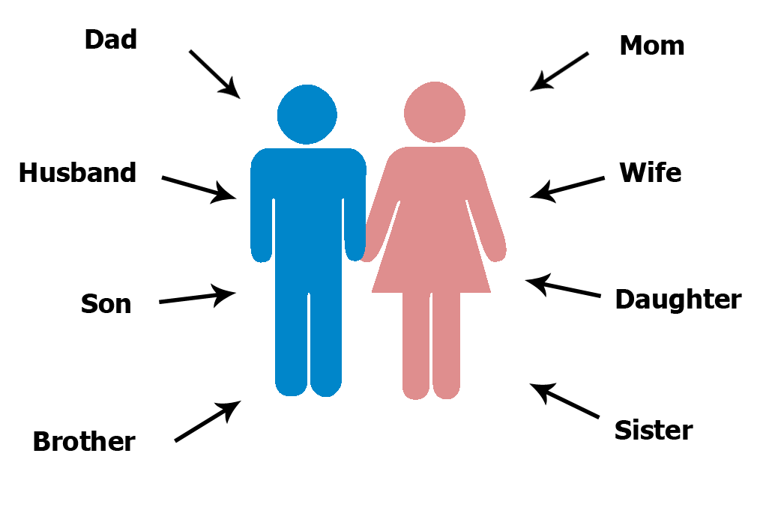
Is it possible to be the same person if we have different roles in our lives?
What impact would it have if we only had one role?

Slide 9
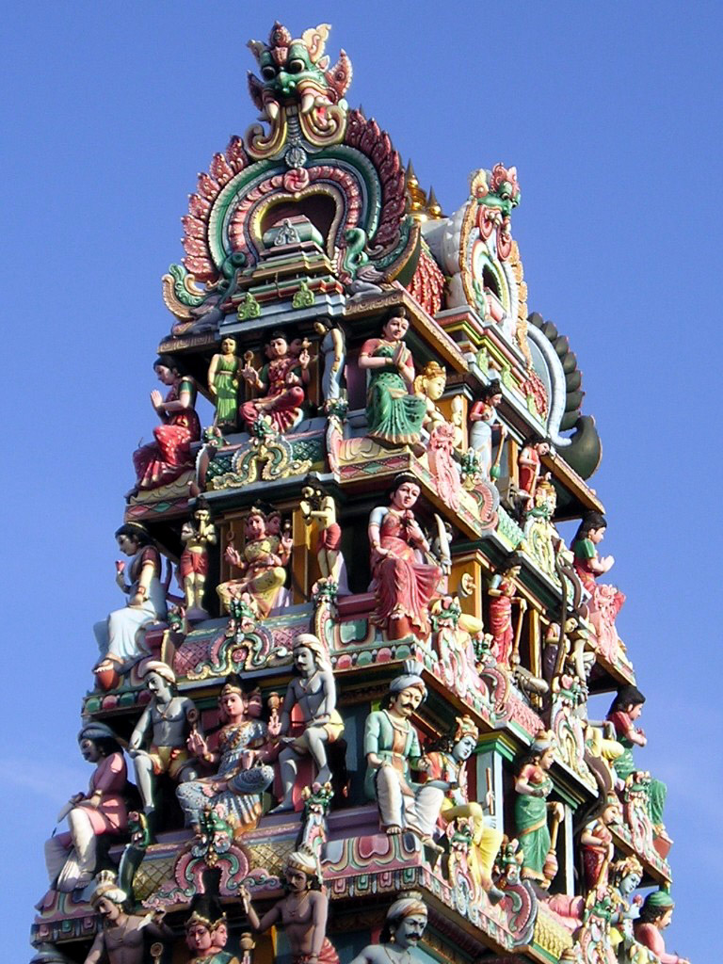
5
9
This is part of a Hindu Temple. These are murtis which represent gods and goddesses each showing an aspect of Brahman. If Brahman is broken down into sections he is easier to understand. These gods and goddesses help Hindus to understand their duties in life and are used to connect to Brahman in worship.
3
2
7
6
8

Slide 10
Each of the different gods and goddesses represent different roles or aspects of Brahman (God) and it is these which are focused on and used in worship in order for Hindus to understand and relate to Brahman. Also, they tell them what their duties are in order to get good karma to be rewarded in their reincarnation.

Slide 11
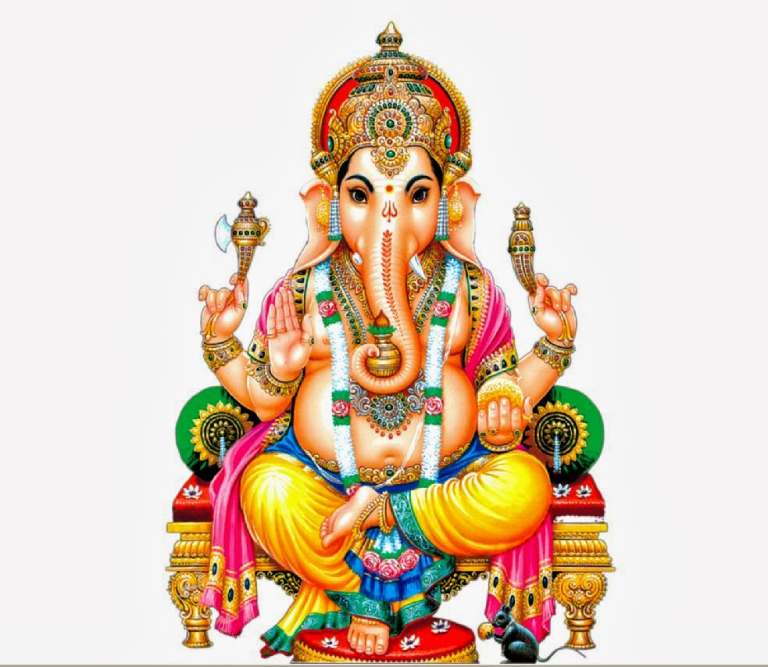
Why do you think there is an elephant head?
Ganesha
The Remover Of Obstacles

Slide 12
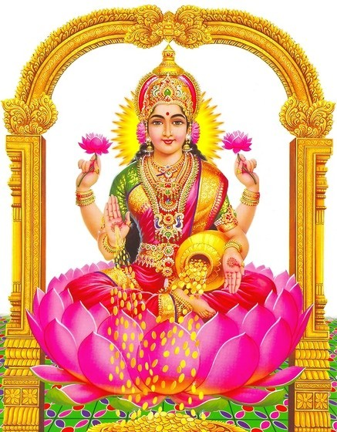
What do you think it means having money spilling from her lap?
The Goddess of Wealth and Beauty
Lakshmi

Slide 13
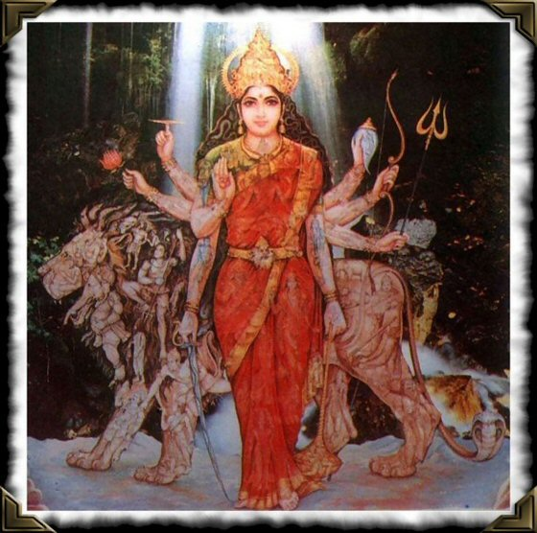
The Goddess of Victory
What can you see in the picture?
What do you think this says about Hindu God’s?
Durga

Slide 14
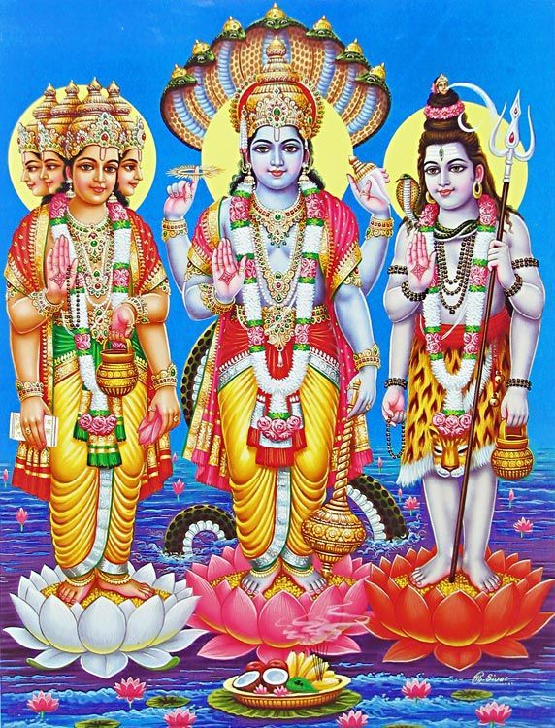
Observe: look at it and reflect on what you see in the image
Express: Discuss what they have observed with a partner. What emotions do you see?
Enter: Imagine entering the picture and put yourself in it. If I was a Character how would I feel?
Relate: Where am I in this scene? What questions do I want to ask of the characters? What is my understanding of what is happening? What is the artist trying to tell me and where do I find the clues to that? What is my relationship with these characters?

Slide 15
The three most important roles are represented by the TRIMURTI.
These are:
BRAHMA
SHIVA
VISHNU

Slide 16
Observe: look at it and reflect on what you see in the image
Express: Discuss what they have observed with a partner. What emotions do you see?
Enter: Imagine entering the picture and put yourself in it. If I was a Character how would I feel?
Relate: Where am I in this scene? What questions do I want to ask of the characters? What is my understanding of what is happening? What is the artist trying to tell me and where do I find the clues to that? What is my relationship with these characters?

Slide 17
Use the laminate sheets and statements and add them to the correct parts of the image
Mala: String of beads used during meditation
The chakra, or discus: symbolises the mind
Scroll: represents the Vedas, the Hindu Scriptures
The lotus flower: an example of glorious existence and liberation
4 heads: Shows Brahma looking in all directions as he created the world
A cobra necklace: the snake represents Shiva's power of destruction and recreation.
Lotus flower: Sign of purity
The conch: the sound this produces 'Om', represents the primeval sound of creation
Water pot: represents the water of life, responsible for the beginning of creation
Animal hide: the tiger skin is a sign of mastery over the world
The mace: represents mental and physical strength
Third eye: The extra eye represents the wisdom and insight that Shiva has
The trident : The three-pronged trident represents the three Tri-murti
The vibhuti : three lines drawn horizontally across the forehead in white ash. They represent Shiva's all-pervading nature, his superhuman power and wealth

Slide 18
Mala: String of beads used during meditation
Brahma
4 heads: Shows Brahma looking in all directions as he created the world
Scroll: represents the Vedas, the Hindu Scriptures
Water pot: represents the water of life, responsible for the beginning of creation
Lotus flower: Sign of purity

Slide 19
The chakra, or discus: symbolises the mind
Vishnu
The conch: the sound this produces 'Om', represents the primeval sound of creation
The lotus flower: an example of glorious existence and liberation
The mace: represents mental and physical strength

Slide 20
Third eye: The extra eye represents the wisdom and insight that Shiva has
Shiva
The vibhuti : three lines drawn horizontally across the forehead in white ash. They represent Shiva's all-pervading nature, his superhuman power and wealth
A cobra necklace: the snake represents Shiva's power of destruction and recreation.
The trident : The three-pronged trident represents the three Tri-murti
Animal hide: the tiger skin is a sign of mastery over the world

Slide 21
Looking at the picture what do you learn about the Tri-Murti?
What does it tell us about Hindu beliefs about God?
Does the images of the Tri-Murti make it easier or harder to understand God in Hinduism?

Slide 22
4. Explain Hindu beliefs about the Tri-murti (4)
Draw on the beliefs and understanding you have gained from this lesson about what Hindus believe about Tri-murti.
You should write 2 PEE paragraphs
One god of the Tri-Murti is………….. One thing that Hindus believe about this god is……………………………
Another god of the Tri-Murti is………….. One thing that Hindus believe about this god is……………………………

Slide 23
Some alternative ideas…

Slide 24
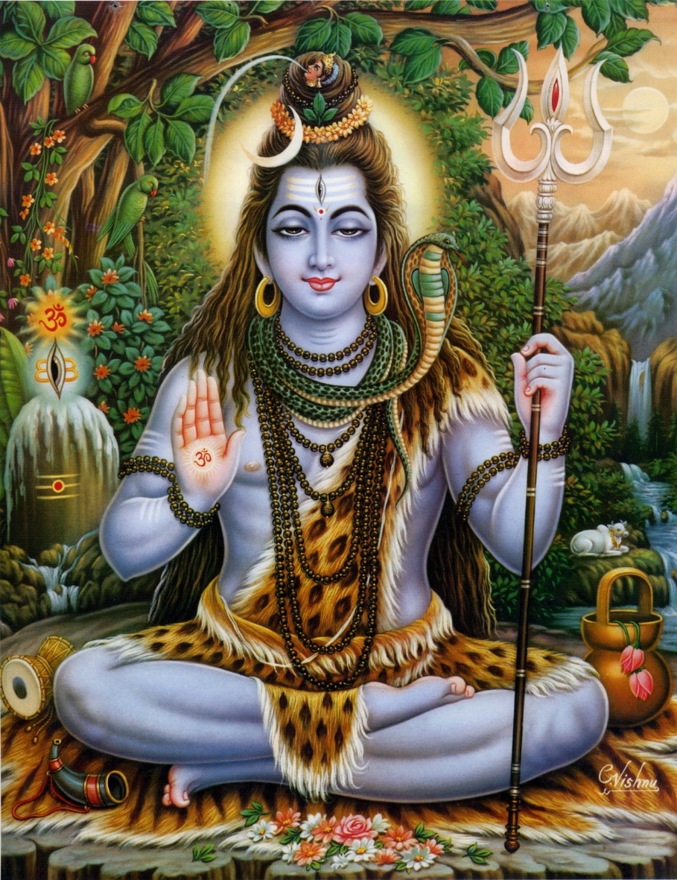
Look at the picture really carefully
Using your best guess what do you think is behind the blue circles?

Slide 25
Which parts are linked to the symbolism?
The sign of an ascetic and mastery over the powerful tiger
Represents the three deities of the Tri-Murti
Represents Shiva’s creative powers after destruction
Symbolises knowledge and power
Represents that Shiva drank poison that was meant for the world
Represents the Ganges and everlasting time
These represent the male and the female to show Shiva is both male and female
Shows Shiva’s calm and gentle aspects and courage

Slide 26
Represents the Ganges and everlasting time
Symbolises knowledge and power
Represents the three deities of the Tri-Murti
Represents that Shiva drank poison that was meant for the world
Represents Shiva’s creative powers after destruction
Shows Shiva’s calm and gentle aspects and courage
The sign of an ascetic and mastery over the powerful tiger
These represent the male and the female to show Shiva is both male and female

Slide 27
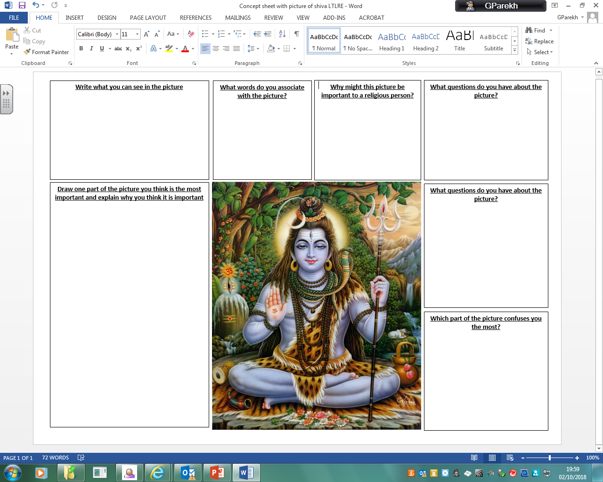

Slide 28
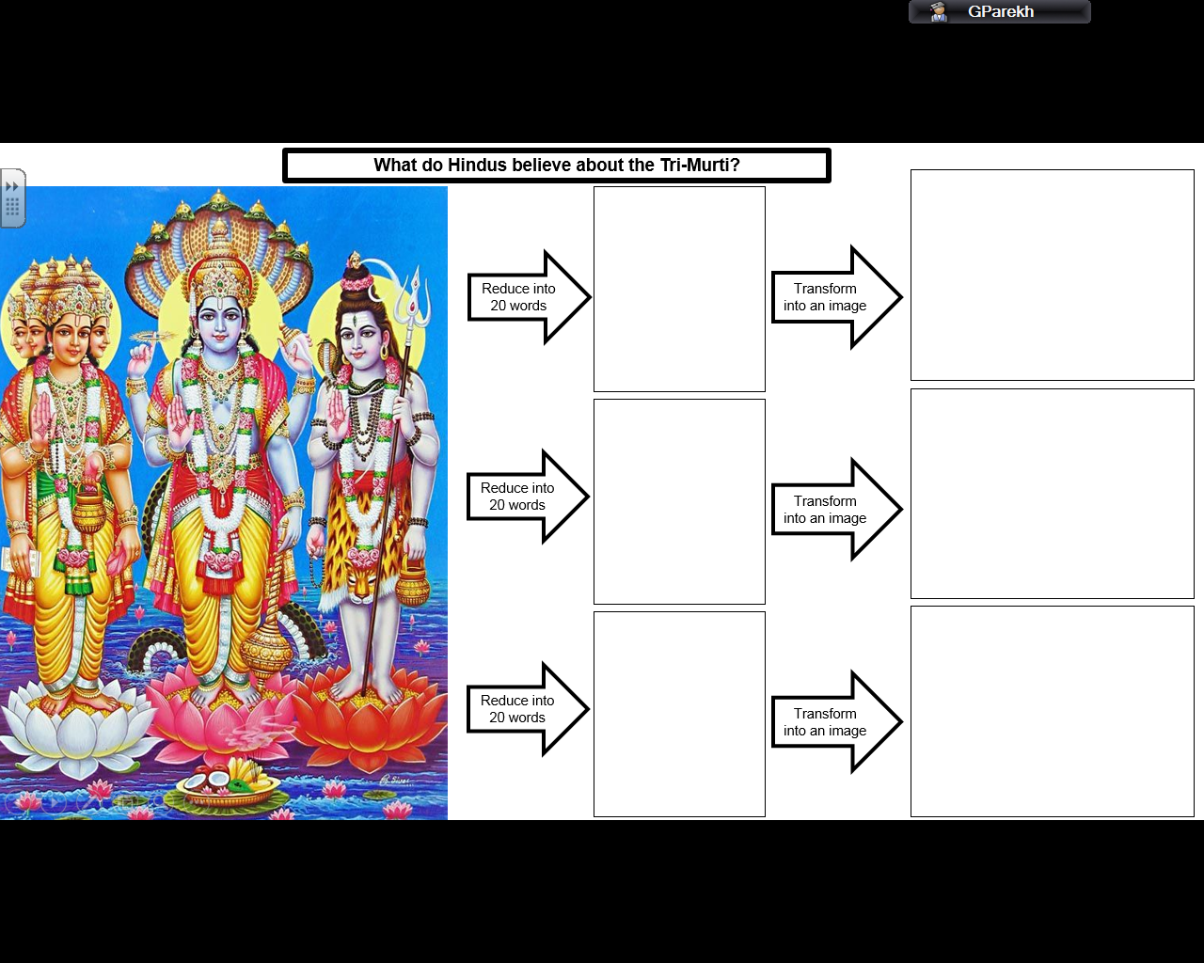

Slide 29
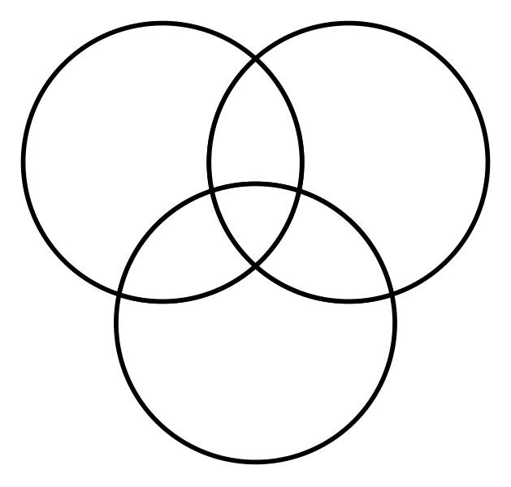
Similarities between Brahma and Shiva
Brahma
Similarities between all three
Similarities between Brahma and Vishnu
Similarities between Shiva and Vishnu
Shiva
Vishnu

Slide 30
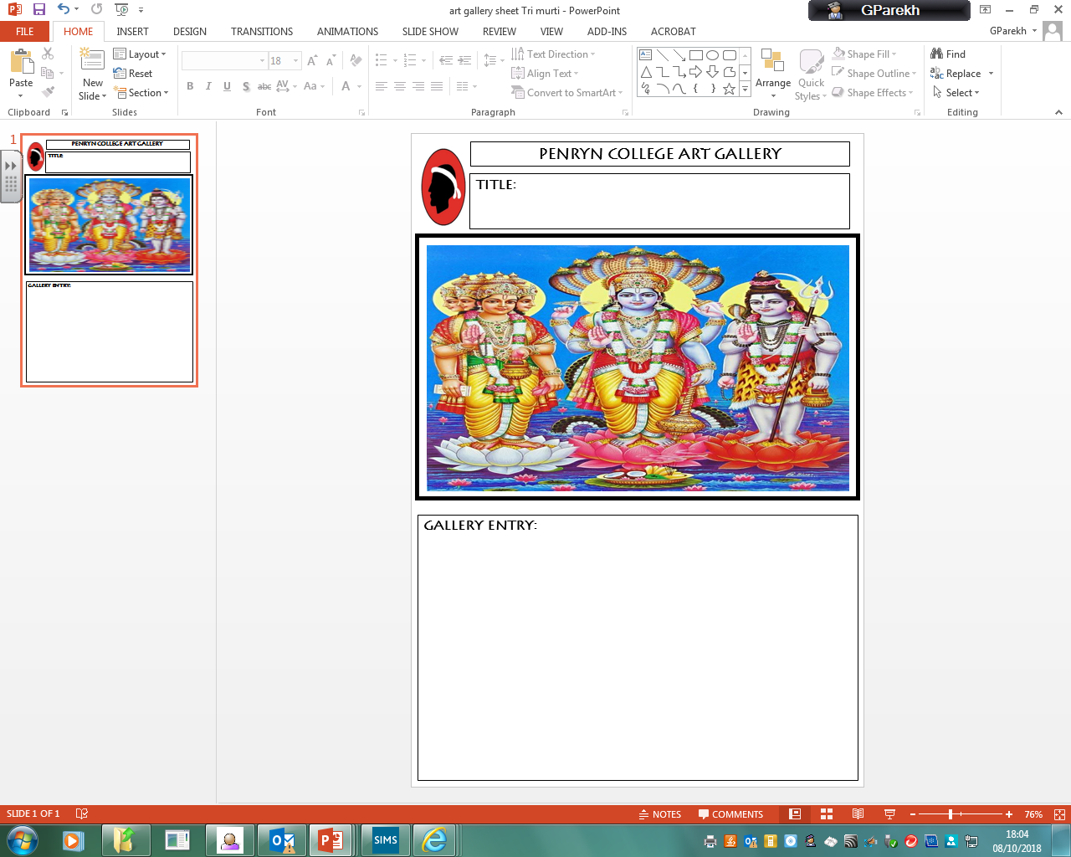
Imagine this picture is going to be displayed in a gallery
You must come up with:
A title for the picture – it needs to help people looking at the picture know what it is all about; it should also be interesting and make people want to look
The entry for a gallery catalogue – This should give some information about the work of art and some questions to think about

Slide 31
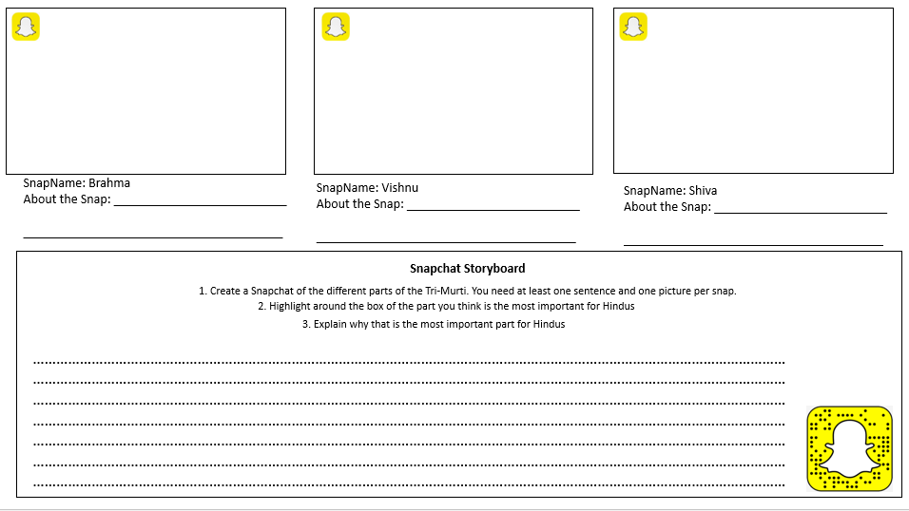
Create a Snapchat story board of the Tri-Murti

Slide 32
The Trinity in artwork!
Nicki Bonnell

Slide 33
Looking at the concept of God
Katie Freeman
Katie.freeman@stmatthewsstcmat.org
@KatieKates84
St Matthews C of E Primary and Nursery Academy

Slide 34
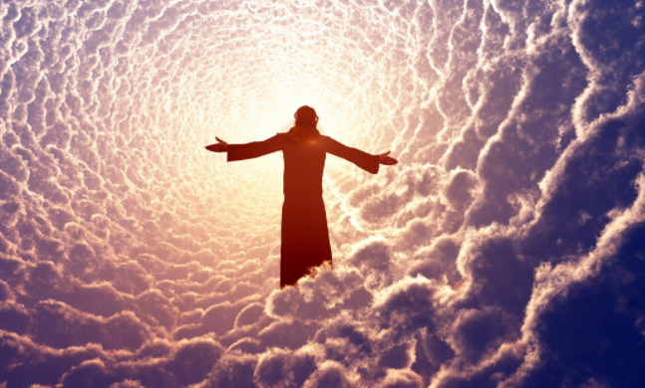
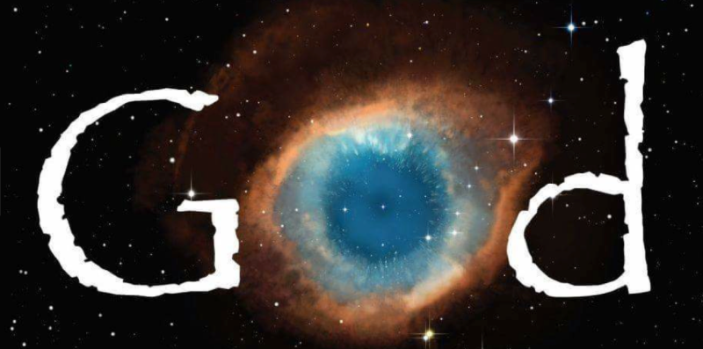
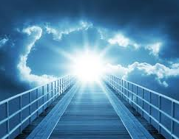

What did the children think?

Slide 35
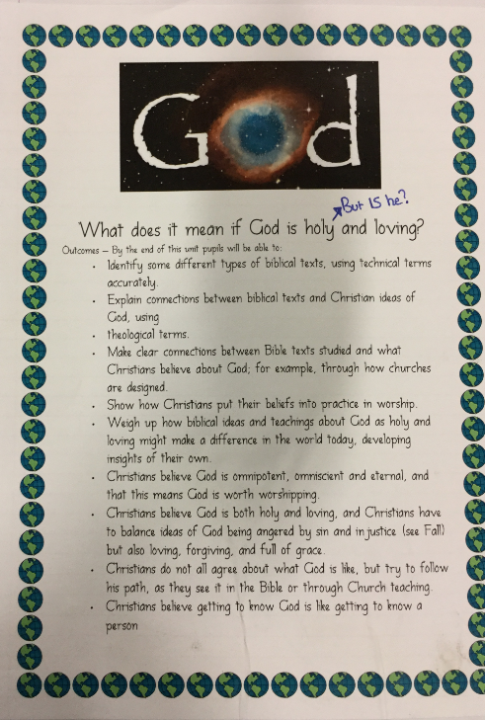

Slide 36
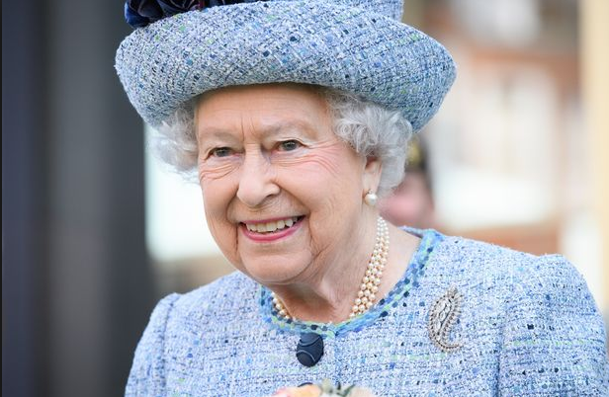
Who is this? What do we know about her?

Slide 37
What’s the difference between knowing someone and knowing of someone?
How is it different if we talk to someone?
How do we find out about people?
What’s the difference between knowing a friend and knowing a celebrity?
https://www.youtube.com/watch?v=7vWdhCDeTkU

Slide 38
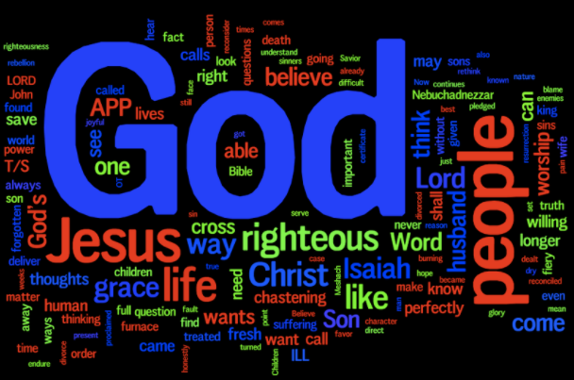
Creating wordles
Think of words that best describe your view of God.
Present the words creatively.
Now turn to a friend a explain why you have chosen each word.
Is there anything that you would change?

Slide 39
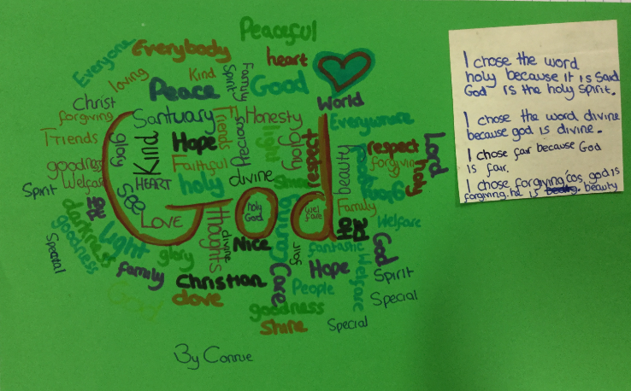

Slide 40
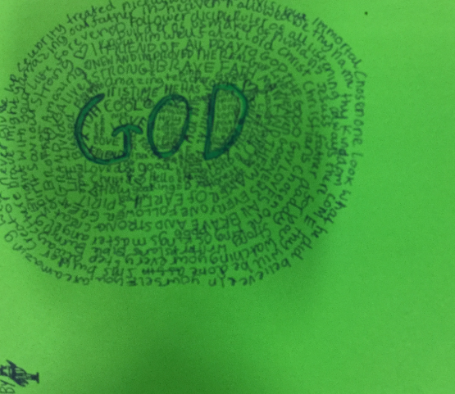
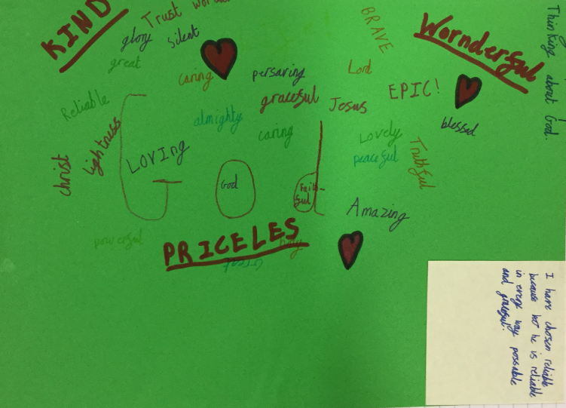

Slide 41
What do we mean by omnipotent and omnipresent?

Slide 42
1 John 4:7-13
God’s love and ours
⁷ Dear friends, let us love one another, for love comes from God. Everyone who loves has been born of God and knows God. ⁸ Whoever does not love does not know God, because God is love. ⁹ This is how God showed his love among us: he sent his one and only Son into the world that we might live through him. ¹⁰ This is love: not that we loved God, but that he loved us and sent his Son as an atoning sacrifice for our sins. ¹¹ Dear friends, since God so loved us, we also ought to love one another. ¹² No one has ever seen God; but if we love one another, God lives in us and his love is made complete in us.
¹³ This is how we know that we live in him and he in us: he has given us of his Spirit.

Slide 43
Isaiah 6:1-5
Isaiah’s Commission
6 In the year that King Uzziah died, I saw the Lord, high and exalted, seated on a throne; and the train of his robe filled the temple. ² Above him were seraphim, each with six wings: With two wings they covered their faces, with two they covered their feet, and with two they were flying. ³ And they were calling to one another:
“Holy, holy, holy is the Lord Almighty;
the whole earth is full of his glory.”
⁴ At the sound of their voices the doorposts and thresholds shook and the temple was filled with smoke.
⁵ “Woe to me!” I cried. “I am ruined! For I am a man of unclean lips, and I live among a people of unclean lips, and my eyes have seen the King,the Lord Almighty.

Slide 44
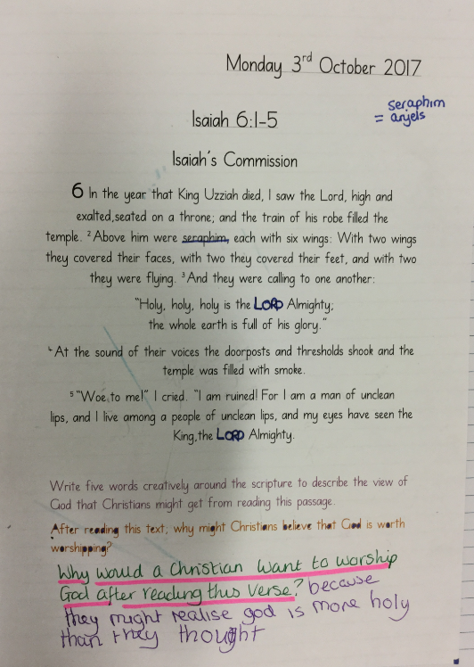
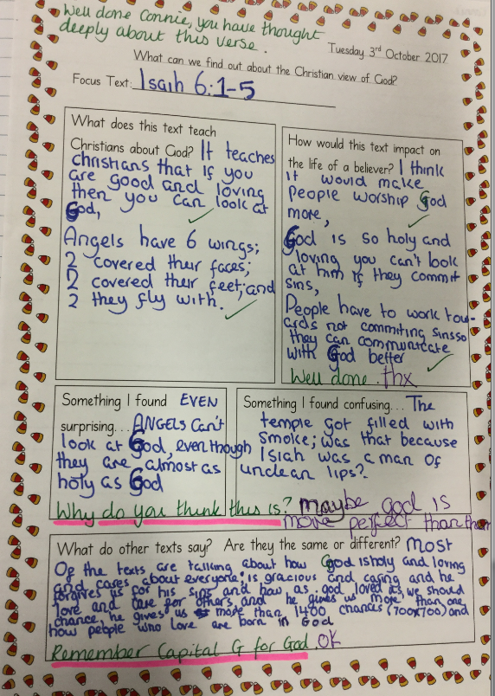

Slide 45

Now edit your wordles using key words from the text

Slide 46
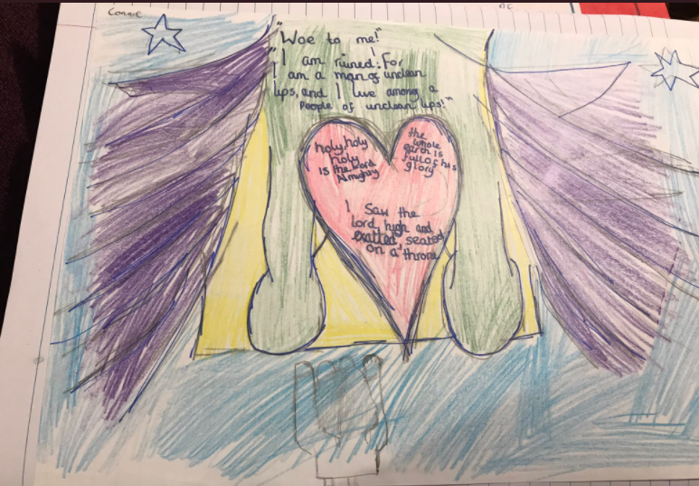

Slide 47
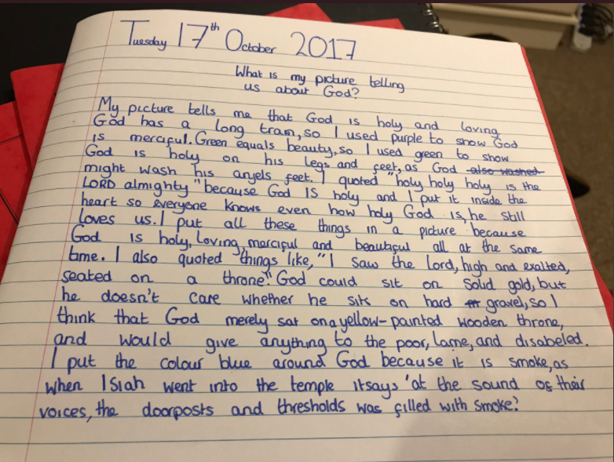

Slide 48
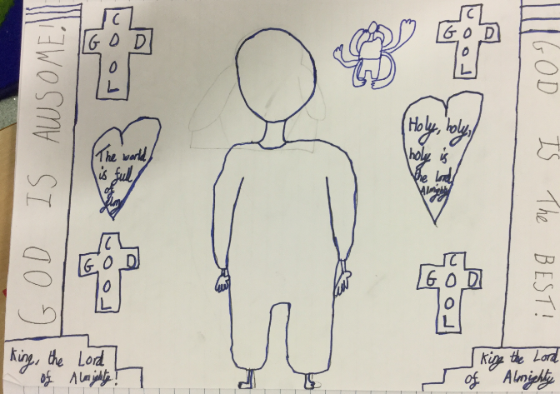

Slide 49
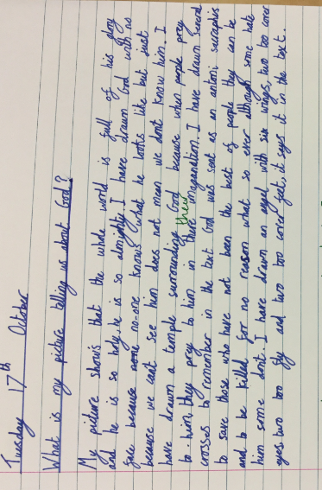

Slide 50
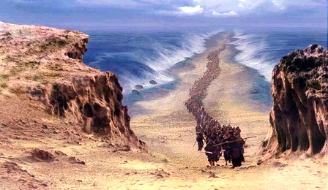
What did this lead to?

Slide 51
How would you answer this?
Miss, you know how God chose Moses to take his people out of Egypt? Did Moses have a choice to go or did God ask him because he knew he’d go so he didn’t get a choice?

Slide 52
How did I answer?
Tom, what do you think?
Tom’s response: ‘Ah Miss, why do you always answer questions with questions’.
My response: ‘…because I’m an RE teacher’.
‘Ok so if God is omnipotent and omnipresent then I think that he knew Moses would say yes to leading the people out of Eygpt but he gave him the choice to do it anyway. People have to be able to choose and God knows that.’

Slide 53
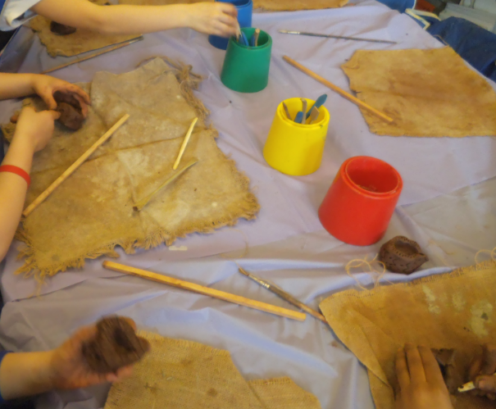
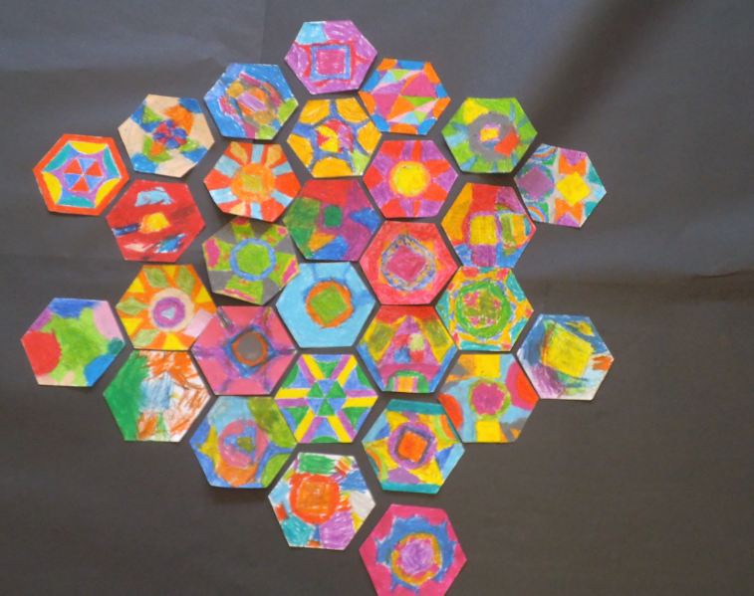
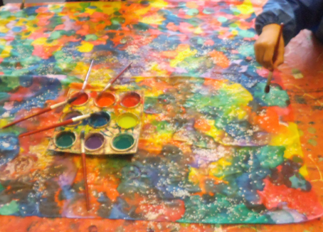
RE and Arts Weeks

Slide 54


Any Questions?

