Slide 1


Literacy and Extended Writing in RE

Slide 2
Why is developing literacy so important?
“Literacy is a bridge from misery to hope. It is a tool for daily life in modern society. It is a bulwark against poverty, and a building block of development, an essential complement to investments in roads, dams, clinics and factories. Literacy is a platform for democratization, and a vehicle for the promotion of cultural and national identity. Especially for girls and women, it is an agent of family health and nutrition. For everyone, everywhere, literacy is, along with education in general, a basic human right.... Literacy is, finally, the road to human progress and the means through which every man, woman and child can realize his or her full potential.”
-Kofi Annan

Slide 3
Why extended writing in RE?
language is central to all learning. Therefore, by increasing the literacy requirements of a subject, you will improve learning and raise attainment in that subject.

Slide 4
The value of extended writing in RE
Extended writing can raise standards in RE through better task setting that enables clearer thinking and response to the encounters with religion.

Slide 5
Variety of forms to write for a range of purposes
Telling a story from a different point of view-e.g the Good Samaritan
Formal letter writing
The story re-told by an animal e.g what the donkey saw.
Newspaper articles
Recipes
Diary of…

Slide 6
Investigative activities e.g the empty tomb and a report at the end.
Keyhole-description of what you could see through the keyhole.
Journeys-imagine what happened on the way.
Poetry (would this count as extended writing?) e.g senses poems.
biographical account of the life of a key figure
booklets, pamphlets, brochures, guidebooks

Slide 7
National literacy trust May 2018
Only half of children in the UK enjoy writing
Younger children enjoy writing almost twice as much as their older peers (68.5% of 8 to 11-year-olds, 46.5% of 11 to 14-year-olds, 36% of 14 to 16-year-olds).

Slide 8
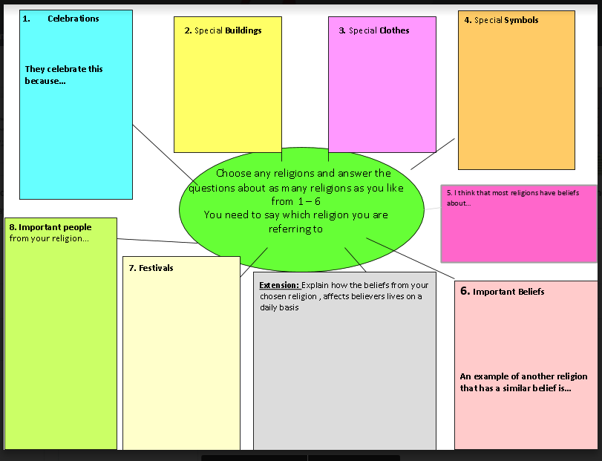
Year 7 baseline assessment

Slide 9
Extended writing task primary/secondary
“Does following a religion help people to make good choices?”
We asked students in both primary and secondary to complete the same extended writing task to explore the difference in the quality of extended writing.

Slide 10
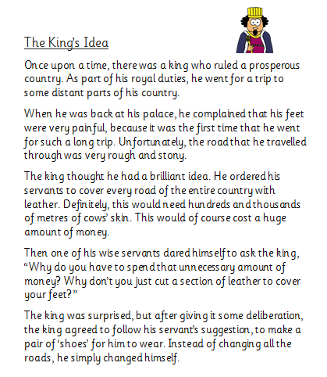
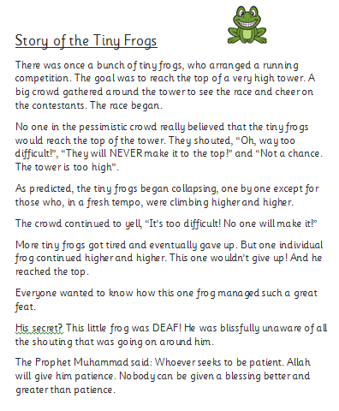
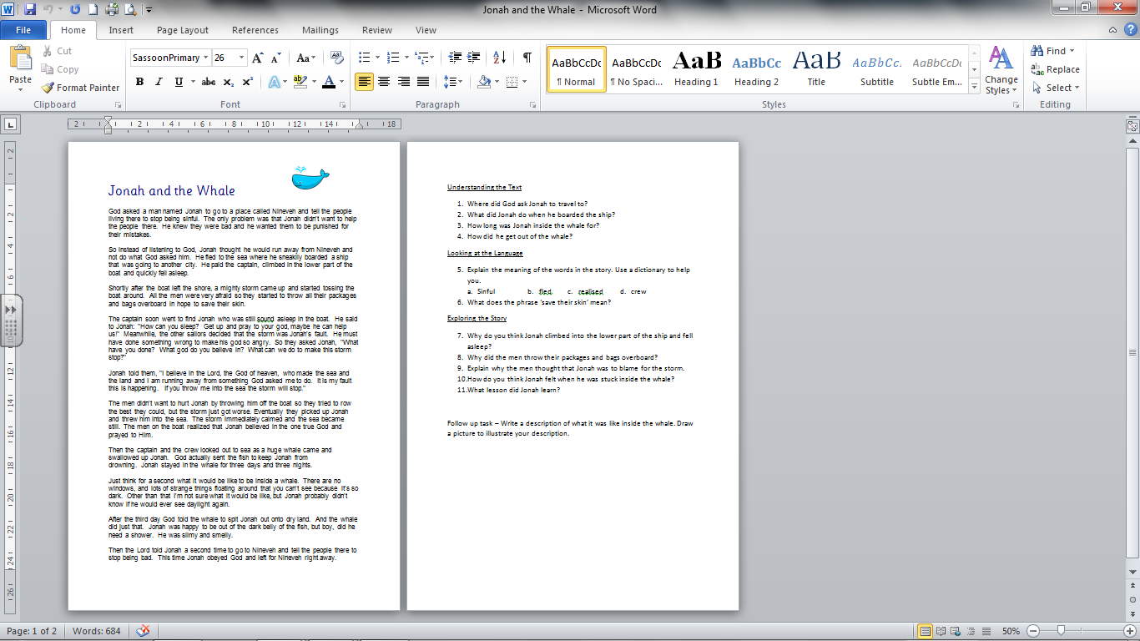
Guided Reading
Notes:
Examples of stories from different religions and comprehension questions.

Slide 11
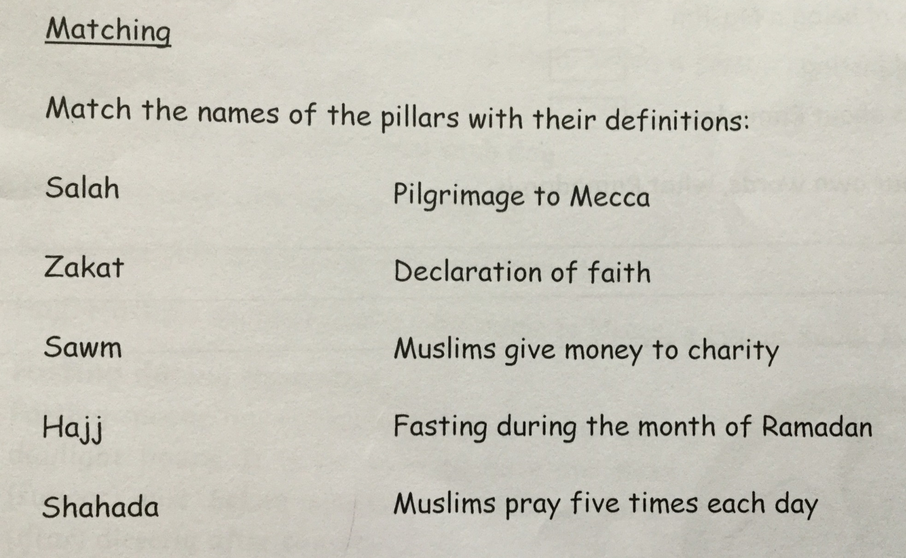
Notes:
SATs style questions based on Ramadan

Slide 12
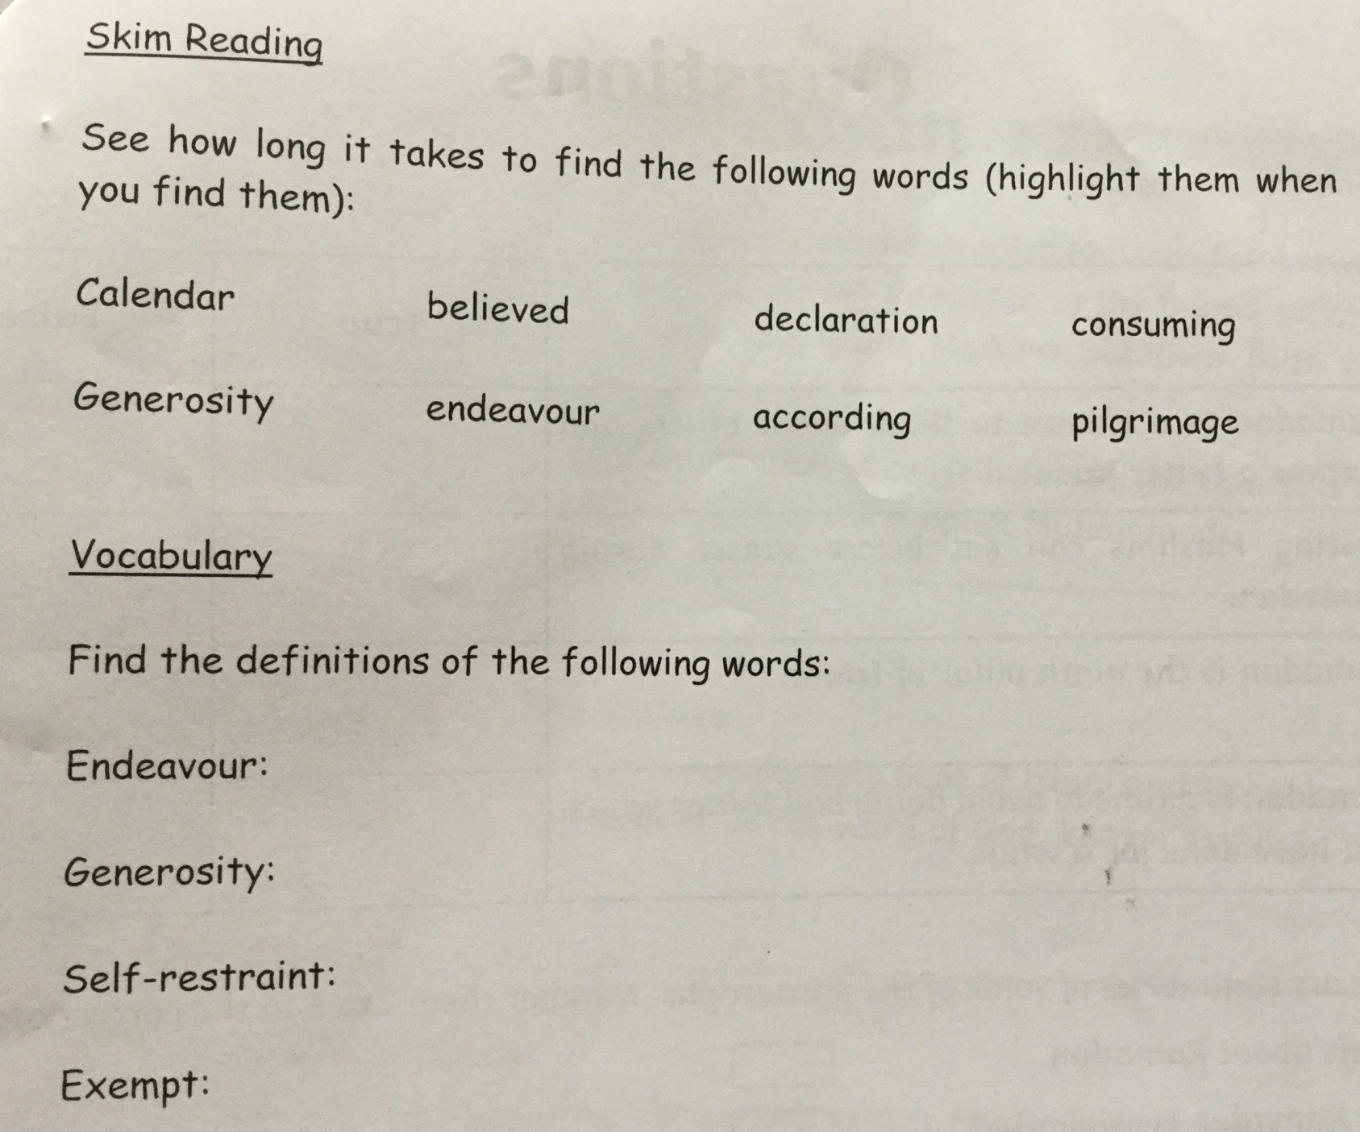
Notes:
More SATs style questions based on Ramadan

Slide 13
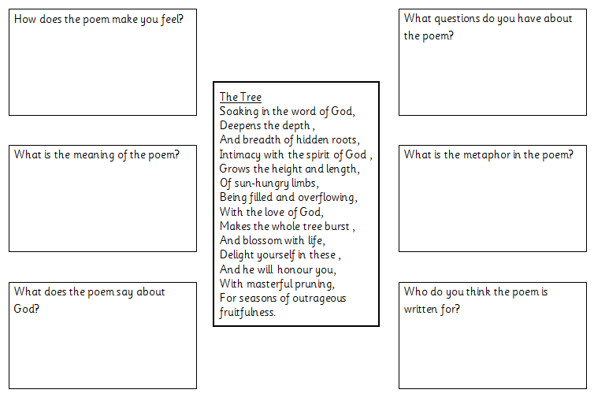
Notes:
Using a for guided reading – keep the focus on the religious meaning

Slide 14
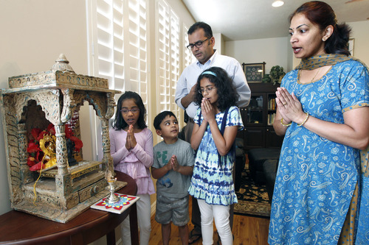
Know
Think
Wonder
They are praying to the shrine because of how they have their hands.
I think they are Hindu because they have a Murti in their shrine.
I wonder what they are saying in their prayer.
Notes:
Using a picture for inference. It also gives an opportunity for assessment of their knowledge and is an opportunity for discussion and picking up on misconceptions.

Slide 15
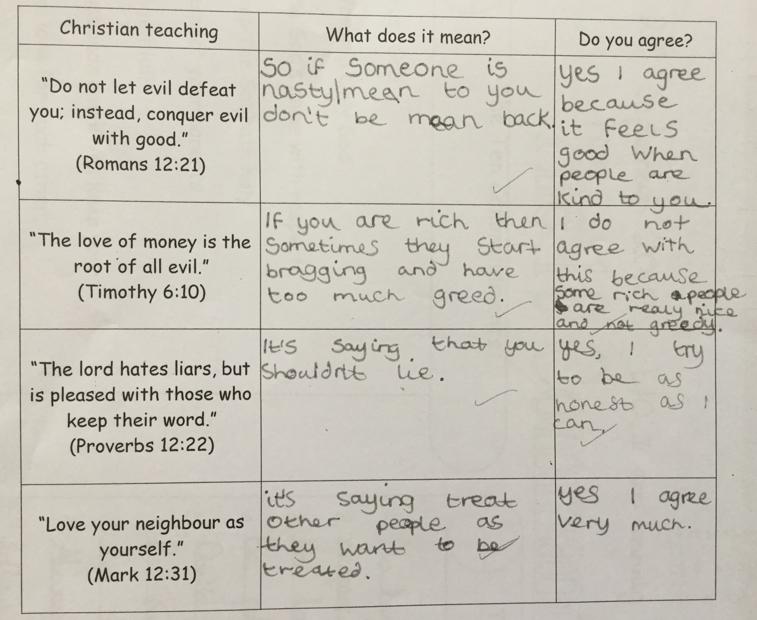
Notes:
Using quotes for inference and meaning. ‘Do you agree?’ section is AT2 – learning from religion and spirituality.

Slide 16
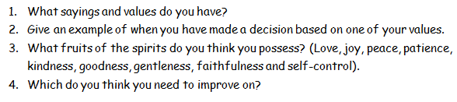
Writing
Notes:
Short piece of follow-up writing based on their own views and lives.

Slide 17
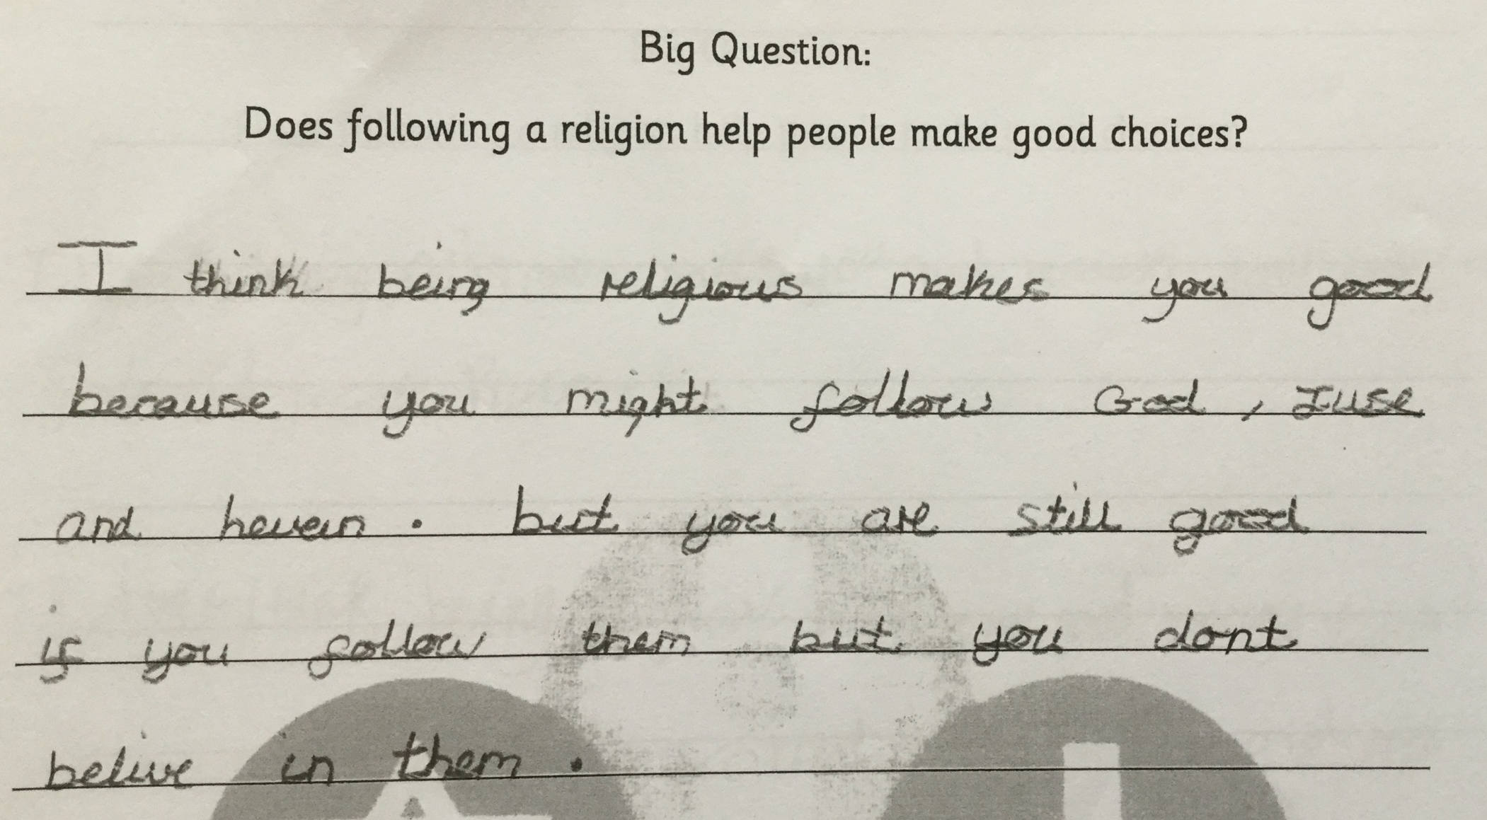
Notes:
Religious vocabulary and spellings.

Slide 18
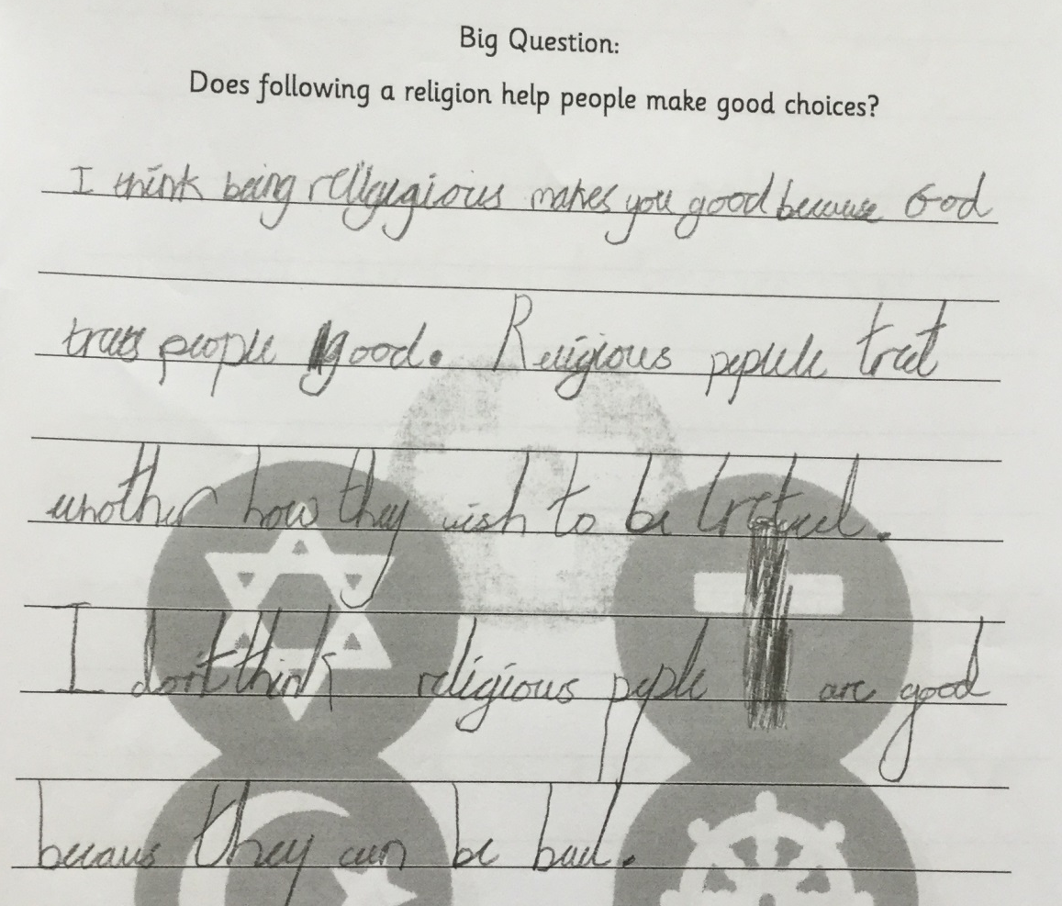
Notes:
Mentions religious teachings

Slide 19
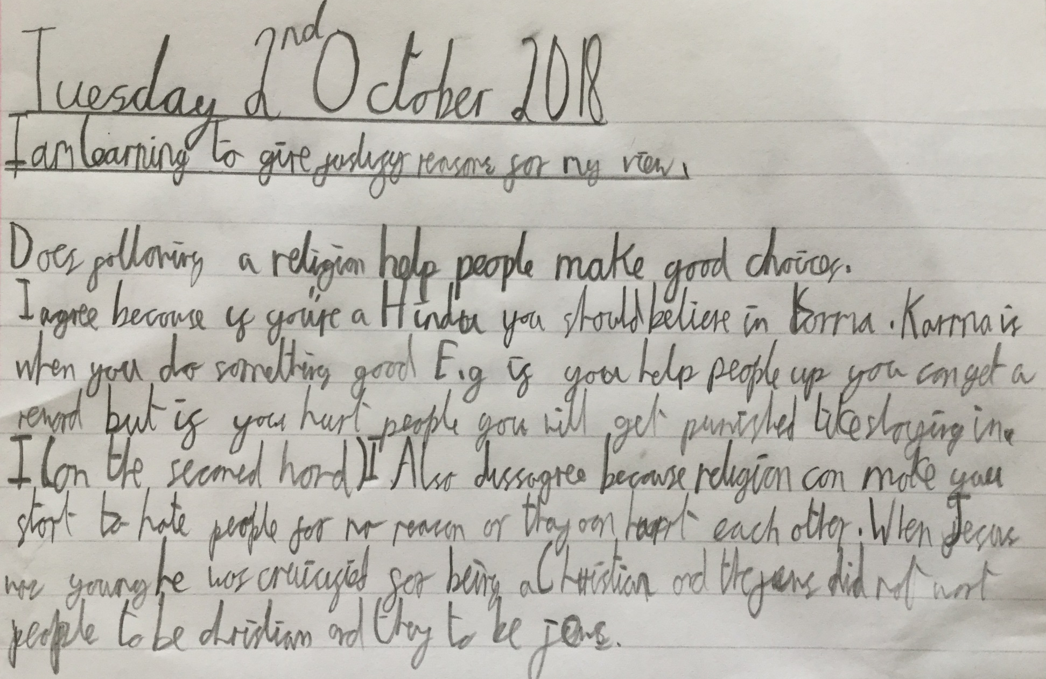
Notes:
Assessing religious knowledge and picking up misconceptions.

Slide 20
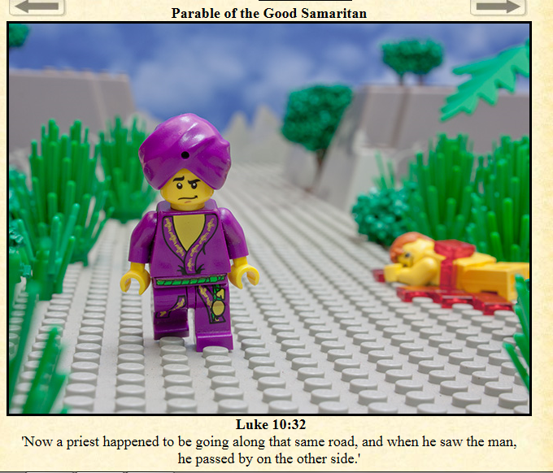
Why is he not helping me?
Notes:
Read the story then get them to think of how the characters may feel. Which character would they write a diary entry for? What other types of writing could they do?

Slide 21
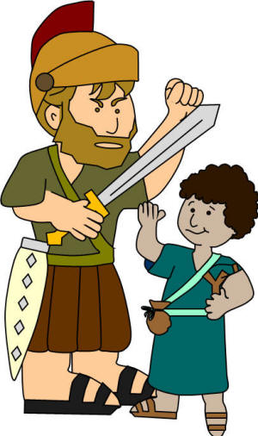
You are too small to beat me at anything!
Strength is not always about size...
Notes:
Read the beginning of David and Goliath. Discuss the two opinions. Write the end of the story based on who you think might win.

Slide 22
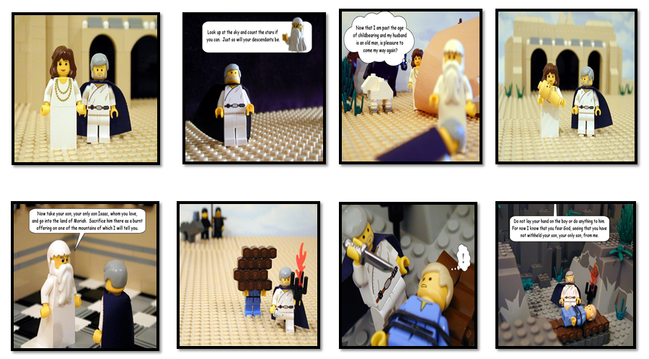
http://www.thebricktestament.com/
Notes:
Read the story of Abraham then retell the story using the pictures and writing captions underneath.

Slide 23
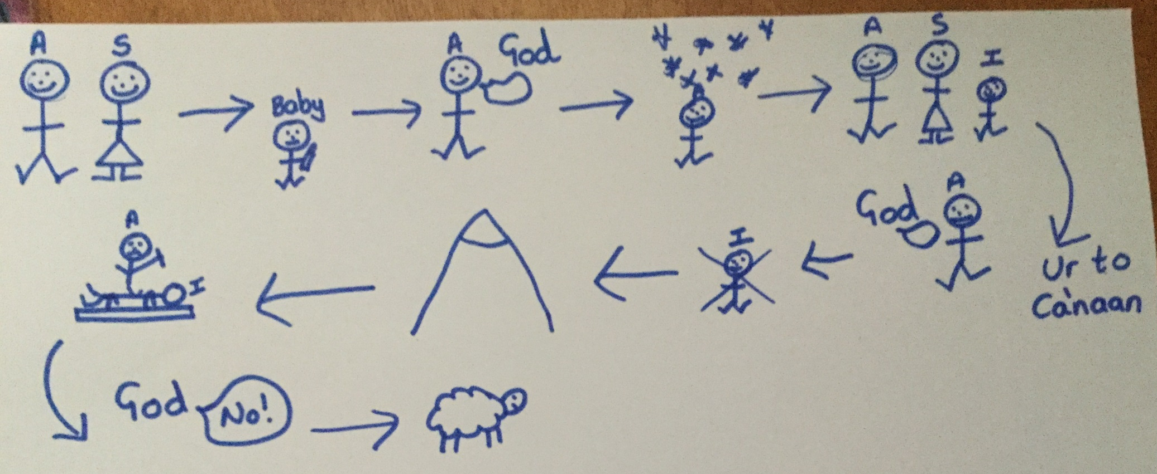
Notes:
Use a story map so that the story can be retold using Pie Corbett and Talk for Writing.

Slide 24
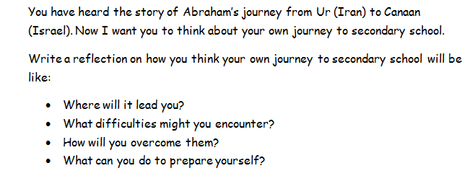
Notes:
Transition to secondary school writing.

Slide 25
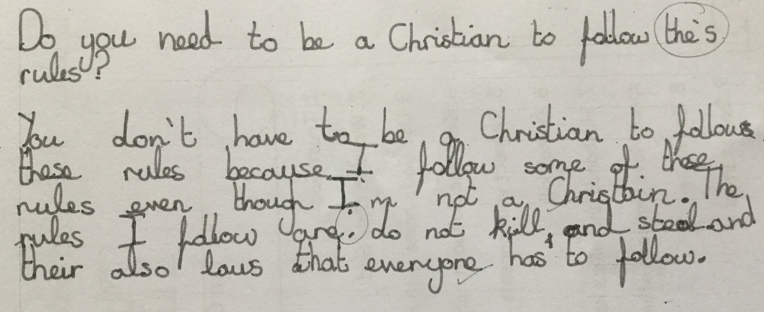
Notes:
Follow up writing from year 6 children who were learning about The Ten Commandments.

Slide 26
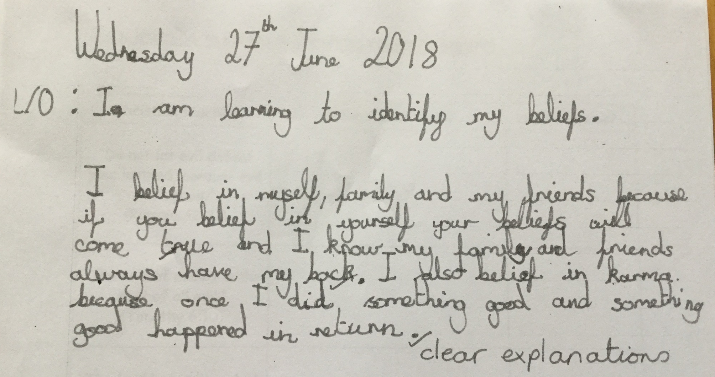
Notes:
Writing about their beliefs – helps to build their identity and spirituality.

Slide 27
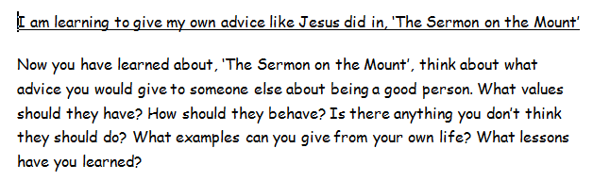
Notes:
Writing advice and learning from religion.

Slide 28
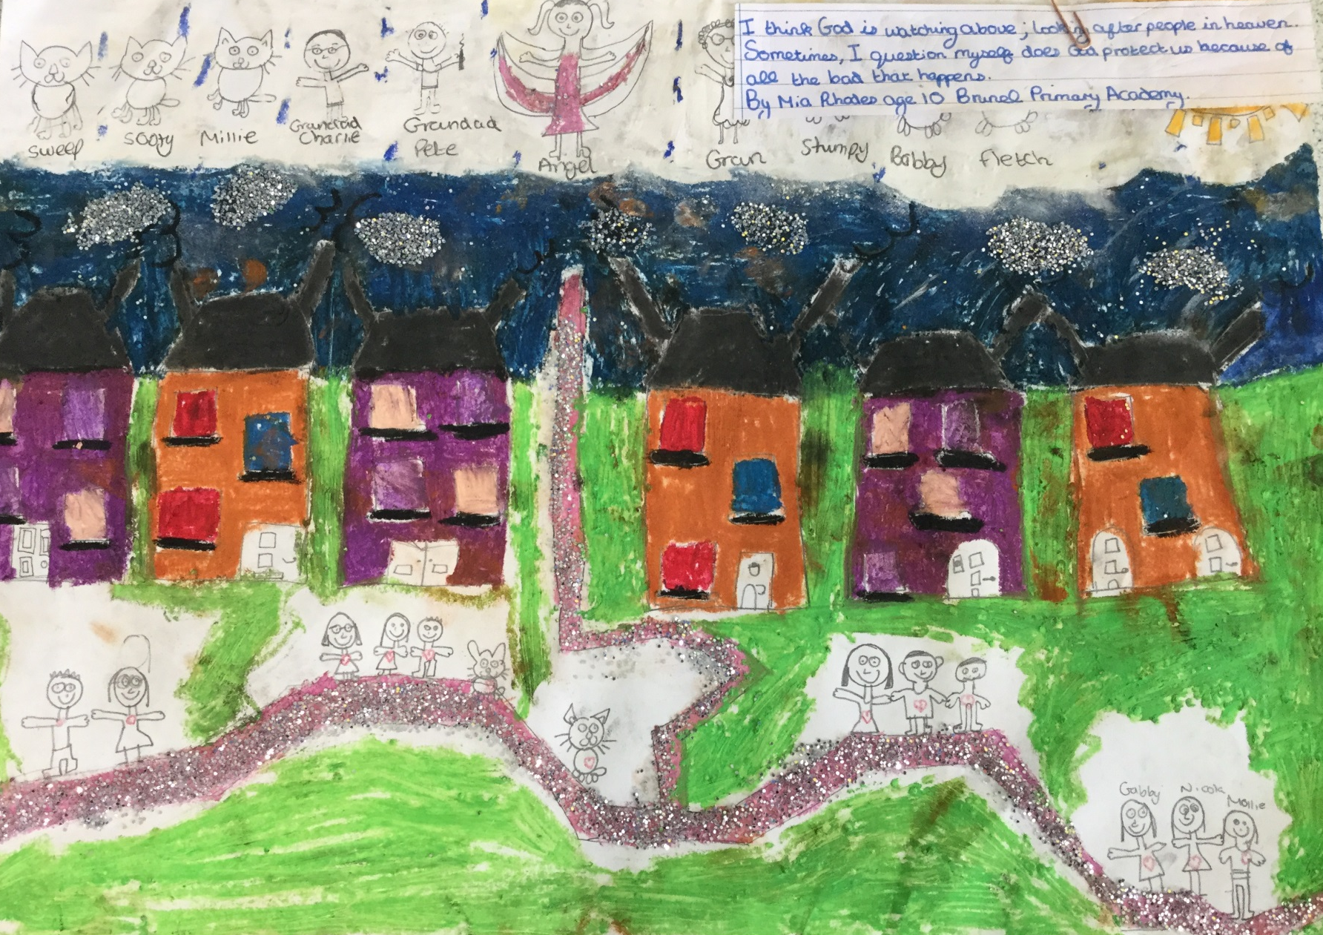
I think God is watching above; looking after people in heaven. Sometimes, I question myself does God protect us because of all the bad that happens.
Notes:
Spirited Arts work – short piece of writing to go with the art. Getting children to explain their ideas.

Slide 29
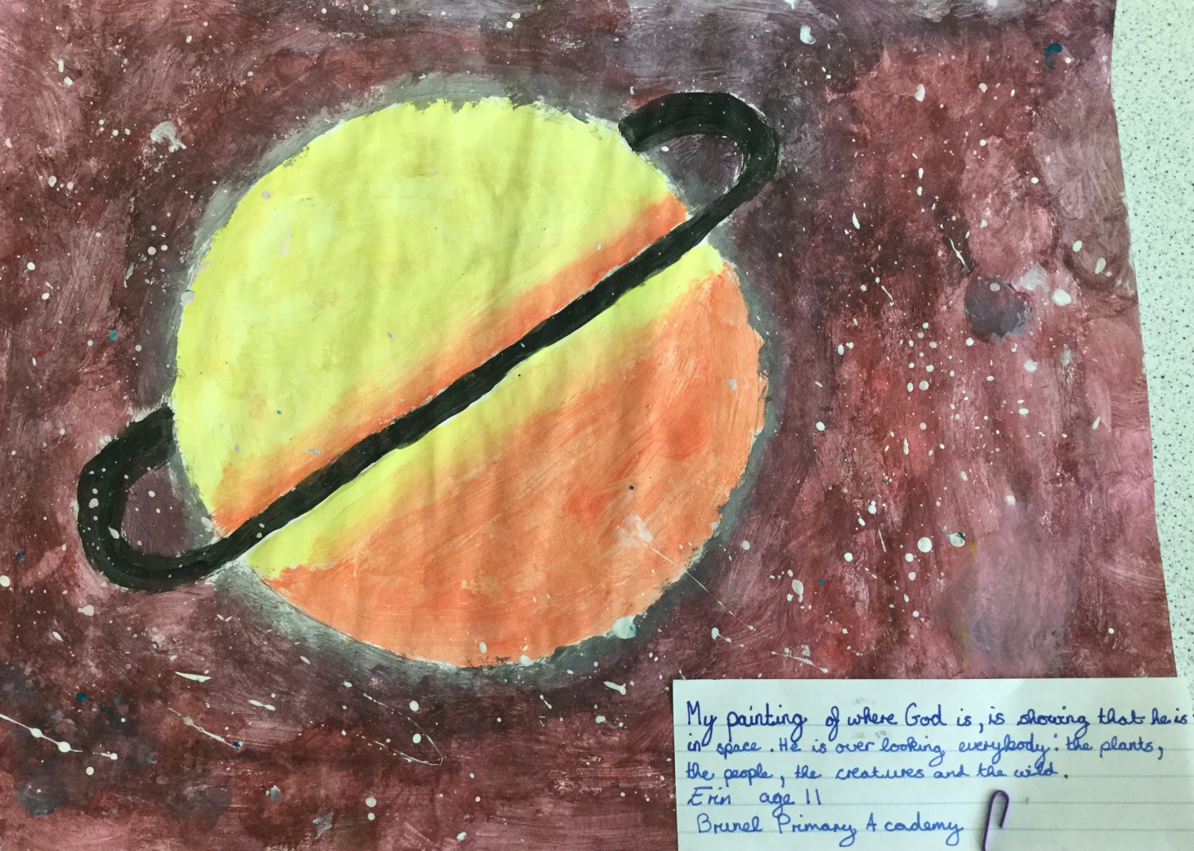
My painting of where God is, is showing that he is in space. He is over looking everybody: the plants, the people, the creatures and the wild.
Notes:
It gives children the opportunity to share their opinions without having to share them in front of the class.

Slide 30
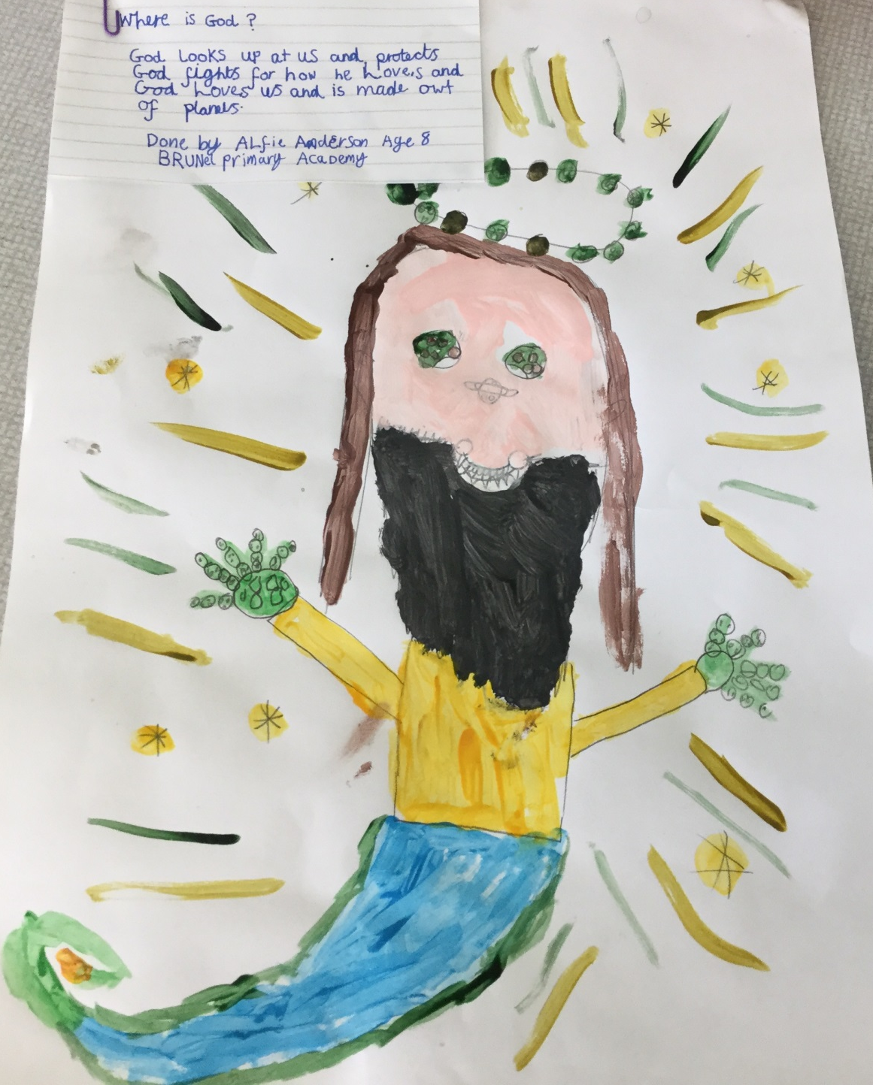
God looks up at us and protects. God fights for who he loves and God loves us and is made out of planets.
Notes:
It could be a whole school project….children could then build upon their original ideas and write a story or a poem.

Slide 31
Organising a whole text effectively
A literacy skill, that pupils’ need to be able to demonstrate ,in many subjects, is the ability of organise a whole text effectively and to be able to structure their writing so that there are links between the paragraphs.

Slide 32

Speed Writing Challenge
On the top of your sheet of A3 paper write down a topic. You have 4 minutes
2) Write down as many ideas as you can about this topic.
Pilgrimage
Example

Slide 33
Connectives
First
Next
Then
After that
Finally
Meanwhile
Initially
Eventually
In the end
At last
As a result of this
Consequently
Therefore
Due to this...
As a result of which...
On the other hand
Furthermore
More importantly

Slide 34
Evaluation questions in RS
The biggest challenge that secondary RE teachers are facing is developing extended writing and evaluation skills for the new demands of GCSE.
We have tried to develop student’s writing skills by developing scaffolds including solo strategies.

Slide 35
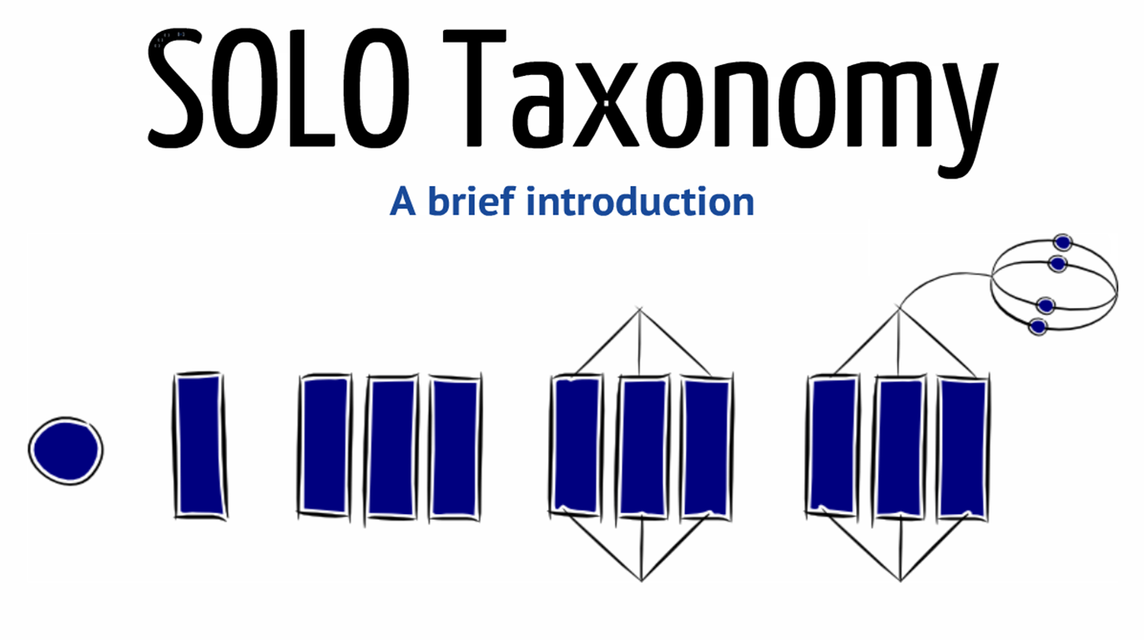

Slide 36
What is it?
“Structure of Observed Learning Outcome” (SOLO)
It is a ‘taxonomy’: It classifies, categorises learning.
It describes increasingly complex stages of learning.
SOLO can be taught to students to identify where they are in their understanding and where they should aim to be.
It encourages independent learning

Slide 37
How does it work?
5 stages of understanding in SOLO taxonomy
Pre-structural
Uni-structural
Multi-structural
Relational
Extended Abstract

Slide 38
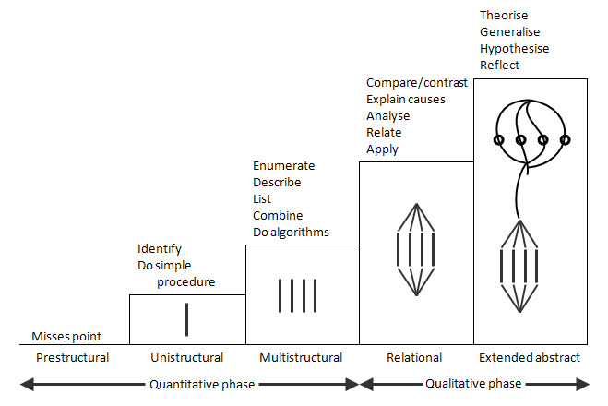

Slide 39
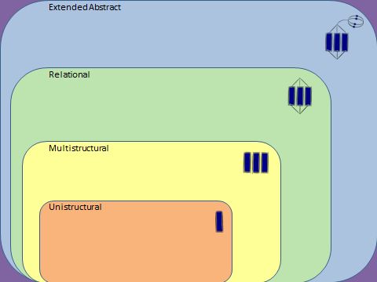

Slide 40
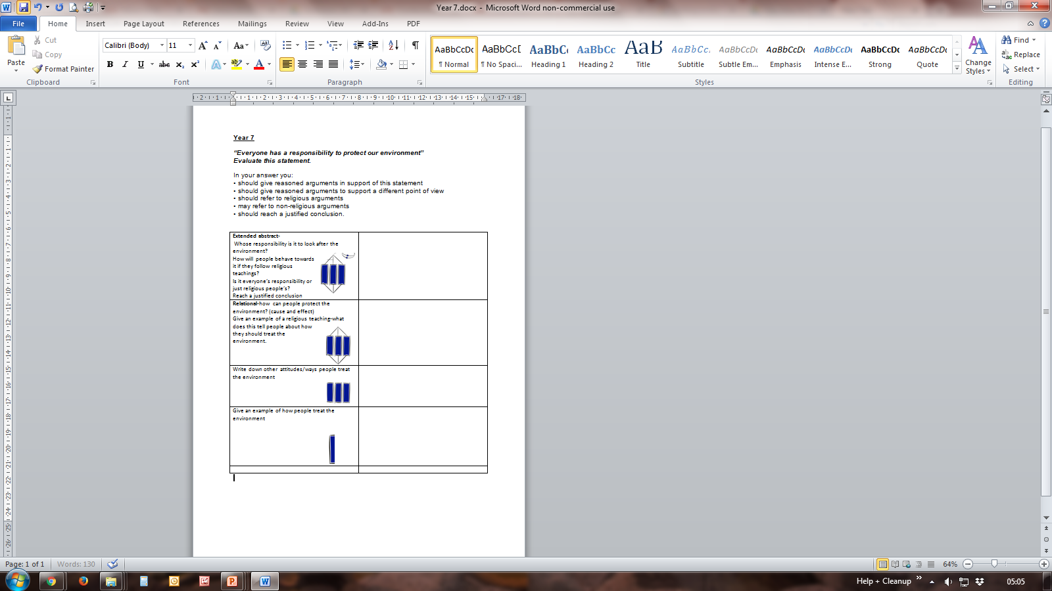
An example of a KS3 planning sheet for an evaluation question

Slide 41
Teaching
Belief
Action
CAUSE
EFFECT

Slide 42
FARMERS
F = For | A = Against
R= Religious point for | M = Multiple religious views against
E= Evaluation (Which is the most convincing argument and why?)
R = Refer back to the question S = Scripture. Make sure you quote from religious texts, E.G the Bible or Qur’an

Slide 43
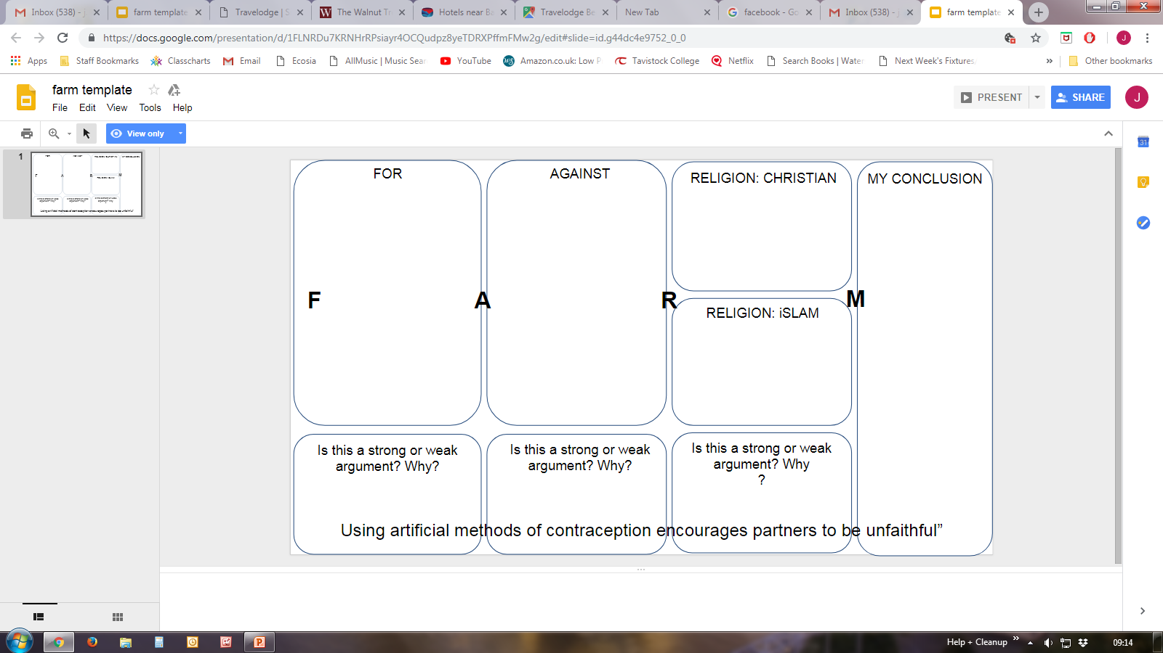

Slide 44
AQA 12 mark questions
‘Ibrahim is the perfect role model for Muslims’. Evaluate this statement. (12 marks)
‘A Muslim’s approach to life should be based on their beliefs about the afterlife’. Evaluate this statement. (12 marks)
‘It is more important to study the Qur’an during Ramadan than it is to fast.’ Evaluate this statement. (12 marks)

Slide 45
“The stories of the incarnation prove that Jesus was the son of God”. Evaluate this statement.(12 marks)
‘Private worship has more meaning for a Christian than public worship’. Evaluate this statement. (12 marks)

Slide 46
‘Parents should not have their children baptised if they have no intention of bringing them up as Christians’. Evaluate this statement. (12 marks)
‘There are no good reasons for countries to possess nuclear weapons’. Evaluate this statement. (12 marks)

