Slide 1


Slide 2
The Commission on Religious Education (CoRE) has spent the last two years listening to evidence from a wide-range of concerned parties including pupils, teachers, lecturers, advisers, parents and faith and belief communities
The Commission received over three thousand submissions

Slide 3

Key findings
RE needs rejuvenating for three reasons:
Pupils today encounter a growing diversity of religions and beliefs in their locality and in the media
There is a variable quality of RE experienced by pupils across the country
The legal arrangements around RE are no longer working as more schools become academies

Slide 4

Re-brand: Religion and Worldviews
The study of religious and non-religious worldviews is a core component of a rounded academic education
Young people today are growing up in a world where there is increasing awareness of the diversity of religious and non-religious worldviews
They will need to live and work well with people with very different worldviews from themselves

Slide 5
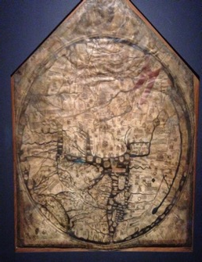
Studying worldviews
Everyone has a worldview
This is our way of seeing and making sense of the world
Worldviews give coherence and meaning to our experience and behaviour
An individual’s worldview may be more or less systematic and more or less consciously held
It may or may not refer to institutional or communal religious or non-religious perspectives
Mappa Mundi
Medieval worldview

Slide 6

Lived Experience
The shift in language from ‘religion’ to ‘worldview’ signifies the greater attention that needs to be paid to individual lived experience, the complex, plural and diverse nature of worldviews at both institutional and individual levels, and the extension of the subject beyond six major world faiths and humanism.

Slide 7
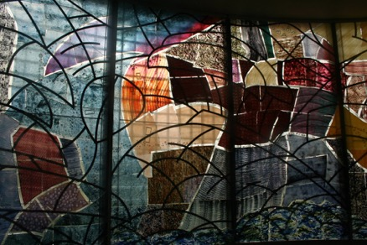
Recommendations
The report sets out a National Plan to ensure that all pupils receive their entitlement to an academically rigorous and rich study of religious and non-religious worldviews

Slide 8

Recommendations
1 The name of the subject should be changed to Religion and Worldviews
2 The National Entitlement to the study of Religion and Worldviews should become statutory for all publicly funded schools.
3 Non-statutory programmes of study for each of Key Stages 1–4 should be developed at a national level
4 SACREs should no longer have the duty to review and create a locally agreed syllabus.
5 GCSE and A-level specifications should be reviewed in the light of the National Entitlement

Slide 9

6 Primary ITE should offer a minimum of 12 hours training on Religion and Worldviews
7 The government should allocate funding for CPD for Religion and Worldviews to support the delivery of the new non-statutory national programmes of study
8 SACREs should be re-named as Local Advisory Networks for Religion and Worldviews. They will be expected to facilitate the implementation of the National Entitlement to the study of Religion and Worldviews in all schools within the local authority boundaries by providing information about sources of support available, and must connect schools with local faith and belief communities and other groups that support the study of Religion and Worldviews in schools

Slide 10
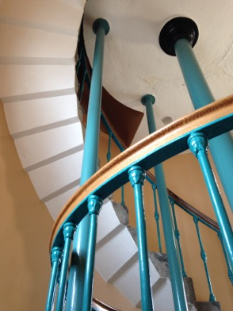
9 Ofsted or Section 48 inspectors must report on whether schools are meeting the National Entitlement
10 The DfE should consider the impact of school performance measures on the provision and quality of Religion and Worldviews, including the impact of excluding Religious Studies GCSE from the Ebacc and of excluding GCSE Short Courses from school performance measures
11 The DfE should review the right of withdrawal from Religion and Worldviews and provide legal clarification on whether parents have a right to withdraw selectively from parts of Religion and Worldviews

