Slide 1


Slide 2

9.00 Refreshments on arrival
9.30-10.30 Welcome
KEYNOTE address Dr Jim Harris
10.30-11.00 Refreshment break
11.00-12.15 Workshop 1
12.15 -12.30 Hub-bub: Discussion sessions in hub groups, supported by members of the steering group
12.30 Lunch
1.30-2.45 Workshop 2
2.45-3.15 Ed Pawson and Corrine Guntrip in raconteur role, drawing the threads together and feeding back. What are you taking away from the conference?
3.15 Evaluations and close

Slide 3
Dame Alison Peacock, Chartered College of Teaching

Slide 4
RE Updates
Keep in touch
Website: https://www.ltlre.org
Facebook: LTLRE South West
Twitter: @ltlre
#ltlre2018

Slide 5

LTLRE website https://www.ltlre.org

Slide 6

LTLRE on Facebook

Slide 7

NATRE (National Association of Teachers of RE)
https://www.natre.org.uk

Slide 8




Slide 9


Slide 10
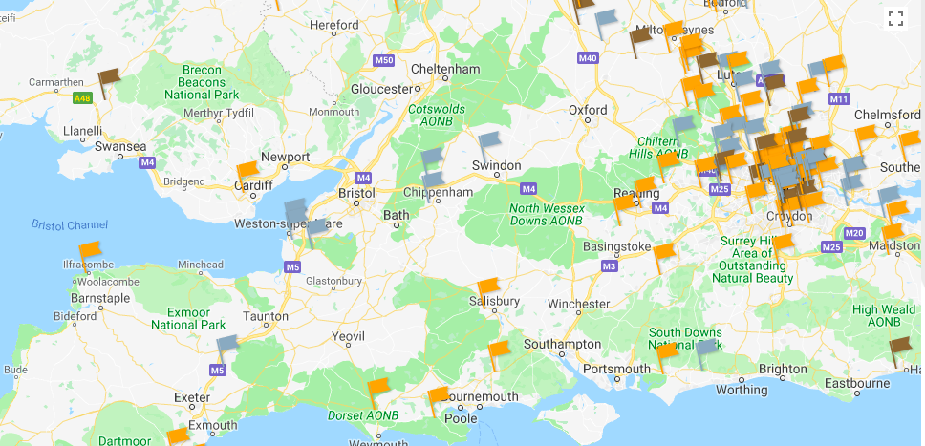
REQM Award Holders

Slide 11


Slide 12
The Commission on Religious Education (CoRE) has spent the last two years listening to evidence from a wide-range of concerned parties including pupils, teachers, lecturers, advisers, parents and faith and belief communities
The Commission received over three thousand submissions

Slide 13

A New National Plan for RE
Three point plan to retain high academic standards and prepare pupils for life in a society of diverse worldviews
1 A name change to ‘Religion and Worldviews’, reflecting a broader and more inclusive emphasis for the subject
2 All pupils should have access to high quality teaching. A National Entitlement should apply to all schools.
3 A significant investment to ensure the provision of highly qualified and knowledgeable teachers.

Slide 14

Lived Experience
The shift in language from ‘religion’ to ‘worldview’ signifies the greater attention that needs to be paid to individual lived experience, the complex, plural and diverse nature of worldviews at both institutional and individual levels, and the extension of the subject beyond six major world faiths and humanism.

