Slide 1

Time To Wonder
(reflective storytelling for everyone)

Slide 2

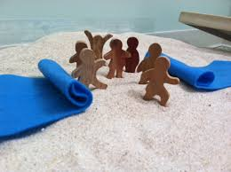
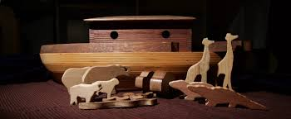
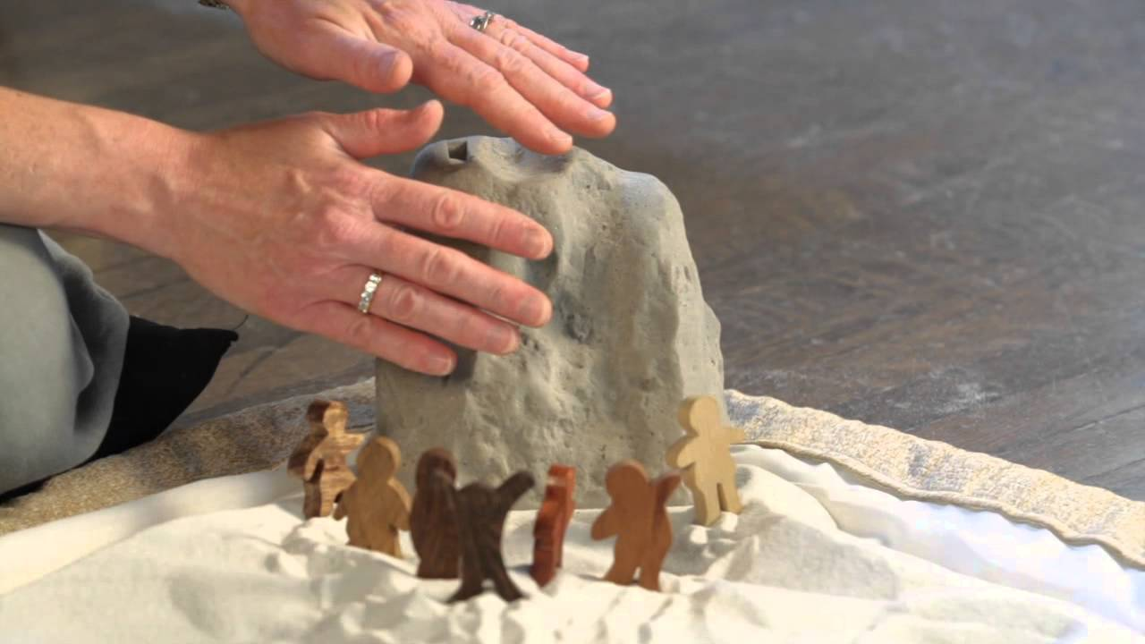
Where are its roots?
Maria Montesorri - Italy
Jerome Berryman – USA
Rebecca Nye –UK
Godly Play UK

Slide 3

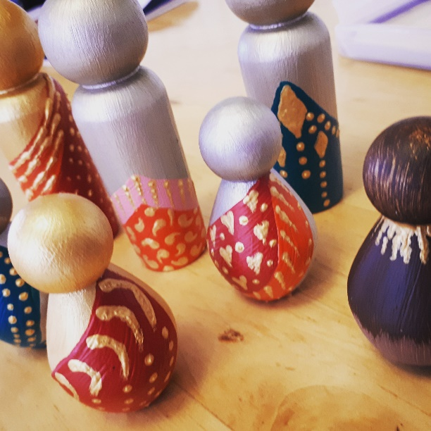
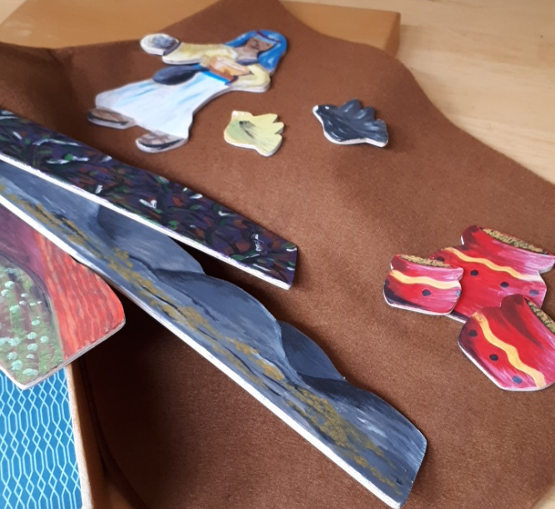
Time To Wonder
Invites listeners into the stories.
Experiential, immersive and non-coercive.
Uses symbols and objects as well as words.
Explores existential questions.
Supports areas of the current RE curriculum.
Promotes religious literacy.
Slows the pace.
Promotes spiritual wellbeing.

Slide 4
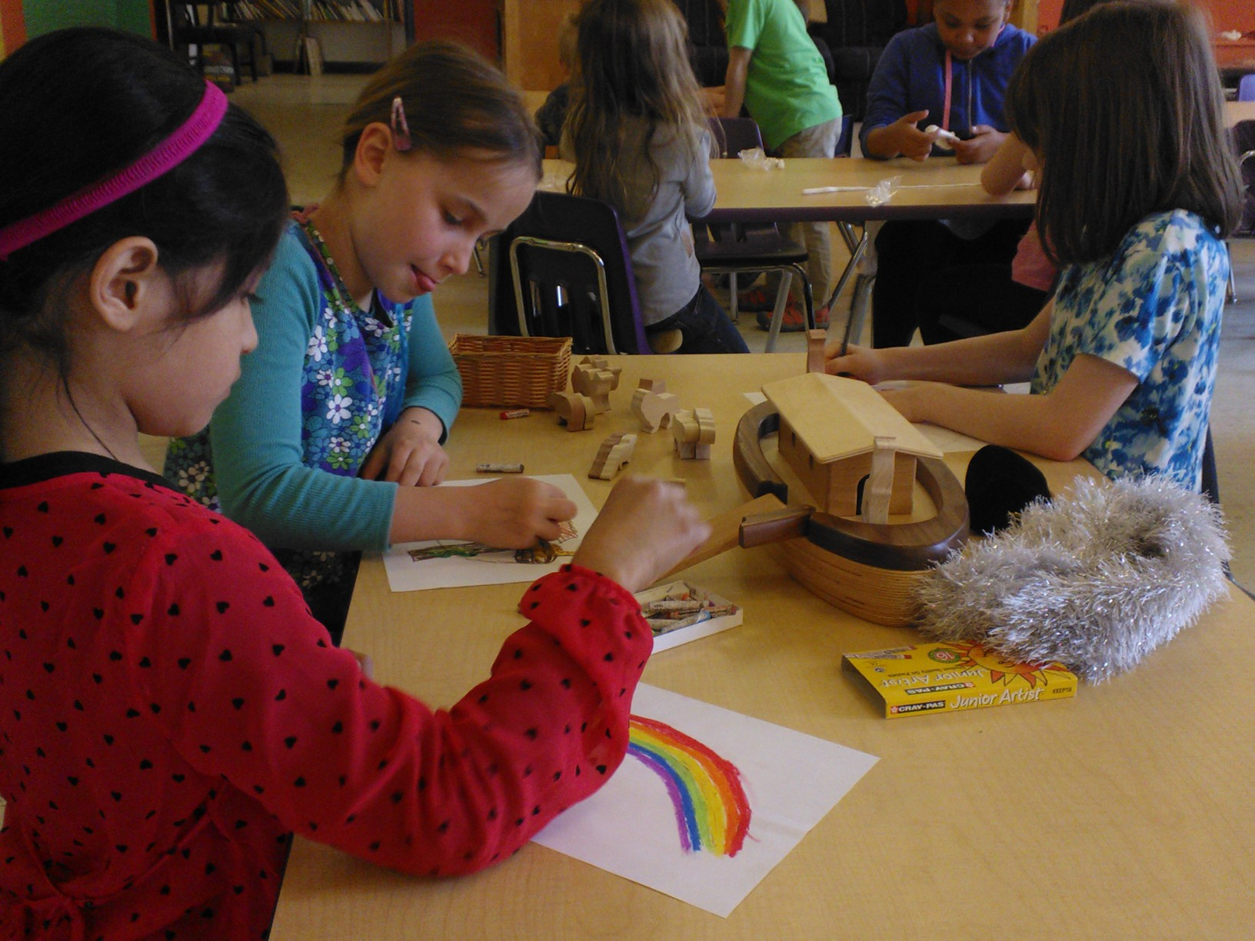
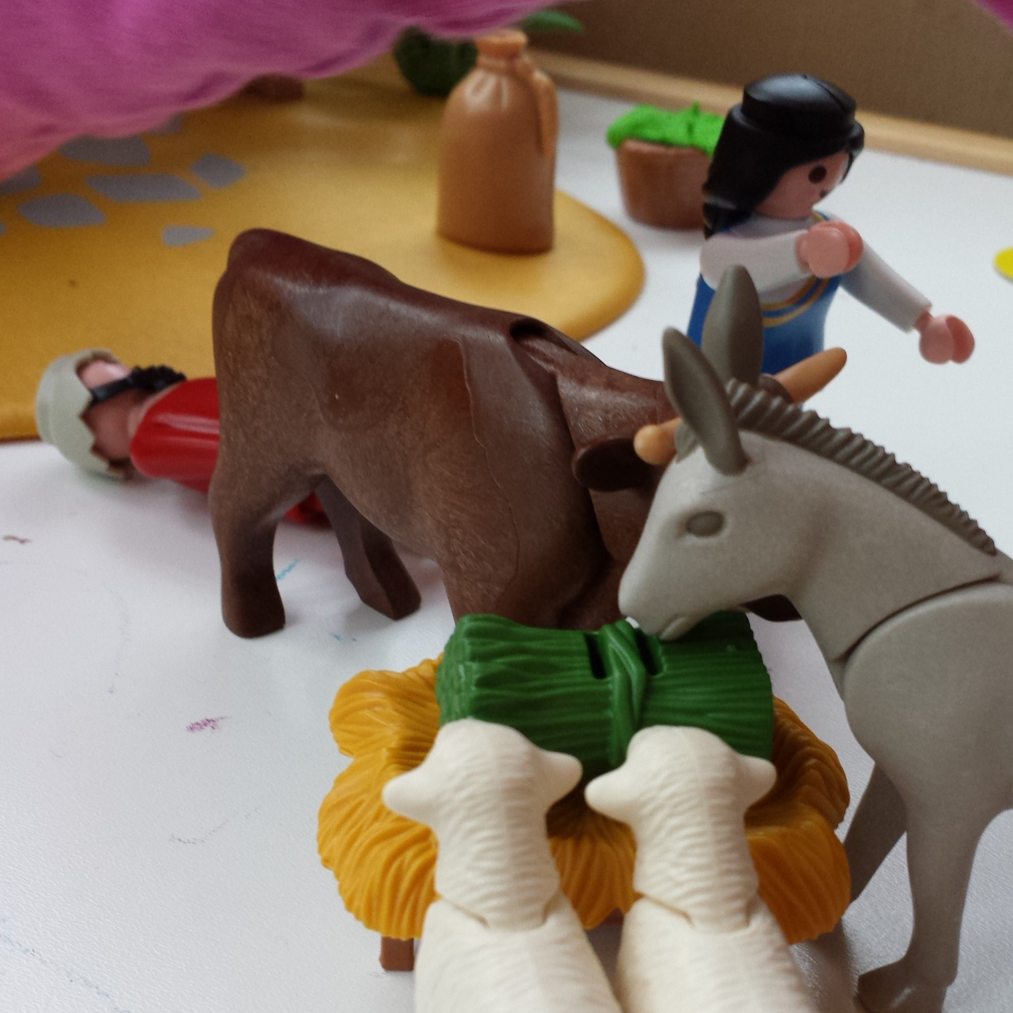
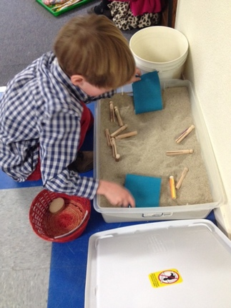
Considerations:
Commitment to the process.
Suitable space.
Creating a curriculum to include reflective storytelling.
Resourcing (time and equipment)

Slide 5

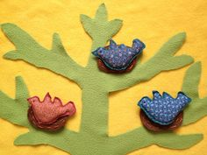
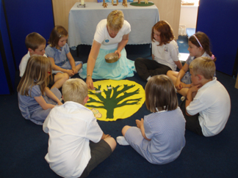
Time To Wonder
Katherine Taylor Mob.07906007282 Email:KTaylor3@educ.somerset.gov.uk

