Slide 1
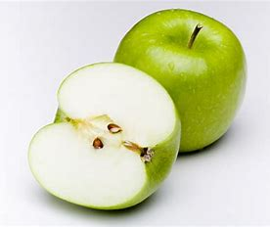
The Trinity
Can you explain to your friend how an apple can help us to understand the Trinity?

Slide 2
The Trinity
The peel is like God the Father, because He is a protector.
The flesh is like God the Son, because Jesus is God made flesh.
The seeds are like the Holy Spirit because He helps Christians to grow.

Slide 3



Slide 4




Slide 5
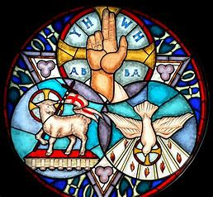
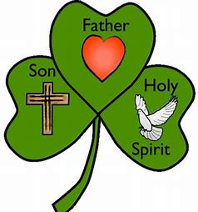
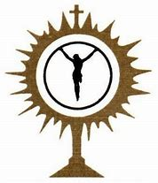

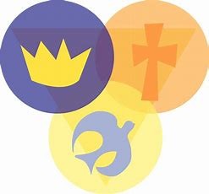
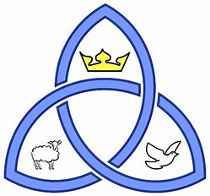
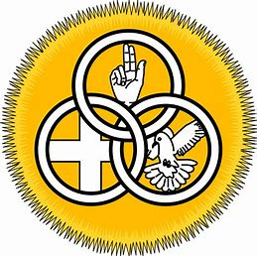

Slide 6
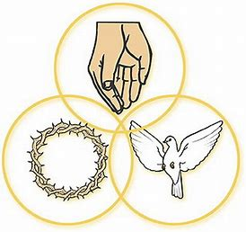
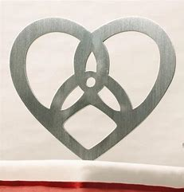
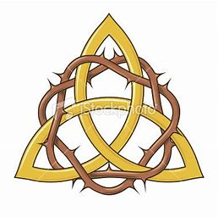

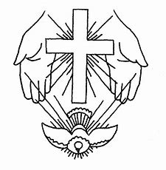

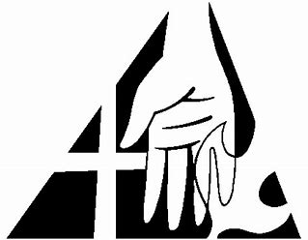

Slide 7
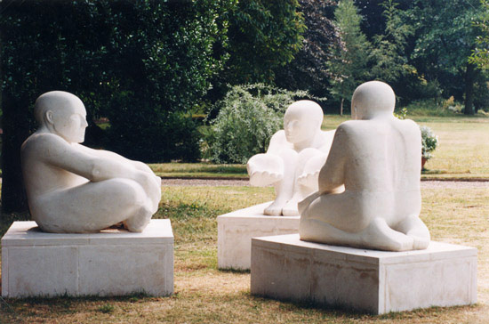
Brain Buster Challenge!
How does this sculpture reflect the Trinity to you?

Slide 8
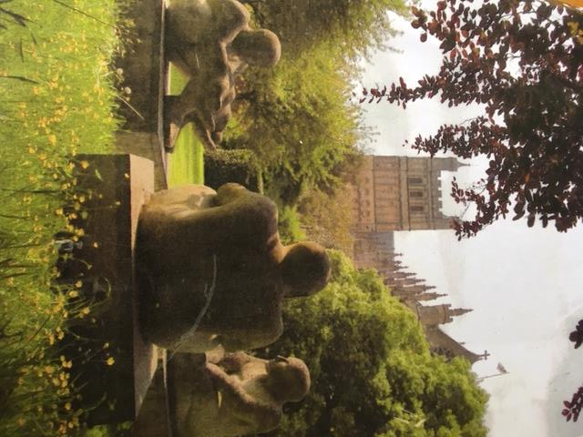
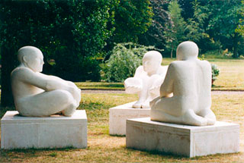
Frana Favata “The Trinity”
Frana Favata (Frances May Favata)
www.favata-sculpture.com
Can be found in the Bishop’s Palace in Exeter
Made out of Beer Stone
Each sculpture weighs about 3 tons each
It took her 5 years to build

