Slide 1

Worldviews and RE

Slide 2
Aims
To unpack elements of worldviews
To identify aspects of own worldviews
To examine the process of construction and reconstruction of worldviews
To analyse how worldviews influence the teaching of RE
To consider how reflexivity can be developed in RE teaching
(to use this session to evaluate and inform the design of my future research)

Slide 3
Challenges of RE – teachers’ voices
“engaging the pupils”
“lack of subject knowledge”
“answering children’s questions honestly (without offending parents)”
“It is sometimes hard to answer questions about religion/God.”
“Children can come into school with a negative view of RE.”
“To ensure I don’t influence children in their personal spiritual choices”
“Time”
Notes:
Quotes form the pre session questionnaire
Some of these to do with pupil attitude and some teacher attitude or anxiety.
Today going to address you as the teacher – tackling limited subject knowledge,
unsure of how to answer questions,
desire to be careful not to influence pupils

Slide 4

A key for RE
Examine worldviews
Develop understanding and empathy
How to approach new subject knowledge
Increasing confidence
Notes:
What are the key elements of RE? Examine worldview to aid us with this.
Various ideas on how to identify worldview. going to examine some today.
For teachers examining their own worldview could assist their understanding and empathy for others with differing views of the world.
They are therefore in a stronger position to understand how to approach new subject knowledge and indeed what subject knowledge they need to enquire about.
Their confidence can improve as the fear of the exotic is replaced by an understanding instead of shared experience

Slide 5
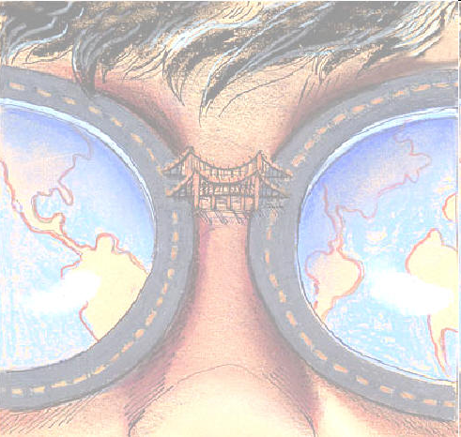
What constitutes a worldview?
“A worldview is a set of presuppositions (or assumptions) which we hold (consciously or unconsciously) about the basic make-up of our world.”
Sire, J. (1997:16)
The Universe Next Door
Our world view is:
the way we see the world,
the way we see reality,
a shared framework of
ideas we have about the
world.
Notes:
Why is it important?

Slide 6

WORLDVIEWS:
Visions of/for Life and Ways of Life
The Big Picture
Ultimate stories, narratives
Metaphysical beliefs
Principles, ideals, values
Mental models (Walsh and Middleton, 1984)
Comprehensive frameworks (Aerts et al, 2007)
Maps of the mind (Lappe, 2003)
The glasses or filters out of which we view the world.
Overarching philosophy (Samovar and Porter, 2004)
System to guide its adherents (Olsen, 1998)
Weltanschauung
Notes:
Metaphors to explain worldviews. Not all the same. Contentious
Our vision of life or worldview
is how we look at the world.

Slide 7
John Valk
Examining worldviews
Worldview Frameworks
Personal Identity
Ultimate Questions
Worldview Dimensions
Epistemological/Ontological
Primary/Secondary Values
Notes:
Inclusive…place all together.
What are the key elements of RE? Examine worldview to aid us with this. John Valk worldview tool (2010) Which aspect of worldview is impacted by religion? Which are impacted by it? Examine the printed sheets and discuss in groups. Religion not about rituals, clothes and liturgy but about answering big questions of life. With differing answers comes different behaviour – think back to EPS lecture and concentric circles activity in the seminar.
How do we identify worldviews?
Schools use sheets on identity…shields or likes and dislikes…show demonstration…what is the issue with that? Only answers part of the first section on personal identity. Can we delve deeper to address more of this? Help pupils to identify their identity…and can see how this might imapct their learning…same for teachers. There will be a range of worldviews in the class and amongst teachers.

Slide 8
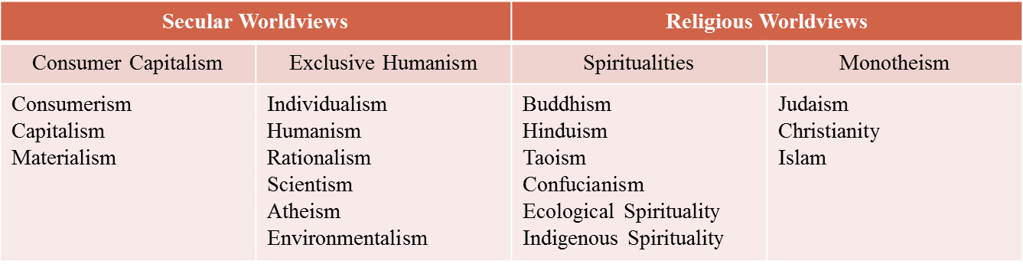
Notes:
Valk’s questions led his students to then identify with one of these identified worldviews. Sikhism not there…are one or two exceptions.
Each one of these conatins answers for the aprts in the last slide like persoanl dieinitty, ultimate quetsion etc… and each can contain a variety fo resposnes. Peopl may relate to differeign worldveiws…no one set wroldveiw….true of all religions too.

Slide 9
Dynamic and evolving worldviews
‘A world view is a system of co-ordinates or a frame of reference in which everything presented to us by our diverse experiences can be placed. It is a symbolic system of representation that allows us to integrate everything we know about the world and ourselves into a global picture, one that illuminates reality as it is presented to us within a certain culture.’ (Aerts et al, 2007:7)

Slide 10
Frames of reference
Examine this selection of pictures
Choose one that you think portrays different perspectives in a way that appeals to you
Discuss in your groups

Slide 11
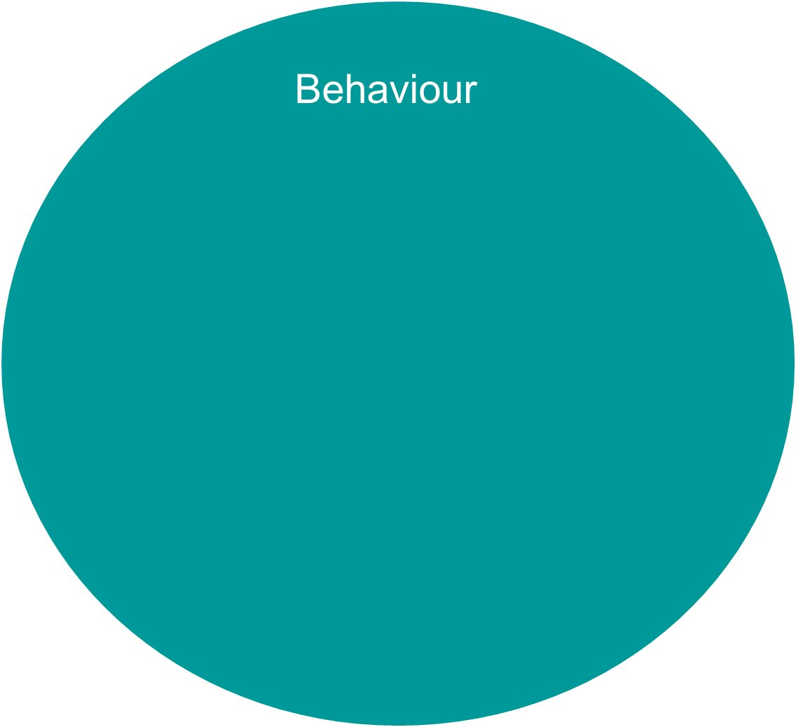
Values
Beliefs
Notes:
Look at individual child or parent and see behaviour…but cant just isolate that. Need to look beneath at the values and beliefs that have formed that behaviour.
Our beliefs diff therefore values diff and therefore behaviour diff.
Sometimes belief same but behaviour diff…ie believe imp to respect those in authority. Some south east Asian cultures to show respect for teacher never look them in the eye…British culture if don’t look teacher in the eye seen as disrespectful….need to listen or try and ascertain what belief is…and understand the behaviour in line with that.

Slide 12
1967 Plowden Report
Behaviour:
topic based learning
Values:
Importance on building
child’s interest
Belief:
Child should be at the centre of education
Notes:
Sometimes behaviour can be different but the beliefs and values is the same ie belief teachers in authority need respect, respect those in authority

Slide 13
Behaviour:
Don’t steal
Values: Wrong to steal
Belief:
deity will punish me if I steal
Notes:
Sometimes behaviour can be different but the beliefs and values is the same ie belief teachers in authority need respect, respect those in authority eg teacher who when telling off a child was annoyed they didn't make eye contact as that seen as disrespectful. But child form Asian background where not look at elders in the eye to show respect. https://www.youtube.com/watch?v=6_WAmt3cMdk for funny example.
Fill in the concentric circles sheet and discuss.

Slide 14
Activity
Behaviour:
Values:
Belief:
Notes:
Sometimes behaviour can be different but the beliefs and values is the same ie belief teachers in authority need respect, respect those in authority eg teacher who when telling off a child was annoyed they didn't make eye contact as that seen as disrespectful. But child form Asian background where not look at elders in the eye to show respect. https://www.youtube.com/watch?v=6_WAmt3cMdk for funny example.
Fill in the concentric circles sheet and discuss.

Slide 15
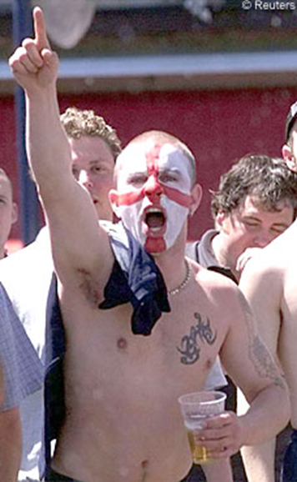
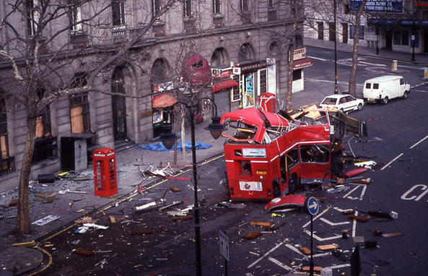
What belief do these behaviours express?
Notes:
Picture on left actually IRA bomb in Feb. 1996. picture on right is not EDL/BNP but an England football supporter
Portuguese picture of UK …IRA bomb and football hooligans
More than just race and family background…but also for those with limited life exp of other culture can be perceived they have no culture but theirs is the norm: norm behaviour, norm values and norm beliefs…judging of the other
As teachers can make a difference here! Exp of the “other”

Slide 16
IRA bomb, February 1996
England football supporter
Notes:
Look at the pictures on different sheets….choose one that you like and explain to a partner what you like about it…what perspectives shown?
Portugal…media infleunce

Slide 17
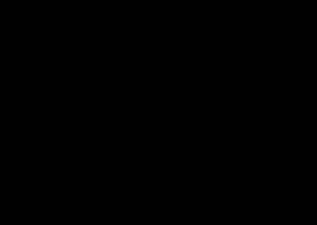
Worldview norms
https://www.youtube.com/watch?v=6_WAmt3cMdk
Notes:
Video…Stereotypes on both sides. Funny. Often these miscommunications are not funny misunderstandings but can lead to hurt and confusion for our students. One student upset her flat mate by selfishly taking showers at 1 or 2 in the morning . However, what the flat mate didn’t understand was that in this student’s culture showers are taken when you go to bed and not when you get up in the morning.

Slide 18
How are worldviews formed?
Paul Ricoeur:
Identifications are associated ‘with values, norms, ideals, models and heroes, in which the person or community recognises itself’ (1992: 122)
To understand self Ricoeur suggests an examination of narrative: ‘Self-understanding is an interpretation; interpretation of the self in turn , finds in narrative….a privileged form of mediation; the latter borrows from history as well as from fiction, making a life story a fictional history or, if one prefers, a historical fiction’ (1992: 114)
Notes:
French Philosopher 1913 – 2005. one of the most distinguished philosophers of the 20th century. He wrote on a broad range of issues. Key work for this project is his work on hermeneutics and narrative
Life narrative/story can enable a greater understanding of self.
Friend in the 1990s wanted to come to the UK from Portugal but her mum didn't want her to. Y? all she knew about the UK was from the media and at the time it was full of images of IRA bombs and football hooligans. What do we know of other faiths? Is it all from media? Media portrayal of Muslims at the moment very mixed. Many children and parents have negative attitudes…ie school in Cornwall who cancelled a trip to Exeter mosque because some parents withdrew permission as they were afraid that their child would get shot. Lostwithel school http://www.westernmorningnews.co.uk/Parents-Cornwall-ban-children-school-trip-Exeter/story-26407519-detail/story.html

Slide 19
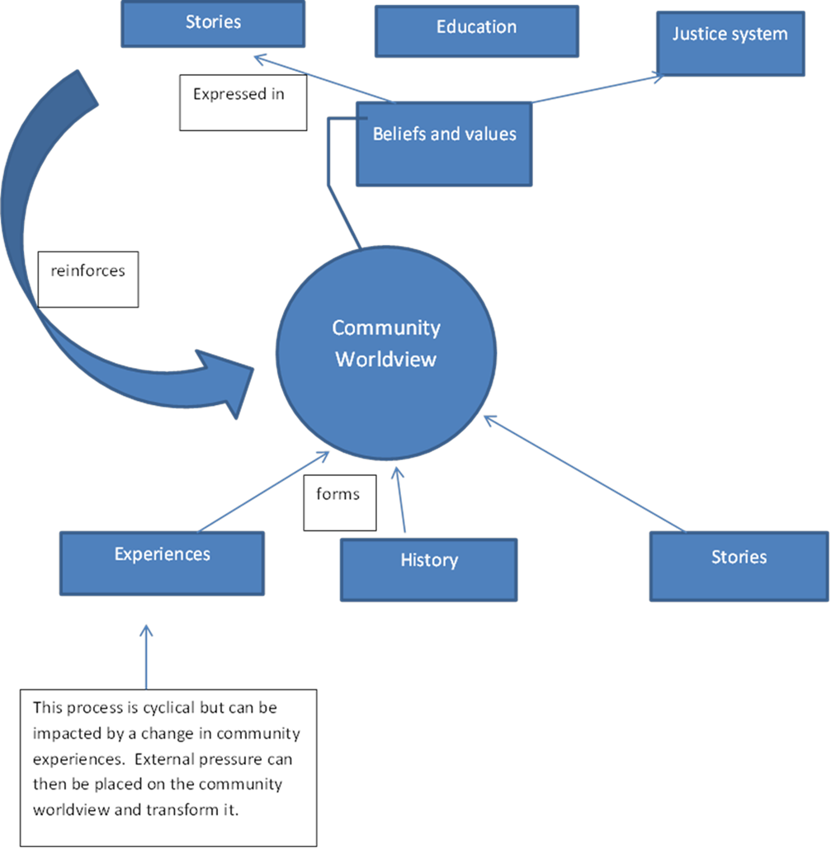
How are worldviews formed?
Notes:
Look at one aspect of our life narrative in relation to RE. This is looking specifically at RE in this case as an example of the impact of possible peer pressure on enjoyment of a subject, or the impact of exposure to other religions on RE. IE the life narrative of the individual and whether these events have any impact on the individuals like/dislike of the subject or interest in the subject to unpack how this might be true in other areas of worldview. E.g. Between your perception of other pupils attitudes and your own attitude towards RE lesson? Or between your experiences of other religions and your attitude towards RE

Slide 20
Bricolage nature of worldviews
Van der Kooij et al (2013)
Draws key distinctions between ‘personal’ worldviews, with norms, values, ideals and practices, and ‘organised’ worldviews.
Personal worldviews can be based on an organised religious worldview but can be eclectic and idiosyncratic.
‘Bricolage’ (Hervieu-Leger, 2006) - a ‘mishmash’ of ideas, symbols and practises from different traditions which moulded together to construct a personal religious profile (2013:213-214).
Whilst not rejecting Valk’s model Van der Kooij et al claim that this distinction needs to be made explicit.
Notes:
Van der Kooij et al (2013) add a further dimension in drawing key distinctions between ‘personal’ worldviews, with norms, values, ideals and practices, and ‘organised’ worldviews. These personal worldviews can be based on an organised religious worldview but can be eclectic and idiosyncratic. Indeed, he borrows the term ‘bricoleurs’ from Hervieu-Leger (2006). ‘Bricolage’ is described as a ‘mishmash’ of ideas, symbols and practises from different traditions which moulded together to construct a personal religious profile (2013:213-214). They challenge the debate on definitions of worldview and examine elements of worldviews in an attempt to find consensus to form ‘organised’ worldviews (2013:214). Whilst not rejecting Valk’s model Van der Kooij et al claim that this distinction needs to be made explicit.

Slide 21
How are worldviews formed?
Take a look at the answers from the circles activity task.
Choose one answer
Can you identify the origins of any of your views?
(such as education, parent, teacher, peer influence, life experience?)
Notes:
Look at one aspect of our life narrative in relation to RE. This is looking specifically at RE in this case as an example of the impact of possible peer pressure on enjoyment of a subject, or the impact of exposure to other religions on RE. IE the life narrative of the individual and whether these events have any impact on the individuals like/dislike of the subject or interest in the subject to unpack how this might be true in other areas of worldview. E.g. Between your perception of other pupils attitudes and your own attitude towards RE lesson? Or between your experiences of other religions and your attitude towards RE

Slide 22
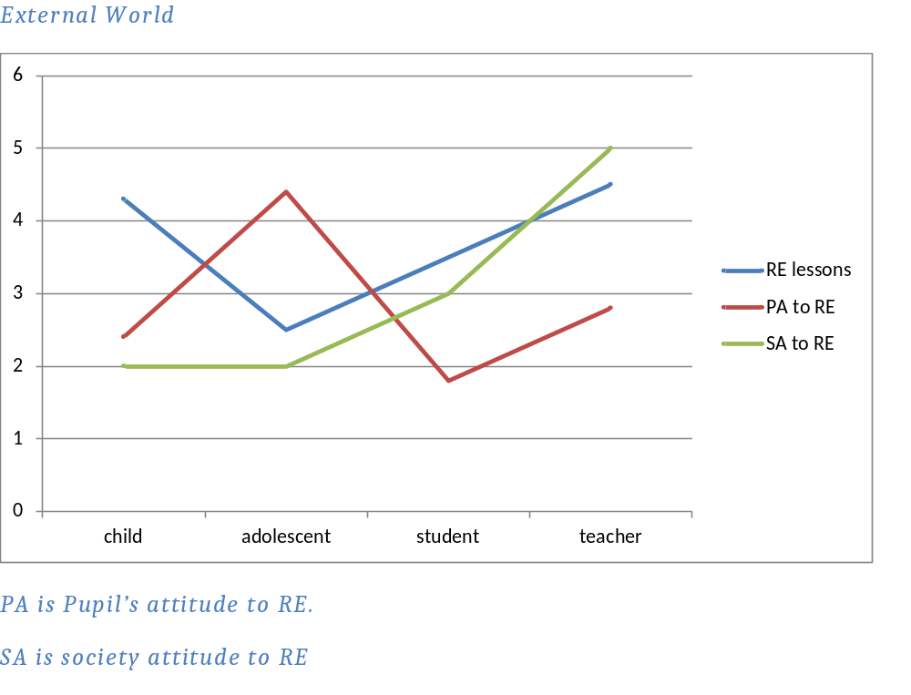
External world
PA is pupil’s attitude to RE
SA is society's attitude to RE

Slide 23
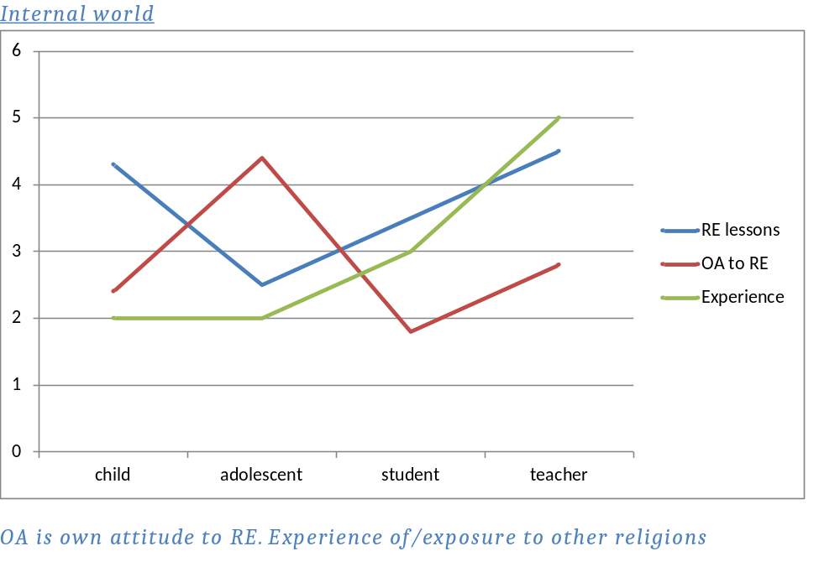
Internal world
OA is own attitude to RE
Experience of/ exposure to religion(s)

Slide 24

Why are worldviews important?
Assists Communication
Helps overcome fears
Promotes diversity
Helps pupils/teachers relate to RE
Notes:
Impacts the way we see everything. The lens through which individuals see all around them. In teaching value and beliefs will impact the way we teach subjects, the enthusiasm the teacher shows or the weight they give the subject. Impacts communication which is crucial in teaching:

Slide 25
‘By seeing worldview as a concept that makes sense of the world, which can be different due to different life experiences, may assist understanding that what one perceives as the ‘norms’ of life are merely a product of our own life narrative and worldviews.
To recognise this prevents the views of others as being negatively perceived as ‘other’, ‘exotic’ or even ‘wrong’, as they deviate from individuals’ accepted norms, but rather view these as shared responses to life experience.’ (Flanagan, 2018)

Slide 26
Perhaps the main question for a teacher is not is there an objective truth but is it possible to be neutral? An individual is a product of socio cultural and personal history but this does not negate truth rather it negates neutrality and acknowledges that all individuals are engaged in ‘informed’ interpretation:
as ‘active participants in the process of interpretation …we must abandon any strict claim to neutrality and objectivity’ (West, 2012:399).
(Flanagan, 2018.)

Slide 27
The impact of teacher beliefs
‘The beliefs teachers hold with regard to learning and teaching determine their actions’
Korthagen (2004: 81).
‘few would argue that the beliefs the teachers hold influence their perceptions and judgments which in turn, affect their behaviour in the classroom, or that understanding the belief structures of teachers and teacher candidates is essential to improving their professional preparation and teaching practice’
Pajares (1992: 207)
Notes:
Korthagen's research into what makes a good teacher.
Pajares cites : (Ashton, 1990; Ashton & Webb, 1986; Brookhart & Freeman, 1992; Buchmann , 1984; Clark, 1988; Dinham & Stritter, 1986; Feinman-Nesmer & Flden) (1992: 307)

Slide 28

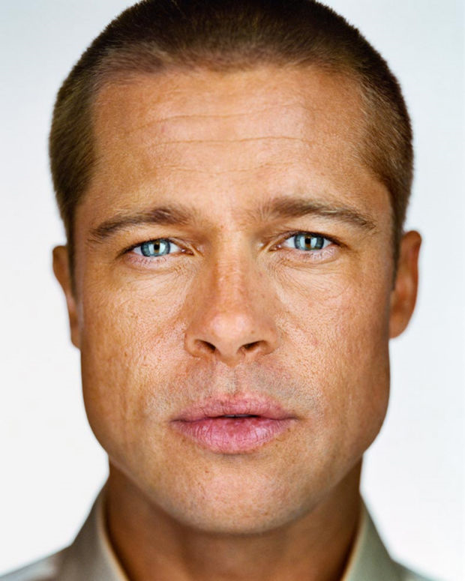
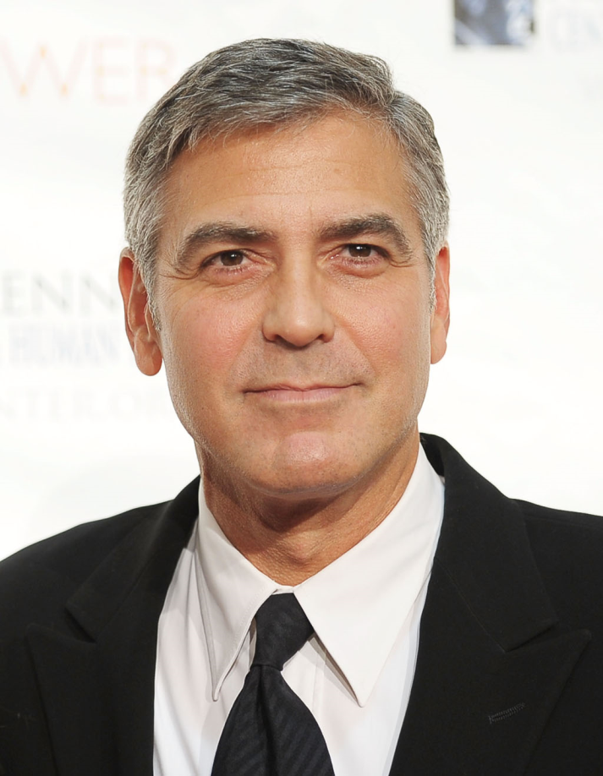
Cat
Encode
Transmit
Decode
Notes:
Works well when have the same frame of reference…..same world view.
TedX talk. Tommy McCall talks about graphicacy, the next great leap forward at TEDx East. Filmed May 9, 2011 at the NY Times Centre
http://www.youtube.com/watch?v=7ZvsZtUfQQs

Slide 29
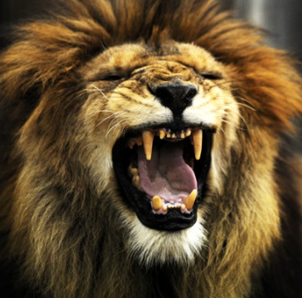
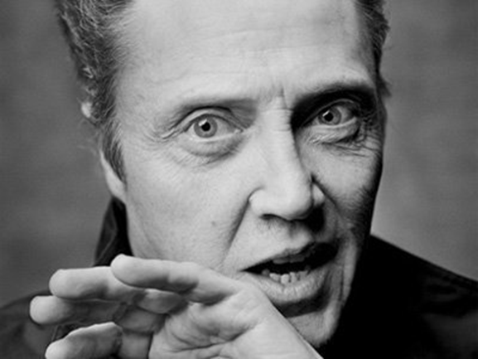
Cat
Encode
Transmit
Decode
Notes:
Works well when have the same frame of reference…..same world view but Christopher walkern was a lion tamer before he became famous!

Slide 30

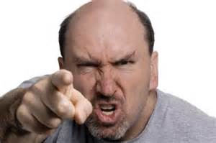
Father
Encode
Transmit
Decode
Notes:
Works well when have the same frame of reference…..same world view. Actually George Clooney according to the media, has a good relationship with his father…but if he didn’t this might be the image that the word conjures up in his mind.

Slide 31
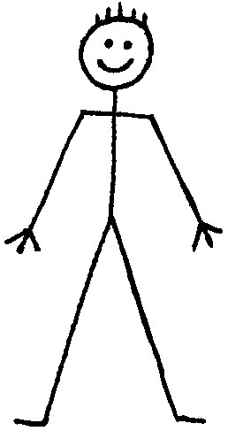
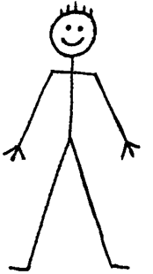
Communication
Frame of reference barrier
Frame of reference
barrier
Intended message
Actual communication
Perceived
message

Slide 32


Cross cultural communication
Frame of reference barrier
Frame of reference
barrier
Intended message
Actual communication
Perceived
message
Notes:
Even greater extent when different world views in the mix! Also not just verbal communication also issue of behaviour

Slide 33
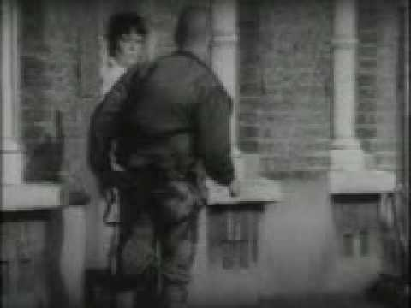
Watch this clip from an advert for the Guardian.
https://www.youtube.com/watch?v=M3bfO1rE7Yg
Notes:
Need to see the whole picture and see world not merely from our point of view.
Look at the worldview cards. Read through. Which are helpful? Which would you use with a class?

Slide 34
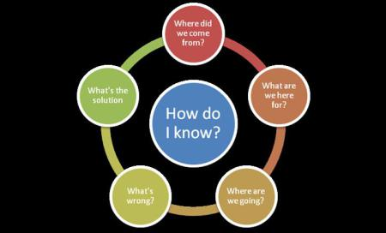
Notes:
https://salternlite.wordpress.com/2012/03/30/world-view-diagram/
Ultimate questions. All have different perspectives…need to understand and name our own …

Slide 35

Notes:
A worldview is a system of presuppositions by which one witnesses world and culture. Chuck Colson defined worldview as “the sum total of our beliefs about the world.” It’s an ideology or philosophy of how the world works and how to engage the world. Often only idneitfy when come up against difference.
Christmas….eg. How did you spend Christmas day?
We all have a worldview – a set of personal biases by which we engage context, culture, life, and politics. The direct question asks, “What is your worldview?” What set of biases or beliefs incorporate your established framework or worldview? Review in seminar

Slide 36
My own worldviews
How would I answer these questions?
Framework | Components
Ultimate Questions | Meaning/Purpose
 | Responsibilities/Obligations
 | Discerning Right/Wrong
 | Righting our Wrongs
 | Greater Force/Power/Being
 | Eschatos: Life after this life
Notes:
ON A3 paper draw stick man in the centre for you and write the answers to each category around the paper.
This is one aspect of your worldview which informs on the rest and is relevant to RE

Slide 37

What is the purpose of life? Do I have any responsibilities or obligations? How do I discern what is right/wrong?
How can I right any wrongs? Is there a greater force/being? Is there an after life?
Notes:
Don’t need to show anyone else but imp to be aware of own answers in order to see if they influence attitude to RE or understanding of other worldviews.

Slide 38
Using one religion attempt to discover how does it answer the big questions?
How does this differ from your own?
Framework | Components
Ultimate Questions | Meaning/Purpose
 | Responsibilities/Obligations
 | Discerning Right/Wrong
 | Righting our Wrongs
 | Greater Force/Power/Being
 | Eschatos: Life after this life
Notes:
ON A3 paper place one of the photos in the Centre and write the answers to each category around the paper. The photos are generalizations put hopefully positive ones. Discuss with children assumptions about faith by dress and ethnicity. What did first Christians look like? Etc…

Slide 39
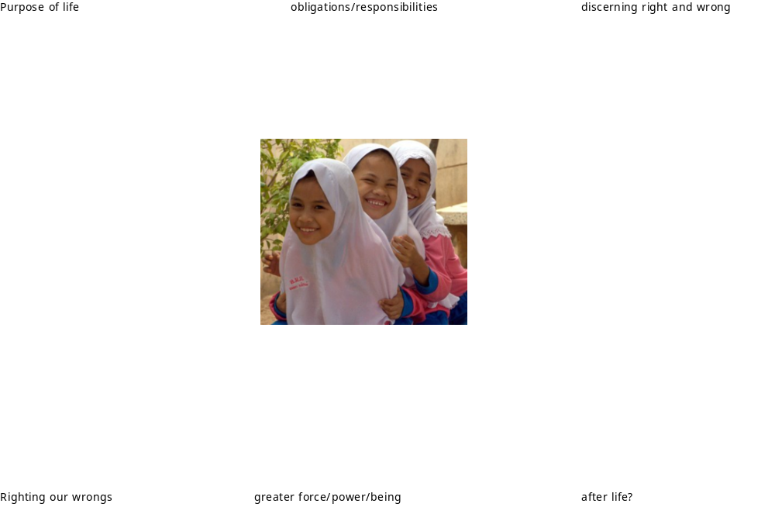
Notes:
Some sheets available on Buddhism. Can never be expert on every religion but if have a framework to start form and an understanding of root of religious worldviews can know here to start with a religion and how to compare world religions…not just about clothes they wear or rituals but about worldview. We all have one and therefore to be able to identify our own we can then

Slide 40
Worldviews and RE
All religions contain worldviews
All people have views of the world
Worldviews evolve and form through life experience
They are flexible and continually evolving
Identifying our own is important:
a) impact and influence on our teaching
b) enable us to understand and teach the worldviews of others
Notes:
The last point is the one we wish to assess….in two months would like to interview a few of you to see if a growing awareness of worldview has in fact influenced your teaching of RE in anyway poss.… confidence, or effectiveness, enthusiasm for RE etc…
For teachers examining their own worldview could assist their understanding and empathy for others with differing views of the world. They are therefore in a stronger position to understand how to approach new subject knowledge and indeed what subject knowledge they need to enquire about. Their confidence can improve as the fear of the exotic is replaced by an understanding instead of shared experience

Slide 41
Any questions?
Please let me know if you would be happy to take part in a short interview later this term or at the start of next term.
Thank you for your help with this research.
r.flanagan@exeter.ac.uk

Slide 42
Some key references
Aerts et al. (1994) Worldviews: from fragmentation to Integration. VUB press
Brussels. Internet edition. 2007. Available at http://www.vub.ac.be/CLEA/pub/books/worldviews.pdf accessed on 7/3/18.
Korthagen, F. (2004) In search of the essence of a good teacher: towards a more holistic approach in teacher education. Teaching and Teacher Education. Vol 20: 1, p 77 – 97.
Pajares, M.F. (1992) Teachers' Beliefs and Educational Research: Cleaning Up a Messy construct. Review of Educational Research. Vol 62: 3, p 307- 332.
Ricoeur, P. (1992) Oneself as another. Translated by Blamey, K. University of Chicago Press, Chicago.
Valk, J. (2010a) Worldview education in a changing world. Lecture at New Brunswick University, ISREV Ottawa.
Van der Kooij, J., de Ruyter, D. Midema, S. (2013) ‘Worldview’: the meaning of the
concept and the Impact on Religious Education’. Religious Education, 108:2,
p201 -228.

