Slide 1


Teachers of RE in all phases of education are invited to attend the 2019 West of England LTLRE 4th annual conference
‘Don’t fence me in’
Religion and Worldviews: beyond stereotypes towards lived experiences
Keynote speakers
Dr Helen John
What are worldviews and how do they fit into RE?
Dr Chris Hewer
Do all Muslims share the same beliefs and life patterns?
Juliet Lyal
What do teachers of RE need to take note of from the new Ofsted framework?
Ajahn Jutindharo
Thoughts from a Buddhist who grew up Jewish

Slide 2
Programme for the day
8.45 - 9.15 | Arrival and Refreshments | Michael Tippett Centre
9.15- 9.20 | Welcome: Dr Rebecca Schaaf
9.20- 9.30 | Introduction: Ed Pawson and Katy Staples
9.30 - 10.15 | Keynote 1 - Dr Helen John: Worldviews
10.15 - 10.35 | Refreshments
10.45 - 11.30 | Workshop A | Newton Building
11.35 - 12.20 | Workshop B
12.30 - 1.30 | Lunch | Michael Tippett Centre
1.35 – 2.30 | Afternoon Reflection: Ajahn Jutindharo and Katherine Taylor.
2.40 - 3.25 | Keynote 2 (primary focus) - Juliet Lyal: Will the new Ofsted framework fence us in? | Newton Building
2.40 - 3.25 | Keynote 2 (secondary focus) - Dr Chris Hewer: Exploring diverse traditions in Islam
3.25 - 3.30 | Thanks and evaluations

Slide 3
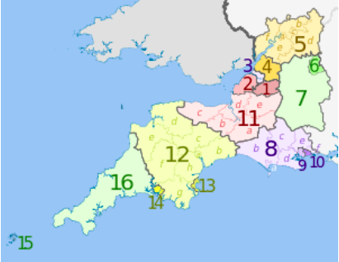
LTLRE Area 2 includes the Local Authority districts of:
Bath and North East Somerset
North Somerset
Bristol (3),
South Gloucestershire
(6) Swindon
(7) North Wiltshire (part of 7)
(11) Somerset
Area 2 (West of England) LTLRE
Area 2 of LTLRE covers the areas served by the Diocese of Bath and Wells and Bristol, stretching from Minehead to Swindon.

Slide 4
Learn, Teach, Lead RE (West of England, Area 2)
Hub leaders
 | Primary | Secondary
Taunton | Katherine Taylor | Mike Keogh
Mid/South Somerset
North Somerset | Laura Harris
Bristol | Adam Robertson | Alice Sarbicki
S Glos
Bath | Paul Marvin | Mary Patterson
Swindon/N Wilts | Emma McCarthy | Emma Ainslie-King

Slide 5

LTLRE website https://www.ltlre.org

Slide 6

LTLRE on Facebook

Slide 7
RE Updates
Keep in touch
Website: https://www.ltlre.org
Facebook: LTLRE South West
Twitter: @ltlre
#ltlre2019
More info: efpawson@gmail.com

Slide 8
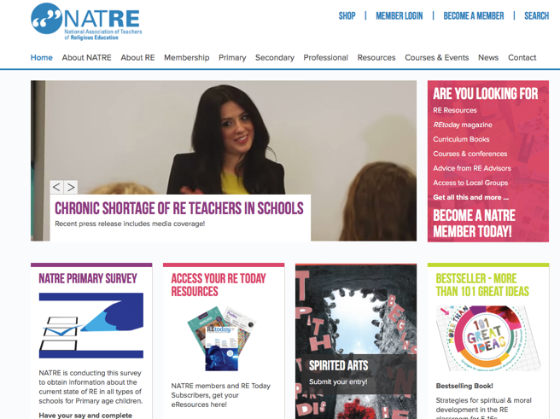
NATRE (National Association of Teachers of RE)
https://www.natre.org.uk
Why join NATRE?
https://www.youtube.com/watch?v=oWHy-nVWsJM

Slide 9




Slide 10


Slide 11
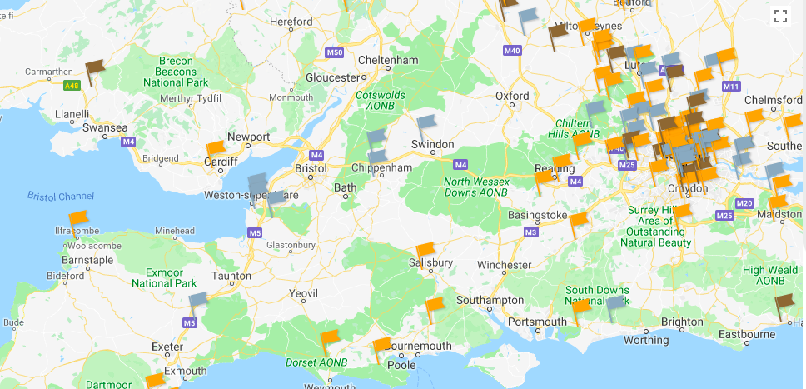
REQM Award Holders

Slide 12


Slide 13
A New Vision for RE
1 A name change to ‘Religion and Worldviews’, reflecting a broader and more inclusive emphasis for the subject
2 All pupils should have access to high quality teaching. A National Entitlement should apply to all schools.
3 A significant investment to ensure the provision of highly qualified and knowledgeable teachers.

Slide 14
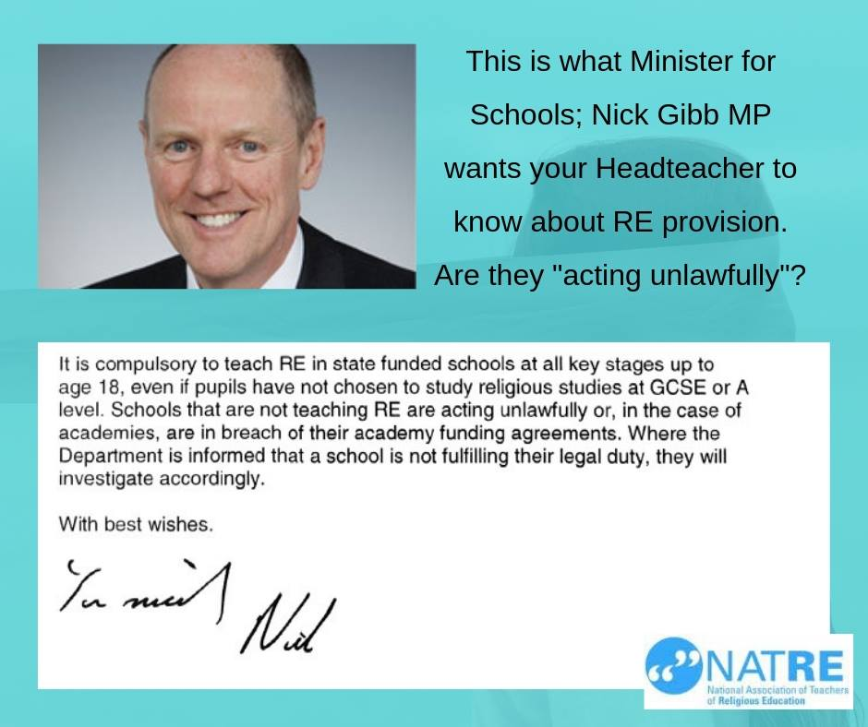

Slide 15
Programme for the day
8.45 - 9.15 | Arrival and Refreshments | Michael Tippett Centre
9.15- 9.20 | Welcome: Dr Rebecca Schaaf
9.20- 9.30 | Introduction: Ed Pawson and Katy Staples
9.30 - 10.15 | Keynote 1 - Dr Helen John: Worldviews
10.15 - 10.35 | Refreshments
10.45 - 11.30 | Workshop A | Newton Building
11.35 - 12.20 | Workshop B
12.30 - 1.30 | Lunch | Michael Tippett Centre
1.35 – 2.30 | Afternoon Reflection: Ajahn Jutindharo and Katherine Taylor.
2.40 - 3.25 | Keynote 2 (primary focus) - Juliet Lyal: Will the new Ofsted framework fence us in? | Newton Building
2.40 - 3.25 | Keynote 2 (secondary focus) - Dr Chris Hewer: Exploring diverse traditions in Islam
3.25 - 3.30 | Thanks and evaluations

