Slide 1
The new Ofsted Framework through a primary RE lens– don’t fence us in!
LTLRE West of England Conference
28th June 2019
Delivered by Juliet Lyal
NATRE Exec and Local Groups officer,
CoRE Commissioner

Slide 2
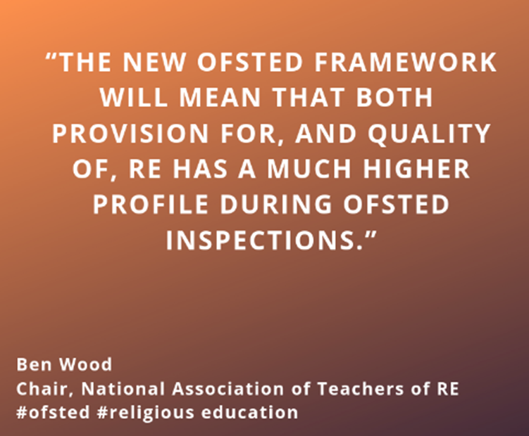
Ofsted’s new education inspection framework was published on May 14th 2019 along with the School inspection handbook
Notes:
Press release May 2019 www.natre.org.uk

Slide 3

Paragraph 172, School inspection handbook (SIH)
ALL pupils
ALL key stages
ALL schools
Notes:
1. Paragraph 172 (page 42) of the Handbook and footnote 68 about academies

Slide 4
What does the school inspection handbook say that’s particularly relevant to RE?
Before making a final judgement on overall effectiveness, inspectors will always consider the spiritual, moral, social and cultural development of pupils at the school, ... paragraph 166, School Inspection Handbook (SIH)
All pupils in maintained schools are expected to study the basic curriculum, which includes national curriculum, religious education and age-appropriate relationship and sex education. Academies are expected to offer all pupils a broad curriculum that should be similar in breadth and ambition
paragraph 172 (SIH)
Academies must include English, mathematics, science and religious education in their curriculum.
Footnote 68 (SIH)
In evaluating the implementation of the curriculum, inspectors will primarily evaluate how the curriculum is taught at subject and classroom level. Research and inspection evidence suggest that the most important factors in how, and how effectively, the curriculum is taught and assessed are that: Teachers have expert knowledge of the subjects that they teach. If they do not, they are supported to address gaps in their knowledge so that pupils are not disadvantaged by ineffective teaching paragraph 180, 181, (SIH)
NB Not just ‘knowledge’ but ‘expert knowledge’
Notes:
‘Teachers have expert knowledge’ – not just ‘knowledge’ but ‘expert knowledge’

Slide 5
What else?
Provision for the spiritual development of pupils includes developing their:
- ability to be reflective about their own beliefs (religious or otherwise) and perspective on life
knowledge of, and respect for, different people’s faiths, feelings and values paragraph 216 (SIH)
Provision for the cultural development of pupils includes developing their:
- ability to recognise, and value, the things we share in common across cultural, religious, ethnic and socio-economic communities
interest in exploring, improving understanding of and showing respect for different faiths and cultural diversity and the extent to which they understand, accept, respect and celebrate diversity. This is shown by their respect and attitudes towards different religious, ethnic and socio-economic groups in the local, national and global communities. Paragraph 219 (SIH)

Slide 6
Personal Development
Sources of evidence specific to personal development Inspectors will use a range of evidence to evaluate personal development, including:
how curriculum subjects such as citizenship, RE, and other areas such as personal, social, health and economic education, and relationship and sex education, contribute to pupils’ personal development
paragraph 222 (SIH)

Slide 7


Have a drink and a stretch

Slide 8
The Education Inspection Framework
Key judgements:
quality of education
behaviour and attitudes
personal development
leadership and management

Slide 9
Quality of Education
At the heart of the EIF is the new ‘quality of education’ judgement, the purpose of which is to put a single conversation about education at the centre of inspection.
This conversation draws together curriculum, teaching, assessment and standards. In doing this, we draw heavily on the working definition of the curriculum that Ofsted has used over the last couple of years. This definition uses the concepts of ‘intent’, ‘implementation’ and ‘impact’ to recognise that the curriculum passes through different states: it is conceived, taught and experienced.
Leaders and teachers design, structure and sequence a curriculum, which is then implemented through classroom teaching. The end result of a good, well-taught curriculum is that pupils know more and are able to do more. The positive results of pupils’ learning can then be seen in the standards they achieve.
The EIF starts from the understanding that all of these steps are connected.
Paragraph 5 (Inspecting the curriculum, May 2019)
Notes:
Inspecting the curriculum, published May 2019

Slide 10

Table Talk
How you draw together the ‘curriculum, teaching, assessment and standards’ of RE in your school?
How is your RE curriculum ‘conceived, taught and experienced’?
How do you know that your pupils ‘know more and are able to do more’ in RE?

Slide 11




The 3 I’s
Intent
conceived
Implementation
taught
Impact
experienced
What is Ofsted is looking at?

Slide 12

Intent - curriculum leadership: school, subject, curriculum leaders
The school’s curriculum is rooted in the solid consensus of the school’s leaders about the knowledge and skills that pupils need in order to take advantage of opportunities, responsibilities and experiences of later life. In this way, it can powerfully address social disadvantage.
It is clear what end points the curriculum is building towards and what pupils need to know and be able to do to reach those end points.
The school’s curriculum is planned and sequenced so that new knowledge and skills build on what has been taught before and towards its clearly defined end points.
The curriculum reflects the school’s local context by addressing typical gaps in pupils’ knowledge and skills.
The curriculum remains as broad as possible for as long as possible.
There is high academic/vocational/technical ambition for all pupils, and the school does not offer disadvantaged pupils or pupils with SEND a reduced curriculum. Paragraph 170 (SIH)
Notes:
Judgement focuses on factors that both research and inspection evidence indicate contribute most strongly to an effective education where pupils achieve highly. These are the key factors

Slide 13

Curriculum Flexibility
Flexibility within this structure:
All pupils in maintained schools are expected to study the basic curriculum, which includes national curriculum, religious education and age-appropriate relationship and sex education. Academies are expected to offer all pupils a broad curriculum that should be similar in breadth and ambition.
paragraph 172 (SIH)
Academies must include English, mathematics, science and religious education in their curriculum
Footnote 68, para 172 (SIH)

Slide 14
What does this mean for RE?
Schools that are following a locally agreed syllabus, Understanding Christianity units or VA plans must be clear about what they are teaching and why they are teaching it. Their curriculum intent should link clearly to the locally agreed syllabus.
VA schools who set their own curriculum need to be clear about why they teach what they teach. For example is the teaching of the other world religions reflective of the communities in the locality of the school?

Slide 15
How do I evidence this?
Policies – your intent for your curriculum should be clear in your RE policy.
You do not need to write a 13 page document detailing each step of your RE curriculum.
Your whole staff should be able to talk about your curriculum and why you teach what you teach.
Within each of your units use cover sheets to show the intent for learning.
Are you able to talk knowledgeably about the end points in your RE curriculum and where you are trying to get your pupils to?

Slide 16
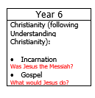
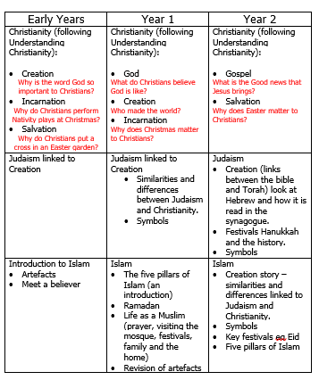
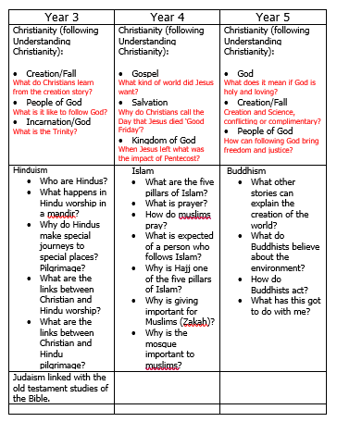
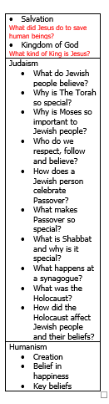
Curriculum Overviews
Curriculum overview provided by Katie Freeman
Notes:
Breadth and ambition! (para 177)

Slide 17


Table Talk
What is your RE curriculum intent?
Does your RE policy reflect your curriculum intent?
Is the intent clear?
Have you explained what your curriculum is and who learns what and when?
Have you noted what your end point will be?
Back at school….go through your policy, edit and make notes about what you will change and why.
Are your staff able to talk about what the RE curriculum intent is?

Slide 18

Implementation
In evaluating the implementation of the curriculum, Ofsted inspectors will primarily look at how, and how effectively your subject is taught in the classroom. Paragraph 180 and 181 (SIH)
As an RE lead, you need to know exactly what is going on in the RE classroom and that the planning that you are receiving matches what is being taught.

Slide 19

What will an inspector look for?
Teachers have expert knowledge of the subjects that they teach. If they do not, they are supported to address gaps in their knowledge so that pupils are not disadvantaged by ineffective teaching.
Teachers enable pupils to understand key concepts, presenting information clearly and encourage appropriate discussion.
Teachers check pupils’ understanding effectively, and identify and correct misunderstandings.
Teachers ensure that pupils embed key concepts in their long-term memory and apply them fluently. Paragraph 181 (SIH)
Notes:
Expert knowledge! That’s a challenge! Where do teachers gain this? LTLRE!!! NATRE, REonline Culham St Gabriel’s https://www.teachre.co.uk

Slide 20

What else?
The subject curriculum is designed and delivered in a way that allows pupils to transfer key knowledge to long-term memory. It is sequenced so that new knowledge and skills build on what has been taught before and pupils can work towards clearly defined end points.
Teachers use assessment to check pupils’ understanding in order to inform teaching, and to help pupils embed and use knowledge fluently and develop their understanding, and not simply memorise disconnected facts.
paragraph 181 (SIH)

Slide 21
What does this mean for RE in our schools?
High level of subject knowledge is important for all teachers who are teaching the subject.
If their subject knowledge is not of a high level then what are we doing about it?
Materials such as the Understanding Christianity resources help to support subject knowledge, but are we challenging the most able? How do we know?
Is the depth of challenge evident in our children’s books?
Does CPD and action planning reflect our support for staff subject knowledge development?
Notes:
Money!

Slide 22

Assessment
Assessment will also be a key feature of this part of the inspection.
Inspectors will want to see that assessment data is used to inform teaching and learning.
Inspectors will therefore evaluate how assessment is used in the school to support the teaching of the curriculum ….. Paragraph 184 (SIH)

Slide 23

How do you monitor your pupils’ progress in RE?
In your school, how do you:
ensure support for children working below the expected standard in RE?
support the children to meet the expected standard?
challenge pupils who are working above the expected standard?
use data to support children’s next steps?
ensure that RE features in pupil progress meetings?
support the vulnerable and disadvantaged pupils, including those with SEND?

Slide 24

What activities will provide inspectors with evidence about the school’s implementation of its intended curriculum?
discussions with curriculum and subject leaders and teachers about the programme of study that classes are following for particular subjects or topics, the intended end points towards which those pupils are working, and their view of how those pupils are progressing through the curriculum
discussions with subject specialists and leaders about the content and pedagogical content knowledge of teachers, and what is done to support them
paragraph 187 (SIH)

Slide 25

What activities will provide inspectors with evidence about the school’s implementation of its intended curriculum?
discussions with classroom teachers about how often they are expected to record, upload and review data
observations of and interviews with pupils or classes who are following this curriculum in lessons, including scrutinising the pupils’ work
reviews of schemes of work or other long-term planning (in whatever form subject leaders normally use them), usually in discussion with curriculum leaders
paragraph 187 (SIH)

Slide 26

Pedagogy in RE
https://www.reonline.org.uk/knowing/how-re/

Slide 27

Editing Action Plans
Back in school…
Look through your action plans for RE and ensure that subject knowledge development is an action.
You might like to think about particular concepts or religions in which you want to develop your staff’s understanding.
Your school might also focus on challenge and how to support your Greater Depth pupils.

Slide 28

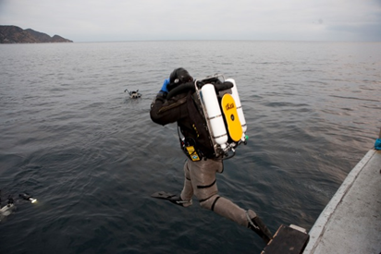
Impact
This part of the inspection framework sees inspectors looking for the impact of your intent and implementation on the pupils.
They will look at depth of knowledge and understanding in all subjects and discuss progress of all pupils.
Do pupils know more, remember more and can they do more?
This is where the phrase ‘deep dive’ is being used
That’s the inspector….not you!

Slide 29

Carrying out deep dives
In primary schools, inspectors will always carry out a deep dive in reading and deep dives in one or more foundation subjects, always including a foundation subject that is being taught in the school during the time that inspectors are on-site. In addition, inspectors will often carry out a deep dive in mathematics. The total number of deep dives will vary depending on the size (tariff) of the inspection. In small schools (with less than 150 pupils), the methodology will be adapted to reflect the tariff of inspection.
paragraph 20 (Inspecting the curriculum, May 2019)
Notes:
We are led to believe that this to be a ‘small number’ ;
Watch the wording here! It says ‘including a fs that is being taught in school that day’ that doesn’t mean to say they won’t deep dive into fs not being taught that day!
We are led to believe that in the pilot, up to 4 subjects had the ‘deep dive’ of which 2 were fs. Also that the inspectors chose the subjects but also gave the school a choice in one or two! anecdotal.

Slide 30


Carrying out deep dives
Notes:
Interpretation of paragraph 20 ‘Inspecting the Curriculum’ May 2019

Slide 31
Schoolsweek,May, 2019
Following an initial conversation with school leaders (the ‘top-level view’), inspectors will embark on a ‘deep dive’ to “[gather] evidence on the curriculum intent, implementation and impact over a sample of subjects, topics or aspects.”
Alongside more conversations with school leaders, curriculum leaders, teachers and pupils, ‘lesson visits’ and ‘work scrutiny’ will be a key source of information for inspectors
Could this be a useful way to understand how school leaders and subject leaders plan and deliver their curricula?
Each deep dive “will typically focus on a sample of four to six subjects, looking at a wide variety of pupils in different year groups across that sample.” There is no clarity on what a ‘wide variety of pupils’ means or how they will be identified!
Notes:
Schoolsweek – we are led to believe! Until we get some reports and feedback we won’t know for sure.

Slide 32
What does this mean for RE?
Is our assessment process clear?
Does the level of our work in RE match that of English and Maths?
Do we as RE subject leaders have a good knowledge of where our children are and where they need to get to?
Are we supporting SEND pupils to achieve high standards in RE?

Slide 33

Action Plans and Policies
Do our policies clearly reflect our assessment processes?
Are we using assessment to inform planning and to target groups in RE?
Does RE feature on our school action plan?
What are our next steps?
Back at school…Consider editing your policies and action plans to reflect what you need to do next.

Slide 34
NATRE’s reflections on the implications of the new Ofsted framework on RE
14
22
Paragraph 44
Paragraph 166
Paragraph 172
Paragraph 173
177
180-181
216 & 219
222
Notes:
Handout – just on the EIF , not on ‘Inspecting the curriculum’ publication

Slide 35



Don’t let yourself be fenced in

Slide 36
This PowerPoint is shared work between
Katie Freeman, LTLRE Devon, NATRE primary Vice-chair
and Juliet Lyal, NATRE Exec, Local Groups officer, CoRE Commissioner
June 2019
kfreeman@bickleighdown.devon.sch.uk
juliet.lyal@btopenworld.com localgroups@natre.org.uk

