Slide 1
What, Why, Which Worldviews?
Dr Helen C. John
University of Exeter

Slide 2
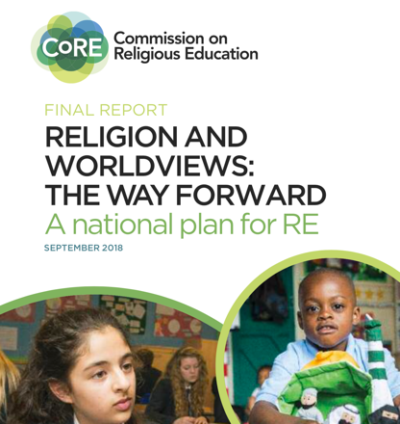
The Commission on Religious Education

Slide 3
The Commission on Religious Education
RE → RW

Slide 4
RE → RW: critiques
Religion(s)
+
Worldview(s)
_____________________
= less rigorous/diluted RE

Slide 5
The Commission on Religious Education
Principles underlying the NE suggest that students should appreciate:
the complexity of the concepts ‘religion’ and ‘worldview’;
the diversity that exists within dynamic institutional worldviews;
that personal worldviews draw on multiple sources and complex interactions;
that practice, emotion and lived experience are as significant as doctrine;
that the study of religion and worldviews is multidisciplinary.
CoRE 2018, 36-7

Slide 6
The National Entitlement
NE1: content of worldviews (religious and non-religious)
NE2: concepts ‘religion’ and ‘worldview’
NE3: diversity within and between worldviews
NE4: interaction between worldviews
NE5: rituals and practices in worldviews
NE6: questions of meaning and purpose
NE7: connections to moral and social norms (individual and societal)
NE8: powerful and influential nature of worldviews
NE9: multidisciplinary study of
CoRE 2018, 34-5

Slide 7
What does ‘worldview’ mean?
A worldview is a person’s way of understanding, experiencing and responding to the world. It can be described as a philosophy of life or an approach to life. This includes how a person understands the nature of reality and their own place in the world. A person’s worldview is likely to influence and be influenced by their beliefs, values, behaviours, experiences, identities and commitments.
CoRE 2018, 4
Notes:
So, how does that play out? Let’s look at a cross-cultural example.
Explain your approach to biblical scholarship:
Academic vs grassroots, and across cultures (UK-northern Namibia), taking an anthropological approach.
How do people in another context and from another cultural worldview interpret this text, and what can that show me about interpretations from my worldview?

Slide 8
Jesus Stills a Storm (Mk 4, NRSV)
³⁷ A great windstorm arose, and the waves beat into the boat, so that the boat was already being swamped. ³⁸ But he was in the stern, asleep on the cushion; and they woke him up and said to him, “Teacher, do you not care that we are perishing?”
³⁹ He woke up and rebuked the wind, and said to the sea, “Peace! Be still!” Then the wind ceased, and there was a dead calm.
⁴⁰ He said to them, “Why are you afraid? Have you still no faith?” ⁴¹ And they were filled with great awe and said to one another, “Who then is this, that even the wind and the sea obey him?”

Slide 9


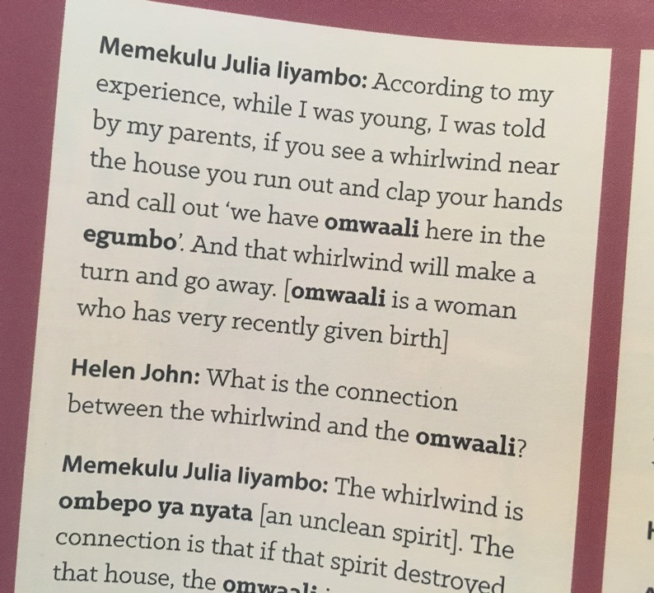



Multiple sources → worldview
Jesus Stills a Storm (Mk 4)
³⁷ A great windstorm arose, and the waves beat into the boat, so that the boat was already being swamped. ³⁸ But he was in the stern, asleep on the cushion; and they woke him up and said to him, “Teacher, do you not care that we are perishing?”
³⁹ He woke up and rebuked the wind, and said to the sea, “Peace! Be still!” Then the wind ceased, and there was a dead calm.
⁴⁰ He said to them, “Why are you afraid? Have you still no faith?” ⁴¹ And they were filled with great awe and said to one another, “Who then is this, that even the wind and the sea obey him?”

Slide 10
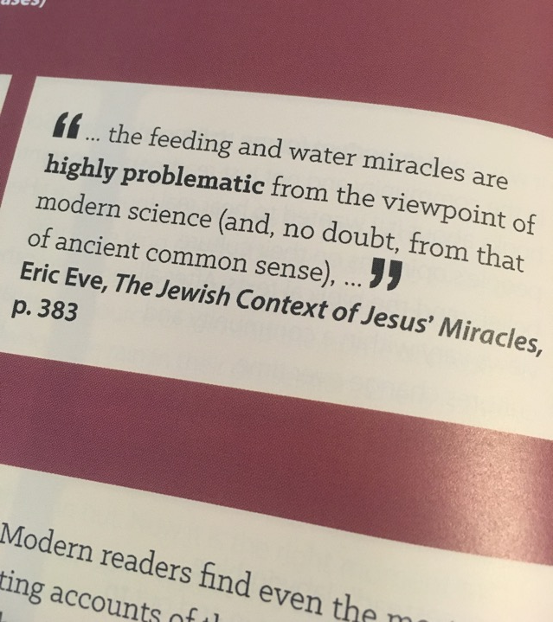
Multiple sources → worldview
Jesus Stills a Storm (Mk 4)
³⁷ A great windstorm arose, and the waves beat into the boat, so that the boat was already being swamped. ³⁸ But he was in the stern, asleep on the cushion; and they woke him up and said to him, “Teacher, do you not care that we are perishing?”
³⁹ He woke up and rebuked the wind, and said to the sea, “Peace! Be still!” Then the wind ceased, and there was a dead calm.
⁴⁰ He said to them, “Why are you afraid? Have you still no faith?” ⁴¹ And they were filled with great awe and said to one another, “Who then is this, that even the wind and the sea obey him?”

Slide 11


Institutional and Personal
Science (L)
Scientist (R)
Notes:
The worldview of a scientist is not entirely governed by the overarching scientific scheme in which she/he participates. So she/he is not ONLY a scientist! (even though ‘Science’ is presented as an unquestionable, objective explanatory theory. It is also a lens through which we, in scientific contexts, view the world). What else governs the way the look at the world?

Slide 12


Institutional and Personal
Christianity (L)
Christian (R)
Notes:
The same goes for a religious individual. They are not ONLY their religion. Otherwise, the claim would seem to be that all Christians everywhere were the same carbon copies of the institutional belief system, which of course is not the case. So, the question becomes, to what extent is the institutional worldview ‘Christianity’(L) reflected in the personal worldview of the individual ‘Christian’ (R)?
Aren’t worldviews a bit more ‘messy’ than this? Everington 2018: 7

Slide 13

What is missing?

Slide 14

Representing your worldview
Notes:
Show the chemistry molecular modelling kit

Slide 15
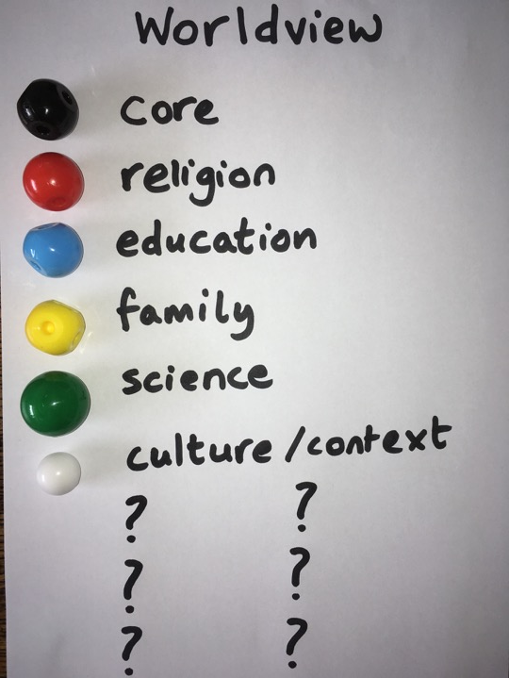

Slide 16

A ‘worldview web’?
Notes:
At a personal level, you can think of the person as a builder (or what has been called in RE research a ‘bricoleur’), someone engaged in the constant construction and modification of their worldview. Due to multiple sources of influence, the structure being build is constantly under renovation. Or, you could think of the person as an artist, who is always adding and taking away from their worldview ‘collage’.

Slide 17
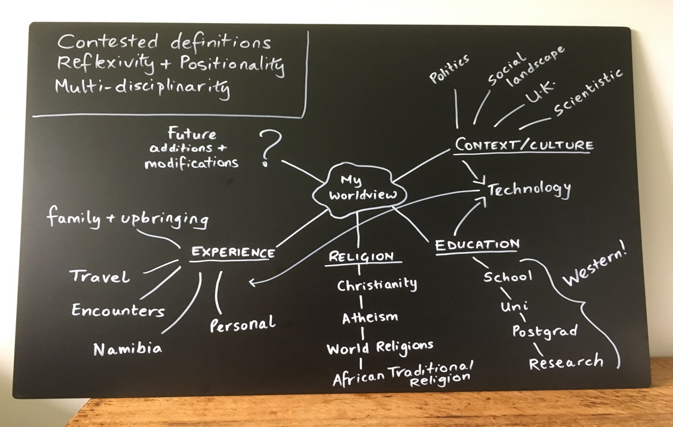






Slide 18
Key points
Imprecision TERMS, RELIGIONS, WORLDVIEWS, CONTEXTS
Positionality ‘I’ IN THINKING, KNOWING, LEARNING, TEACHING, RESEARCHING
Multi- ‘SORW’ DISCIPLINES, METHODS & APPROACHES
Notes:
These are all key ideas about METHOD, about how we go about studying in our field, and yet, they do not feature particularly prominently in our teaching. Let’s go back to the science example…

Slide 19

Big Ideas of Science Education
Big Ideas in Science (PRECISE CONTENT)
PLUS
Big Ideas about Science (METHODS)
Harlen 2010

Slide 20

Big Ideas of Religious Education
‘Big Ideas for RE’
Wintersgill, ed., 2017
MISSING
Big Ideas about SORW
Freathy & John, 2019

Slide 21
Big Ideas about SORW
1. Encountering religion(s) and worldview(s): Contested definitions and contexts
2. Encountering Oneself: Reflexivity, Reflectivity and Positionality
3. Encountering Methodologies and Methods: Discernment and Diversity
4. Encountering the ‘Real World’: Relevance and Transferability
Rob Freathy & Helen C. John (2019)
‘Religious Education, Big Ideas and the study of religion(s) and worldview(s)’
British Journal of Religious Education, 41:1, 27-40
Notes:
And what we can see, is that there is close alignment here with what the Commission recommends…

Slide 22
The Commission on Religious Education
Principles underlying the NE suggest that students should appreciate:
the complexity of the concepts ‘religion’ and ‘worldview’;
the diversity that exists within dynamic institutional worldviews;
that personal worldviews draw on multiple sources and complex interactions;
that practice, emotion and lived experience are as significant as doctrine;
that the study of religion and worldviews is multidisciplinary.
CoRE 2018, 36-7

Slide 23
In a forthcoming article…
‘In relation to a newly conceived RW, we now suggest that the “Big Ideas about the study of religion(s) and worldview(s)” could usefully be used to guide the selection of worldviews. A focus on method of enquiry alleviates pressure to pin down a fixed list of worldviews for inclusion on curricula and, rather, directs selection toward worldviews that exemplify or generate discussion of each of these Big Ideas. Worldviews become the instruments by which these Big Ideas are explored. Within this perspective, students are conceived as co-researchers, whose inquiry is as focused on ‘the study of…’ (epistemology and methodology as curriculum content) as it is on the religion(s) and worldview(s) themselves.’
Freathy & John, forthcoming, emphasis added
Notes:
So, this is what my colleague and I suggest…

Slide 24
Big Ideas about SORW
1. Encountering religion(s) and worldview(s): Contested definitions and contexts
2. Encountering Oneself: Reflexivity, Reflectivity and Positionality
3. Encountering Methodologies and Methods: Discernment and Diversity
4. Encountering the ‘Real World’: Relevance and Transferability
Rob Freathy & Helen C. John (2019)
‘Religious Education, Big Ideas and the study of religion(s) and worldview(s)’
British Journal of Religious Education, 41:1, 27-40
Notes:
So what I want to highlight, is the ways in which these points can come to the fore in the approaches that we take and the resources that we use. Much of this, I note, you are doing already, but could simply be more explicit about. In other words, share these methodological issues with your student.

Slide 25



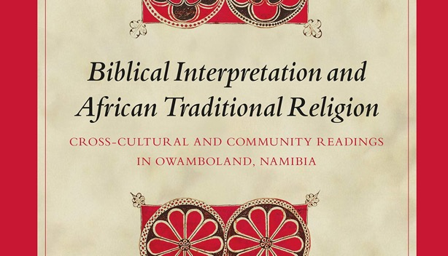
Notes:
Big Idea ABOUT 1. Encountering religion(s) and worldview(s): Contested definitions and contexts
Get the students thinking through the usefulness and problematic nature of the terms and generalisations. What does worldview mean? Who gets to define what Islam is? Do all Christians have the same views about the environment? If not, why not? How do different cultural worldviews shape different expressions of Christianity and lived experience of Christianity and/or biblical interpretation? How does your UK/European/Western scientistic context inform how you interpret miracle stories?

Slide 26

Reflection & Reflexivity
Own worldview
Teacher and Student (co-researchers)
How does your worldview affect what and how you teach?
In what ways do student worldviews affect what they want to learn about? How they prefer to learn? What knowledge they come out with at the end?
KNOWER – KNOWING – KNOWLEDGE
Notes:
2. Encountering Oneself: Reflexivity, Reflectivity and Positionality

Slide 27


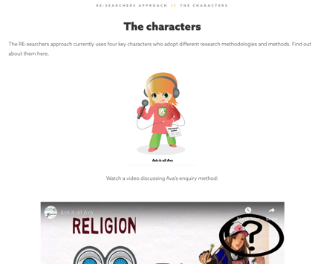


Notes:
3 Encountering Methodologies and Methods: Discernment and Diversity
At a primary level

Slide 28

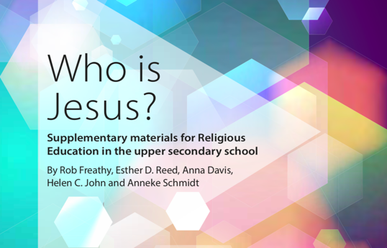
Notes:
3 Encountering Methodologies and Methods: Discernment and Diversity
At a secondary level

Slide 29
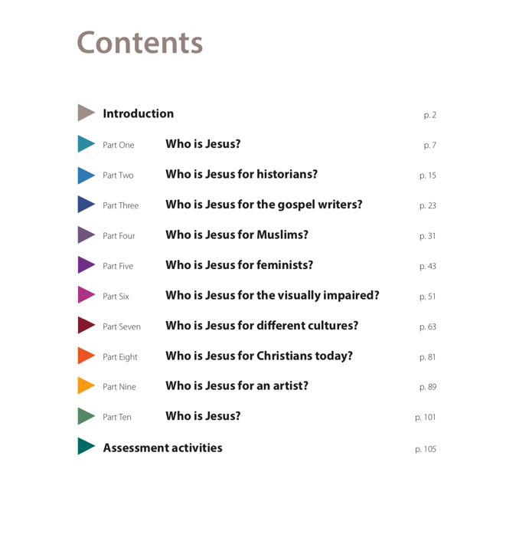
Diversity of
Perspective
+
Method

Slide 30

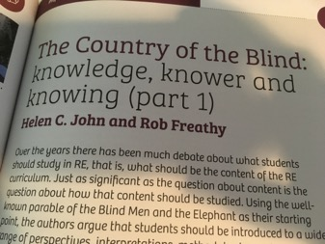
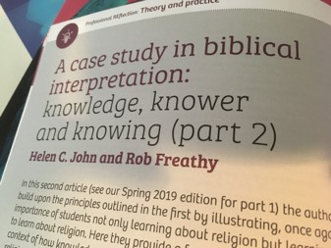
Notes:
In case you want to read more, Rob Freathy and I have written pieces in the two most recent issues of REToday on the relationship between the Knower, their Ways of Knowing, and the Knowledge they gain.

Slide 31
Big Ideas about (4)
4. Encountering the ‘Real World’: Relevance and Transferability
The study of religion(s) and worldview(s) is a vital tool in gaining knowledge and understanding of the various religions and worldviews in the world, as well as their engagement in contemporary public and private affairs. It offers many transferable skills, which are invaluable in many domains of life experience, including further education and employment.
Freathy and John (2019, 8-10)
Notes:
I would anticipate that a better understanding of the concept ‘worldview’ would only add to the sense, for religious and non-religious students, that this subject is truly relevant and transferable. So, let’s wrap and get onto any questions you may have. Before that, I’ll just summarise quickly…

Slide 32
Reflection
Critics of the suggested move from ‘RE’ to ‘RW’
  Academic rigour
  Dilution
Quite the reverse!
  Nuanced appreciation of terms
  Active inquiry through encounters with difference
  Diversity of lived experience
  Self-reflection & self-awareness
  Particularism vs generalisations
  Recognition of context
  Methods & approaches
  + + + + + + +
Richness
Rigour
Alignment with SORW

Slide 33
Q&A
H.C.John@exeter.ac.uk
Dr Helen C. John

Slide 34
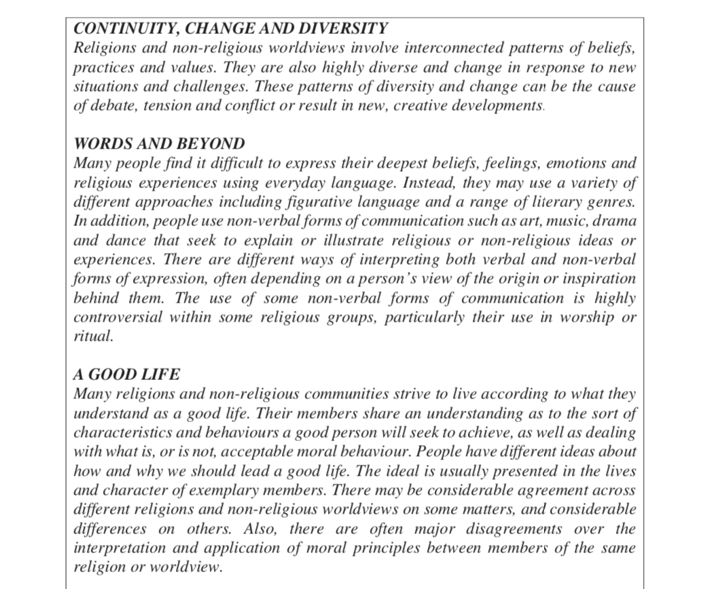

Slide 35
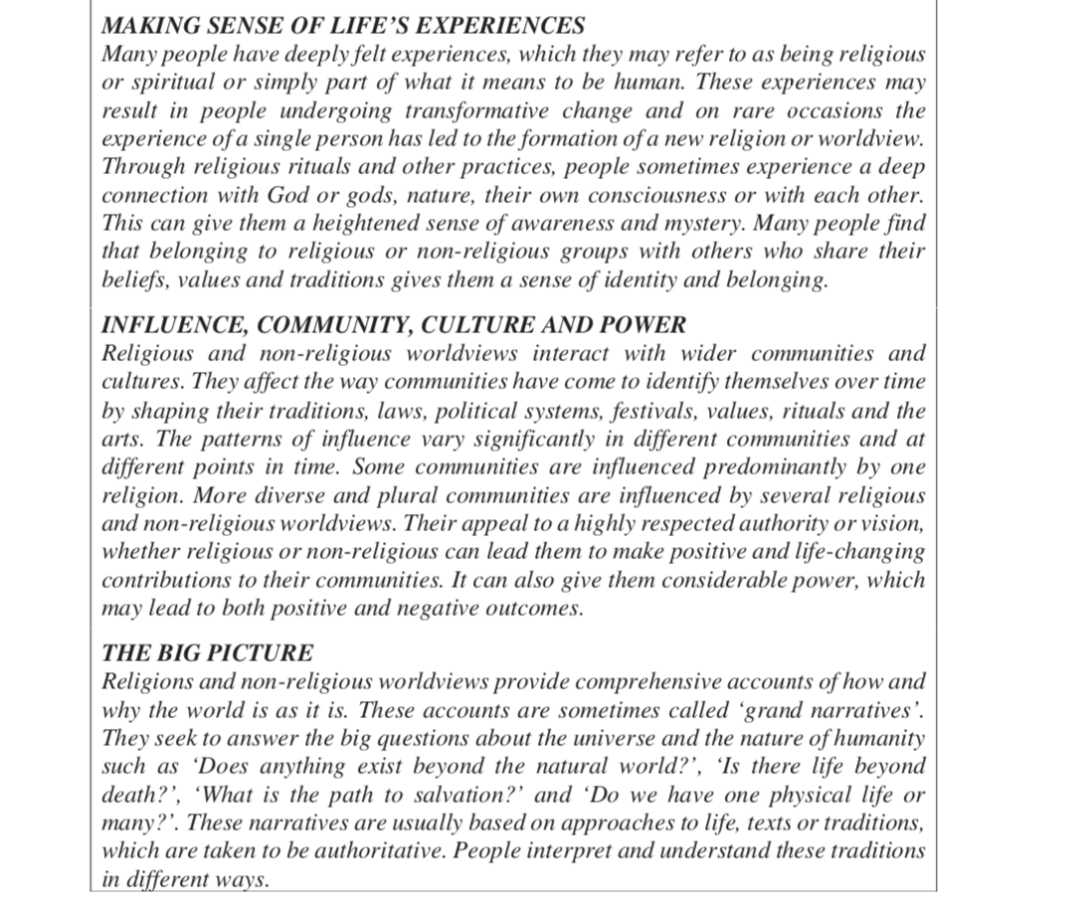

Slide 36
Big Ideas about (1)
1. Encountering religion(s) and worldview(s): Contested definitions and contexts
There is no uncontested definition of ‘religion’ or ‘worldview’, nor is there certainty about the nature of individual religions or worldviews. There is no uncontested definition of what the study of religion(s) and worldview(s) is, or what it should involve. A critical-analytical, empathetic, and inquisitive approach – alongside an awareness of dynamic contexts – is required at all times.
Freathy and John (2019, 8-10)

Slide 37
Big Ideas about (2)
2. Encountering Oneself: Reflexivity, Reflectivity and Positionality
Who we are (place, era, culture, aspects of identity, etc.) affects – and sometimes determines – what we know about religion(s) and worldview(s). Encounters with unfamiliar peoples, cultures, religions and worldviews assist us in understanding ourselves better. In turn, this equips us better to investigate and understand religion(s) and worldview(s).
Freathy and John (2019, 8-10)

Slide 38
Big Ideas about (3)
3. Encountering Methodologies and Methods: Discernment and Diversity
The study of religion(s) and worldview(s) is inherently multi-disciplinary and methodologically diverse. The disciplinary and methodological approaches taken to the study of a religious phenomenon or worldview will contribute significantly to the results.
Freathy and John (2019, 8-10)

Slide 39
Big Ideas about (4)
4. Encountering the ‘Real World’: Relevance and Transferability
The study of religion(s) and worldview(s) is a vital tool in gaining knowledge and understanding of the various religions and worldviews in the world, as well as their engagement in contemporary public and private affairs. It offers many transferable skills, which are invaluable in many domains of life experience, including further education and employment.
Freathy and John (2019, 8-10)

