Slide 1
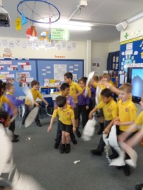
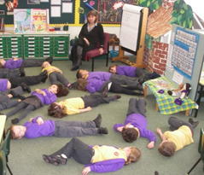
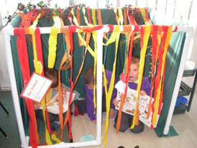
Religion and Worldviews for 4 -7yr olds: Don’t fence them in!
Learn Teach Lead RE (West of England) Conference
June 28th 2019
Don’t fence me in
Juliet Lyal

Slide 2
Aim of this session
To experience creative and cross curricular teaching ideas for RE in an Infant school
To explore what teachers might do to develop the ideas in their teaching of religion and worldviews – don’t let yourselves be fenced in
To expose what Infant pupils are capable of doing and thinking – don’t let them be fenced in
Don’t fence me in

Slide 3
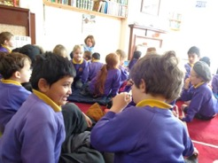
Some children in Year 2 say…
RE means Really Exciting!
Others say it’s ‘interesting’ and they ‘love learning about what other people believe and do’
Visiting our local mosque
Some say ‘what’s the point of all this?’
What do your pupils say?
What do they understand by ‘religion’?
What do they understand by ‘worldviews’?
Don’t fence me in
Notes:
TTYP
Religion and Worldviews = RW = Really Wonderful?!
Yr 1 example when teaching UC Unit on Creation: Christian, Muslim, Atheist ….

Slide 4
Religion and Worldviews
CoRE report, September 2018
11 recommendations: R2: The National Entitlement to the Study of Religion and Worldviews
Teaching ‘must reflect the complex, diverse and plural nature of worldviews. They may draw from a range of religious, philosophical, spiritual and other approaches to life including traditions within Christianity, Buddhism, Hinduism, Islam, Judaism and Sikhism, non-religious worldviews and concepts including Humanism, secularism, atheism and agnosticism…’
AGE APPROPRIATE!
Don’t fence me in
Notes:
NB ‘Draw from a range’….

Slide 5
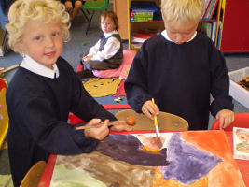
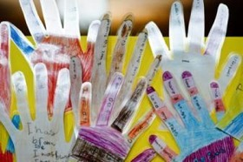
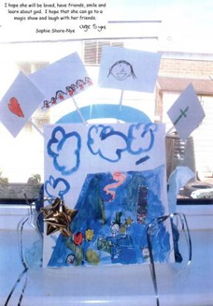
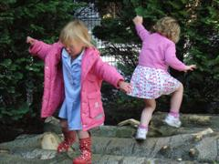
During Foundation Stage RE children:
explore
listen
talk
reflect
appreciate
wonder
enquire
sense
imagine
respond
Don’t fence me in

Slide 6
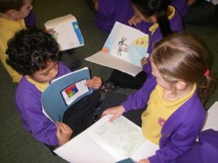
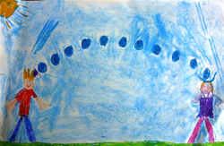
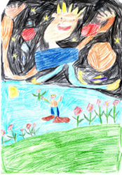
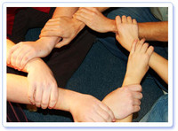
Throughout Key Stage 1 RE children:
explore
encounter
respond
express
value
question
listen
wonder
imagine
talk
reflect
recount
describe
Don’t fence me in

Slide 7
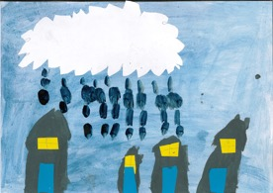
What excites our pupils about RE?
(will the ones who say ‘what’s the point?’ change their minds?)
Action stories…on the floor…with props
Role play area being a nativity scene
Visiting places of worship
Visits from our local Rabbi, Imam and Vicar
Chalky church
Looking at artefacts and making our own
Filming (stop animation) and being filmed!
Festivals
Thinking corner and being still
Cooking and making special gardens
Lego
Thinking, painting and thinking again
Asking BIG questions
"Raindrops"
Isabella (6)
God is in every cloud and inside
every raindrop. He falls from the
clouds onto people. He doesn’t
mind who he falls on.
Don’t fence me in

Slide 8
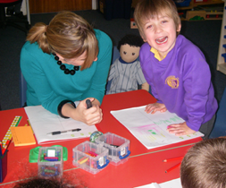
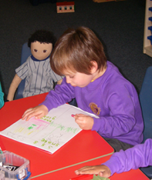
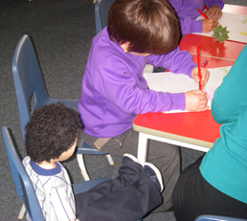
Meet my friend –
Persona Dolls
This is Zak from Reception Class.
He is working with Toby. They started this session by
talking about people who are special to them.
Toby is very fond of Zak and they have been sharing their ideas.
Don’t fence me in

Slide 9
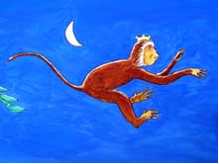
Action stories…on the floor… with props
Telling a story sitting on the floor with the children
‘Godly Play’ style can be applied to all children and to all faiths (and world views)
The Monkey King – a Buddhist faith story
Showing care and concern
Injustice
Saying sorry
Being greedy
Don’t fence me in

Slide 10
The Story of the Monkey King – who gave up his life for others
Story script from: Essex County Council, RE MATTERS FOR EVERY CHILD, Support materials for Key Stage 1
Buddhist Story – resources
Cloth for the river
Mango
Small world people
Model trees
Palm reed
Crown
Toy monkey
Laminated script, key vocabulary
As you tell the story use the props appropriately, try not to look at the children too often. If you are looking at your props, they will probably follow your eyes.
Don’t fence me in

Slide 11
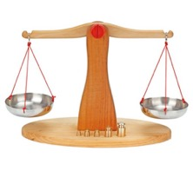
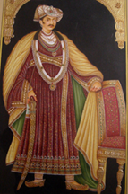
What next?
Where would you go next with this story?
Which speaking and listening, questioning, enquiring, role play or recording activity might you do to follow up on this story?
Don’t fence me in

Slide 12
Yr 1 responded to the story of the Monkey King by….
dressing up and retelling parts of the story
painting different scenes from the story
using percussion instruments to represent their feelings about different characters
talking about what they thought the ‘message’ might be
Using speech bubbles to record what they wanted to say to/ask the king
deciding whether the king was really a ‘baddie’ and what happened that changed him
sharing times when they may have made the wrong decision or were greedy for something
Don’t fence me in

Slide 13
What other stories can you think of that would illustrate this theme?
Showing care and concern for others
Injustice and greed
Sacrifice…tricky for Yr 1…’giving up something for love’
Religious and non-religious beliefs and way of life
Appreciation of the natural world
Don’t fence me in

Slide 14
On the Stage - role play the Nativity
Using your role play area as a starting point for learning about a festival and how it is celebrated - by religious and non-religious people.
Eg Christmas – Nativity story
Reception children set up a stage with their teacher, with props, labels and costumes to retell the story.
Children decide which characters and ‘crew’ should be included and write their own labels
Don’t fence me in

Slide 15
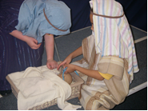
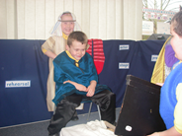
Reception Pupils on their
Nativity Stage
Don’t fence me in

Slide 16
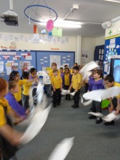
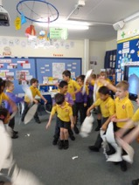
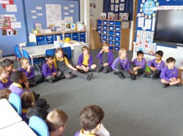
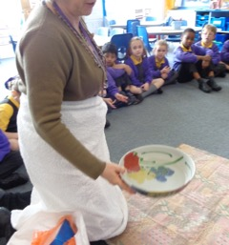
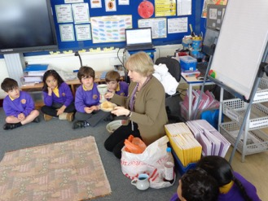
Yr 2 retelling the Easter Story
When we returned from the Easter holidays Ishak,
who is a Muslim, age 7 said “ I think God made
Jesus alive again because he was a very special
prophet and he didn’t have time to tell people
everything about God before he died and he still
had more things to tell people.”
Imagine the discussion that led us on to!
Don’t fence me in
Notes:
More photos on sheets

Slide 17
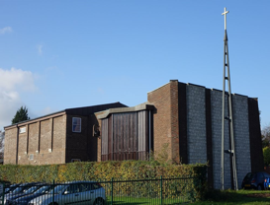
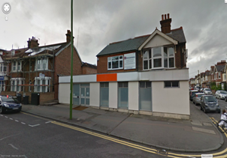
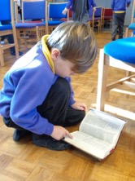
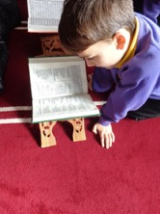
Visiting places of worship
Yr 2’s visit the Anglican church next door and the Mosque down the road
Don’t fence me in

Slide 18
Yr2 Responded by….
Making a variety of links between the two places of worship – mostly similarities, but some differences
Asking and answering questions about the church and the mosque, people who worship there, what they do when and why, who prays when and where and why - and why they are important to the Muslims and Christians in our local community
Creating lego models of aspects of the places of worship
Looking at, drawing and talking about parts of each place of worship, the objects they saw and touched, or didn’t touch.
Interviewing each other , taking different roles in the places of worship
Don’t fence me in

Slide 19
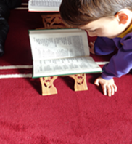
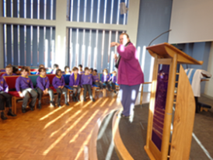
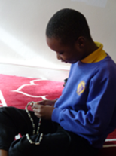
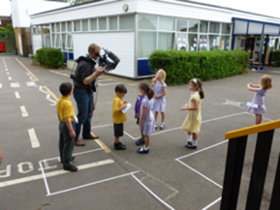
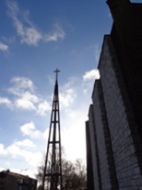
Worship spaces and chalky church…
… or chalky mosque, synagogue, mandir, gurdwara…
June 2013, Yr 1 filming for REToday

Slide 20
Visiting a place of worship
This could follow a visit to any place of worship - we chose to visit two churches near our school.
If you can’t manage a ‘real’ visit, then try a virtual one. Try ‘request.org.uk’ for starters
http://request.org.uk/life/church/church-tours
For virtual visits to many more places of worship try
http://www.reonline.org.uk/specials/places-of-worship/videos.htm
This leads you to short film clips about different places of worship – suitable for UKS2 but short clips can be selected for younger pupils

Slide 21
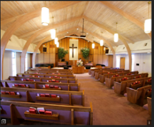
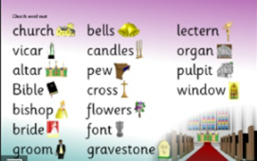
Chalky Church
Children in small groups, recall what they can remember about the church they visited – drawings or writing on sugar paper
Share with whole class and identify key areas
The children are going to design their own church on the playground!
Once built they are going to decide what they want to put inside their church e.g. font, altar, pulpit, lectern…

Slide 22
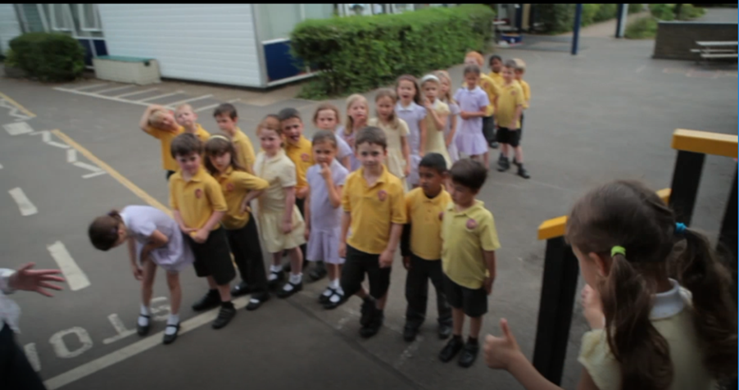
Chalky Church
Now, to build the church!

Slide 23
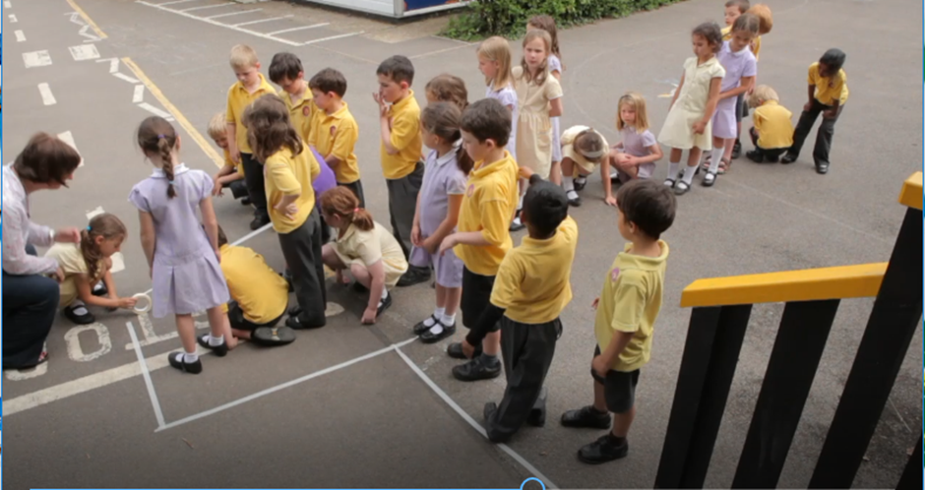

Slide 24
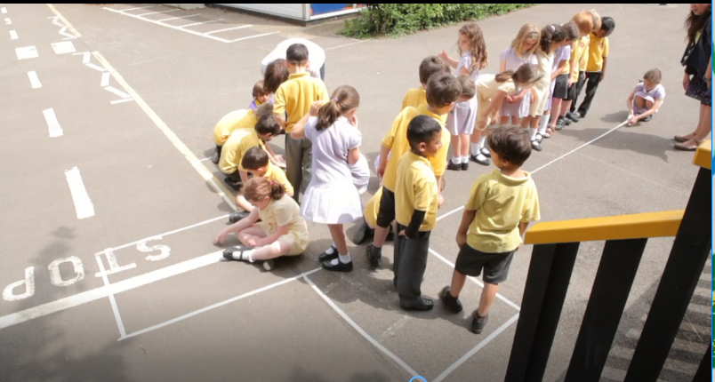

Slide 25
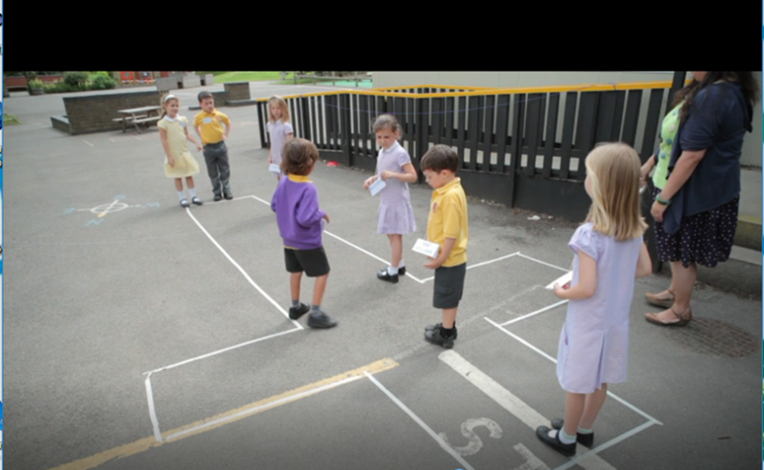

Slide 26
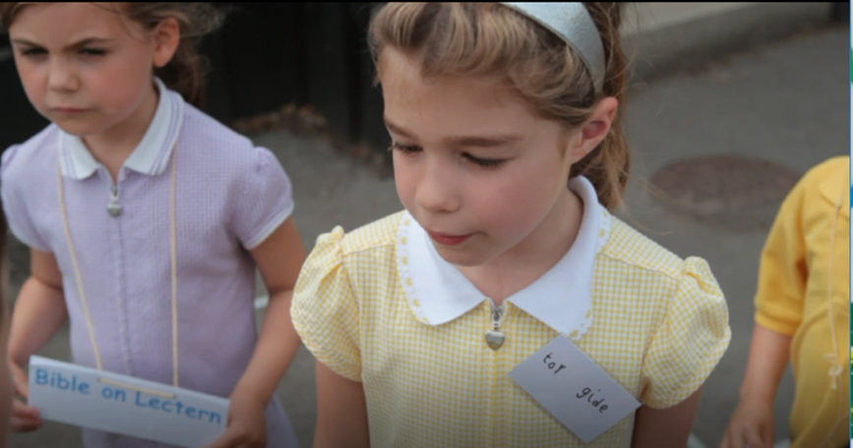
Using ‘Word’ the children have already made labels for each part of the church that they think is important for Christian worship
Notes:
And written their own badges

Slide 27
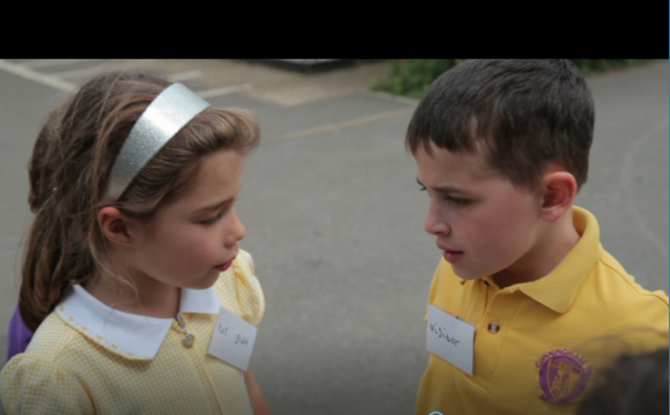
Others sub-divide into ‘visitors’ and ‘tour guides’

Slide 28
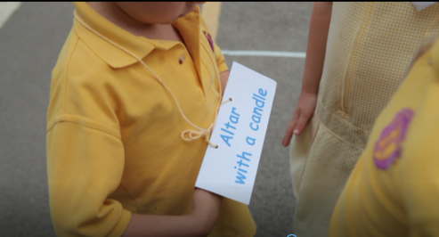
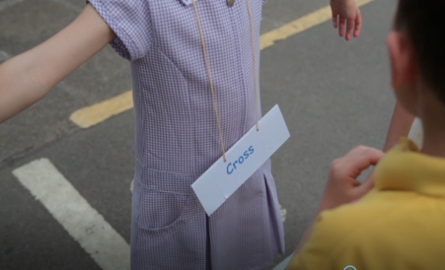
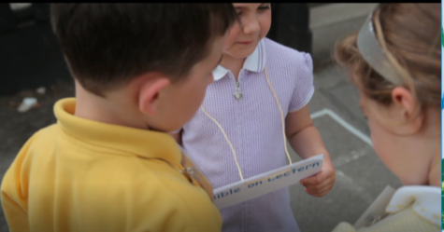
Children choose to be the different parts of the church and wear the appropriate label

Slide 29
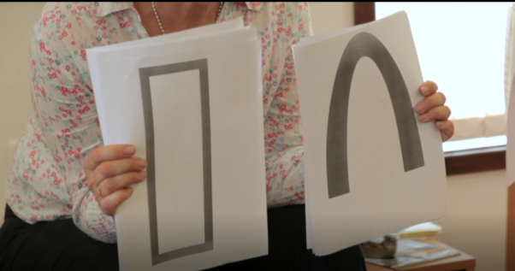
Chalky Church
In the classroom children discussed ‘If I looked in through one of the Abbey arches or a St Luke’s window on a Sunday morning I would see….’ (clip from REtoday film)
Notes:
If time show film clip 0.07.59 to the end (2 mins)

Slide 30
Chalky Church
We left our church in the playground until the rain and little feet had worn away the masking tape
We left the labels and badges out too.
Tours became a feature of our outdoor learning whilst indoors more investigations took place - ‘What’s the point of a church?’ [Lucas]
During play times the Yr 1 children took others on a tour!
Notes:
Photos to be added JL

Slide 31
Being still
For our Reception classes, the stilling was the starting point for exploring places that are important to them
We used Lat Blaylock’s Stilling script from the Diocese of St Albans units of work on Christianity
The children were
completely still for
almost fifteen minutes!
Don’t fence me in
Notes:
Even the youngest of children can be still; they need space and time
Hand out Lat’s stilling script

Slide 32
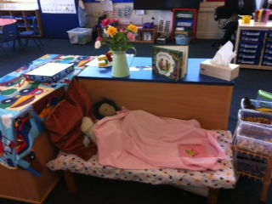
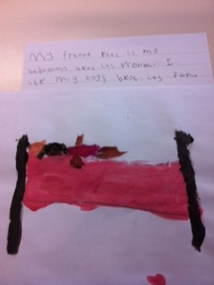
Our Reception children responded by…
Creating a place in their classroom
for their persona doll, Maisie.
Drawing her pictures
Making her feel safe, loved and appreciated
Thinking about places that are important to them – where
they like to feel peaceful – at home and at school
Don’t fence me in

Slide 33
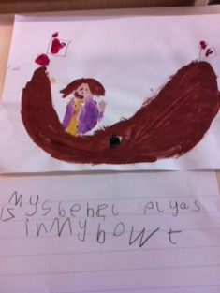

Outdoors too
What makes these places special?
Why do you like going there?
What do you like doing there? Why?
All this builds up experiences which will help young children to make the links needed to understand why and how places of worship are special and important for people of faith
Don’t fence me in
Notes:
‘special’ places, not referred to so much now, but…..for young children, that is exactly what they are!

Slide 34



Exploring the cross
Have a variety of crosses to display in your class.
Place them in an area where the children can stop and look, ask questions, touch, photograph, draw, paint, design
Have an ‘I wonder…’ box ready for the children to post their questions
Have a lap top, books and images set up for any ‘finding out’ that the children want to do
Explore the Salvadorian cross in more details and children design their own.
Don’t fence me in
Notes:
The Jerusalem cross, also known as Crusaders‘ cross or the "Five-fold Cross", is a heraldic cross or Christian symbol consisting of a large crosspotent surrounded by four smaller Greek crosses, one in each quadrant.
These crosses are called El Salvador crosses but are also called Crosses of Hope when made by refugees. The images of life shown on the cross are things that give the people meaning in their everyday lives e.g sun, land, village, family, home, animals and where they find God present to them. The cross is their sign of freedom and hope. It is also a sign of their belief that the future will be better.

Slide 35
Singing and D&T –
We’re building a Sukkah!
A good cross curricular starting point to Harvest Celebrations which could be part of a whole school activity alongside learning about how Jews celebrate Sukkot
Retell the story of Sukkot and how it is celebrated.
Explore the instructions given about how the ‘shelter’ should be constructed
Children can plan their role play area, deciding what they need to include.
Song: ‘We’re Building a Sukkah’
Don’t fence me in

Slide 36


These Yr 1 children remembered the fruit to hang from their Sukkah and the open roof so that they could see the stars.
The children organised a rota for sitting in the sukkah and being ‘quiet’. They chose suitable books to read and ate their daily fruit with their milk each day. They also learnt the Sukkah song!
Don’t fence me in

Slide 37

From Golden Domes and Silver Lanterns to Muslim and Christian giving
https://www.youtube.com/watch?v=UadbtM_5600
Notes:
Sides 5 – 10 At least 3 lessons!
Explain the story and read it; have the appropriate artefacts alongside;
Have the Youtube version of the story up on the screen (silent) so everyone can see it whilst I read.
Have Class books and Talking books for teachers to look at during the break

Slide 38

Golden Domes and Silver Lanterns
Read the story
Discuss the artefacts
Choose a colour or
invite the children to.
Would you have one
colour for the whole
class? Or one per group?
Why would you choose
that colour?
Where will it lead you and
your class to?
Explore the Glossary:
unpack the meaning;
link the vocabulary to
the artefacts; ask and
answer questions
I have chosen yellow
because I want to explore
Zakat.
‘Deen’ – my ‘religion’,
my ‘way of life’.
What does it mean to
have a religion and a way of life?
There’s still
Orange!
Which colour would you
choose today?
Notes:
Read the story, discuss the artefacts (are they ALL counted as artefacts? …what do we mean by an artefact?)
Either decide for yourself which are to develop or invite the children to or class work in groups each taking a different colour….
What is the item linked to the colour? What is it used for? When? How?
I’m taking Yellow – the Zakat Box, because I want to find out more about Muslim giving

Slide 39

Yellow is the box we fill on Eid with gifts of Zakat for those in need
What is Zakat?
Check the glossary again for meaning
Who could we talk to about Zakat?
Who could tell us more abut it?
What would you like to know about Zakat?
What does ‘those in need’ mean?
Who do you know who you think is ‘in need’?
How do you and your family go about helping ‘those in need’?
What about in school?
Notes:
Ask and answer questions; give children opportunities for their own questions. What might KS1 pupils ask?
Can anyone give Zakat? What do people who are not Muslims do? Is it only Muslims who help those in need?
Unpack any misconceptions
This is an opportunity for inviting a Muslim visitor to talk to the children; or focus on Zakat when visiting a Mosque
Discuss with partner what you would do.

Slide 40

Responding to Zakat
Collecting tin task
We learnt about Muslims giving ‘zakat’ and having a Zakat box at home or at the Mosque
Your Muslim friend asks you to help choose a charity
Who would you like to help? Why?
Write the charity in the heart and your
reasons on the tin
Notes:
Share the different charities that children already know - most schools give to charities all the time!

Slide 41


Responding to Zakat
In small groups ask pupils to help Zara decide which charity to donate to.
Create a poster that can be displayed in school
REToday resources
www.retoday.org.uk

Slide 42

Making connections
Christian giving: TrueTube: ‘Charlie and Blue’ series of films
Charlie and Blue find out why Christians give to charity and why they do their best to follow Jesus by helping other people
https://www.truetube.co.uk/film/charlie-and-blue-find-out-about-jesus
What about non-religious people?
Do they give to charity?
Of course!
EXPLORE
Notes:
Show C&B film 5 mins
NATRE resources link www.natre.org.uk

Slide 43

Looking at Art and Spirited Arts
Spirited Arts can be found on: www.natre.org.uk
Use the extensive gallery of pictures by children from as young as 4 yrs old as the starting point for exploring:
Who is God? Where is God? What is Heaven?
Where is God?
God is everywhere. He’s like a huge hug.
He puts his arms around the whole world.
God is everywhere.
Mimi, age 7 (2018)
Don’t fence me in
Notes:
What If God Controlled The Weather?
Etta Saunders (5)
What if God controlled the weather? The World wouldn't suffer floods, tornados or earthquakes.
My picture shows God controlling the weather using control sticks made out of cotton buds. The gold one controls the sun, the silver controls the clouds, the blue controls the rain and the green controls the rainbow. I imagine that God wears a long T-shirt and He has a grey beard and gold sparkles to show He is special.

Slide 44


Yr 2 ‘Who is God?’
I think God is real because if he was not
alive we would be dead by now.
In my painting I draw a rainbow around
me to show that he loves me.
Daijhan, 2015
Don’t fence me in

Slide 45
Resources on your tables
Storybags – keep turning them inside out to tell a story
Story sack – A sacks full of objects to help you tell a story
Resource Centres in the West of England….
Where can teachers go to borrow resources?
Don’t fence me in

