Slide 1
Organising a multi-faith RE day
This teacher’s journey!

Slide 2
Who, what, when, where, why, how?

Slide 3
Who, what, when, where, why, how?
Start with the why--- INTENTION!
Why?

Slide 4
SMSC
SIAMS
OFSTED
PREVENT
BRITISH VALUES
Why?

Slide 5


Why?

Slide 6
What is your aim?
Making connections?
Enhancing current provision?
Changing attitude?
Raising awareness of diversity?
Why?

Slide 7
“RE should develop in pupils an aptitude for dialogue so that they can participate positively in our society, with its diverse religions and beliefs.”
P 7 Devon and Torbay Agreed Syllabus”
Why?

Slide 8
Implementation

Slide 9
5 schools in rural North Devon
Pilton Bluecoat
Brayford
Umberleigh
High Bickington
Witheridge
Opportunities to encounter, spend time with, meet, befriend people from different backgrounds.
Who?

Slide 10
Getting everyone on board
Contacting schools in MAT
Sharing the cost
Making the most of opportunities to share with colleagues.
In school environment so no opt-out!
Who?

Slide 11
Contacts
LTLRE website- list of contacts
Cultural Champions (Exeter based)
Social Media- eg Natre, RE Teacher FB pages, #rechatuk
Other contacts:
https://dorkemmyn.org.uk/
http://www.pcfcd.co.uk/
Who?

Slide 12
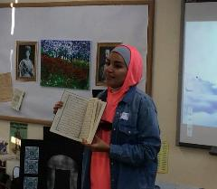
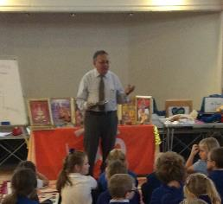
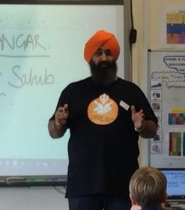
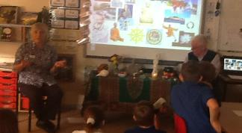
Mona
Muslim
Ravi and Jaashti
Hindu
Chaz and Sarah
Sikh
Jeremy and Jeanine
Buddhist
Who?

Slide 13
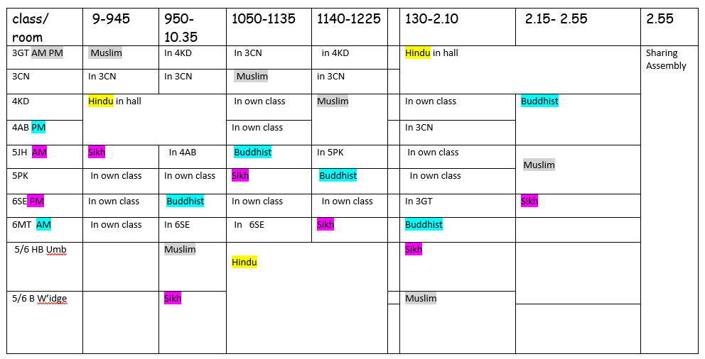
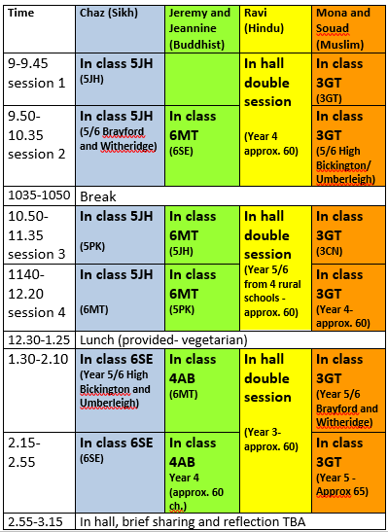
Organising the day:
What/How/where/ arrrgggh?

Slide 14
Before the day
Speaking to the visitors-
What is your intention for the day? Eg key theme,
Are they used to speaking to the age group?
Any sensitive issue they need to be aware of?
What sort of space do they need?
What sort of workshop do they offer?
How?

Slide 15
Offering lunch- ensuring that kitchen staff are able to offer appropriate food (Chose to have a vegetarian day)
Getting to the school;
How far were they travelling? Car or train?
Travel expenses
Would they need any thing- laptop, artefacts (Mona)
How?

Slide 16
On the day
Delegate the welcome- how can you get the children involved?
Ethos Ambassadors- welcoming and showing visitors to the classrooms, taking them to the lunch hall.
Encourage staff to be welcoming- they need to part of the package too!
Lunchtime: staff, children and visitors eating together where possible.
How?

Slide 17
Affording it…..
Sharing cost among schools.
Asking for small donations from families
Pupil Premium funding (Why not… often, the most vulnerable children are at a greater risk of hearing and acting on negative stereotype….)
PTFA
Not all the visitors charged.
How?

Slide 18


November 15 2018
When?

Slide 19

peace
What?

Slide 20
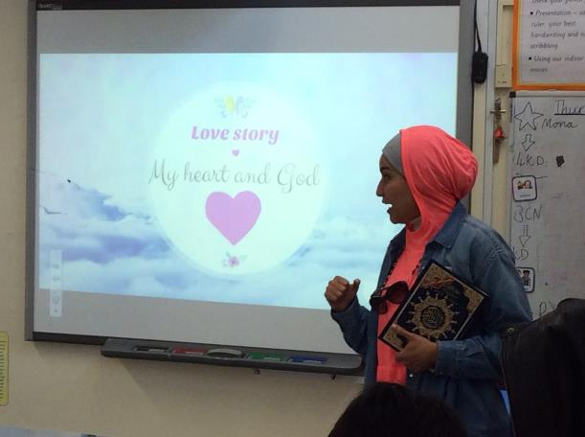
Mona- talking about her love story
What?

Slide 21
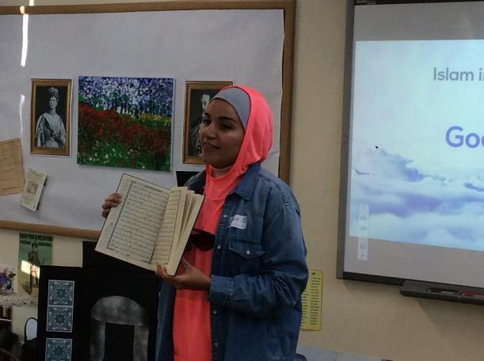
What?

Slide 22
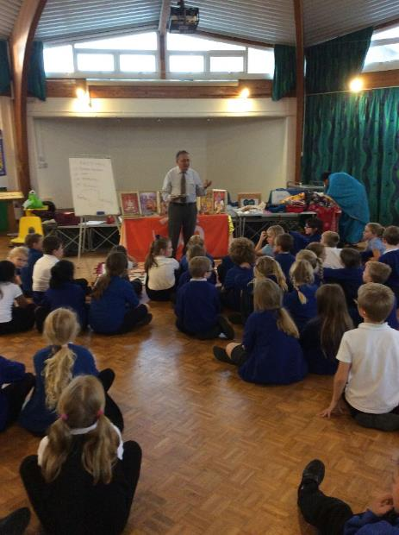
Ravi and Jaashti- Hindu faith and culture
What?

Slide 23
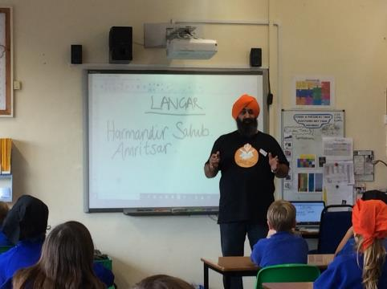
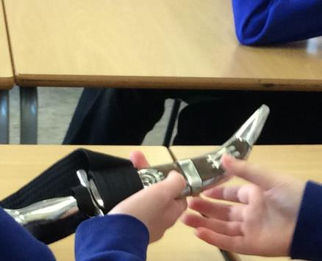
Chaz and Sarah- Life as a Sikh in the UK
What?

Slide 24
Putting it on:
I felt slightly nervous, yet happy. People said it suited me and that made me happier still.
Break:
I felt embarrassed as people questioned me and laughed. After a bit some stopped giggling meaning I felt better. It felt warm yet itchy.
After:
It feels a privilege and honour to wear a turban. I could wear this every day maybe but I may get bullied. At lunch a lot of adults and kids asked about what it was like and how it felt. I went to Pathfield Buddies and Mum saw me in the turban. My day had been amazing as we have learnt about Sikh and other religions. As I said, it has been a privilege and honour even if it was hot. Thank you (Chaz) for this unique experience.
One child wore turban all day and wrote about his experience.

Slide 25
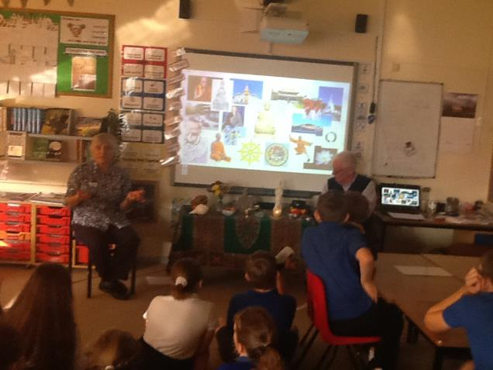
Jeremy and Jeannine- life as a Buddhist
What?

Slide 26
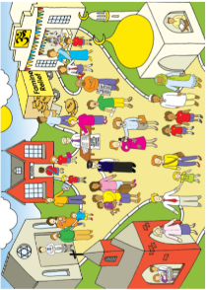
Making the most of the day
This is Yawtown.
What do you notice?
What do you recognise?
Is anything unfamiliar?
What questions do you have?
Make notes around the outside
Resources from REToday services
What?

Slide 27

Yawtown- REToday Services
The people of Yawtown would really love a place where they can all come together. Can you design a garden for the town that promotes peace and collaboration but also celebrates their diversity?

Slide 28
Researching garden
Children looked at a variety of garden designs to pick out features they could use, that might provide a tranquil setting (Giving opportunity to explore the different meanings of the word “peace”)
They also researched peace symbols and were given some scriptures from Christianity, Islam and Hinduism about peace to incorporate into their garden designs.
What?

Slide 29
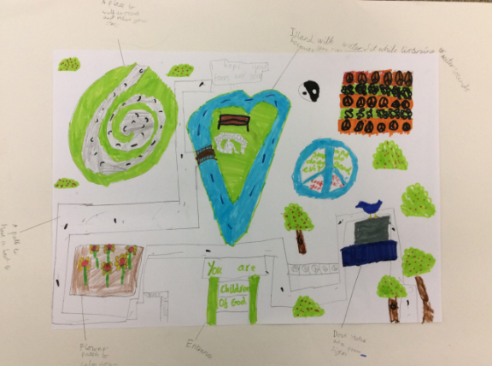
Some examples
What?

Slide 30
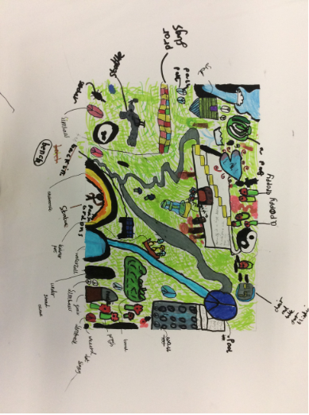
What?

Slide 31
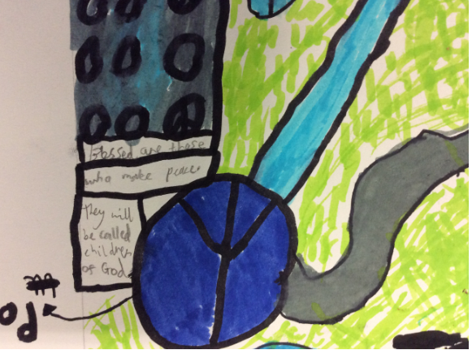
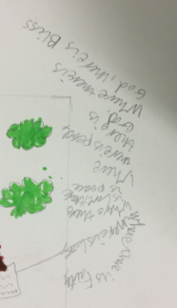
Incorporating scripture from different faith traditions

Slide 32
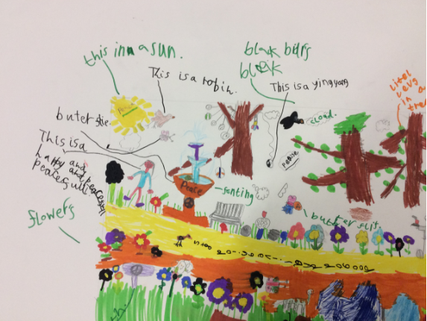
What?

Slide 33
Other LKS2 ideas
Yawtown picture- can they identify religious symbols, building, events?
Drama: situations where they might encounter racism or prejudice- what can they do to get rid of it? Take photos and add speech bubbles, or write a script. (Possibly to act out at end of day if there are any suitable)
Some can create piece of art work that would be the front cover of a book of poems about peace between people- with reference to today’s learning and thinking. (OR ALTERNATIVELY their own version of the Yawtown picture)

Slide 34
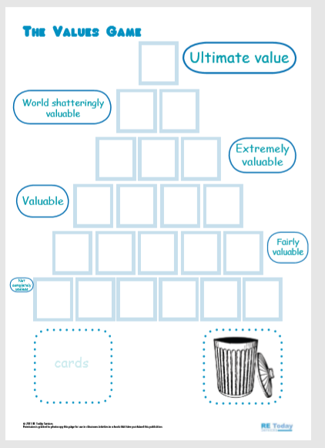
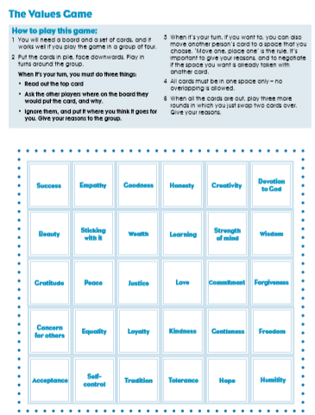
Ideas for UKS2
Main activities:
Values thinking skills game.
Design an event that celebrates the diversity of religions and worldviews found in Devon. What do they need to know? How might they incorporate people of no faith? What activities might bring people together in a spirit of peace?
Write a reflection (not prayer) to be used at the end of the day to get us thinking about peace, each other’s value
Create a piece of art work that sums up our shared humanity
Resource from REtoday Services

Slide 35
Ideas for UKS2
Design a wing of the peace museum in Bradford to raise awareness about religious discrimination and look for ways to fight it and work towards better relationships (can link to recent attacks on Synagogues in Exeter and America)

Slide 36
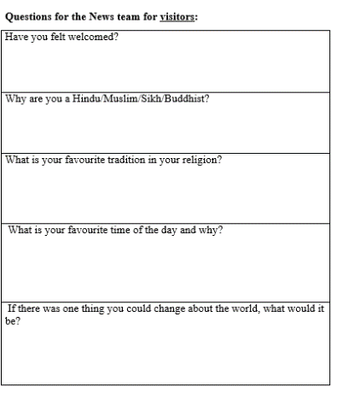
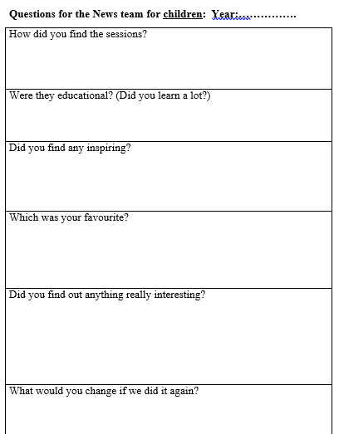
Opportunities for Gifted and Talented…
News/ filming team with adult:
Record the events of the day, interview pupils, adults and guests (when and where appropriate eg lunch time, break time)
Put together a montage of photos and footage from the day to share on website.
Write a news report for the North Devon Journal and school website (check who can’t be photographed).
What?

Slide 37
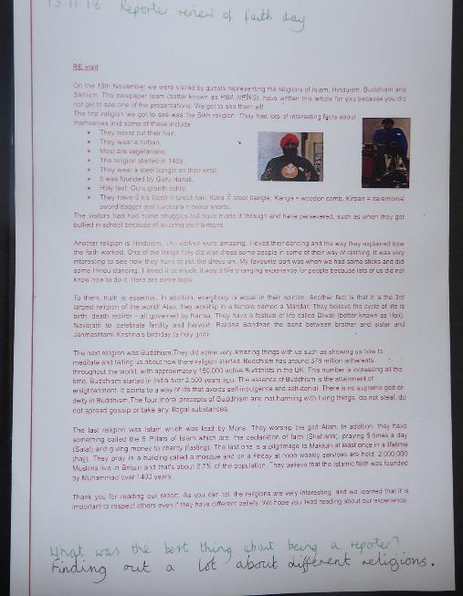

Slide 38
End of the day
Sharing drama
Sharing poetry
Sharing experience

Slide 39

I commit to peace by….
Ethos ambassadors
Visitor
Visitor
Sharing the light
Ethos ambassadors
Ethos ambassadors
Visitor

Slide 40
IMPACT
Follow up….

Slide 41
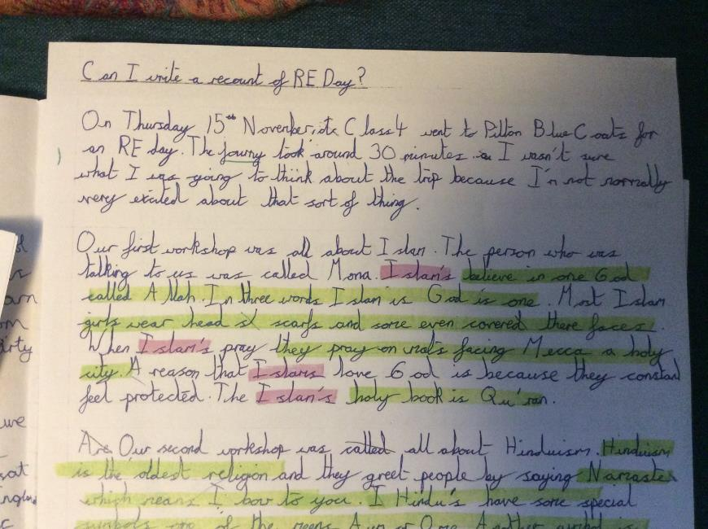

Slide 42
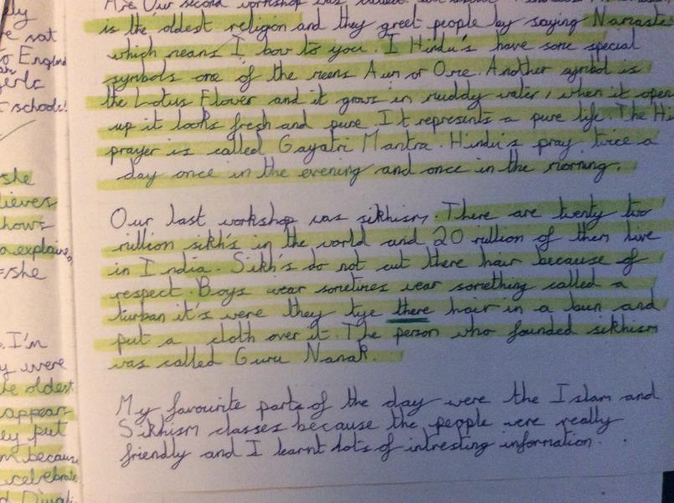

Slide 43
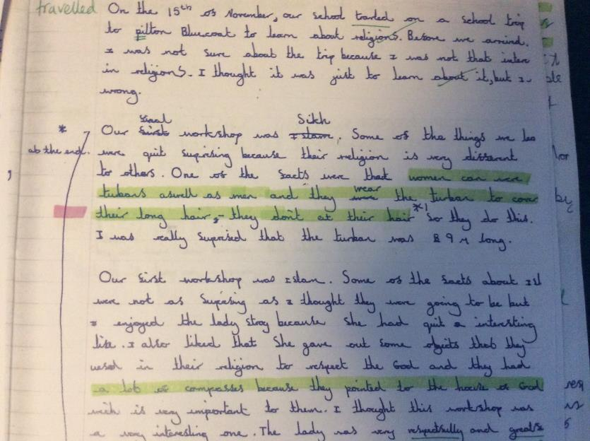

Slide 44
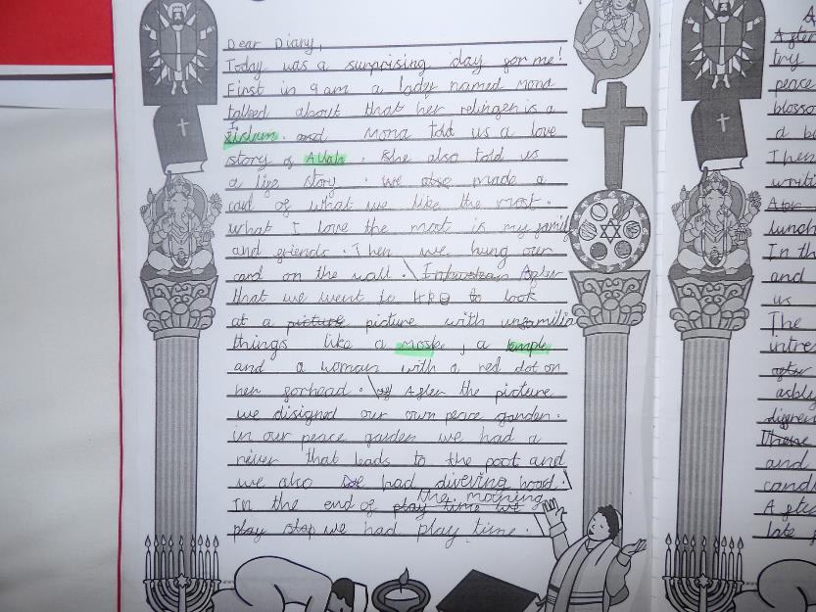

Slide 45
Impact on…
Learning
Attitudes: from “them and us” to “just like us”
Attitudes to RE- can something like this make a difference to the way RE is perceived?
Children’s engagement with ideas, cultures, people….
Lasting memories and future encounters?

Slide 46
Key lesson for Mrs Tewkesbury:
DELEGATE! Get others involved

Slide 47
Some tips from RE Today:
A few pointers in addition might include:
• Be clear about the aims of the event, linking it in particular to the requirements of your RE syllabus. This will include identifying the religions you will include in the day.
• Draw upon the faith communities local to the school – your SACRE will be an important resource and may be a potential source of funding, and parents of some of your pupils will want to help too
• Give yourself plenty of time to organise the event – choose a project leader who has some experience of organising events with large numbers of children and ensure your workshop leaders are experienced and effective in working with children.
• Identify a venue large enough to take the numbers involved and make early contact with the other schools you hope will support and attend the event
• Don’t forget to ask children and adults involved for their feedback – and make sure that you report widely on the success of the conference! Parents, SACRE, Local Authority, the press.

