Slide 1

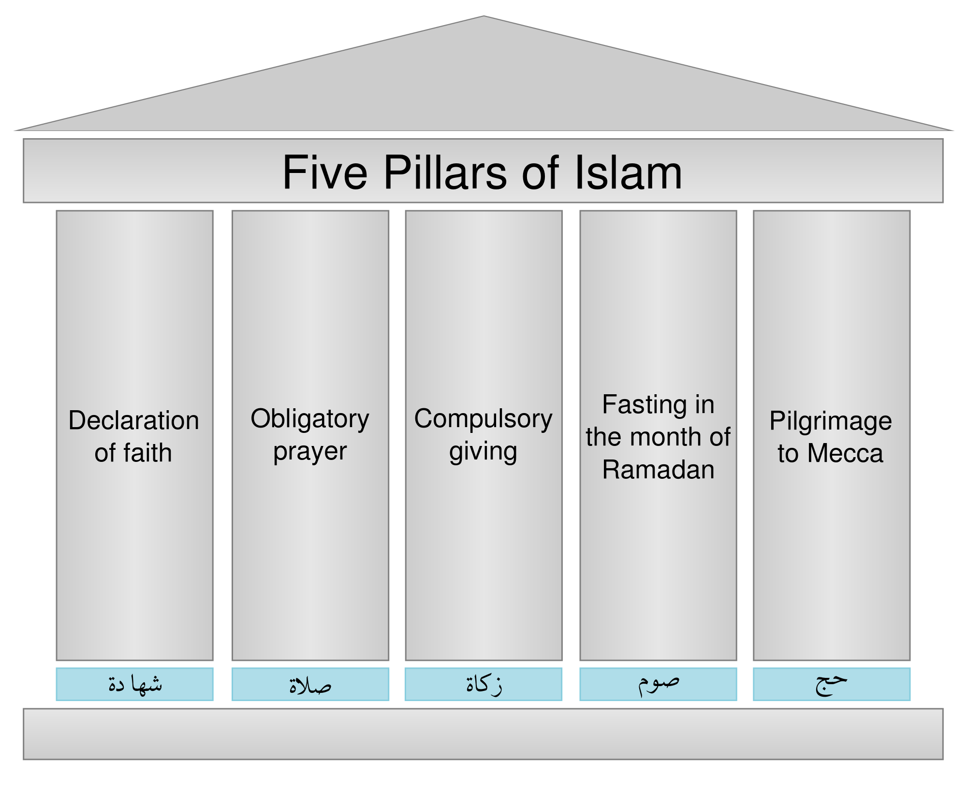
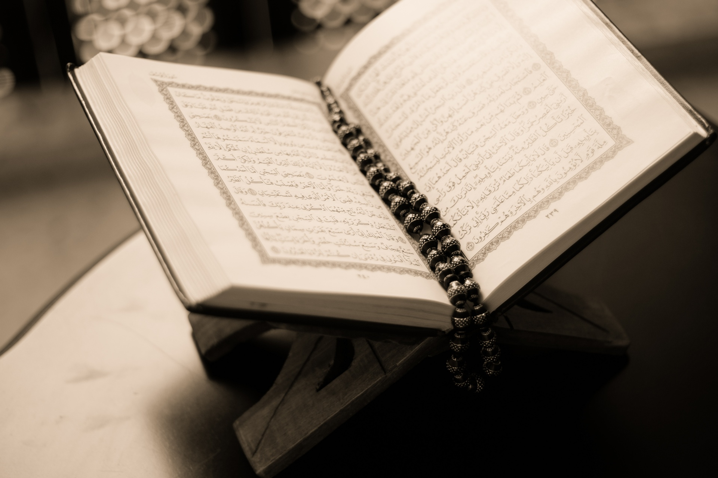

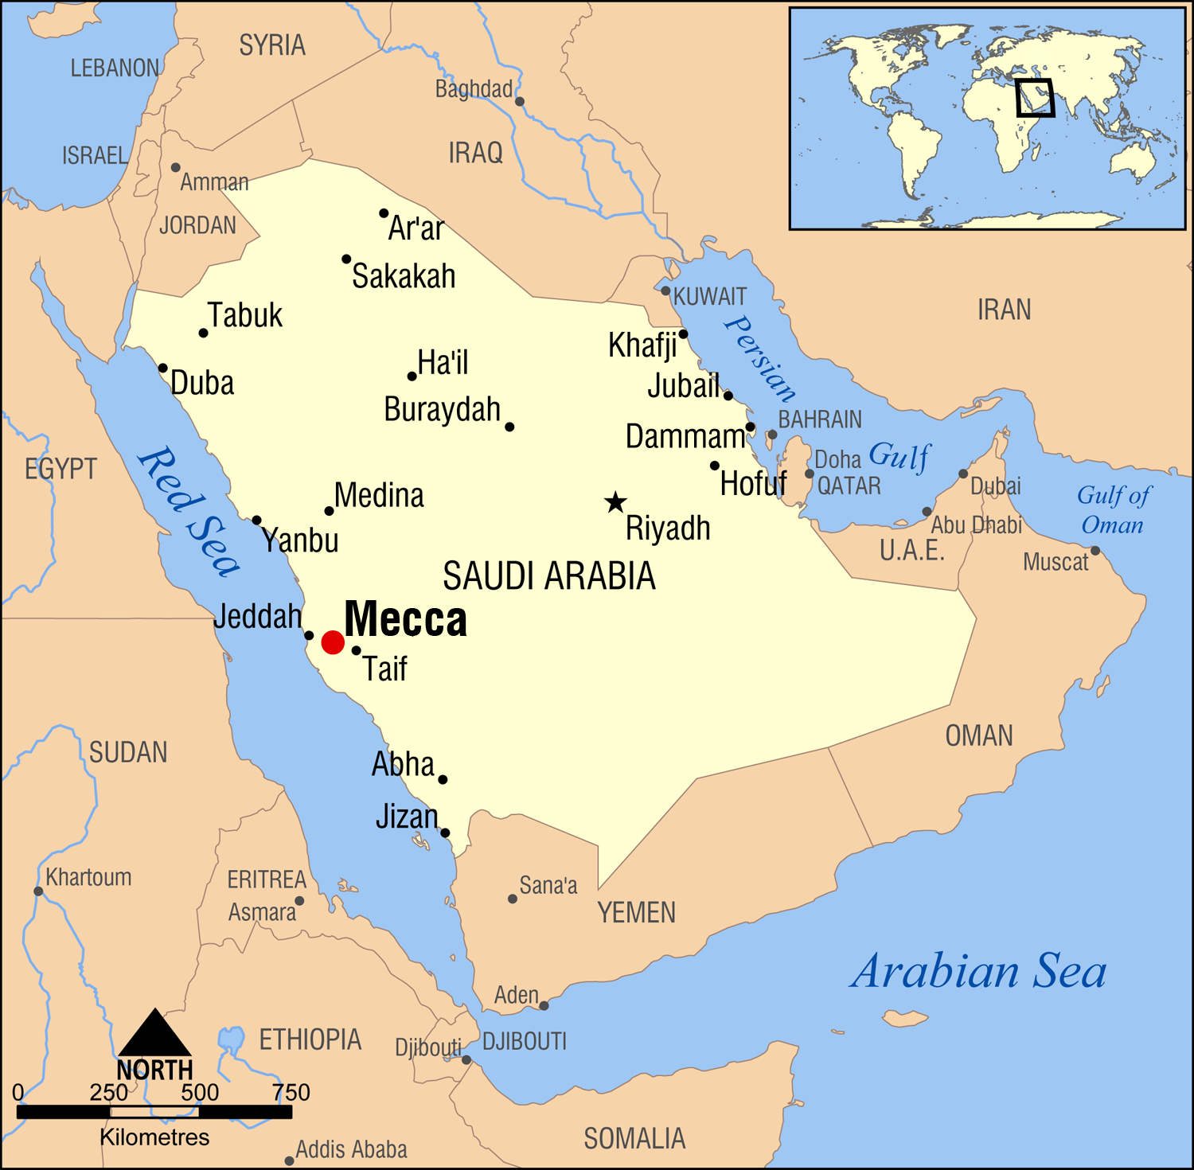
ISLAM
Key Vocabulary
Tahwid | The absolute oneness of ALLAH (God)
Ibadah | Worship and any action that is performed with the intention of obeying Allah
Iman | Faith
Mosque | Place of worship
Key Beliefs
Muslims believe there is only one God (Allah). They believe Allah is the only ruler of the universe. Islam means submission and obedience to Allah. Muslims believe that the prophet MOHAMMAD is the Messenger of ALLAH and that the qur’an is Allah’s message.
Mohammad is so highly respected by Muslims that they say ‘Peace be upon him’ (PBUH) after his name is spoken.
The Qur’an is the holy book of ISLAM. Muslims believe that the words of the qur’an are the words of Allah.
Akhlaq
Akhlaq is a term that cannot be translated by a single English equivalent. It means behaviour, morality, manners, attitudes, and the social and ethical codes by which Muslims should live. Included are aspects of family and social life and also issues for the whole of humanity.
SHAHADAH
SALAH
ZAKAT
SAWM
HAJJ
Muslims believe that Allah is too special to be drawn.

