Slide 1

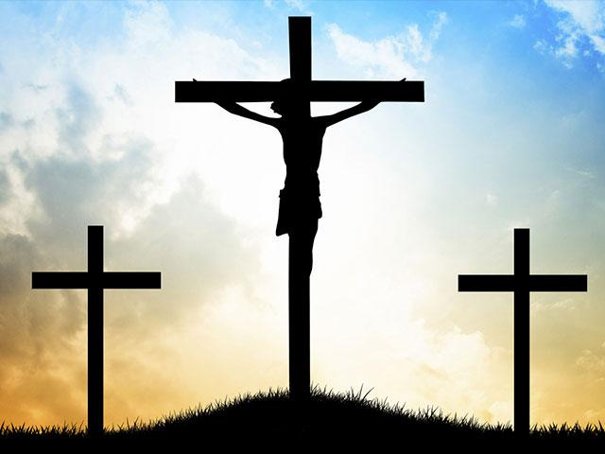

Why do some people believe in God?
Key Vocabulary
Theist | a person who believes in the existence of a god.
Agnostic | a person who believes that nothing is known or can be known of the existence or nature of God.
Atheist | a person who disbelieves or lacks belief in the existence of God.
Beliefs | an acceptance that something exists or is true, especially one without proof.
Reasons people do believe in god
- They have been brought up that way. - They have experienced God – seen him, had a prayer answered. - They have seen a miracle. - They can see evidence that God exists in the world. - They just know God exists (faith).
Religious people try to be ‘good with God’, but others think you can be ‘good without God’.
British Humanist Association: Be honest
Use your mind
Tell the truth
Do to other people what you would like them to do to you.
Evolution -
the process by which different kinds of living organism are believed to have developed from earlier forms during the history of the earth.
What do Christians believe?
Christians believe there is only one God, but that he is revealed in three different forms: •God the Father
•God the Son
•The Holy Spirit
Christians model themselves on the life and teachings of Jesus Christ. Jesus taught people to love God and love their neighbour.
Christians believe that God sent Jesus to live as a human being in order to save humanity from the consequences of its sins.
Reasons people don’t believe in god
- They can’t see any evidence. - There are scientific explanations for the world. - There are too many bad things in the world – would God make people suffer? - Prayers aren’t always answered.
In in uk 2011 census 59% of the population were christian, 25% declared no religion and 5% were muslims.

