Slide 1
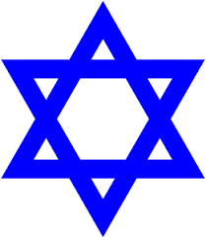
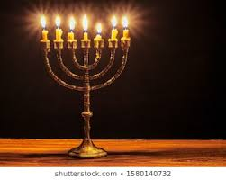
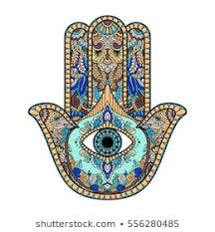
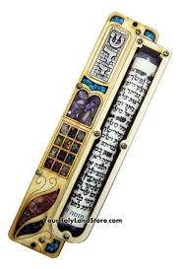
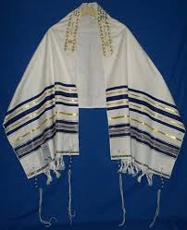
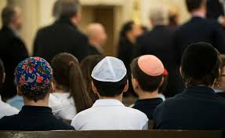
Who is Jewish and how do they live?
Key Vocabulary
Judaism/jewish | Faith
Torah | The five books of moses: the hebrew bible (which christians call the old testament)
Hanukkah | Jewish festival of lights, traditionally celebrated in November or december
purim | Jewish holiday which commemorates the saving of jewish people from haman - February
Passover (pesach in hebrew) | Jewish festival which commemorates the liberation of the Jewish people from slavery in Egypt - Spring
Rosh hashanah | Jewish new year - September
Synagogue | Place of worship
Symbols of Judaism
Key Beliefs
The most important teachings of judaism is that there is one god, who wants people to do what is just and compassionate. Judaism teaches that all life is special and belongs to God. Jews believe that God is the Creator of all life.
Star of David
Menorah
Mezuzah
Hamsa
Kippah
Tallit

