Slide 1

LTLRE Area 1
Secondary RE Inspection Toolkit
These slides have been developed collaboratively by teacher colleagues across the SW to help RE leads prepare for inspections.
We will revisit and tweak them as we learn more.
Thanks also to NATRE, Adam Roberston, Katy Staples and Laura Harris

Slide 2

Key Website Features
School’s vision statement
A description of what RE is
An overview of what your school RE curriculum looks like
RE outcomes/examples of children’s learning
RE Policy

Slide 3
Remember
You are not alone. You are part of a wider school team
If you have additional questions your local LTLRE hub leader may be able to help

Slide 4

School’s Vision Statement
Record your school’s vision statement and explain what it means and how it links to RE
Example:
Vision: Excellence for all
Our school seeks excellence in all that it does and aims to provide a broad, balanced, simulating and challenging curriculum for every child, of which RE plays a key part.
All our children will have their education enhanced by a culture that values and promotes the part played by each individual in order to prepare them for the years ahead.

Slide 5

What is RE?
Principle Aim The principal aim of religious education is to explore what people believe and what difference this makes to how they live, so that pupils can gain the knowledge, understanding and skills needed to handle questions raised by religion and belief, reflecting on their own ideas and ways of living.
(Taken from the Devon, Plymouth, Cornwall and Torbay agreed syllabus for RE)
RE Intent (in child speak) RE explores big questions about life, to find out what people believe and what difference this makes to how they live. RE helps pupils to make sense of religion and belief, reflecting on their own ideas and ways of living.
(Taken from the Devon, Plymouth, Cornwall and Torbay agreed syllabus for RE)

Slide 6

Curriculum Overview
Year Group | Autumn 1 | Autumn 2 | Spring 1 | Spring 2 | Summer 1 | Summer 2
Reception | Christianity (Creation) Why is the word God so important to Christians? | Christianity (Incarnation) Why do Christians perform Nativity plays at Christmas? | Thematic Being special: where do we belong? | Christianity (Salvation) Why do Christians put a cross on their Easter garden? | Thematic Which places are special and why? | Thematic Which stories are special and why?
Year 1 | Christianity (Creation) Who made the world? | Christianity (Incarnation) Why does Christmas matter to Christians? | Judaism Who is Jewish and how do they live? | Christianity (God) What do Christians believe God is like? | Thematic What does it mean to belong to a faith community? | Thematic How should we care for the world and why does it matter?
Year 2 | Christianity (Gospel) What is the good news that Jesus brings? | Christianity (Gospel) What is the good news that Jesus brings? | Islam Who is a Muslim and how do they live? (Part 1) | Christianity (Salvation) Why does Easter matter to Christians? | Islam Who is a Muslim and how do they live? (Part 2) | Thematic What makes some places special to believers?
Year 3 | Christianity (People of God) What is it like to follow God? | Christianity Incarnation/God What is the Trinity? | Islam How do festivals and worship show what matters to a Muslim? | Judaism How do festivals and family life show what matters to Jewish people? | Christianity (Creation/Fall) What do Christians learn from the creation story? | Thematic How and why do people try to make the world a better place?
Year 4 | Christianity (Gospel) What kind of world did Jesus want? | Christianity (Kingdom of God) When Jesus left; what was the impact of Pentecost? | Hinduism What do Hindus believe God is like? | Christianity (Salvation) Why do Christians call the day that Jesus died ‘Good Friday’? | Hinduism What does it mean to be a Hindu is Britain today? | Thematic How and why do people mark the significant events of life?
Year 5 | Christianity (God) What does it mean if God is Holy and loving? | Islam What does it mean to be a Muslim in Britain today? | Judaism Why is the Torah so important to Jewish people? | Christianity (Creation and Fall) Creation and science, conflicting or complimentary? | Christianity (People of God) How can following God bring freedom and justice? | Thematic What matters most to Humanists and Christians?
Year 6 | Christianity (Gospel) What would Jesus do? | Christianity (Incarnation) Was Jesus the Messiah? | Hinduism Why do Hindus want to be good? | Christianity (Salvation) What difference does the resurrection make to Christians? | Christianity (Kingdom of God) What kind of king is Jesus? | Thematic Why do some people believe in God and some not? How does faith help people when life gets hard?

Slide 7

RE Outcomes
Photographs of children’s work (start and end points)
Pupil voice comments about RE curriculum and learning
Information and photographs of special RE events in school.
Photographs of trips and visits to places of worship.
Photographs of visitors to RE lessons
Photographs of children learning and getting involved in debates

Slide 8
In other areas of your school website, you might like to include…
Knowledge organisers
Useful websites
Links to policies
Topic overviews
Links to other curriculum areas
Information about RE champions (children taking the lead)
Assessment processes

Slide 9

Implementation:
How is RE taught across the school, and in the classroom?

Slide 10
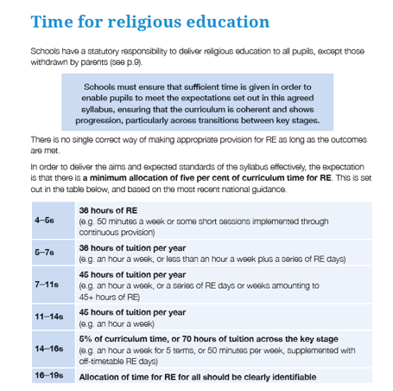
So, how much time do we need?
p. 11

Slide 11

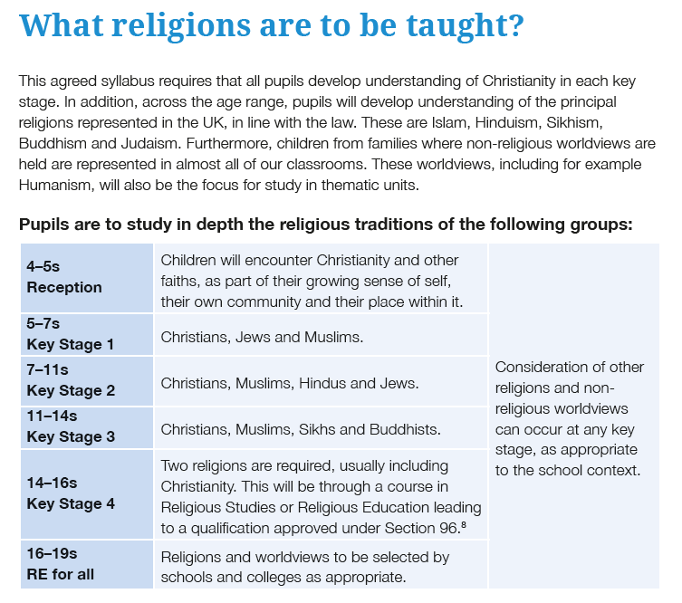
So, what should we teach?
Which religions, and when should pupils meet them?
These are guidelines – can be adapted to your setting and local community
Non-religious worldviews should really be included
CK4RE– the statutory annexe reflects Cornish element materials produced
in 2011 and 2014, and the four units presented here must be used by schools to replace the
corresponding units in the Cornwall syllabus.
p. 12

Slide 12

So, what should we teach?
What do we teach in RE?
In RE we aim to give children a grounded understanding of Christianity and religious and non-religious world views through encounters with living world views.
As the children progress through the school they will encounter different religious and non-religious worldviews. In KS1 children will encounter Christians, Jews and Muslims, as well as non-religious world views. In KS2 children will revisit these religious and non-religious world views, but will also encounter Hindus. (See our curriculum map for more details).
An important aim of RE is that children are encouraged to reflect on their learning and make their own decisions about what they believe. The aim of RE is not to make children into religious believers, but to understand that religion and world views continue to influence and sustain many people in the world today. Also, to consider the wisdom of traditions within religious and non-religious worldviews, and reflect on what they might take from these.
We provide a space for all children to express their home faith or worldview (in Church schools teaching is rooted in the Church of England).
We follow the Cornwall/Devon/Torbay/Plymouth Agreed Syllabus and use Understanding Christianity to complement this.

Slide 13
Effective RE needs a well thought through curriculum structure
Our RE curriculum is structured so that it…
Makes sense to pupils
Focusses on core concepts
Allows pupils to encounter diverse examples of religious and non-religious worldviews
Enables pupils to embed learning into their long term memory
Makes space for pupils’ own religious or non-religious worldviews
Encourages pupils’ personal development, applying their learning to living

Slide 14

This is what a typical unit looks like:
Children’s knowledge will be benchmarked
Planning will include different learning style opportunities
RE will be text rich even in EYFS
Children will be encouraged to use key vocabulary
Planning will form part of a spiral curriculum

Slide 15
An example long term plan
Building on learning about Christians from KS1.
The learning about Judaism is built on from unit 1.7 Who is Jewish and how do they live.
This builds on year 2 unit 1.6 Who is a Muslim and how do they live?.
This unit links to 1.9 How should we care for the world and for others and why does it matter?

Slide 16
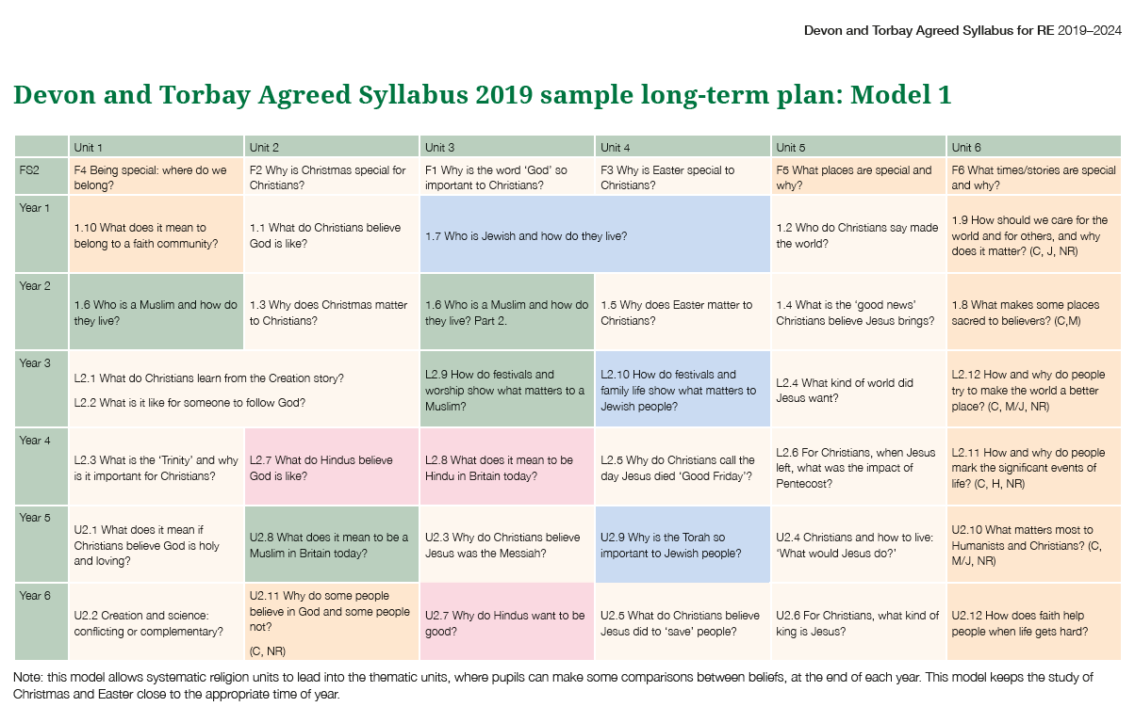

p. 147

Slide 17

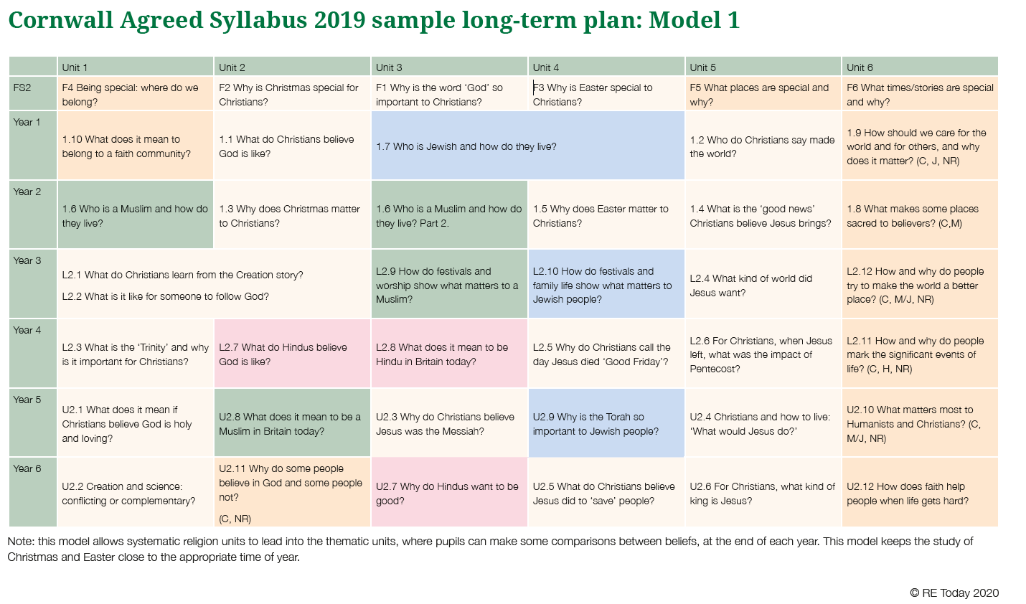
p. 147

Slide 18
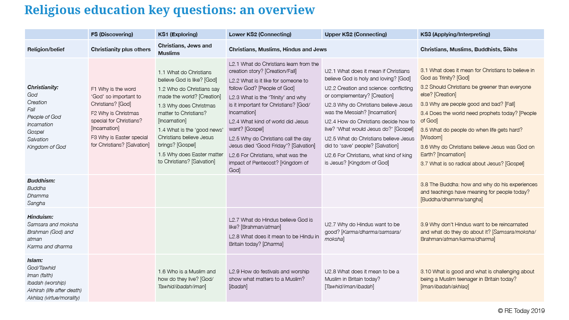

A build up of concepts and key questions
p. 16 - 17

Slide 19
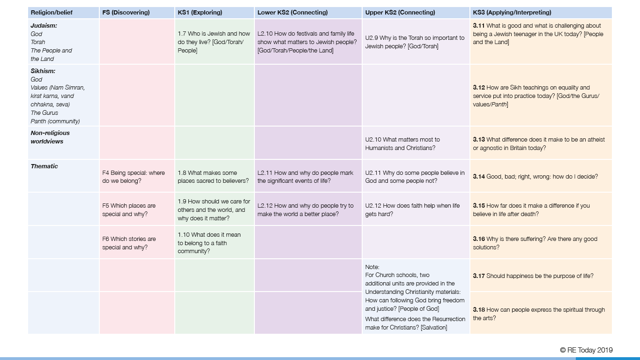

A build up of concepts and key questions continued…

Slide 20
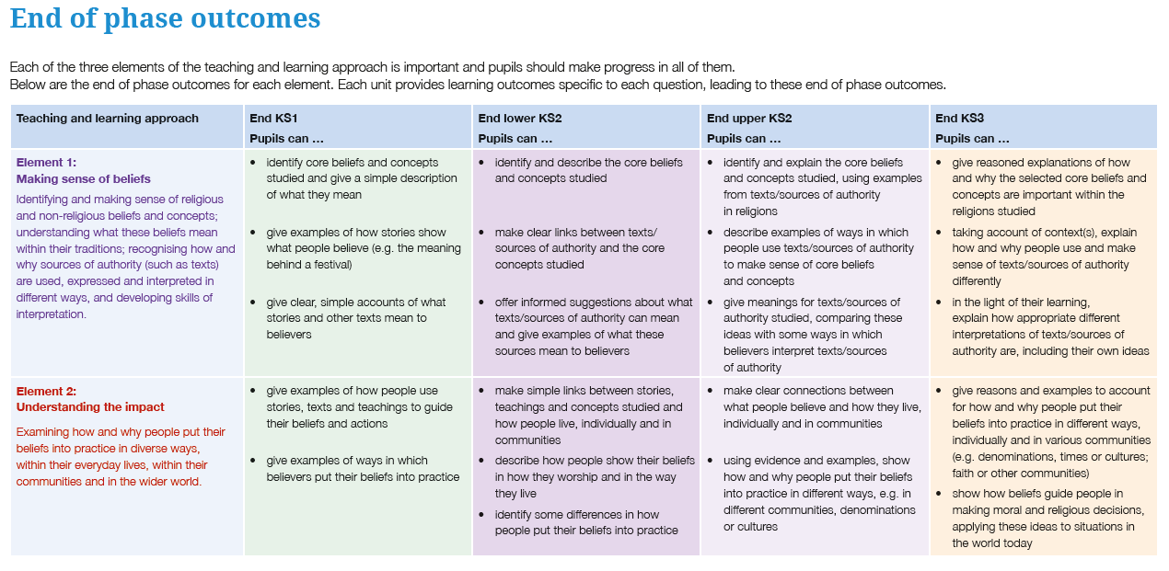
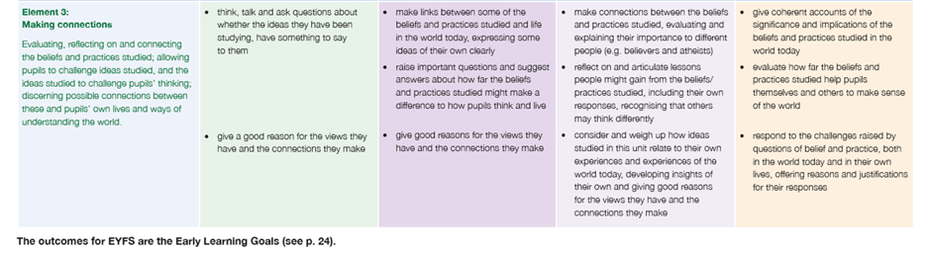

Progression in outcomes
p. 18 - 19

Slide 21

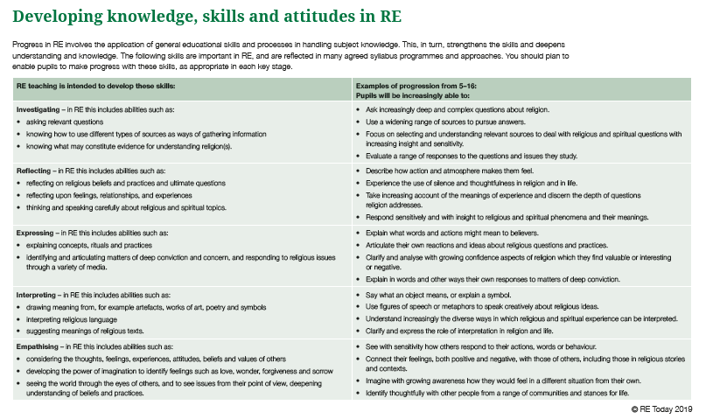
p. 152 - 153

Slide 22

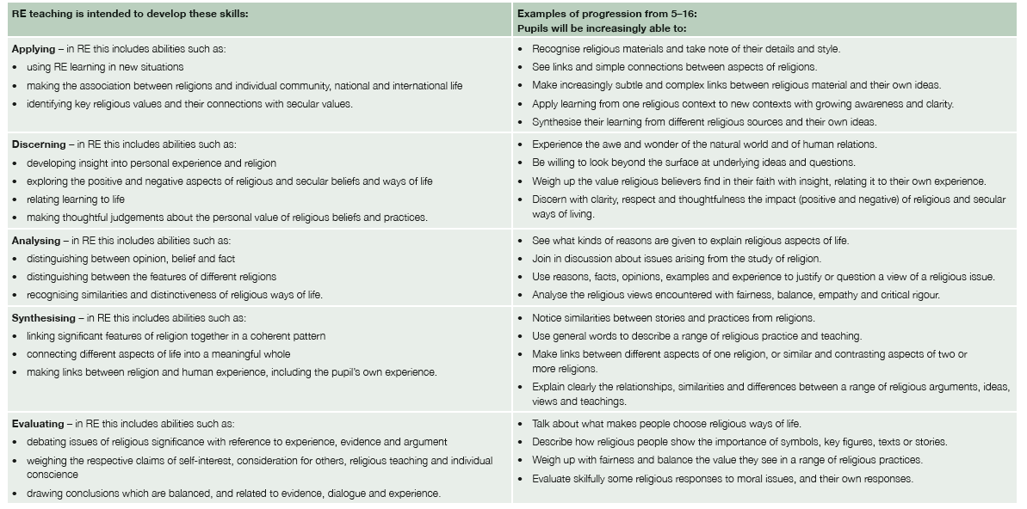
Continued…

Slide 23
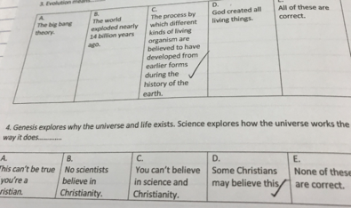

Examples of how pupils can learn and remember more
The 5 finger mnemonic
Key story
Key artefact
Use of trips and visitors
Use of artwork
Small quizzes
Knowledge organisers?

Slide 24
What makes a good knowledge organiser?
Knowledge organisers can be used as a tool to support learning, aid assessment and give a window into a child’s learning for parents. BE CLEAR about their purpose and use across the school.
A4 piece of paper: balance the need to use concise space-saving definitions while still including meaning enough for it to be useful.
Powerful knowledge, is specialised rather than general knowledge
How material is presented? Commonly presented in list form, which not be the best way to depict it in terms of showing links between ideas.
Assessing your knowledge organiser
Is it pupil friendly?
Does it focus on key or ‘powerful’ knowledge
Not just a list but shows relationships
Can clearly be used in the classroom as part of teaching and learning
Best work on this in RE that I have found is by Gillian Georgiou
www.lincolndiocesaneducation.com/page/?title=Key+Documents&pid=31

Slide 25
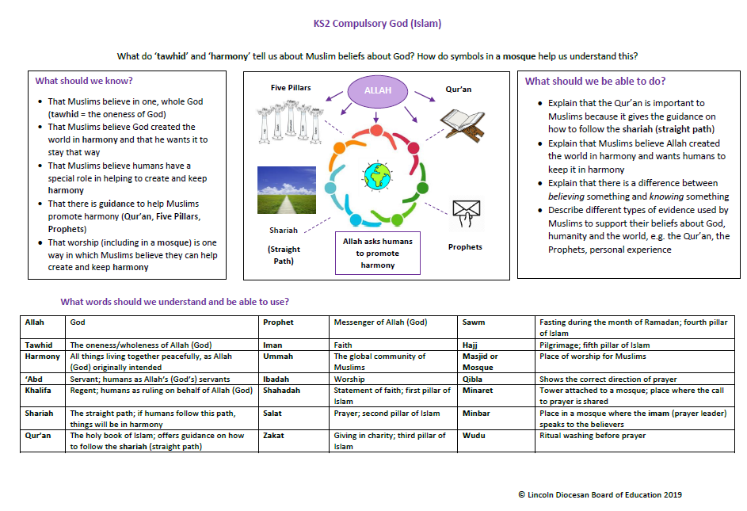
Gillian Georgiou: Lincoln Diocese

Slide 26
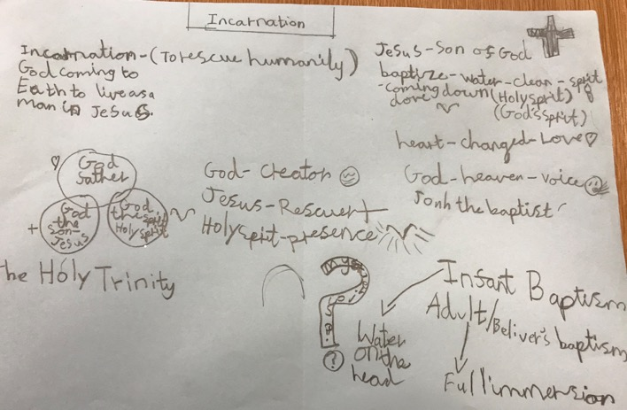
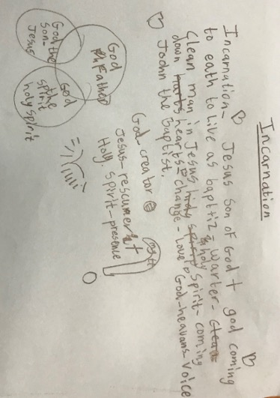

Year 3 pupils co-construction: Examples from Rachel Buckby

Slide 27
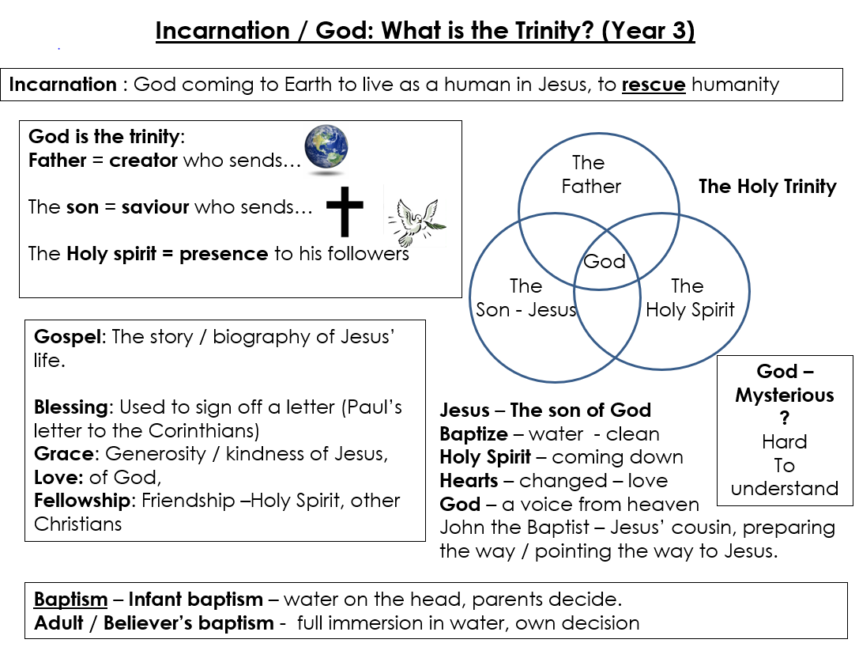

Slide 28
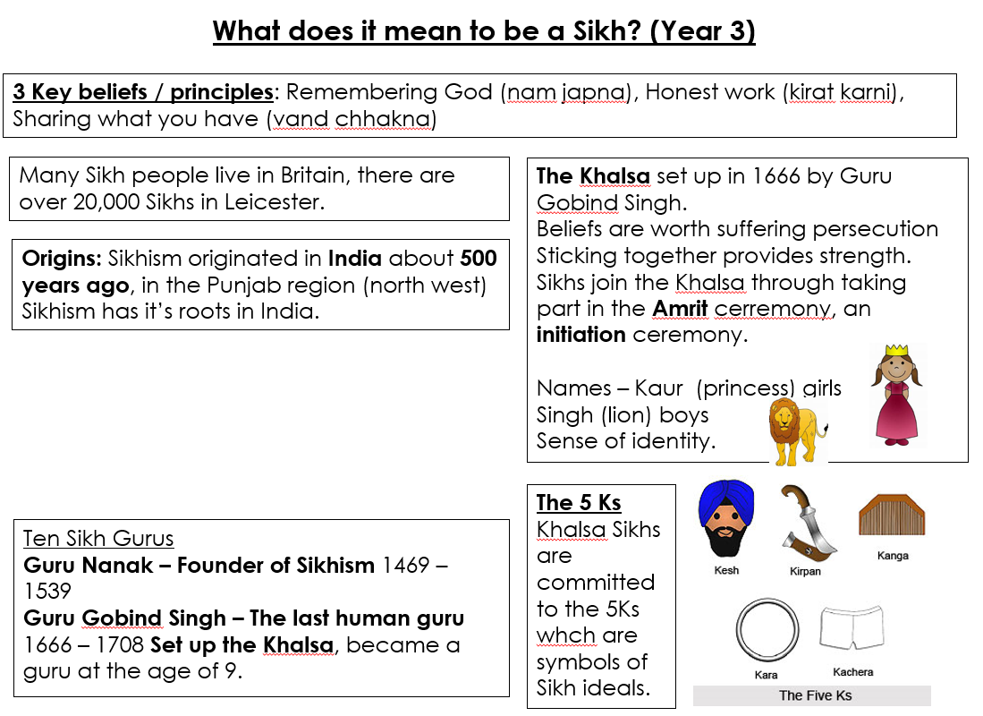

Slide 29
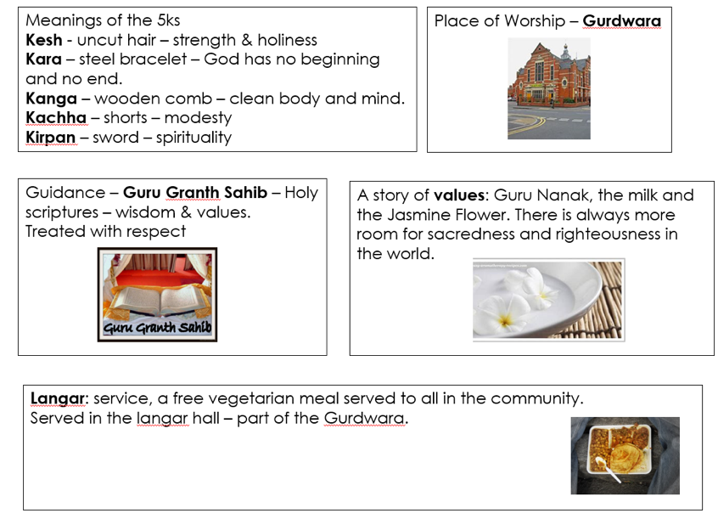

Slide 30
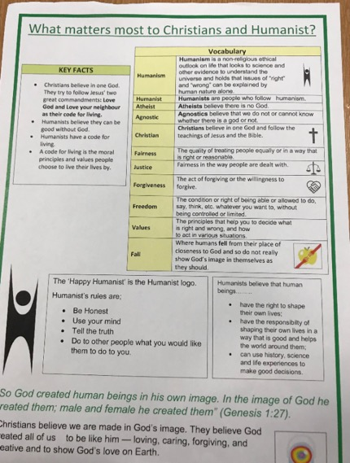
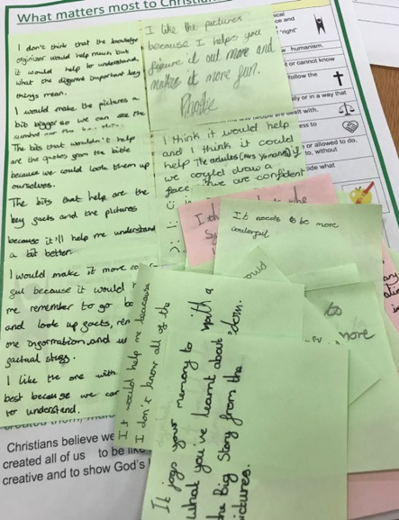
Pupils aiding construction

Slide 31
IMPACT
What have pupils learned in their RE lessons?
What evidence is there they have reached the agreed end points?

Slide 32

Judging the impact of RE in light of the rest of the curriculum
What you do in RE should be consistent with other humanities subjects
If your school has a particular vision, focus or mission statement this should be part of your monitoring as a subject leader. For example if as in one school curiosity is a core value monitoring should look for evidence of this with RE.
We recommend including the purpose of RE on the front of RE books and the learning intent for each unit of work at the start of a new sequence of work.

Slide 33
Assessment
Must be proportionate to the time spent
Should fit with other humanities subjects
Must be useful and for a purpose

Slide 34
Summative Assessment
Way of checking understanding
Chance to see what children learnt
Must relate directly to the learning outcomes
Great to have a real world context

Slide 35

Summative impact:
This looks at what pupils learned in their RE lessons?
What evidence is there they have reached the agreed end points?
Outcomes for our Agreed Syllabus focus on making sense of belief, understanding the impact and making connections
End points for every unit are available and a summary can be found on page 127-134
The support end of phase outcomes on page 126
At the end of a unit teachers can identify which pupils are expected, exceeding and working towards by listing initials against statements

Slide 36
Insert photo

Slide 37
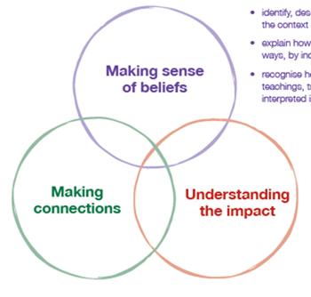

The RE Quality Mark (REQM) offers a helpful framework for monitoring impact
We recommend strand 1 Learning as a tool for monitoring after it shared with staff.
Schools should be consistently ‘bronze’ as a starting point. If you don’t have the information you need talk to your senior leader.
Pupil conferencing a valuable tool. It is
helpful for children to bring examples
of work with them.
The REQM gives some starting questions.
You might add questions lined to the
3 circles and to discuss specific pieces
of work

Slide 38

Formative assessment shows children what the next step is.
At the start a unit it is helpful for children to do a task that helps identify what they already know.
From this you can identify misconceptions and plan your sequence of lessons so they are better matched to children’s need.
Your planning needs to be mindful of your end point. When introducing a new syllabus this can be a challenge but should be your ambition. The spiral curriculum supports catch up over time.
It is helpful for children to know the end point at the start of unit. Knowledge organisers, working walls (virtual of physical), KWL grids can support this.

Slide 39

Assessment
Purpose of assessment is to ensure that pupils improve what they know, understand and can do regarding the aspect of RE they are studying.
Formative assessment is most important.
Assessment doesn’t have to be just writing or just individual work.

Slide 40
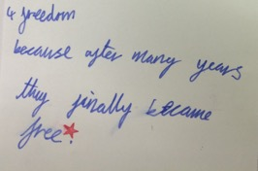
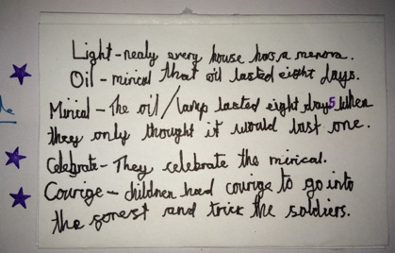
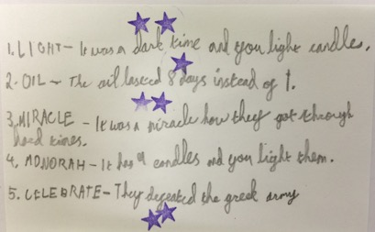

Not always neat can be effective!
Five words to sum up Hannukah
- can children justify their choices?

Slide 41
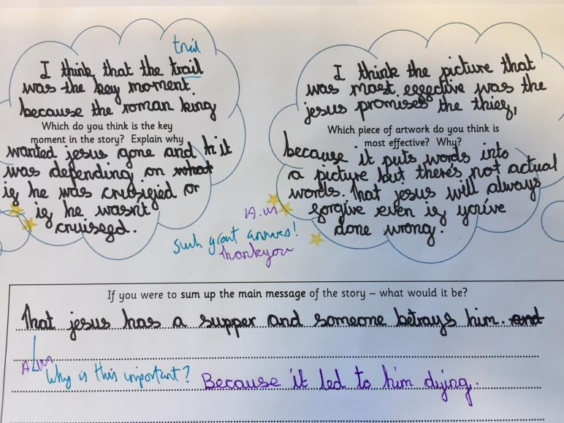

Slide 42
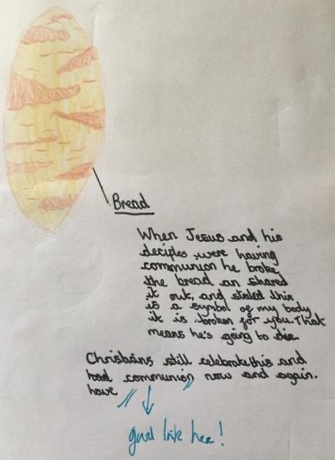
What matters most at Easter?

Slide 43
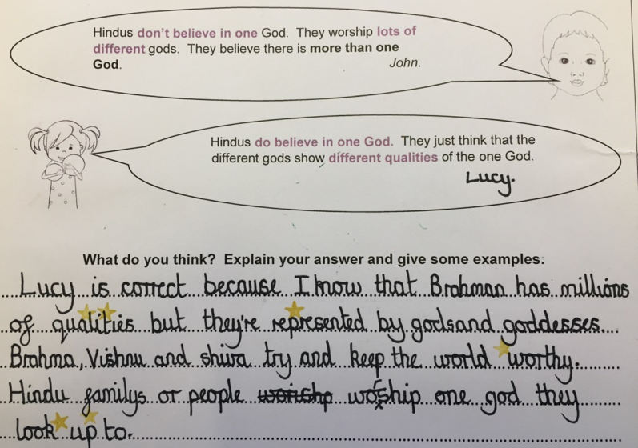

Slide 44
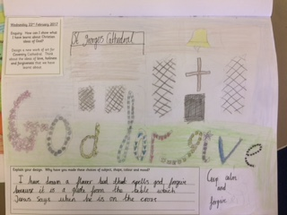
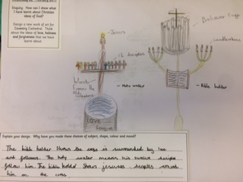
Artwork for Coventry Cathedral
Assessment:
Not just writing!

Slide 45
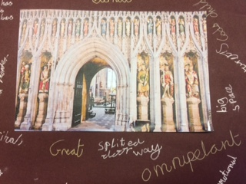
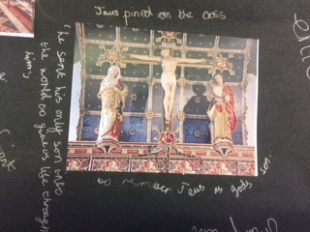
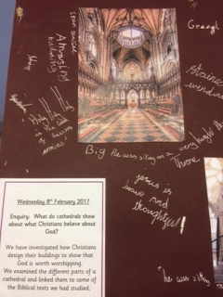
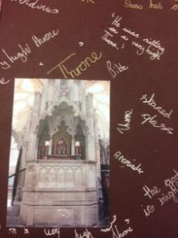
Assessment: Group responses

