Slide 1
‘This is my truth , now tell mE yours’
LTLRE conference June 2021
Ruth Flanagan

Slide 2
Which is the truth?
Go to menti.com
Room code 19327237
I have climbed Everest
I have swum among coral reefs in the Red Sea
I am bilingual
Which one is the truth?
Two lies and a truth

Slide 3
If I am bilingual which additional language can I speak?
Nepalese
Hindi
Arabic
Amharic
Russian

Slide 4
If I am bilingual which language is it?
Nepalese
Hindi
Arabic
Amharic
Russian
What is the truth?
What clues are there?

Slide 5
Truth?
Fixed?
Climbed Everest – top? Implied.
Bilingual – level? Fluency?
Second set assists with the first?

Slide 6
True: A dictionary definition
1: being in accordance with the actual state of affairs true description
being that which is the case rather than what is manifest or assumed the true dimension of the problem
being consistent true to character
2: properly so called true love, the true faith, the true stomach of ruminant mammals
  possessing the basic characters of and belonging to the same natural group as a whale is a true but not a typical mammal
3: steadfast, loyal, honest, just.
4: legitimate, rightful true and lawful king.
5: that is fitted or formed or that functions accurately, conformable to a pattern - accurate
6: determined with reference to the earth's axis rather than the magnetic poles true north
7: logically necessary
8: Narrow, strict the truest sense
9: corrected for error
Notes:
True | Definition of True by Merriam-Webster1a(1): being in accordance with the actual state of affairs true description
(2): conformable to an essential reality
(3): fully realized or fulfilled dreams come true
b: IDEAL, ESSENTIAL
c: being that which is the case rather than what is manifest or assumed the true dimension of the problem
d: CONSISTENT true to character
2a: properly so called true love, the true faith, the true stomach of ruminant mammals (the fourth and final stomach compartment in ruminants. rumen—primary site of microbial fermentation
reticulum
omasum—receives chewed cud, and absorbs volatile fatty acids
abomasum—true stomach)
b(1): possessing the basic characters of and belonging to the same natural group asa whale is a true but not a typical mammal
(2): TYPICALthe true cats
3a: STEADFAST, LOYAL
b: HONEST, JUST
4: LEGITIMATE, RIGHTFULour true and lawful king
5a: that is fitted or formed or that functions accurately
b: conformable to a standard or pattern : ACCURATE
6: determined with reference to the earth's axis rather than the magnetic poles true north
7: logically necessary
8: NARROW, STRICTin the truest sense
9: corrected for error
E.g. 1.True to character – want to entertain – try to find light hearted side to any topic. Or please person
2. Typical true teacher – bit controlling take charge…or so I am told!
3. True friend –aim to be loyal etc
4. Rightful - …
5. Floor tiles conform to a pattern?
6. etc..

Slide 7
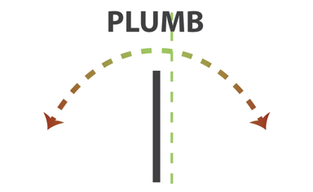
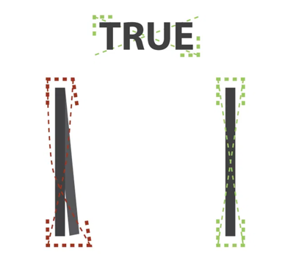
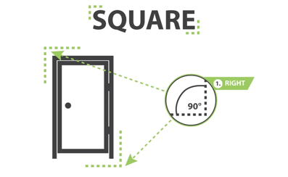
Can there be different ‘truths’?
Notes:
LEVEL PLUMB SQUARE & TRUE. What do they really mean? (jentratools.com)
We hear these words used all the time, but have you ever taken the time to really think about what they mean? Equally important, these terms can have a major impact on your next door or window installation. Take a read below to make sure your fenestration terminology is up to par.
1. LEVEL
The best way to describe LEVEL is to imagine a straight line that is perfectly horizontal. Take a look at the picture above, the dotted green line represents LEVEL. If a door or window is installed out of LEVEL, it will tend to rub on the jamb and it will be hard to get the reveal (spacing between the door and frame) to line up. If the reveals don’t line up, the sash will not seat up properly with the weather-strip seals. As a result, you risk losing the Energy STAR rating your door or window came with.
2. PLUMB
To visualize what PLUMB represents, look at the dashed green line above. PLUMB is the term used to refer to a perfectly vertical line, thus why the clever tool used to find PLUMB is called a plumb-bob. If a door or window is installed out of PLUMB, it will cause a host of issues. Such as: sagging open in the corner, unwanted opening or closing doors, and binding during operating.
3. SQUARE
The definition of SQUARE is a 90 degree corner. A speed square, framing square, and T squares are all good examples of tools used to find SQUARE on a jobsite. Installing a door or window SQUARE involves being both LEVEL & PLUMB at the same time. This is important to prevent: binding during operation, springing open on the corners and again to insure proper sealing between the sash and frame. Take a look above for a visual explanation of SQUARE.
4. TRUE
By far, the most forgotten term of a door installation. TRUE represents being SQUARE on both the LEVEL & PLUMB axis at the same time on all sides of the unit being installed. The picture above describes TRUE. A door or window can be installed perfectly LEVEL, PLUMB & SQUARE on one side, but if the other side’s aren’t LEVEL, PLUMB & SQUARE, the unit will not be TRUE and will create many of the problems mentioned above.
These terms are hard to differentiate at first, but by gaining a good understanding of LEVEL, PLUMB, SQUARE & TRUE you are sure to get better results out of your next installation.

Slide 8

Does Defining ‘truth’ matter FOR RE?
Can you have a different truth to me?
What if they clash?
Is there one truth or many?
Focus on ‘substantive’, ‘disciplinary’ and ‘personal knowledge’ (Ofsted review, 2021)
Yet if Knowledge is ‘Justified True Belief’ (Plato, 369BC)?

Slide 9
Does Defining ‘truth’ matter FOR RE?
‘Seeing the beliefs of another as true—that is, learning from them—is therefore impossible. Or, if it is possible, it becomes a form of irrational conversion. Is it possible to rationally change one’s mind about religious issues as a result of an encounter with the religious other, whether as the result of reading texts or through personal engagement? Is it possible to see truth in another’s religion?’ (Casey 2019: 26)

Slide 10
Four theories of truth
The correspondence theory of truth — that whatever corresponds to observable reality is true. (Moore, 1901, and Russell, 1906)
The coherence theory of truth — that claims are true if they follow logically and coherently from a set of axioms (or intermediate propositions). (Walker, 1989)
The consensus theory of truth — that what is true is what everyone agrees to be true. (Habermas, 1968)
The pragmatic theory of truth — that what is true is what is useful to you, or beneficial for you. (Pierce, 1878, Adams, 1902, James, 1909, Dewey, 1922)
Notes:
For further reading:
Correspondence: The Correspondence Theory of Truth (Stanford Encyclopedia of Philosophy)
Coherence: The Coherence Theory of Truth (Stanford Encyclopedia of Philosophy)
Consensus: Truth | Internet Encyclopedia of Philosophy (utm.edu)
Pragmatism:Pragmatism (Stanford Encyclopedia of Philosophy)
Jane Adams pragmatist conviction that knowledge and theories should be consistent with practice. Awarded Nobel peace prize. She founded the Women's International League for Peace and Freedom in 1919, and worked for many years to get the great powers to disarm and conclude peace agreements. In the USA, Jane Addams worked to help the poor and to stop the use of children as industrial laborers.
She rejected the idea, popular among sociologists of her time, that institutions like Hull House were ‘laboratories’ from which to derive pure theory (Deegan 1988, pp. 34-5; Twenty Years, p. 308). She wrote that her energies were directed “not towards sociological investigation, but to constructive work” (Hull House Maps and Papers, pp. vii-viii). Her pragmatist goal was to use the knowledge she gained from her experiences at Hull House in the application of practical changes and improvements to society and the lives of the people she served, not to derive knowledge for its own sake or out of pure curiosity.

Slide 11
Critical Realist approach to truth
Bhaskar (1975) delineates between
The ‘observable’
The ‘real’
– at a basic level the observable world is constructed from individuals’ perspectives and experiences through what has been ‘observed’.
– aspects of the unobservable (or real) world, which may not be directly accessible, may cause observable events.

Slide 12
Critical Realist approach to truth
Bhaskar (1975) delineates between
The ‘observable’ – the observable world is constructed from individuals’ perspectives and experiences through what has been ‘observed’. That which we see and use to make sense of the world.
The ‘real’ – aspects of the unobservable (or real) world, which may not be directly accessible, may cause observable events.
informing our personal worldviews.
the truth claims of religions.

Slide 13
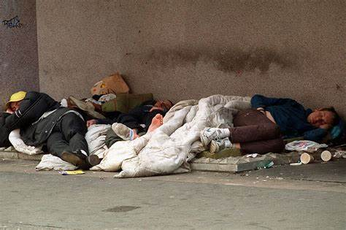
Observable truth

Slide 14
Observable knowledge
‘The perspective of the observer and the object of observation are inseparable; the nature of meaning is relative; phenomena are context-based; and the process of knowledge and understanding is social, inductive, hermeneutical, and qualitative.’
(Sexton, 1997, p. 8)

Slide 15
Knowledge and Power
‘Knowledge linked to power, not only assumes the authority of 'the truth' but has the power to make itself true. All knowledge, once applied in the real world, has effects, and in that sense at least, 'becomes true.' Knowledge, once used to regulate the conduct of others, entails constraint, regulation and the disciplining of practice. Thus, there is no power relation without the correlative constitution of a field of knowledge, nor any knowledge that does not presuppose and constitute at the same time, power relations’ (Foucault, 1977:27).

Slide 16
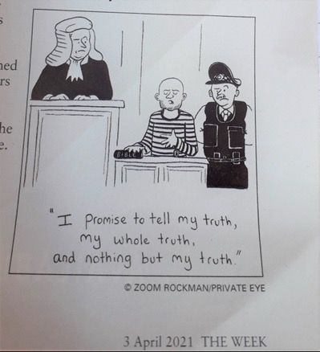
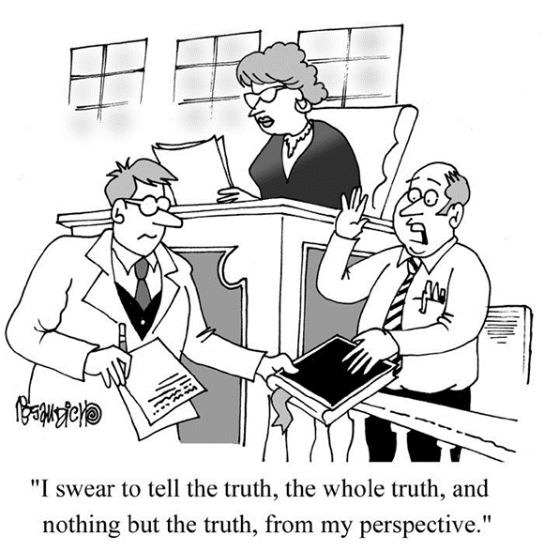
The role of perspective and interpretation

Slide 17
Philosophical developments that impact ‘truth’
Scientific rationalism – post enlightenment nothing accepted as knowledge until ‘proved’ to be true (Descartes, 1644, Kant, 1790).
Relativism meaning and truth are subject to social, cultural and historical contexts - relative and that there is no ‘right’ way to understand the world or ourselves. (Derrida, 1974, Rorty, 1979)
Post-structuralism - the power of language and need to ‘deconstruct’ the ideological biases around religious and philosophical ‘truths’. (Levi-Strauss, 1962, Foucault, 1977)
Post truth – appeals to emotion rather than fact to gain popular support. Admissible in politics? (Arendt, 1971)
Notes:
Post –structuralism emerged from France 1950s
2016 Oxford dictionary declared ‘post-truth’ the international word of the year.
Oxford Dictionaries Word of the Year 2016 is post-truth defined as 'relating to or
denoting circumstances in which objective facts are less influential in shaping public opinion than appeals to emotion and personal belief.
Parallels to propaganda of the Nazis.
“Lying in Politics” is Arendt’s (1971) account of political imagination as a reflection on the Pentagon papers that draws interconnections between “lie, the deliberate denial of factual truth, and the capacity to change facts, the ability to act.” She argues “the lie did not creep into politics by some accident of human sinfulness; moral outrage, for this reason alone, is not likely to make it disappear.” As she argues “factual truths are never compellingly true” as contingent facts they carry no guarantee of truth and “no factual statement can ever be beyond doubt.” Arendt goes on to argue “Facts need testimony to be remembered and trustworthy witnesses to be established in order to find a secure dwelling place in the domain of human affairs” (Peters, 2015). Arendt maintains lying and deception in public life is so easy “up to a point” and does not necessarily come into conflict with truth because facts can always be otherwise (article by Peters, 2017Full article: Education in a post-truth world (tandfonline.com) )

Slide 18
Challenge to post truth?
'The further a society drifts from the truth, the more it will hate those that speak it.‘ George Orwell

Slide 19
Or an example of falsity on the internet?
'The further a society drifts from the truth, the more it will hate those that speak it.‘ George OrwellX
Notes:
There is something oddly delicious about people posting a comment about the importance of truth-seeking while not taking the time to determine whether or not the quote is, in fact, from Orwell. Michela savage defence is when the quote sued… Carnell The Further A Society Drifts From Truth . . . – Brian.Carnell.Com

Slide 20
Philosophical hermeneutics
An individual is a product of socio cultural and personal history but this does not negate truth rather it negates neutrality and acknowledges that all individuals are engaged in ‘informed’ interpretation:
as ‘active participants in the process of interpretation …we must abandon any strict claim to neutrality and objectivity’ (West, 2012:399).

Slide 21
Ricoeur’s philosophical hermeneutics
‘Self-understanding is an interpretation; interpretation of the self in turn , finds in narrative….a privileged form of mediation; the latter borrows from history as well as from fiction, making a life story a fictional history or, if one prefers, a historical fiction’ (1992: 114)
History and truth (1965) acknowledging ‘the radical cultural presuppositions’ – ‘philosophical way of being present to my time’ ‘the pluralisation of the orders of truth in our cultural history’(p166)

Slide 22
Full circle
‘If the beliefs of one’s own worldview provide the resources for making determinations about truth, then one will always, at the result of an investigation, ultimately decide that one’s own worldview is the best one’ (Casey, 2019: 26).

Slide 23
What interpretations are we engaged in as RE teachers?
Defining ‘good’ knowledge for RE
‘Coalition of the reasonable’
‘Darker’ and ‘lighter’ side of religion (Kueh, 2017)
Etc…

Slide 24
Classroom comments
Sadly not everyone has caught up with this…
All religions are the same.
If I had known they were going to say that, I would never have let them speak!

Slide 25
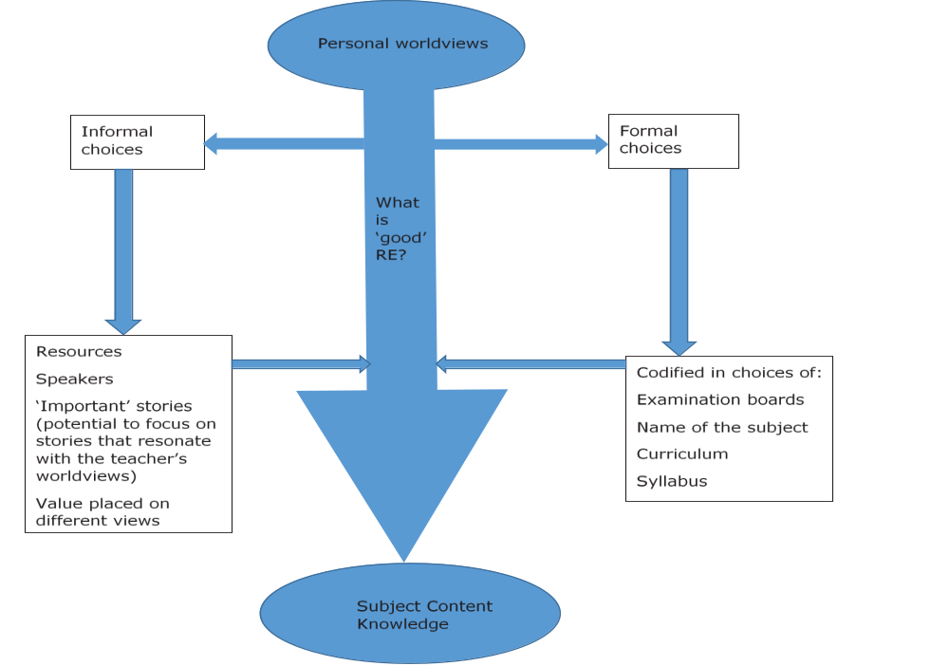
(Flanagan, 2019)

Slide 26



My truth? My interpretation of Truth

Slide 27
Now tell me your interpretation of truth…
RE, at all key stages, provides an incredible opportunity
To disagree well
To debate honestly
To listen respectfully
To model this to an ‘intolerant’ world

Slide 28
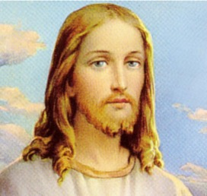
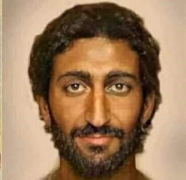

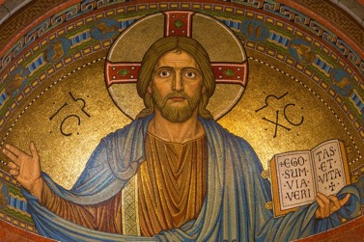
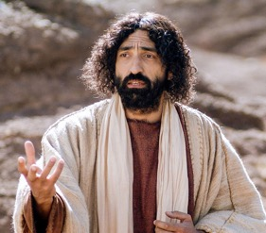


What does this look like in the Classroom
Images: Frames of reference
Notes:
For this activity employ a selection of images of optical illusions or images that provide a different point of view.

Slide 29
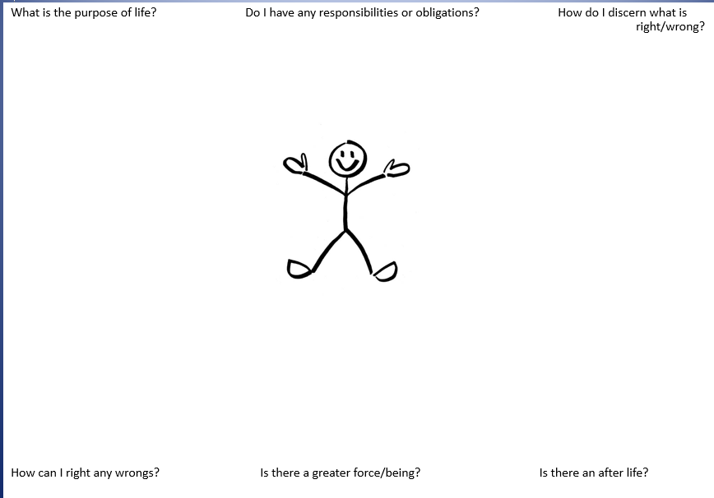

Slide 30
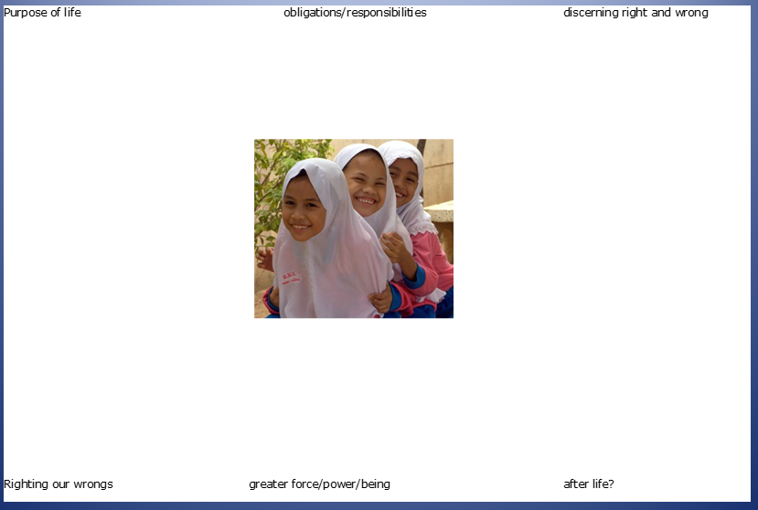

Slide 31
Thank you for listening
Any questions?
If you would like to be interviewed as part of my current research into personal worldviews than please get in touch with me at
r.flanagan@exeter.ac.uk

Slide 32
References
Adams, J (1902) Democracy and Social Ethics. Macmillan,
Arendt, H (1971) ‘Lying in politics: Reflections on the Pentagon papers.’ Lying in Politics: Reflections on The Pentagon Papers | by Hannah Arendt | The New York Review of Books (nybooks.com)
Bhaskar, R. [1975] 2008. A Realist Theory of Science. Routledge.
Casey, P. (2019). Ricoeur on Truth in Religious Discourse: A Reclamation. Horizons, 46(1), 24-52. doi:10.1017/hor.2019.7
Derrida, J., (1974) Of Grammatology, tr., Gayatri Spivak, The Johns Hopkins University Press.
Descartes, R. (1644) Principles of Philosophy. translated with explanatory notes, by Valentine Rodger Miller and Reese P. Miller (1983) Reidel.
Dewey, J. (1922/ 2007) Human nature and conduct. An Introduction to Social Psychology. Cosmio Classics.

Slide 33
Flanagan, R (2019) 'Implementing a Ricoeurian lens to examine the impact of individuals' worldviews on subject
content knowledge in RE in England: a theoretical proposition', British Journal of Religious Education,
DOI: 10.1080/01416200.2019.1674779
Foucault, M. (1977) Discipline and Punishment. Allen Lane.
Habermas, J. (1968) ‘The idea of the theory of knowledge as social theory’. Continental Philosophy
Habermas, J. (2003) Truth and Justification, MIT Press, Cambridge, MA, 2003.
James, W (1909). The Meaning of Truth, Cambridge, MA: Harvard University Press, 1975.
Kant, I. (1781) The Critique of Pure Reason. Translated by Weigelt, M.(2007) Penguin Classics.
Levi-Strauss, C (1962) The Savage mind. University of Chicago Press.

Slide 34
Moore, G. E. (1901-02) ‘Truth and Falsity’; reprinted in Selected Writings, edited by T. Baldwin, Routledge 1993, 20-22.
Ofsted (2021) Research Review series: RE. Research review series: religious education - GOV.UK (www.gov.uk)
Ricoeur, P. (1965) History and Truth. North-western University Press.
Rorty, R. (1979) Philosophy and the Mirror of Nature, Princeton UP.
Russell, B. (1907) “On the Nature of Truth”, Proceedings of the Aristotelian Society, 7: 228–49.
Sexton, T. L. (1997). Constructivist thinking within the history of ideas: The challenge of a new paradigm. In T. L.
Sexton & B. L. Griffin (Eds.), Constructivist thinking in counseling practice, research, and training (pp. 3- 18). Teachers College Press
Walker, R.C.S., 1989, The Coherence Theory of Truth: Realism, anti-realism, idealism, Routledge.

