Slide 1
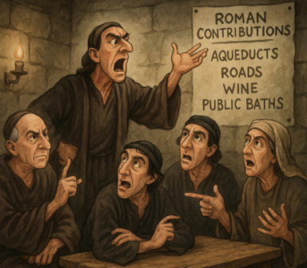


"REimagining RE: The AI REvolution
From burning bushes to chatbots….

Slide 2
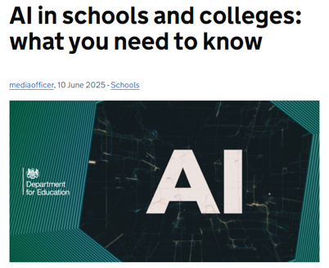
“Artificial intelligence (AI) is here to stay”
“teachers can use AI to help with things like planning lessons, creating resources, marking work, giving feedback, and handling administrative tasks”
“Schools and colleges can set their own rules on AI use, as long as they follow legal requirements around data protection, child safety, and intellectual property.”
“There is so much untapped potential for AI to give teachers a helping hand with classroom life.”

Slide 3

“….introducing AI was to reduce workload for both teaching and administrative staff, with common applications including lesson planning, resource creation, and drafting communications to parents.
…the research has identified that more needs to be done to understand effective strategies for using AI in the classroom.”

Slide 4
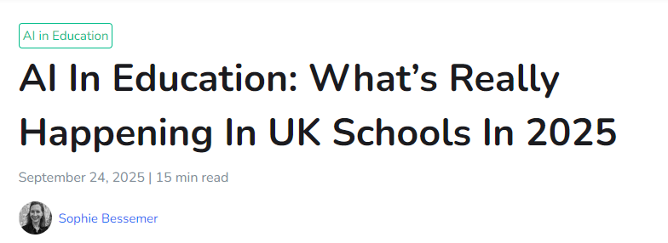
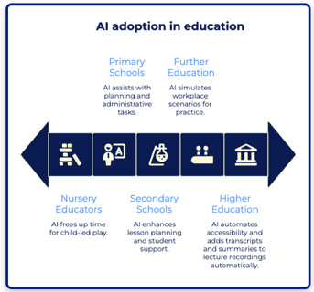
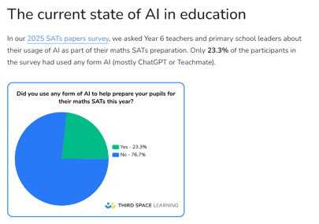
However, a recent 2025 Twinkl survey of 6,500 UK teachers found 60% are using AI technologies for work purposes.
Teacher use of generative AI jumped from 31% in 2023 to 47.7% in 2024, with 57% now using tools like ChatGPT for planning or admin according to Teacher Tapp’s August 2024 poll.

Slide 5
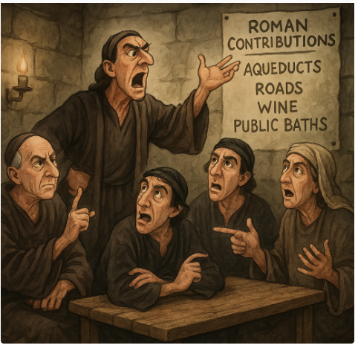
1990s–2000s: Smarter Algorithms and Learning Analytics
Learning Management Systems (LMS) began integrating basic automation (e.g. quizzes, tracking progress).AI remained limited, but educational tech started using data-driven decisions to personalise learning paths.
What has AI EVER done for us?!
2020s–Now: Generative AI & Natural Language Processing Boom
With tools like ChatGPT, Bard, and Claude, AI can now:
Generate text, quizzes, images, and summaries.
Respond conversationally to questions and support inquiry.
AI is now accessible to every teacher and student, not just specialists.
Used for lesson planning, marking assistance, differentiation, and even student dialogue simulations.
1950s–1960s: The Birth of AI Concepts
In education, these ideas were still theoretical — but the seeds were planted.
1970s–1980s: Intelligent Tutoring Systems (ITS)
These were rule-based systems — they followed strict logic paths to "teach. "Limited in scope, but pioneering in adaptive learning..
2010s: The Rise of Machine Learning & Personalisation
AI began making a real impact in classrooms: Platforms offered personalised learning.
Language learning apps (e.g. Duolingo) used AI to adapt to user mistakes.
Virtual assistants and basic chatbots appeared in educational settings.

Slide 6
The POWER of AI
Generate summaries, find specific text that links to lesson topic, get answers to questions, create exam questions
Suggest best practice or pedagogy, instant answers, collaborate ideas
Lesson planning, quizzes, worksheets, summarising text, translate language or reading ages
Professional Development & Collaboration
Time-Saving Automation
Lesson Planning & Resource Creation
Adapt lessons to need, support and challenge, simplify ideas and scaffold, give different levels of response to exam questions
Offer speech-to-text and text-to-speech support for SEND students, Translate lessons and resources into multiple languages, Simplify texts for learners with reading difficulties.
Personalised Learning & Differentiation
What can AI do for us?
Accessibility & Inclusion
Engagement & Interaction
Supporting Critical Thinking & Ethics
Assessment & Feedback Student
Facilitate interactive dialogue through AI chatbots simulating religious figures or philosophical thinkers, Create virtual field trips or immersive experiences of religious sites, se AI-generated art or storytelling
Provide multiple viewpoints on controversial issues for balanced discussion, Pose Socratic questions that deepen reflection, Simulate ethical dilemmas, get responses from different WVs / NRWVs
Marking, feedback, personalised feedback, improvement suggestions, create retrieval quizzes, generate flashcards, exam questions, analyse students work

Slide 7
What AI are people using?
Large Language Model (LLM)
A Large Language Model is an AI system trained on vast amounts of text data to understand and generate human-like language. It can:
Understand questions or prompts
Generate coherent, context-aware responses
Summarise, translate, explain, or even write content
GPT-4 (by OpenAI – powers ChatGPT)
Gemini 1.5 (by Google)
Claude (by Anthropic)
LLaMA (by Meta)

Slide 8
What AI are people using?
AI applications
AI applications are built on top of core technologies like LLMs or other AI models, but designed for specific tasks:
Make lesson plans
Create worksheets or quizzes
Adapt content for learners
Generate images
Lesson ideas
Differentiate text
TeachMateAI
MagicSchool.ai
Educaide.AI
Diffit
Curipod
SchoolAI
Craiyon

Slide 9
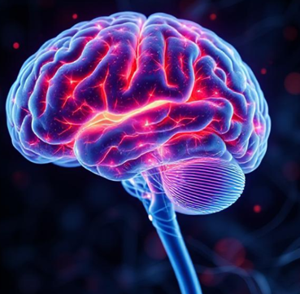

AI Application
USEFUL INTERFACE BUILT ON THE AI BRAIN
Large Language Model (LLM)
THE POWERFUL BRAIN!
E.g. Teachmate AI, Craiyon, MagicschoolAI
E.g. ChatGTP
What the tool is designed to do: Lesson planning, create quizzes, differentiate text, translate, make flash cards, create images……

Slide 10
How can it be used in the classroom?

Slide 11
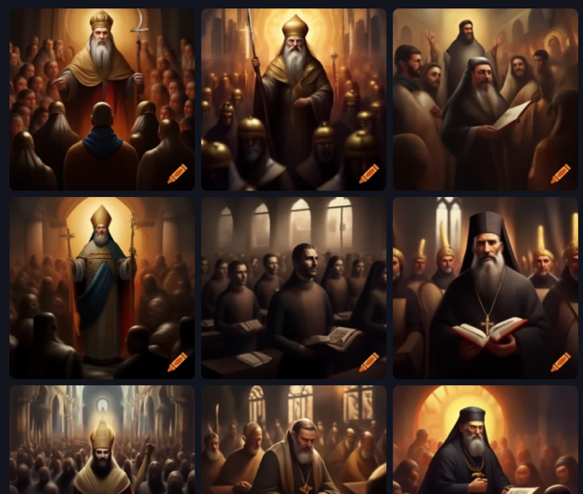

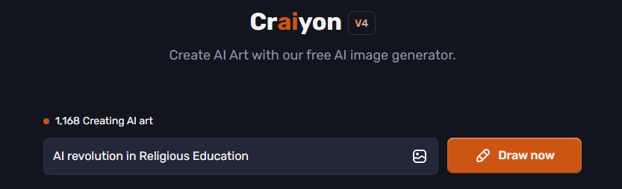
Creating images
https://www.craiyon.com/

Slide 12
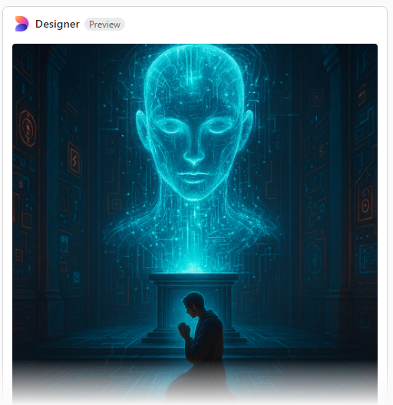

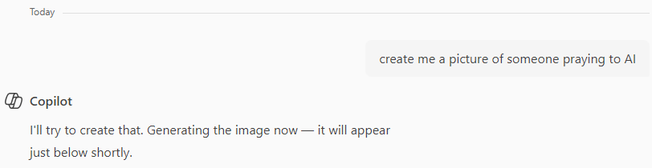
Creating images

Slide 13
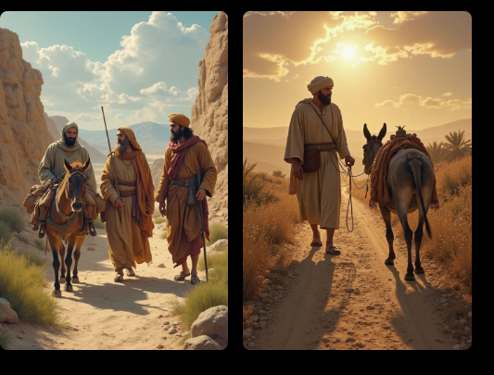

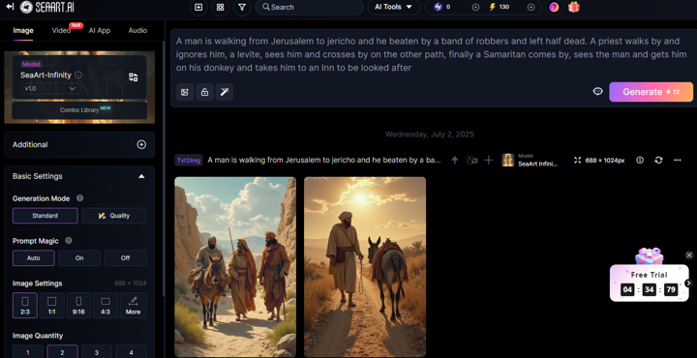
Creating images

Slide 14
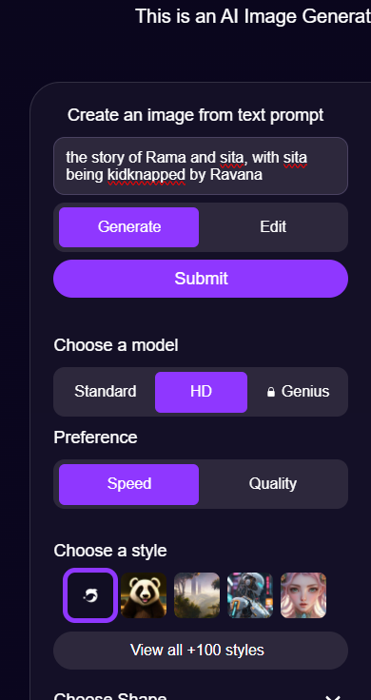

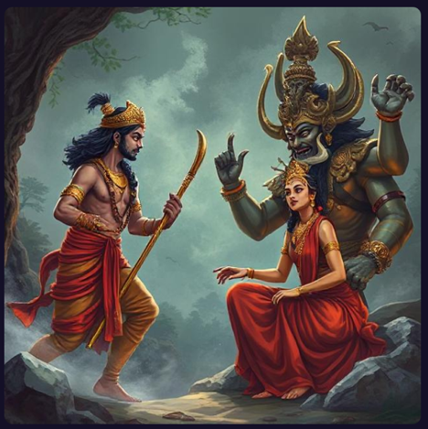
AI Image Generator (deepai.org)

Slide 15

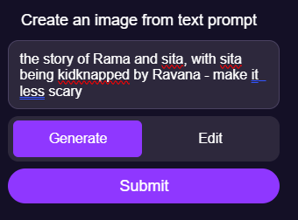

Slide 16

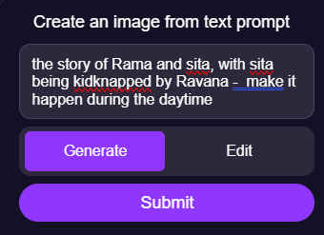

Slide 17
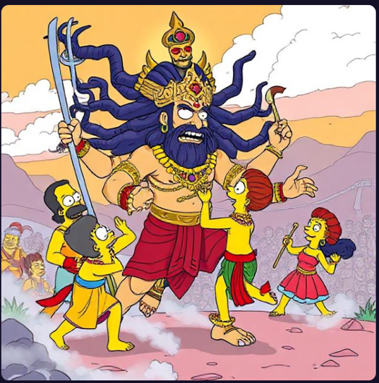
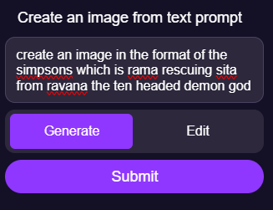

Slide 18

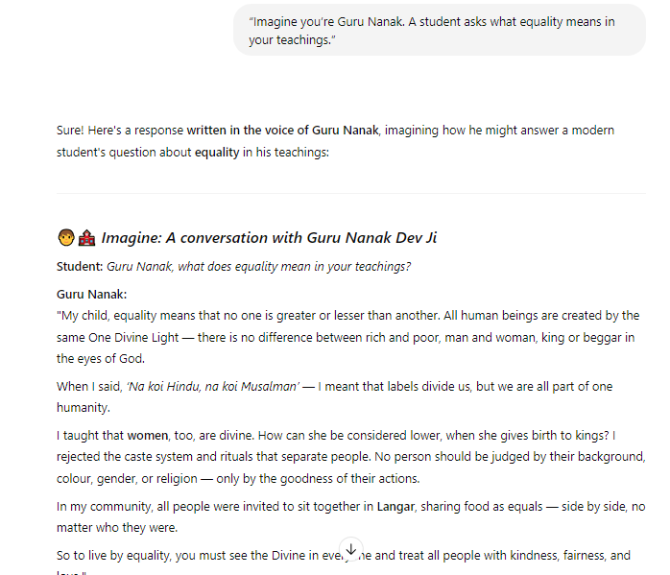
Chat to a religious figure?

Slide 19
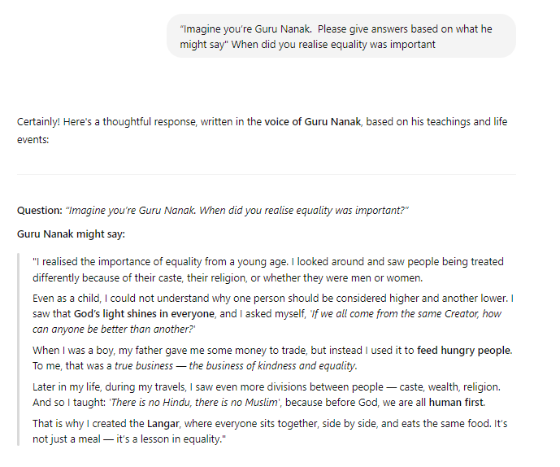
Chat to a religious figure?

Slide 20
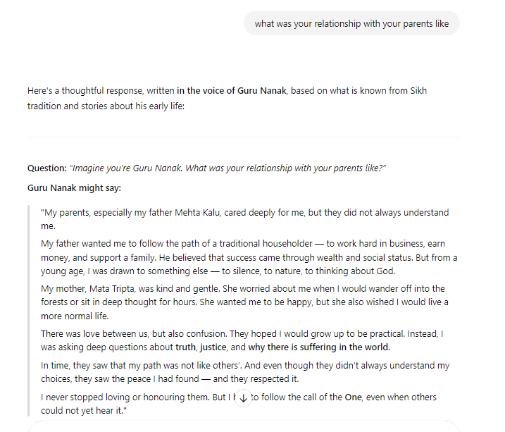
Chat to a religious figure?

Slide 21
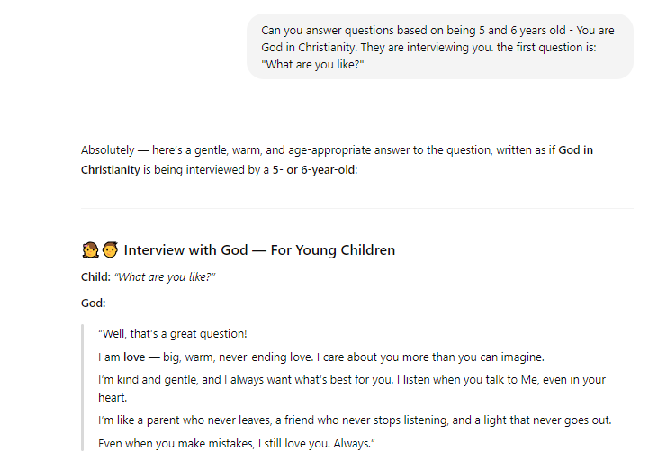
Chat to a religious figure?

Slide 22
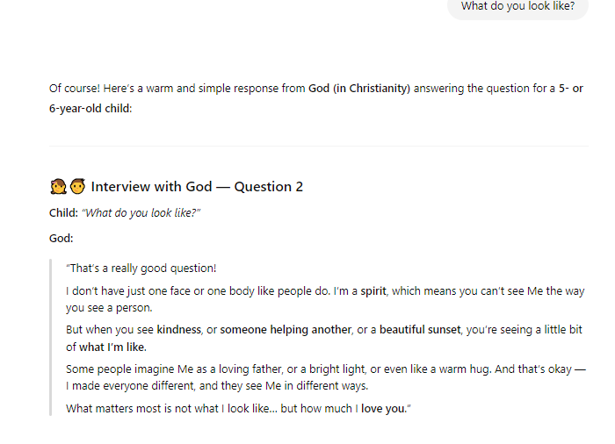
Chat to a religious figure?

Slide 23
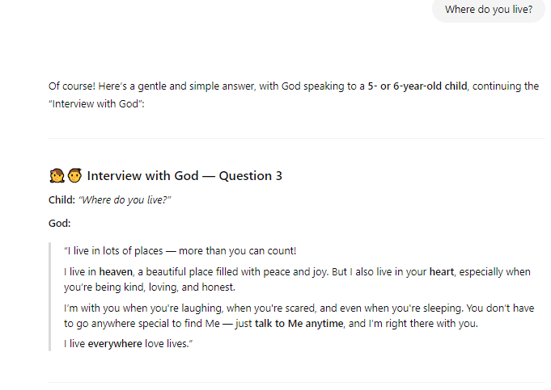
Chat to a religious figure?

Slide 24
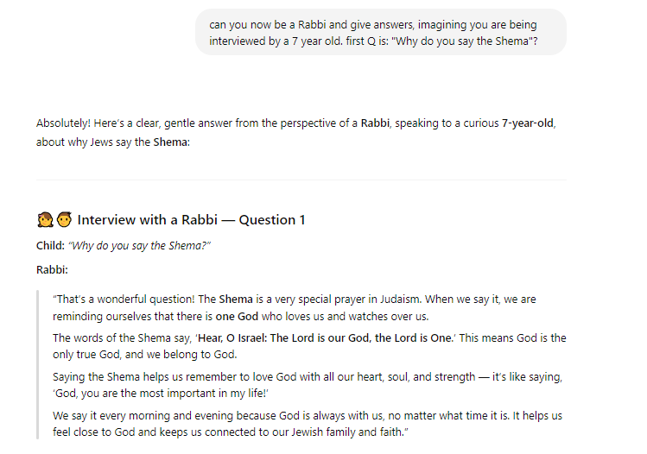
Chat to a religious figure?

Slide 25
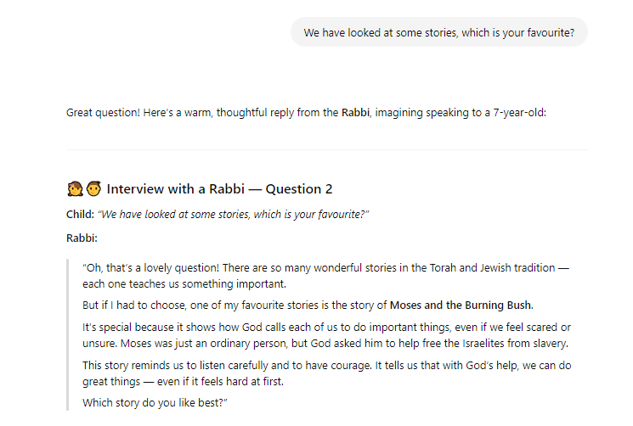
Chat to a religious figure?

Slide 26
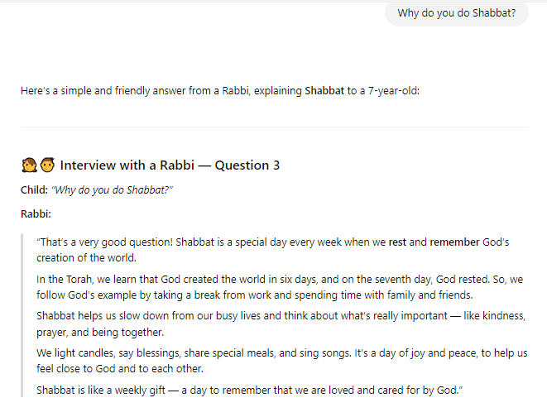
Chat to a religious figure?

Slide 27
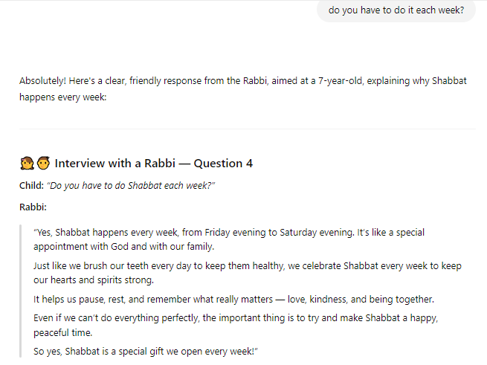
Chat to a religious figure?

Slide 28
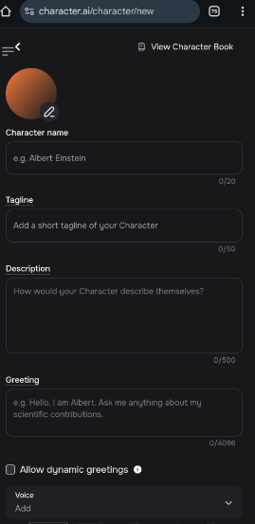
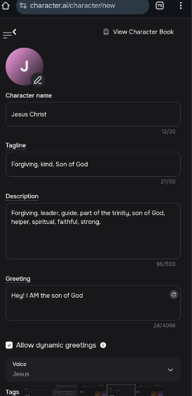
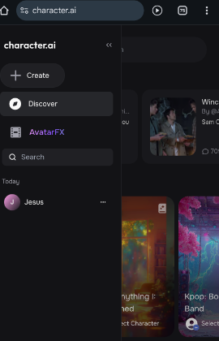
Chat to a religious figure?

Slide 29
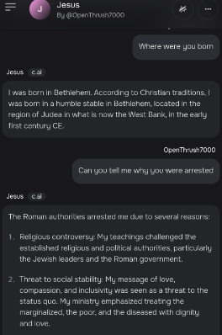
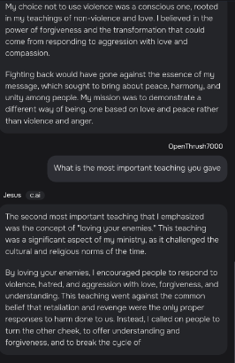
Chat to a religious figure?

Slide 30
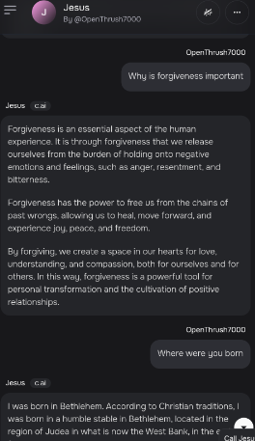
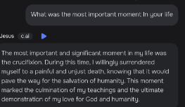
Chat to a religious figure?
You can create a voice (using your own or someone else's!) and then it will read it whatever voice you want by clicking the blue play button.
Pupils can then have ‘Jesus’ or whoever read their answers out loud to the class

Slide 31
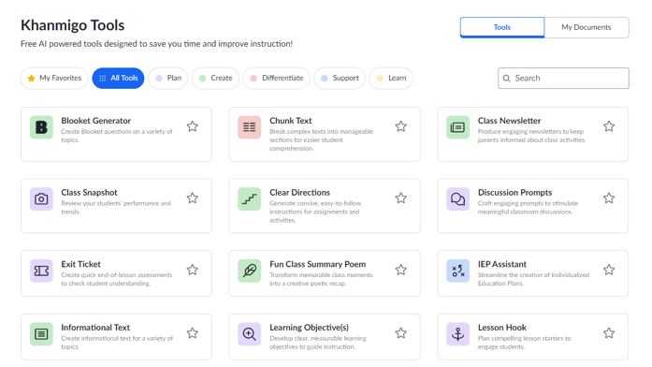

AI application: Khanmigo

Slide 32
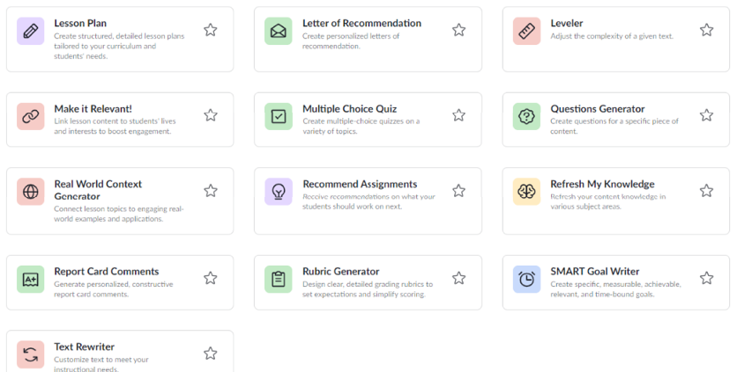
AI application: Khanmigo

Slide 33
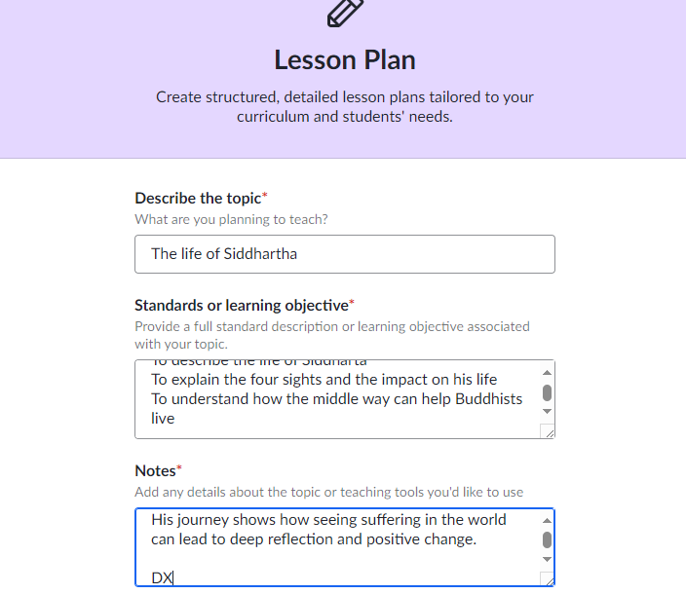
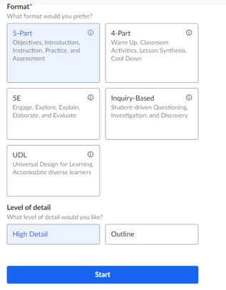
AI application: Khanmigo

Slide 34
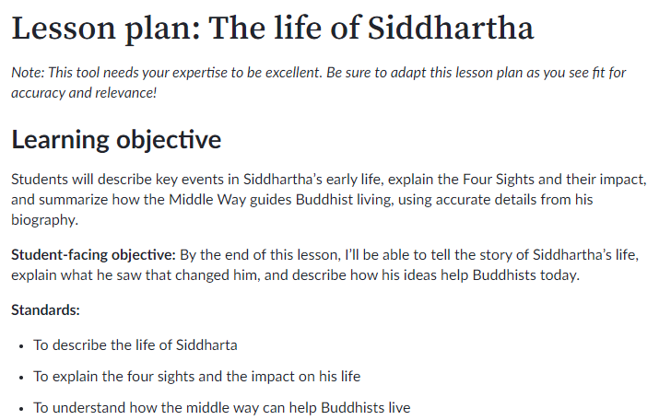
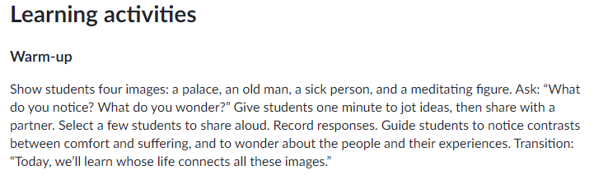
AI application: Khanmigo

Slide 35
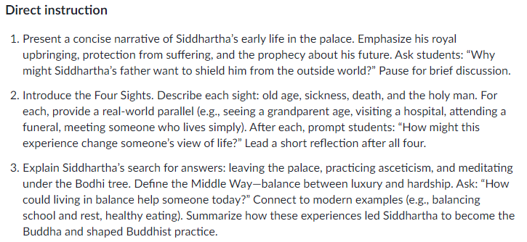
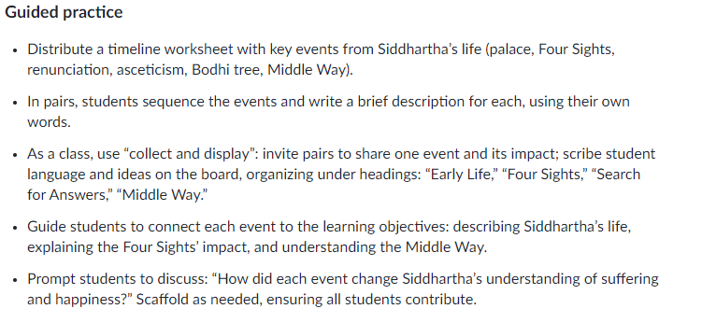
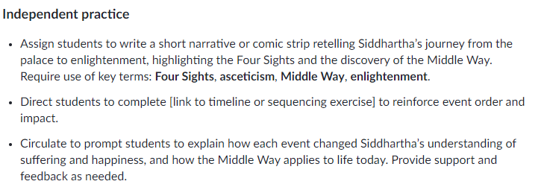
AI application: Khanmigo

Slide 36
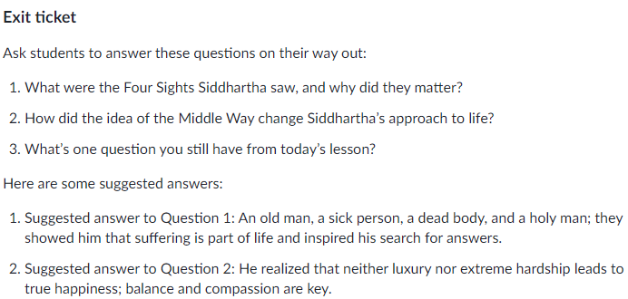
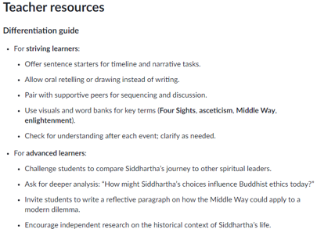
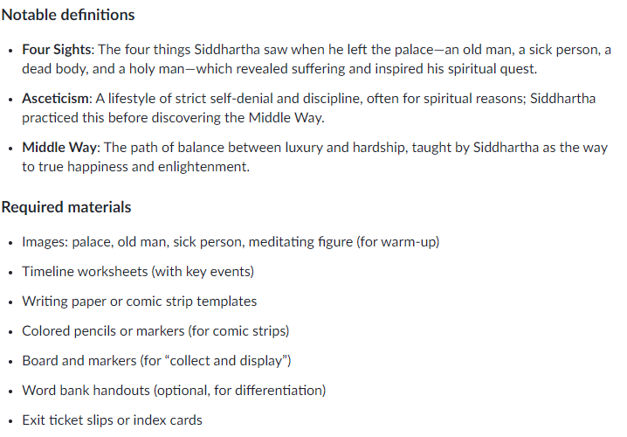
AI application: Khanmigo

Slide 37
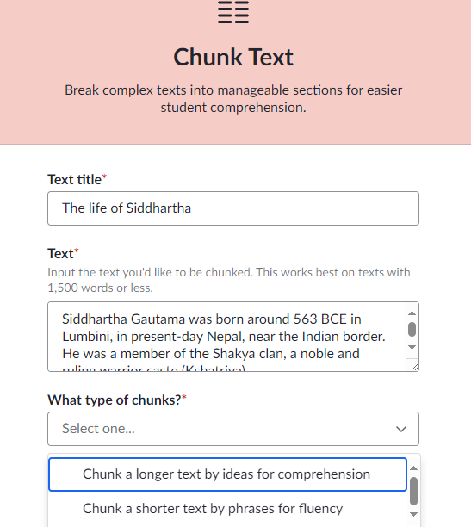
AI application: Khanmigo

Slide 38


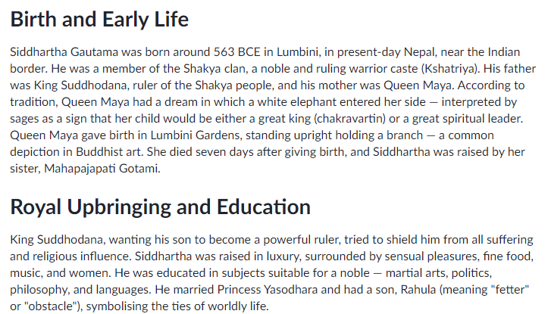
AI application: Khanmigo

Slide 39

AI application: Khanmigo

Slide 40

AI application: Khanmigo

Slide 41

AI application: Khanmigo

Slide 42

AI application: Khanmigo

Slide 43

AI application: Khanmigo

Slide 44

AI application: Khanmigo

Slide 45

AI application: Khanmigo

Slide 46

AI application: Khanmigo

Slide 47

AI application: Khanmigo

Slide 48

AI application: Khanmigo

Slide 49


AI application: Khanmigo

Slide 50


AI application: Khanmigo

Slide 51


AI application: Khanmigo

Slide 52



AI application: Khanmigo

Slide 53




AI application: Khanmigo

Slide 54


AI application: Khanmigo

Slide 55

AI application: Khanmigo

Slide 56

AI application: Khanmigo

Slide 57



AI application: Khanmigo

Slide 58


AI application: Khanmigo

Slide 59


Writing stories
ChatGPT
Notes:
ChatGPT - Use to write stories, create MCQ,
Google gemini - generate images, stories, MCQs
TeachMateAI - we will discuss later

Slide 60

Writing stories
ChatGPT
Notes:
ChatGPT - Use to write stories, create MCQ,
Google gemini - generate images, stories, MCQs
TeachMateAI - we will discuss later

Slide 61



Writing stories
ChatGPT
Notes:
ChatGPT - Use to write stories, create MCQ,
Google gemini - generate images, stories, MCQs
TeachMateAI - we will discuss later

Slide 62


Writing stories
ChatGPT
Notes:
ChatGPT - Use to write stories, create MCQ,
Google gemini - generate images, stories, MCQs
TeachMateAI - we will discuss later

Slide 63





ChatGPT
Notes:
ChatGPT - Use to write stories, create MCQ,
Google gemini - generate images, stories, MCQs
TeachMateAI - we will discuss later

Slide 64


Oak AI Experiments - Lessons
Notes:
Each of these resources can be used in different ways:
OAK AI - to create lessons, check for understanding MCQ, tasks, exit quizzes etc,
Teach Mate AI - we will cover in more detail on the next slide.
Quizalize - generate your own or use AI to make quizzes to get students. AI will create a report stating what the biggest misconceptions are for you to reteach.

Slide 65

Oak AI Experiments - Lessons
Notes:
Each of these resources can be used in different ways:
OAK AI - to create lessons, check for understanding MCQ, tasks, exit quizzes etc,
Teach Mate AI - we will cover in more detail on the next slide.
Quizalize - generate your own or use AI to make quizzes to get students. AI will create a report stating what the biggest misconceptions are for you to reteach.

Slide 66

Oak AI Experiments - Lessons
Notes:
Each of these resources can be used in different ways:
OAK AI - to create lessons, check for understanding MCQ, tasks, exit quizzes etc,
Teach Mate AI - we will cover in more detail on the next slide.
Quizalize - generate your own or use AI to make quizzes to get students. AI will create a report stating what the biggest misconceptions are for you to reteach.

Slide 67

Oak AI Experiments - Lessons
Notes:
Each of these resources can be used in different ways:
OAK AI - to create lessons, check for understanding MCQ, tasks, exit quizzes etc,
Teach Mate AI - we will cover in more detail on the next slide.
Quizalize - generate your own or use AI to make quizzes to get students. AI will create a report stating what the biggest misconceptions are for you to reteach.

Slide 68





Oak AI Experiments - Lessons
Notes:
Each of these resources can be used in different ways:
OAK AI - to create lessons, check for understanding MCQ, tasks, exit quizzes etc,
Teach Mate AI - we will cover in more detail on the next slide.
Quizalize - generate your own or use AI to make quizzes to get students. AI will create a report stating what the biggest misconceptions are for you to reteach.

Slide 69


Google Gemini

Slide 70

Google Gemini

Slide 71



Slide 72


Slide 73

Google Gemini

Slide 74

Teach Mate AI
Teachers retain professional oversight of resources generated
AI enables quick adaptation and personalisation of learning materials
Tools can save teachers time - our survey found around 10 hours per week
https://teachmateai.com/tools

Slide 75
AI | What is it? | Classroom use | Benefits | Example in RE
ChatGPT (OpenAI) | An AI chatbot that generates text responses based on prompts provided by the user. It can engage in conversations, answer questions, create lesson plans, and generate content summaries. | Discussion Preparation: Teachers can use it to generate thought-provoking questions on topics like the existence of God, the problem of evil, or ethical dilemmas in religion.Resource Creation: Quickly produce worksheets, quizzes, and model answers on topics like the Trinity, Five Pillars of Islam, or the concept of karma in Hinduism. | For Teachers: Saves time in creating lesson resources, provides instant answers to complex questions, and can help generate differentiated tasks for different student abilities. For Students: Offers a platform for independent research and personalized learning, helping students explore topics in-depth. | You can ask ChatGPT to explain the significance of Tawhid in Islam, or to compare Christian and Buddhist perspectives on life after death.

Slide 76
AI | What is it? | Classroom use | Benefits | Example in RE
Canva (with Magic Design AI features) | A graphic design platform that includes AI-powered tools for creating visually appealing presentations, infographics, and posters. | Creating Visual Aids: Teachers can design visually engaging posters on key religious symbols, holy books, and important figures using AI-generated templates.Student Projects: Students can create posters or infographics on topics like the Five Pillars of Islam, the Eightfold Path in Buddhism, or the Ten Commandments in Christianity. | For Teachers: Easy to create professional-quality resources without advanced design skills. Saves time with AI-suggested designs and layouts.For Students: Enhances creativity and allows students to present their knowledge visually, improving engagement and retention. | Students create an infographic comparing the role of angels in Christianity and Islam, using AI design suggestions to structure their work.

Slide 77
AI | What is it? | Classroom use | Benefits | Example in RE
QuillBot | An AI-powered writing assistant that helps with paraphrasing, summarizing, and checking grammar. It can enhance students' writing and help them better understand complex texts. | Simplifying Texts: Teachers can use QuillBot to simplify religious texts or academic language for students with different reading levels. Writing Support: Helps students rephrase their answers to exam-style questions, improving clarity and coherence. | For Teachers: Facilitates the preparation of differentiated materials and provides a quick way to adjust the complexity of texts.For Students: Improves writing skills, boosts vocabulary, and helps students understand complex religious texts by paraphrasing them in simpler language. | Students use QuillBot to rephrase a passage from the Qur’an or the Bible to better understand its meaning in simpler terms.

Slide 78
AI | What is it? | Classroom use | Benefits | Example in RE
Google Gemini | Google Gemini is a next-generation AI model designed for multimodal tasks, integrating text, images, and other data types. It provides advanced content generation and analysis. | Lesson Planning: Generate lesson outlines for topics such as "The Five Pillars of Islam" or "Christianity and Environmental Ethics."Visual Aids: Create engaging visual content like infographics to explain complex theological concepts (e.g., Trinity in Christianity).Text Analysis: Assist students in analyzing religious texts by identifying key themes, historical contexts, and connections between scriptures. | For Teachers: Saves time in creating differentiated materials tailored to students' needs. Provides dynamic, multimodal teaching aids.For Students: Enhances understanding by combining text and visual representations, aiding in comprehension of abstract religious concepts. | Create a flowchart that explains the stages of Hajj with key rituals like Tawaf and Sa’i, combined with short descriptions and related Qur'anic verses.

Slide 79
AI | What is it? | Classroom use | Benefits | Example in RE
TeachmateAI | A platform that provides custom teaching resources, quizzes, and administrative support. | Custom Worksheets: Generate differentiated worksheets on topics like Angels in Islam or The Ten Commandments.Feedback Automation: Provide instant feedback on students’ essays about "Why is Tawhid the most important belief in Islam?" | For Teachers: Eases administrative tasks, offering more time for personalized teaching.For Students: Offers tailored learning experiences with targeted practice activities. | Develop a quick quiz testing knowledge of Articles of Faith in Islam (e.g., Tawhid, Malaikah, Kutub) with real-time results.

Slide 80
AI | What is it? | Classroom use | Benefits | Example in RE
Aila: AI-Powered Lesson Assistant | Aila is an AI tool designed to create bespoke teaching resources, including lesson plans, quizzes, and worksheets, tailored to the national curriculum. | Lesson Plans: Use Aila to generate lesson plans on RE topics such as "The Five Pillars of Islam" or "The Problem of Evil", complete with teacher slides and student worksheets.Quizzes: Create topic-specific quizzes, such as testing knowledge of Tawhid or The Ten Commandments, with customizable levels of difficulty.Differentiation: Adapt lesson materials for students with different abilities by simplifying text or introducing higher-order challenges. | For Teachers: Reduces planning time, allowing educators to focus on lesson delivery. Provides editable resources aligned with curriculum standards.For Students: Offers structured, engaging activities suited to their comprehension levels. | Aila could create a complete lesson plan on "Angels in Islam", including a summary of key beliefs, a class quiz on angelic roles like Jibril and Mikail, and a worksheet for reflection on their significance in Islamic theology.

Slide 81
Tool | Key Features | Cost | RE-Specific Applications
TeachMate.AI | Lesson plans, worksheets, quizzes | Freemium / Paid tiers | Generate scripture-based activities and differentiated tasks (e.g. beliefs comparison).
MagicSchool.ai | Behaviour reports, marking support, prompts | Subscription | Quick moral dilemma resources, pupil-friendly explanations of theological concepts.
Khanmigo (Khan Academy) | AI tutor; Socratic questioning | Free (with account) | Simulate dialogues with religious figures, explore ethics via back-and-forth questioning.
Curipod | Interactive slides, polls, quizzes | Free/Paid options | Create RE “exit tickets” or starter polls on worldviews or ethical issues.
ChatGPT + DALL·E | Conversational AI + text-to-image | Freemium / Subscription for GPT-4 | Rephrase sacred texts, generate modern parables, illustrate religious symbols or scenes.
Canva Magic Write + AI image | Poster & presentation design | Free/Paid tiers | Design belief timelines, worship space visualisations, or interfaith poster boards.
GrammarlyGO | Writing support, clarity, tone | Freemium | Help students improve RE essays, refine analysis of religious texts or moral debates.
Otter.ai | Transcriptions & audio summarisation | Free/Paid | Record and transcribe student reflections, teacher feedback, or class discussions.
TLDR This / Resoomer | Summarise long texts | Free/Paid | Condense sacred scriptures or academic articles for easier classroom use and access.
Adobe Firefly | Professional AI image design | Subscription (Adobe plan) | Create vivid, high-quality visuals of faith scenes, ritual imagery, or sacred architecture.
Storybird AI / Tome | AI storytelling & reporting | Free/Paid | Students craft modern parables, retell creation stories with AI support.

Slide 82
Any questions?

Slide 83
https://scale.stanford.edu/genai/repository/impact-artificial-intelligence-students-learning-experience
https://www.cbsnews.com/news/artificial-intelligence-school-students-teachers/
https://education.illinois.edu/about/news-events/news/article/2024/10/24/ai-in-schools--pros-and-cons
https://learningsciences.smu.edu/blog/artificial-intelligence-in-education
https://www.microsoft.com/en-us/education/blog/2025/08/ai-in-education-report-insights-to-support-teaching-and-learning/

