Slide 1


LTLRE Conference 2025
Consolidating knowledge for new RE leads.
Cliffy Banfield
Treleigh CP School
Cornwall SACRE consultant
cliffyvoller@aol.com
Laura Twamley
Kingskerswell Primary
LTLRE Hub leader
ltwamley@kingskerswell.devon.sch.uk
Notes:
Often you find that you are given the RE lead role because you are the newest member of staff, the school like to rotate subject lead roles, or you may have asked for it.
Your role may include some or all of the following:
Review and update key documents, such as the RE policy, know what your SACRE is about and perhaps even climb onboard become an invaluable source of influence, cascade new training to your colleagues, know your substantive knowledge from your ‘ways of knowing’ and multi-discipline lenses, and become that one-stop shop for all things RE.
We hope to de-mystefy as many of these for you today as possible!

Slide 2


Purpose of this workshop
Notes:
Often you find that you are given the RE lead role because you are the newest member of staff, the school like to rotate subject lead roles, or you may have asked for it.
Your role may include some or all of the following:
Review and update key documents, such as the RE policy, know what your SACRE is about and perhaps even climb onboard become an invaluable source of influence, cascade new training to your colleagues, know your substantive knowledge from your ‘ways of knowing’ and multi-discipline lenses, and become that one-stop shop for all things RE.
We hope to demystify as many of these for you today as possible!

Slide 3

SACRE to the Classroom
SACRE
Locally agreed syllabus
School curriculum
Planning

Slide 4



SACRE
The Standing Advisory Council on Religious Education
Local body
Advise on RE: Inclusive, balanced provision reflective of local and national contexts.
Support and monitor schools
Develop the agreed syllabus
Promote religion and worldviews for pupils’ personal and academic development.
Notes:
The Standing Advisory Council on Religious Education (SACRE) is a local body responsible for advising on RE and developing the Agreed Syllabus. SACRE includes representatives from religious groups, teachers, local authorities, and community members. Its role is to ensure that RE is inclusive, balanced, and reflective of local and national contexts.
SACRE supports schools by providing guidance, resources, and professional development opportunities. It also monitors the quality of RE provision and promotes best practices.
In Cornwall, Torbay and Devon, SACRE has played a key role in shaping the current syllabuses, incorporating a greater religion and worldviews approach, and new units that have a greater focus of the shifting local and national narrative.

Slide 5


Cornwall Agreed Syllabus (2025-2030)
Devon & Torbay Agreed Syllabus (2024-2029)
Unpacking the new RE syllabus: Belinda Twiggs
Notes:
An Agreed Syllabus is a statutory document that outlines the content and approach for teaching RE in local authority schools.
The Cornwall Agreed Syllabus and the Devon & Torbay Agreed Syllabus have been by the county’s SACRE and reflect us Education (SACRE) and reflects both national guidance and local context. The Cornwall and Torbay and Devon Agreed Syllabuses provide a structured framework for RE, incorporating a religion and worldviews approach. This includes systematic study of individual religions and thematic units that compare beliefs and practices across traditions. The syllabuses emphasize core concepts such as God, salvation, community, and identity, and encourage pupils to make sense of religious and non-religious worldviews, understand their impact, and make connections to their own experiences. They also integrate the Understanding Christianity framework and promote inclusive, open, and enquiry-based learning suitable for all pupils.​
** We will dive into these a little later. **

Slide 6
RE Policy

Slide 7


Source: Devon and Torbay Agreed Syllabus for RE 2024–2029, page 9
Notes:
Hold onto this when we plan and teach.
RE is about people and so we need to make sure what we plan and teach is reflective of that – people near us, people we c=encounter daily and for our children to know that RE is something that happens in our classroom and outside our school, daily.
It’s not something that happens in books in a far away country,

Slide 8
RE Policy
Cornerstone of your subject
Statutory requirements
Latest research and trends
School development priorities
Ofsted
SIAMS - church schools
Vision, aims, implementation strategies for RE
Notes:
The foundational stage of becoming a new Primary Religious Education (RE) leader involves establishing and reviewing key documents and policies that will guide the RE curriculum and teaching practices. This includes ensuring that essential documents such as the RE policy and long-term plans are in place and up to date. These documents should not only reflect the statutory requirements but also align with the latest educational trends and priorities set by subject leads, Ofsted, and SIAMS (Statutory Inspection of Anglican and Methodist Schools) for church schools.
The RE policy serves as a cornerstone, outlining the vision, aims, and implementation strategies for RE in the school. Exemplars of effective RE policies can be sourced from SIAMS and other professional networks, providing valuable templates and guidance. Additionally, the long-term plan should map out the curriculum across year groups, ensuring progression and coherence in the delivery of RE. This plan should be flexible enough to accommodate updates and responsive to the evolving educational landscape. By laying a strong foundation with these documents, new RE leaders can ensure clarity, consistency, and a shared understanding of the subject’s goals and expectations among staff and stakeholders.
Other things to consider:
A well-crafted RE policy serves as a foundational document that reflects a school's vision and approach to Religious Education. This section outlines essential components including the school's vision and intent, curriculum overview, strategies for inclusion and diversity, and methods for assessment and monitoring. Participants learn how to align their policy with broader educational goals while ensuring it meets the unique needs of their school community.

Slide 9
School Curriculum
Notes:
*This will most likely be your most challenging task. Depending on your school’s curriculum mapping, you will need to ensure that the RE curriculum for your school is unique to your children. There are many examples of curriculum plans which you can find on school websites,
ReToday website, LTLRE website and of course in the Agreed Syllabus.
*The RE curriculum in primary schools is designed to be coherent, progressive, and inclusive. It builds on pupils’ prior knowledge and deepens their understanding over time. Schools use the Agreed Syllabus to plan long-term, medium-term, and short-term units that align with key questions and core concepts. The curriculum includes both systematic and thematic studies, ensuring coverage of major world religions and non-religious worldviews. It also reflects local context, such as Cornish traditions in Cornwall, for example. Effective curriculum planning involves identifying end-of-phase outcomes, integrating cross-curricular links, and using diverse pedagogical approaches.

Slide 10
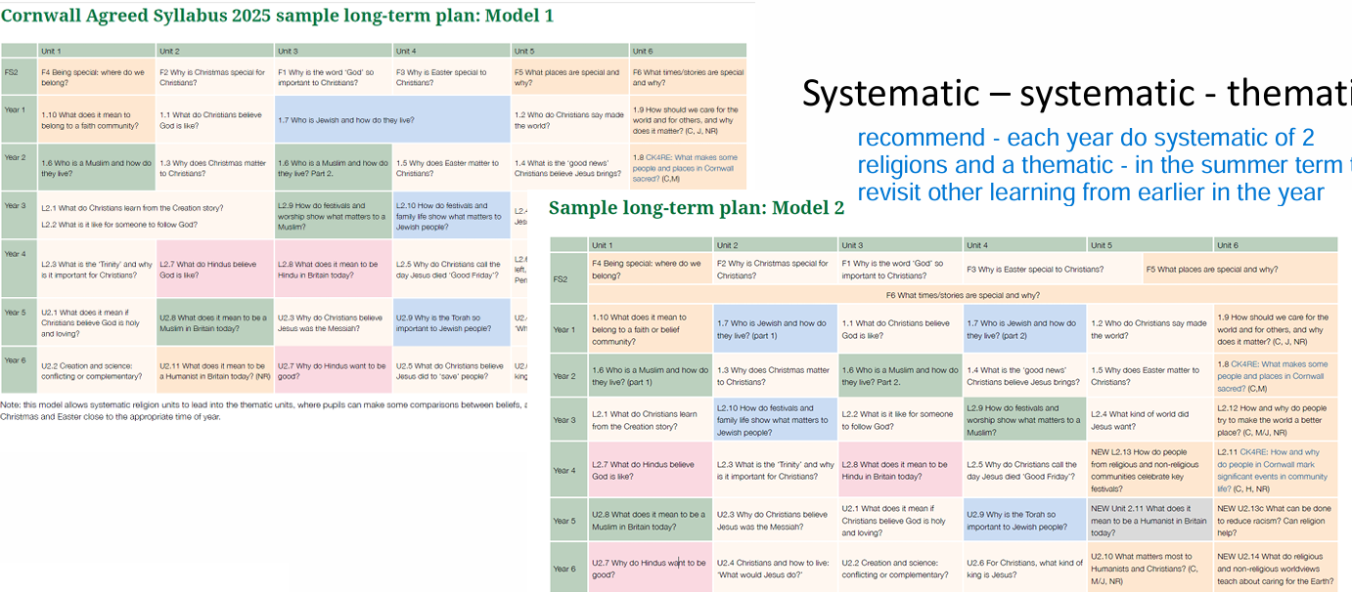
These plans are example only.
You will need to draw up your curriculum long-term plan that fits your setting.

Slide 11
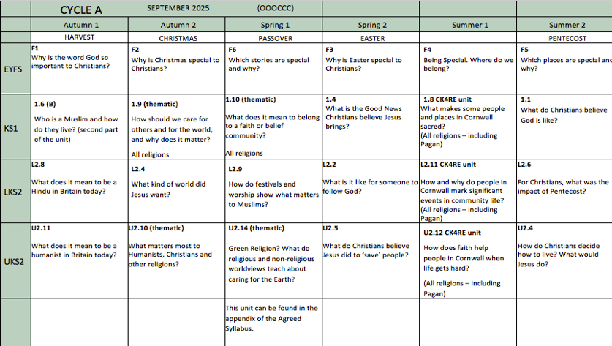
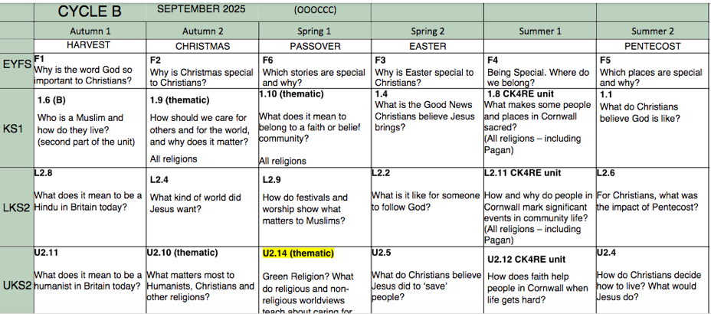
This is an example of a two-year rolling program for a 1 ½ form entry school.
Notes:
If you need help with curriculum planning (Cornwall folk) please don’t hesitate to contact me.

Slide 12
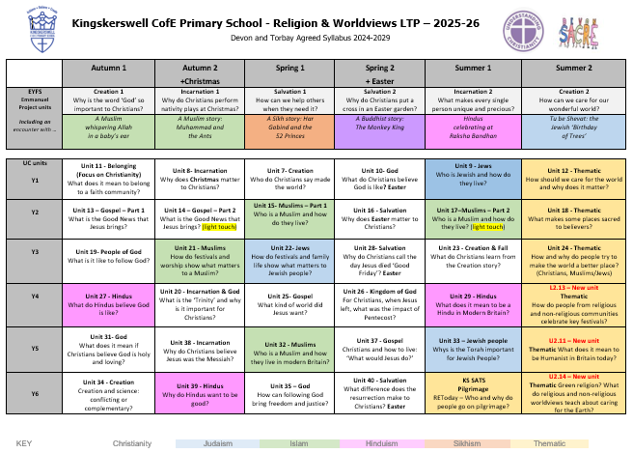
This is an example of a LTP for a 2-form entry school.

Slide 13

Getting down to it…

Slide 14
Teaching & Learning
Knowledge
Substantive knowledge
Ways of Knowing
Worldviews
Religious and Non-religious world views.

Slide 15
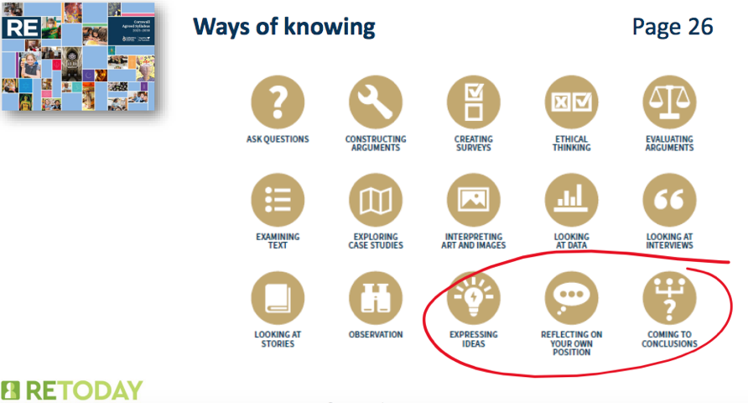
Abby Needs – Ways of Knowing in RE: Using disciplinary characters.
Notes:
In Religious Education, 'Ways of Knowing' refers to the different disciplinary lenses used to explore religion and worldviews:
• Theological – exploring beliefs, texts, and practices from within religious traditions.
• Philosophical – examining questions of meaning, truth, and ethics.
• Human/Social Sciences – understanding religion as lived experience in communities and cultures.
enable pupils to check …
show our working …
provide tools to check and test …
raise questions

Slide 16
Enrichment…
Use the Senses
Stories
Art
Visits & Visitors
Notes:
Add these to the PPT and QR codes for the centres
Resources: Books - Gill Vaisey Time to Wonder by Kathryn Taylor
Visits & Visitors – LTLRE, Faith Forum (Plymouth) RE Hubs, NATRE, RE Online

Slide 17
Assessment

Slide 18
The ‘so what? And ‘how?’
Assessment
Formative
Summative
Book Looks
Pupil conferencing – ask and they will tell you and show you!
Make sure you are getting time to do this at least once a term.
Notes:
The final section of the RE leadership toolkit focuses on assessment—both formative and summative—and the collection of evidence to support pupil progress. Formative assessment involves ongoing checks for understanding during lessons, such as questioning, discussions, and guided group work. This allows teachers to adjust instruction in real-time and provide targeted support. Summative assessment, on the other hand, evaluates learning at the end of a unit or term and can include written tasks, presentations, or creative projects. It is essential to consider what is being assessed—knowledge, understanding, skills—and the implications of the assessment outcomes. Evidence of learning can be gathered in various formats, including individual RE books, class floor books, digital portfolios on platforms like Google Classroom, and audio or video recordings of student discussions. These diverse forms of evidence provide a holistic view of student learning and can be used to inform future planning. RE leaders should encourage teachers to keep the intended outcomes in focus, planning backwards from these goals to ensure that teaching and assessment are aligned. By embedding effective assessment practices, RE leaders can support continuous improvement and demonstrate the impact of RE on student learning.

Slide 19

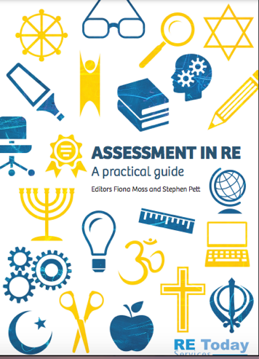
ASSESSMENT
Notes:
You will notice that I will be referring to NATRE/RE Today a lot. If there is one piece of advice I always give to schools is to get a NATRE Enhanced membership. RE Today is part of and linked to NATRE (National Association of teachers of RE) This Booklet is free if you are a member.
Empower your teachers and make your budget stretch further By joining your NATRE – your RE subject association and choosing its most cost-effective membership not only will you become part of a vibrant RE community but you’ll also gain access to a comprehensive toolkit designed to empower your teachers with tried and tested classroom-ready resources for all primary key stages (EYFS, 1 and 2) and, professional development opportunities to cater to teachers at all stages of their careers.

Slide 20

Notes:
These are questions that have been asked since the beginning of time! In my 34 years of teaching, the answers to these questions have changed on numerous occasions.
I honestly believe that in RE we should not be bogged down by assessment. If your outcomes have been met and you have observed, listened to and encouraged dialogue – your assessment is done!

Slide 21
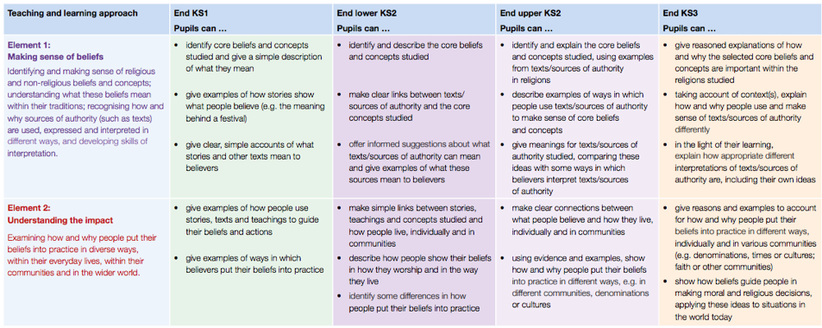

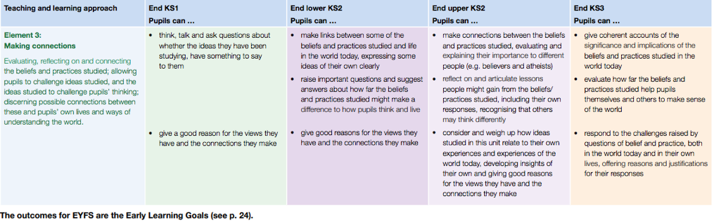
Notes:
The outcomes for the end of each Keystage is set out on pages 20 onwards. As the subject lead, you need to ensure the outcomes are achieve in order for the lessons to be meaningful and achieve the aims of the new AS.

Slide 22
RED TAPE: Bed time reading
Ofsted: Curriculum and standards Review
National Content standards – REC
RE Quality Mark – Self evaluation form
CoRE report 2018

Slide 23

Where to look for help and information.

Slide 24
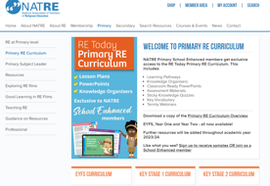
https://www.retoday.org.uk – Linked to NATRE which is a membership resource.
Reasons to join are numerous.
Resources, support, magazine with teaching ideas and booklets.
AND Lessons!! Primary RE Curriculum - RE Today Services (natre.org.uk)
Learn, Teach, Lead RE (ltlre) is a brilliant resource for teachers, in that it was set up for teachers. We hold termly hub meetings where examples of good practice is demonstrated, Assessment discussed, how to achieve outcomes and all things RE. www.ltlre.org
RE Hubs is another way you can find all the areas we have looked at today and are set up with teachers in mind.
www.re-hubs.uk
Notes:
Discuss each of these.
Dates for Diaries : Next Cornwall LTLRE hub meetings. If you have not signed up for emails, let us know and I can put you on the emailing list.
If any of you are interested in digging deeper into your own advancement into personal development, please speak to us.

