Slide 1

Learn Teach Lead RE (Southwest Peninsular) Conference
St Mellion
Friday 17th October 2025
Embracing Diversity and Inclusion through a Religion and Worldviews approach to RE
Find the resources at
https://ltlre.org/resources/ltlre-area-1-conference/

Slide 2

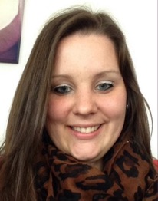
Keynote Speakers
Revd Anjali Kanagaratnam
Racial Justice Project Lead in the Diocese of Bristol
Born in Sri Lanka, she moved to the UK as a child
Former RE teacher
In her racial justice work Anjali leads on a contested heritage project and is passionate about intercultural worship and promoting global cultural awareness in the life and ministry of the Church
Katie Freeman
RE lead at Bickleigh Down CofE Primary School, Plymouth
Chair of NATRE (The National Association of Teachers of RE)
Katie leads the LTLRE Plymouth hub and is the author of extensive primary RE resources

Slide 3
Programme
Timings | Details
9.00am | Arrival and welcomes
9.30 | Ed Pawson, Jo Hunter and Greg Parekh | Introduction to the conference
9.35 | Keynote 1 – Revd Anjali Kanagaratnam Christianity: one faith, many colours | Drawing on her own experience, Anjali will reflect on the why it is so important to represent a diversity of expressions of the Christian faith in RE
10.40 | Refreshment break
11.00 | Workshop 1
11.55 | Lunch break
12.55pm | RE Updates and Local Groups
1.20 | Workshop 2
2.15 | Cake and Tea
2.20 | Keynote 2 – Katie Freeman | ‘Pilgrimage is praying with your feet’
3.00 | Panel: Jeremy Roberts (progressive Christian), Tim Johns (evangelical Christian), Rasha Mahfouz (Muslim) | Why do people go on pilgrimage and what do they get out of it? How does it relate to your faith/worldview?
3.30 | Evaluations and Close

Slide 4
11.00 – 11.55am Workshop 1
Workshop | Leader | KS | Notes | Room
Consolidating knowledge for new primary RE leaders | Cliffy Banfield, Laura Twamley | 1, 2 | Whether you are an experienced teacher or quite new to the classroom, this workshop aims to give you the tools to lead RE across your primary school setting with confidence. It will give guidance towards relevant resources and support materials. | St Mellion B
Creative storytelling in RE | Kate Vernon | 1, 2 | Ideas to incorporate storytelling into your everyday teaching, to engage and challenge children from EYFS to upper KS2 and beyond, and to provide them with valuable opportunities for spiritual reflection. | St Mellion A
Diversity within and between worldviews: how the Oak resources can help | Adam Robertson | 3 | This session will explore ways the new Oak Academy resources for RE can support the planning and teaching of a diverse and pupil-friendly KS3 Religion and Worldviews programme. | St Cleer
Reimagining RE: the AI REvolution | Greg Parekh | 3, 4 | A practical guide to using AI in the secondary RE classroom | Nicklaus Suite

Slide 5
1.20- 2.15pm Workshop 2
Workshop | Leader | KS | Notes | Room
Teaching substantive knowledge at KS1 | Katie Freeman, Sophie Greenaway | 1 | Katie and Sophie will be focusing specifically on RE at KS1, exploring creative ways to introduce key subject knowledge. | St Cleer
Unpacking the new RE syllabus | Belinda Twiggs | 1, 2 | Belinda will be exploring how we can use the new RE syllabus to teach better RE, focusing on specific units and introducing ideas from diverse worldviews. | Nicklaus Suite
Ways of Knowing in RE: using disciplinary characters | Abby Needs | 1, 2, 3 | Abby will be exploring what is meant by ‘Ways of Knowing’ and showing how we can use disciplinary characters to explore diverse perspectives. | St Mellion B
What is the experience of Pilgrimage for Muslims and Christians? How can we use it to teach better RE in primary and secondary? | Tim Johns, Jeremy Roberts, Rasha Mahfouz | 2, 3, 4 | In this session Tim and Jeremy will share their contrasting understandings of walking the Camino in Spain and Rasha will talk about their experiences of completing the Hajj in Makkah. | St Mellion A
Pupil voice and community action in RE | Sky Scott and Emma White | 2, 3, 4 | Sky and Emma will be sharing practical knowledge about how to recruit and train RE Young Ambassadors and how to run a successful community Iftar (fast-breaking) for Ramadan 2026, to engage your local Muslim families. | St Mawes Suite

Slide 6

LTLRE on social media
LTLRE website: https://www.ltlre.org
Facebook: https://www.facebook.com/groups/120605851735865
Twitter: @ltlre
#LTLREconference2025
LTLRE hubs:
West Cornwall
Mid Cornwall
East Cornwall
Plymouth
South Devon/Torbay
Exeter
East Devon
North Devon
Mid Devon
Special School

Slide 7
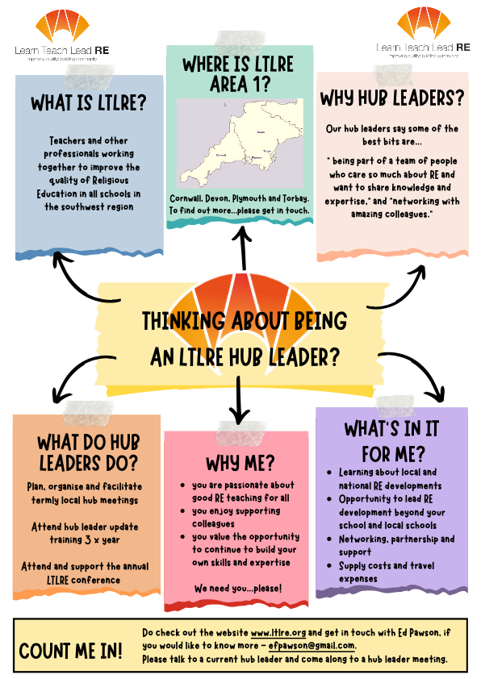
Link

Slide 8

RE Hubs: connecting teachers of RE to the resources they need
How are you using RE Hubs?
Link

Slide 9

Plymouth Centre for Faiths & Cultural Diversity (PCFCD)
Educational Charity based in Plymouth since 2001
Supports schools across Devon & Cornwall in the delivery of high-quality RE.
Offers Faith & Cultural Speakers & Interactive Workshops, (both face-to-face & online) - all major faiths/beliefs
Speaker-led visits to Places of Worship (Plymouth Synagogue, PIETy Islamic Centre, Minster Church of St Andrew & more)
Subscription & Pay-As-You-Use packages available
Go and chat to them today!

Slide 10
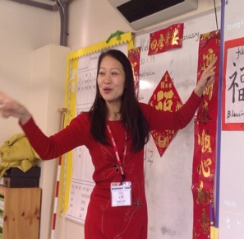
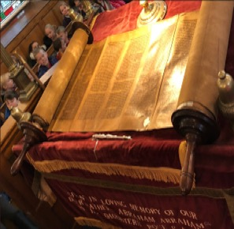
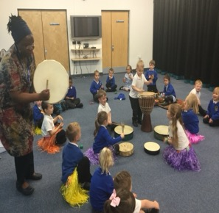
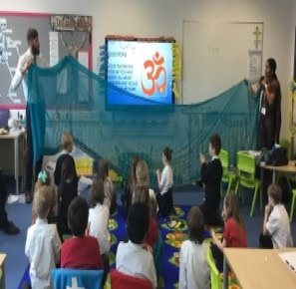
Experiencing diversity first hand allows children to encounter the reality of religion and culture as a way of life and the values that religions and traditions teach
Our speakers & visits to places of worship help schools to address the statutory requirements of their agreed syllabus for Religious Education, through lively and creative learning.
Our work also enables schools develop mutual respect and tolerance of those with different faiths and beliefs, a key aspect of British Values.

Slide 11

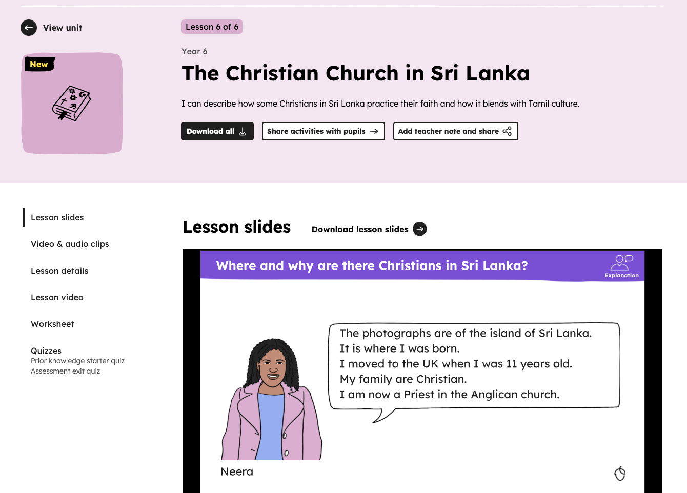
Oak Academy Resources
Year 6 unit: The Christian Church in Sri Lanka
Link

Slide 12
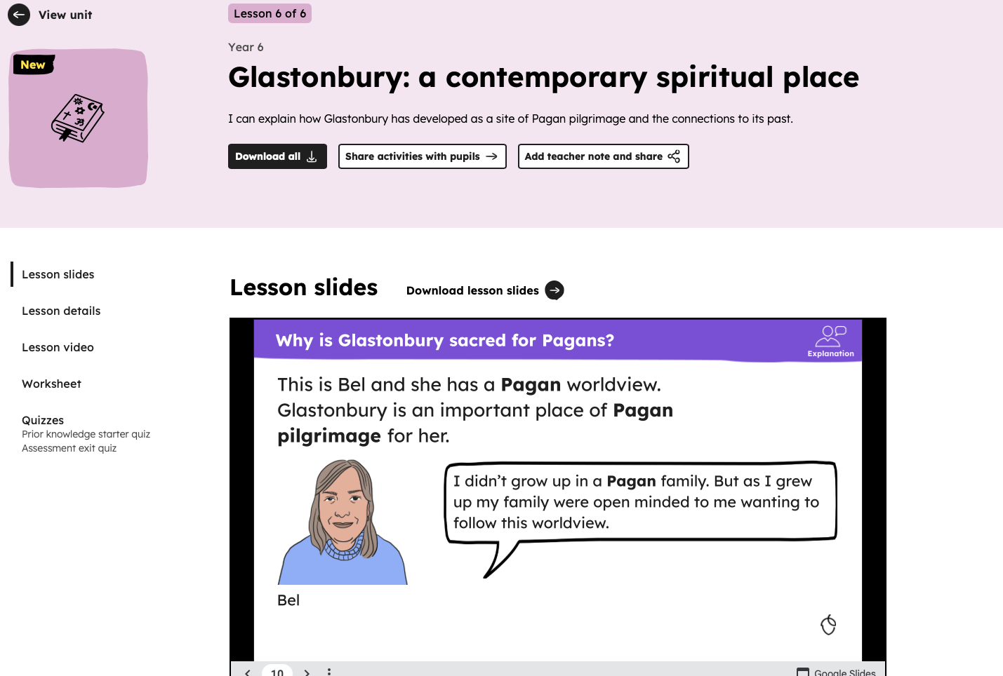
Oak Academy Resources
Year 6 unit: Glastonbury: a contemporary spiritual place
Link

Slide 13
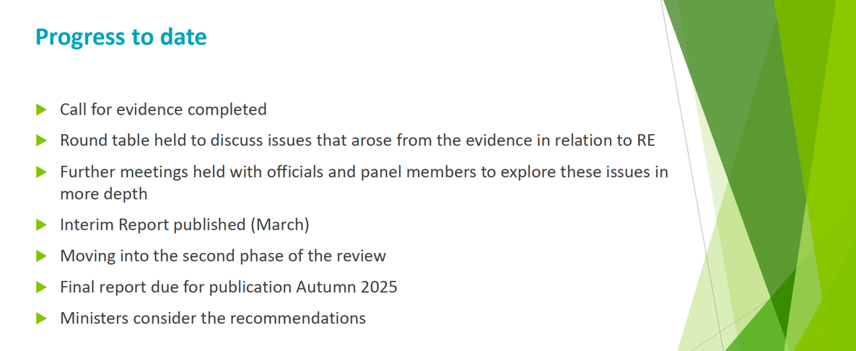
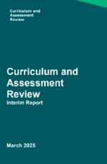
DfE’s Curriculum and Assessment Review

Slide 14
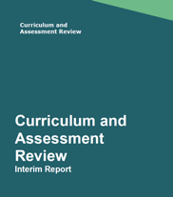
DfE: Curriculum and Assessment Review
Subjects not on the national curriculum
RE and RSHE are subjects that schools are required by statute to provide, but which do not form part of the national curriculum.
Despite the fact that RE is compulsory for all pupils up to the age of 18 (unless they are withdrawn), evidence suggests that a lack of national agreed content standards has led to national disparities in the quality of provision. Similar sentiments have been raised in the Call for Evidence responses and in a Review roundtable with RE organisations.
P29 CaAR Interim Report (published 18/3/20)
https://assets.publishing.service.gov.uk/media/67d9617b594182179fe08778/Curriculum_and_Assessment_Review_interim_report.pdf

Slide 15

Link

Slide 16
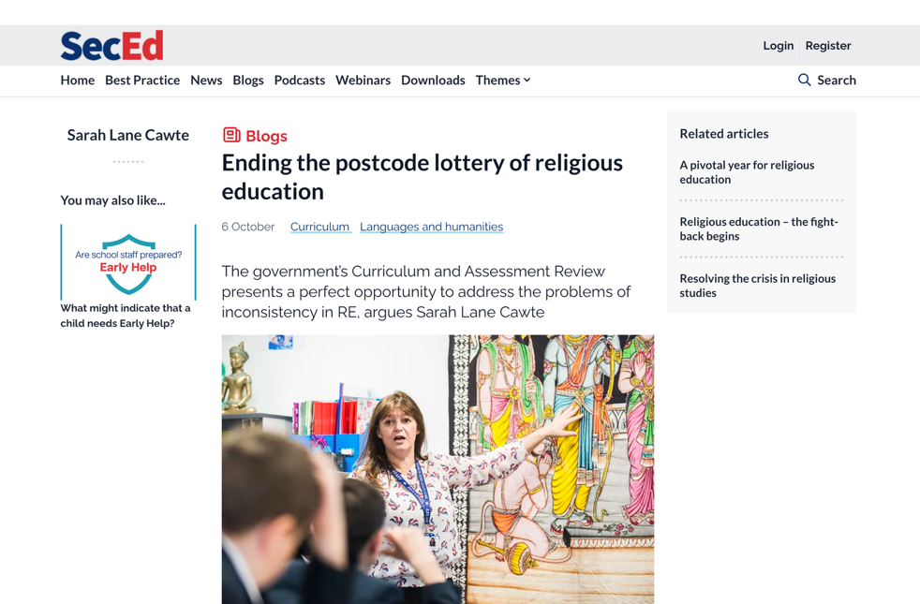
Link

Slide 17

NATRE primary subject leader page (free access)
https://www.natre.org.uk/primary/primary-subject-leader/

Slide 18
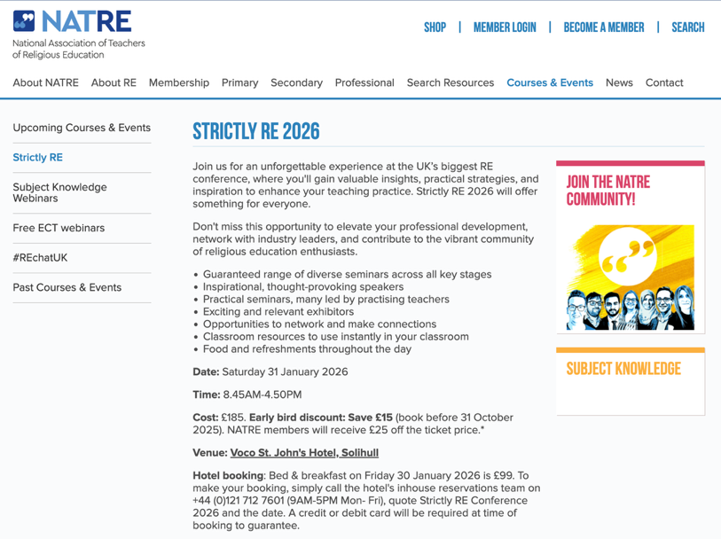
Strictly RE Conference 2026
Saturday 31st January 2026
Strictly RE is NATRE’s annual conference. It’s a great place for RE professionals to come together to share ideas, gain new knowledge and further boost your confidence when teaching RE
https://www.natre.org.uk/courses-events/strictly-re/

Slide 19

Applications are now open.
Closing date is Sunday 26th January 2026
https://farmington.ac.uk/farmington-institute-scholarship/

Slide 20

Find resources for Interfaith Week in schools here:
Link 1
Link 2
Email

Slide 21

TEST and TRIAL PHASE PLANNED FOR SPRING 2026 with the Diocese of Exeter, Education Team
Full training available from the Diocese of Exeter, Education Team from Summer 2026
For more details contact education@exeter.anglican.org

Slide 22
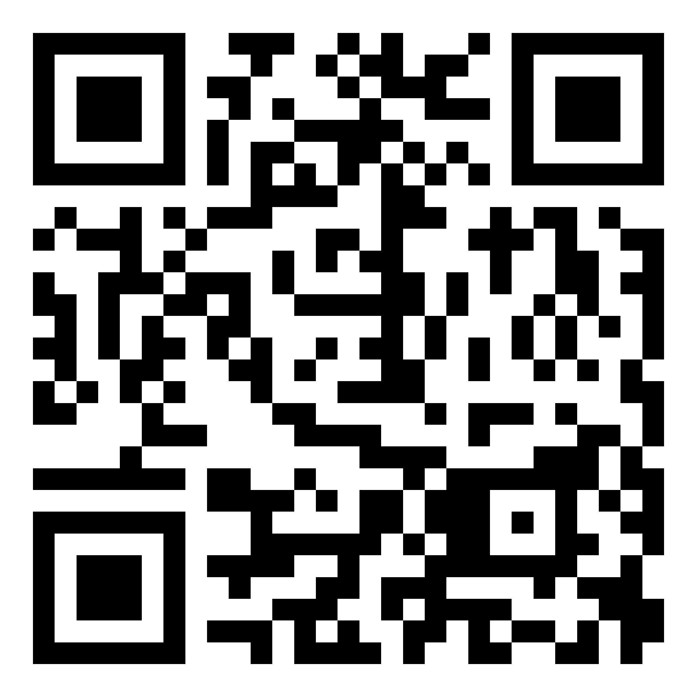
Conference Evaluations

