Slide 1
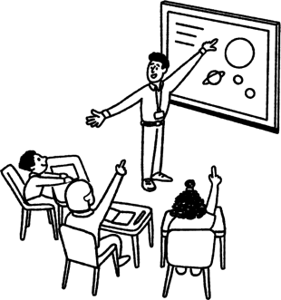
Diversity within and between worldviews
Adam Robertson,
Learn Teach Lead,
17th October 2025

Slide 2


What can you see?
What might you speculate?

Slide 3
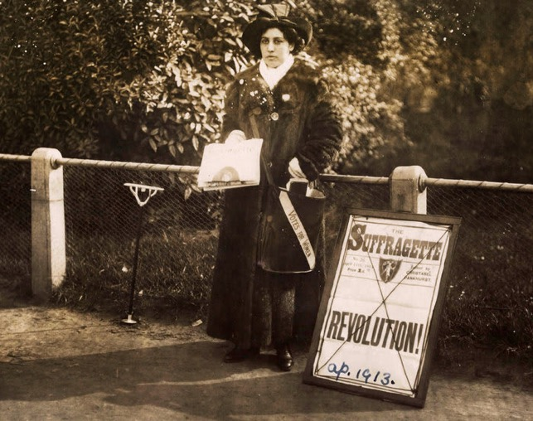
What can you see?
What might you speculate?

Slide 4
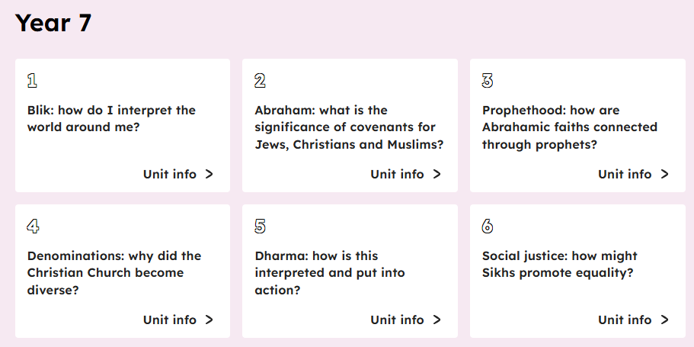
Curriculum sequences
Fully adaptable

Slide 5
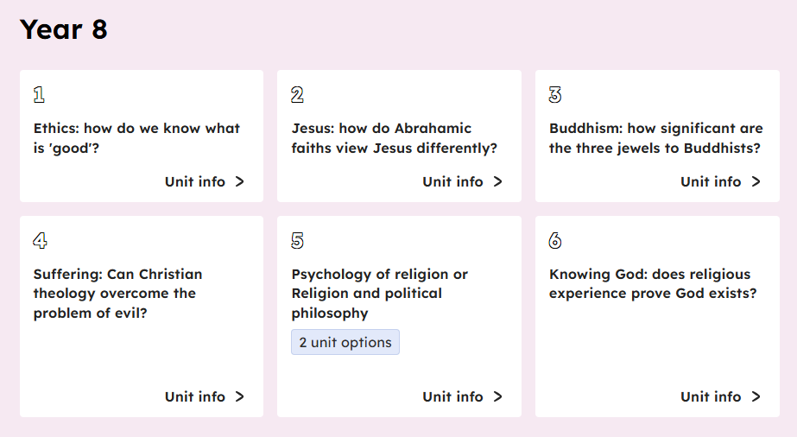
Curriculum sequences
Fully adaptable

Slide 6
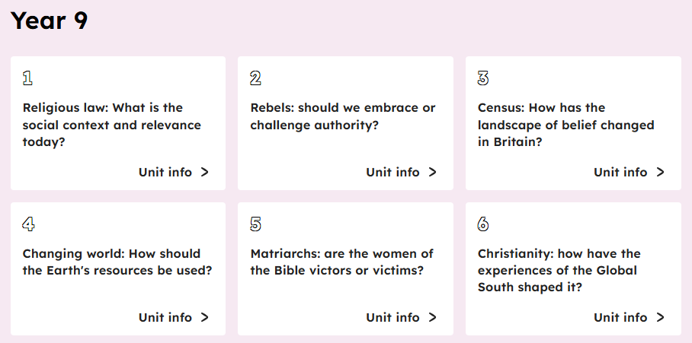
Curriculum sequences
Fully adaptable

Slide 7
What the Oak curriculum resources are…
Consistency of approach across all year groups:
Lesson structure
RE characters
Ways of knowing
Clear and reliable subject knowledge for teachers
Information on slides to give teachers confidence.
Checked with authentic sources.
Photographs, stories and ways to show RE is lived and real.
Case studies to use in the classroom.

Slide 8
What the Oak curriculum resources are not…
A script or set of slides that have to be used exactly as they are.
They are meant to be adapted to your context
The only resource that can now be used in the classroom.
Use video clips, other photographs and objects!
Every lesson ending with a worksheet and the same task every lesson.
Use your pedagogy to adapt the tasks.

Slide 9

Theology and Islamic diversity in Year 9

Slide 10
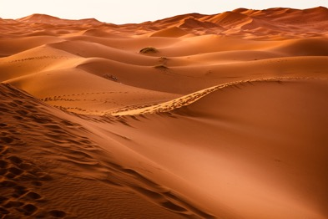
The meaning of Shariah
Imagine you are walking in a desert:
you feel exhausted, hot and dehydrated
you hope there is an oasis of water nearby
in the distance you see a path leading to water
What might you think about that path?

Slide 11
The meaning of Shariah
The term Shariah comes from Arabic and has this root:
Shariah
‘sh’ and ‘r’
the term’s literal meaning is a ‘well trodden path to water’
Shariah is often translated as ‘a path to a water source’ and is a guide for how Muslims can act in order to follow the religion Allah (God) has sent them.

Slide 12




The meaning of Shariah
Izzy wants to find out more about Shariah. She speaks to Sarah, who is a Muslim.
What does Shariah mean to you, Sarah?
Izzy
Shariah is the Islamic laws and ways of life. It guides me everyday in all that I do. It guides me on knowing what is permissible to me as a Muslim, which is known as halal, but also what is forbidden, which is known as haram.
Sarah

Slide 13


The origins of Shariah
Izzy wants to find out about the origins of Shariah. She speaks to Sarah, who is a Muslim.
What are the origins of Shariah law, Sarah?
Izzy
Many Muslims believe that the origins of Shariah law are linked to the first Muslim community.
Allah started revealing the Shariah when they started living together. It is when you live in a community that problems and tensions can begin!
Sarah

Slide 14
Interpreting Shariah using ijtihad
Religious law: What is the social context and relevance today?

Slide 15
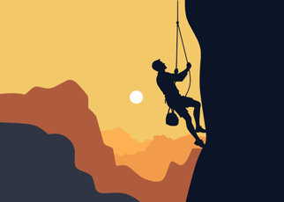
The meaning of ijtihad
The term ijtihad comes from the word jihad, which means struggle, effort, or fight, i.e. the effort or struggle to find the answer.
Ijtihad is the human effort of interpreting the Qur'an and Hadith (the Shariah) to identify the best action today.

Slide 16




The meaning of ijtihad
Alex wants to speak to a different Muslim about using ijtihad. He speaks to Sarah, who is a Muslim living in the UK.
Did the Prophet Muhammad agree with using ijtihad?
Alex
Yes, even during his lifetime. There is a famous story about this in the Hadith. The Prophet sent one of his companions, Muadh, to be a judge in Yemen.
When Muadh was about to set off, the Prophet asked him how he would make judgements.
Sarah

Slide 17


The meaning of ijtihad
This is the conversation found in the Hadith:
According to what will you judge?
Prophet
According to the Book of Allah (Qur’an).
Muadh
And if you find nothing?
Prophet
According to your Sunnah.
Muadh

Slide 18


The meaning of ijtihad
The conversation continued:
And if you find nothing?
Prophet
Then I shall try my best to form my own judgement.
Muadh
Praise be to Allah.
Prophet
This Hadith is seen by many Muslims to allow the use of ijtihad.

Slide 19



The meaning of ijtihad
Ijtihad is required to address new situations that are not addressed in the Qur’an or Hadith.
These issues may include:
use of the internet
use of nuclear weapons
use of new medicines

Slide 20
Interpretation using ijtihad
When ijtihad is used, Muslim scholars look at the Islamic source and ask structured questions such as:
What is being said?
Does this still apply today?
Is the source authentic?
Can the words be understood differently?
Who was this said to?
Is this order or advice?

Slide 21
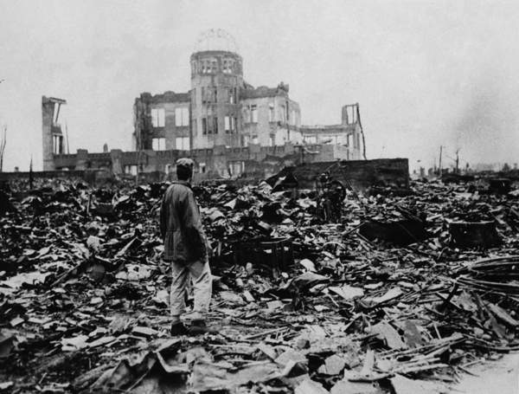
Interpretation using ijtihad
Case Study One: Using ijtihad to think about nuclear weapons:
The Qur’an states:
‘Fight in the way of Allah those who fight you but do not transgress the limits.’
(2:190)
How might this verse be interpreted?
Image: Universal History Archive/UIG / Bridgeman Images

Slide 22
Interpretation using ijtihad
Does this still apply today?
The word ‘limits’ has been interpreted to mean not hurting innocent people or causing unnecessary harm, staying within what was allowed.
What is being said?
Fight in self-defense rather than going beyond the limits.
Is the source authentic?
from the Qur’an - word of God
Can the words be understood differently?
No. The important idea here is what is meant by limits.
Who was this said to?
a Quranic instruction from God, given to Muslims for all time

Slide 23
Interpretation using ijtihad
What conclusion do scholars come to using ijtihad to think about nuclear weapons?
Nuclear weapons are not mentioned in the Qur’an.
The verse in the Qur’an can then be interpreted to mean that nuclear weapons are not acceptable in Islam.
This is because they go beyond the limits because of the destruction they cause.
Image: Universal History Archive/UIG / Bridgeman Images

Slide 24



Interpretation using ijtihad
Alex is confused about why some Muslims start the month of Ramadan on different days.
Why do my Muslim friends at school start fasting for Ramadan on different days, Iqbal?
Alex
Prophet Muhammad said: ‘Whenever you sight the new moon (of the month of Ramadan) observe the fast, and when you sight (the new moon at the end), break it. If the sky is cloudy for you, then observe fast for thirty days.’
This leads to different interpretations of the Islamic calendar.
Iqbal

Slide 25
Interpretation using ijtihad
When Prophet Muhammad was alive and many centuries after his death, people could only use their naked eye to see the moon.
Today, we have many ways to see the moon, including the naked eye, telescopes and moon maps to tell us if the moon is there.
Islamic experts have legal opinions using ijtihad that differ:
you must use only the naked eye still
you can use a telescope
you don’t even have to see it, as long as the moon map shows it is there

Slide 26

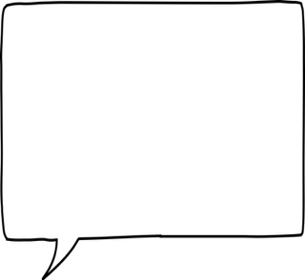


Interpretation using ijtihad
Ahmed and Iqbal, who are both Muslim, discuss their understanding of the Islamic calendar.
I believe that the new moon crescent needs to be seen physically using the naked eye. That is how you know there is a new month.
I believe the new moon crescent can be known through astronomical calculations rather than using the naked eye. That is how I calculate the new month.
How does this explain why Muslims might start fasting for Ramadan on different days?
Ahmed
Iqbal

Slide 27








Interpretation using ijtihad
Andeep, Sofia, Lucas and Aisha are discussing how scholars interpret using ijtihad. Explain who is incorrect and why.
There is no diversity of opinion about issues such as the new moon sighting.
Muslim scholars look at the Qur’an and Hadith and ask questions.
Andeep
Sofia
Ijtihad can be applied to new issues such as the use of nuclear weapons.
A challenge of using ijtihad is that there is not one agreed interpretation.
Lucas
Aisha

Slide 28
Using ijtihad to understand different Muslim attitudes to music
Religious law: What is the social context and relevance today?

Slide 29


Worldviews and ijtihad
Hassan, a Shia Muslim, explains how where a person lives can influence their worldview:
I believe where we live has a major impact upon our worldview. My family are from Pakistan. Pakistan has historical significance for Sikhs too, due to it being the birthplace of Guru Nanak. My father wears a Kara, a steel bangle worn as one of the five signs of the Sikh Khalsa. It is also common for us to call food at the mosque ‘langar’. Langar is the same term used by Sikhs at the gurdwara.
Hassan

Slide 30



Worldviews and ijtihad
Izzy wants to find out why there are different worldviews on music in Islam.
Why are there different views on music in Islam, Hassan?
Izzy
Muslim scholars interpret Shariah law in different ways. Some scholars believe it is acceptable (halal), depending on the lyrics and as long as it doesn’t incite harm, others think it should be avoided (haram) because it might distract people from prayer or encourage harmful actions.
Hassan

Slide 31
Music and different Muslim views
Muslim scholars can also look to the Hadith to interpret teachings on music:
What does this Hadith seem to suggest about the use of musical instruments?
What might the Prophet be saying by having them in this list?
“There will be among my Ummah people who will consider illegal; sex (outside marriage), alcohol and musical instruments as lawful.”
(Hadith of Bukhari)

Slide 32


Music and different Muslim views
Izzy wants to find out more about music. She speaks to Jamila, who is a Sunni Muslim.
What does that Hadith mean to you, Jamila?
Izzy
Some Muslim scholars note that musical instruments have been placed on a list of unacceptable or haram things like alcohol. Therefore they interpret the Prophet as saying that musical instruments are not acceptable. These are the scholars I follow.
Jamila

Slide 33


Music and different Muslim views
Does that mean you don’t listen to any music, Jamila?
Izzy
For me scholars have used ijtihad to say that musical instruments should not accompany a voice. They are following that hadith. So I do listen to nasheeds. This is Islamic singing that does not have instruments. The intention is to glorify God and not distract. I believe this is halal and acceptable.
Jamila

Slide 34
Music and different Muslim views
Muslim scholars can also look to other Islamic scholars to interpret teachings on music:
Why does Al Qurtubi argue music is halal (permissible) using the incident of Muhammad?
Muhammad didn’t stop music being played in front of him on a happy
occasion.
Music may be halal (permitted) if nothing haram is happening.
“Musical instruments were played in front of the Prophet (to welcome him) during his first arrival in Madinah and Abu Bakr wanted to tell off those who were playing the instruments but the Prophet stopped him saying: Leave them alone…our religion is relaxed and accommodating!”
(Al Qurtubi, Islamic scholar)

Slide 35
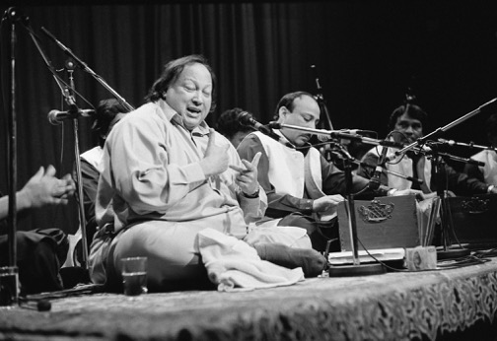
Music and different Muslim views
Nusrat Fateh Ali Khan (1948-1997) is a famous Muslim musician of modern times.
He used music as a way of showing love and devotion towards Allah and Prophet Muhammad.
Image: Michael Harder / Alamy

Slide 36

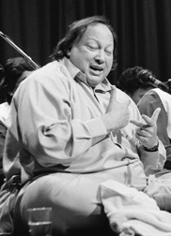
Music and different Muslim views
In 1997, Nusrat Fateh Ali Khan said:
When I sing for God, I feel myself in accord with Allah, and the house of God, Makkah, is right in front of me. And I worship. When I sing for Muhammad (peace be upon him), our prophet, I feel like I am sitting right next to his tomb, Medinah, and paying him respect and admitting to myself that I accept his message.”
Why did Nusrat Fateh Ali Khan sing for God and Muhammad?
Image: Michael Harder / Alamy

Slide 37


Music and different Muslim views
Izzy asks Hassan how his worldview impacts his thoughts on music.
Do you listen to music, Hassan?
Izzy
I grew up in my house listening to Nusrat Fateh Ali Khan. As a Shia Muslim, I think intention is really important. I do listen to music with instruments, that is part of my tradition. I believe it helps bring me to God. But I don’t listen to modern pop music with lyrics that are distracting or immoral.
Hassan

Slide 38
Music and different Muslim views
‘All Muslim scholars believe music is ‘haram’ (not permitted).
Give one reason why a Muslim scholar would agree with the statement.
Give one reason why a Muslim scholar would disagree with the statement.
Explain your answer using evidence from Islamic sources.

Slide 39

What do you think?
What might you use?
What might you adapt?
What might you change?

Slide 40
Some ideas for adapting slide decks
Think about your class and your context
What is the level of knowledge you have in your class?
How much do they know about these religions and worldviews?
Can I put less information on the slides?
Do I need to use all the case studies - get a balance to show diversity within religions.
Think about how long you are teaching this unit for. Some lessons could be split over 2 lessons if there is a lot of content.
Look back at the key learning points - what do you want pupils to know by the end of the unit
The following slides show a before and after for some lessons from units coming up in Term 2 2025.

Slide 41
Using the RE characters in your slide decks
The RE characters tell the story on many of the slides. Why? How could they be used?
They show that RE is about different worldviews
They start with people rather than abstract beliefs
They show diversity within different religious and non-religious worldviews
Their words could be printed out so pupils could read them aloud - to avoid teacher talk
They could highlight important words and phrases

