Slide 1
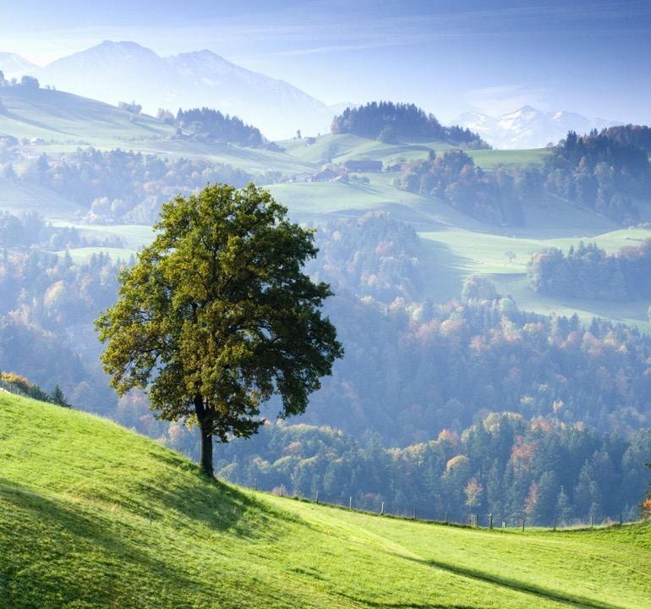
Pilgrimage
Praying with your feet?
Katie Freeman
NATRE Chair
Plymouth LTLRE Hub Leader
@KatieKates_84
Chair@NATRE.org.uk

Slide 2

What do you think of when someone mentions pilgrimage?
Notes:
Do we think of a particular pilgrimage, experience or image?
I would suggest that at times, we feel that we have taught pilgrimage well when we talk about one or two particular experiences. Hoerver, pilgrimage can be diverse, religious, non-religious and life changing. It supports the teaching about spirituality, diversity and lived experience…parts of RE that we should all be ensuring that we talk about.

Slide 3
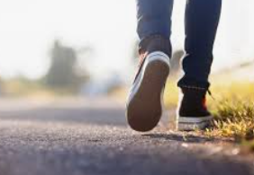
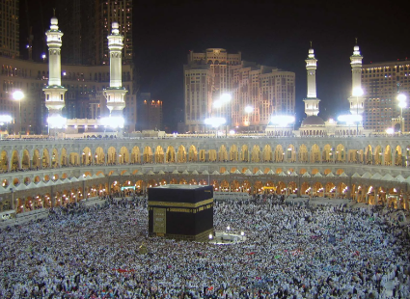
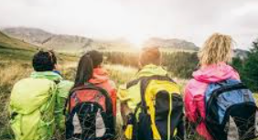
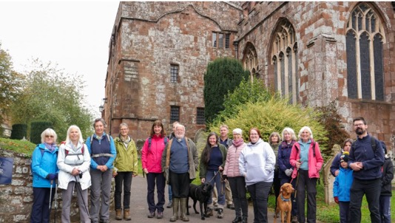
Think about when you talk about pilgrimage…
Notes:
Do we think of particular pilgrimages, people, walking or dialogue?
How can we bring this into the classroom?
Often teachers shy away from teaching about a diverse range of pilgrimages but actually this theme can and will bring diversity, dialogue and understanding into our RE classroom, whichever phase we teach.
The challenge is that our views on pilgrimage are probably what our pupils see.

Slide 4
What is pilgrimage about?
Encounter
Self Knowledge
Dialogue
Experience
Notes:
Encounter = the people pilgrims meet on the journey, learning form them and their lived experience
Self Knowledge = What is taken to pilgrimage – knowledge of self, other and the pilgrim’s own beliefs
Dialogue = The willingness to enter into dialogue, to learn, share and be open to reflexivity of their own positionality
Experience = Does the expected happen? Are there surprises along the way because of their encounter and dialogue?
If we are teaching about pilgrimage well, our pupils will gain an insight through the lenses we give them into what this means for livers of these experiences.

Slide 5

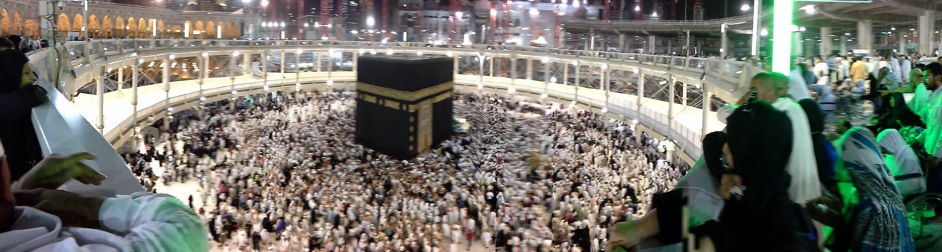
Encounter
The people pilgrims meet on the journey, learning /with them and their lived experiences. The places they visit and the encounter with them.

Slide 6
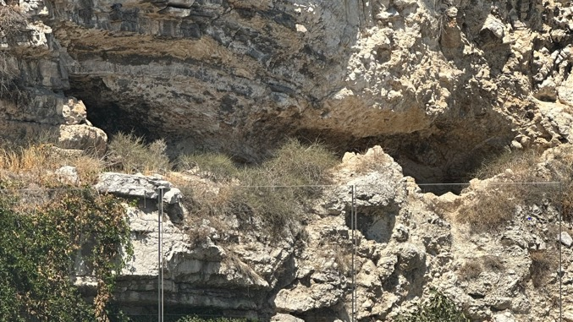
What did the pilgrims feel?
The garden tomb was such a peaceful and reflective place. We returned on Saturday (our free day) and simply sat soaking up the wonderful atmosphere. Also having communion there was a privilege and very meaningful.
Pam

Slide 7
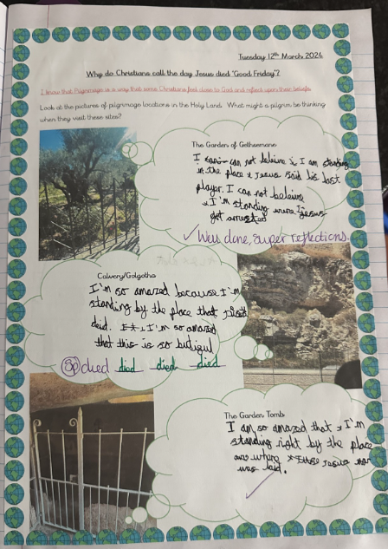
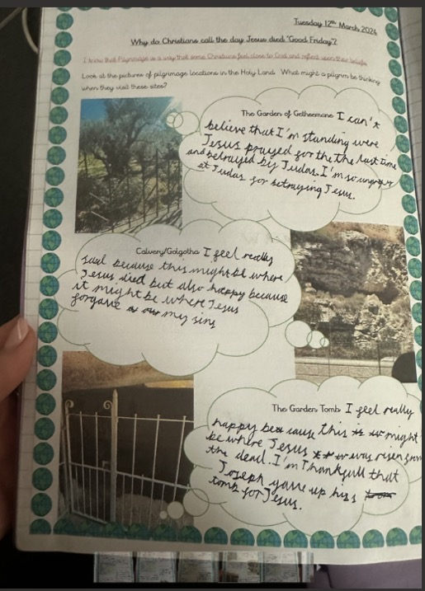
Notes:
Can the children apply their knowledge of why these places might be important? Can they put themselves in the shoes of the pilgrims and consider why these places might be important to real livers’ of religious worldviews?

Slide 8
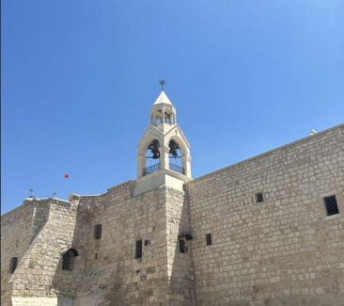
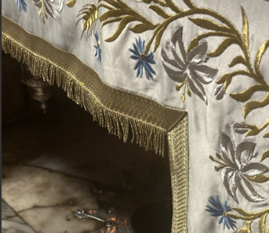
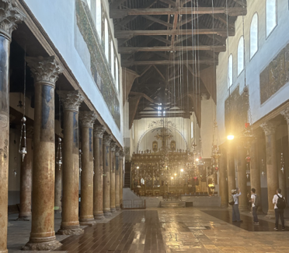
Sometimes encounter can cause ‘worldview shock’
Notes:
Ruth Flanagan talks about ‘worldview shock’ when someone’s own idea and worldview takes a shock because of what they learn, experience or encounter. This happened to me. Share Bethlehem story.

Slide 9

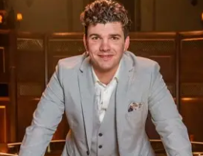
Self Knowledge
What is taken to pilgrimage – knowledge of self, other, the world, the beyond and the pilgrim’s own beliefs
My religion personally has always been strong and I have always known what I believe in. I don’t overcomplicated things. When I saw other pilgrims struggling that changed me. I wasn’t going to change what I believe but I didn’t like seeing them at conflict with themselves and what they believe. I wished I could give them a piece of me so their minds would be opened up and they would be at peace.
Harry form the Traitors
Notes:
Harry form the Traitors shared with us what encounter meant to him, how he was certain of his own worldview, felt this would not be shaken but struggled to hear that people were struggling with their own journeys within faith and belief. His encounters made him feel stronger in his own faith.

Slide 10

Reflexivity and positionality
Notes:
What pilgrim encounter can change their positionality, and thoughts. They might reflect on things they weren’t expecting to or wrestle with what they have encountered through dialogue with others.
Many pilgrims come back from pilgrimage talking about ‘being changed’…preparation for reflexivity and positionality is helpful for some.

Slide 11
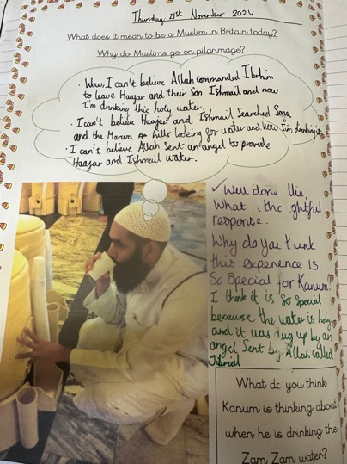
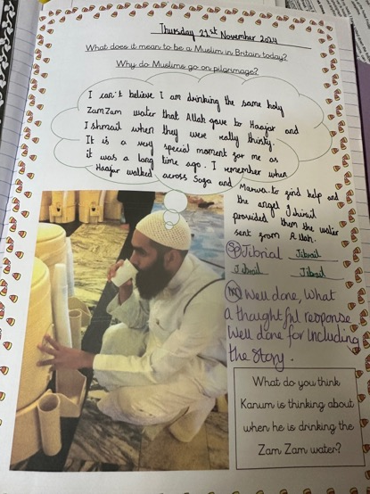

Pupil’s applying knowledge of worldview Positionality
Notes:
After talking about stories linked to elements of pilgrimage. Can children apply the lens of a pilgrim experiencing something for the first time? Do they know why this experience is important whilst acknowledging diversity of view?

Slide 12

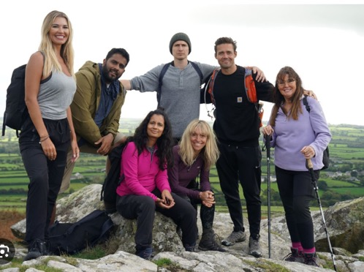
Dialogue
The willingness to enter into dialogue, to learn, share and be open to reflexivity of the pilgrim’s own positionality
Notes:
Dialogue occurring before, during and after the pilgrimage. How does it help? How does it create a bond between pilgrims?
Does it matter what you talk about?
A teacher friend on my own journey through the holy land said that she found it really helpful that our friend Dawn Cox asked really challenging questions about people’s worldviews in a respectful and careful way. This helped her to consider her own positionality and was a huge part of her journey because she could share what she really felt without fear of judgement.
Dialogue can also happen with people who pilgrims meet as part of their journey, sharing lived experience and what they have learnt or are elarning.

Slide 13
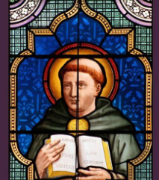
Considering if dialogue needs to be about faith or experience
"To one who has faith, no
explanation is necessary. To
one without faith,
no explanation is possible"
Thomas Aquinas

Slide 14
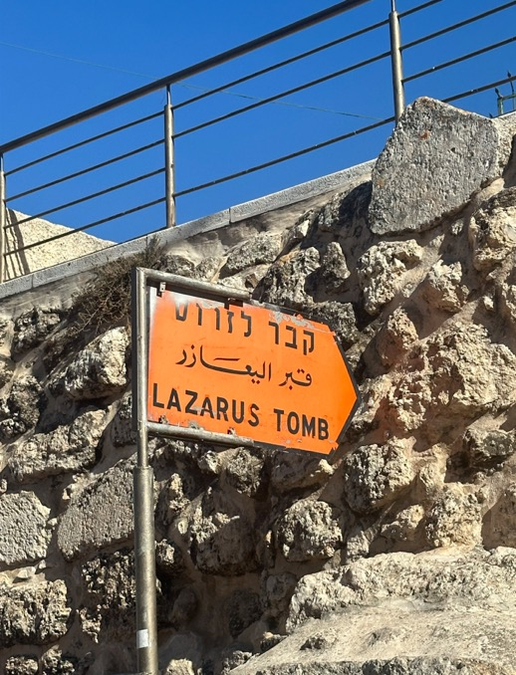
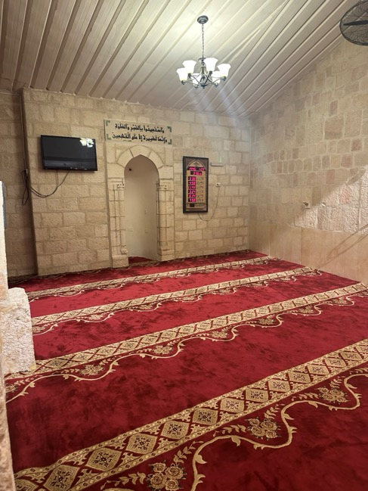
Notes:
Dialogue in Bethany
Hearing from Muslim worshipers and Christian pilgrims about their lived experiences and hearing Christian pilgrims and Muslim woman praying at moque, visiting places that are important for each other and entering into dialogue about lived experience.

Slide 15


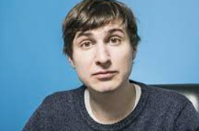
Experience
Does the expected happen? Are there surprises along the way because of the pilgrim’s encounter and dialogue?
I had two or three religious experiences where the divine revealed itself to me. It hasn’t happened since so I am deeply grateful. (Tom)
Notes:
BBC Pilgrimage series – focuses on people from different worldviews walking together and traveling on pilgrimage sharing lived experience.
Tom R – explained that his family had Jewish history but he did not believe himself, he felt he was going on a journey to talk with people and walk. He was surprised by his experience and encounter.
Explain Tom’s enthusiasm for pilgrimage and how this changed his worldview.

Slide 16
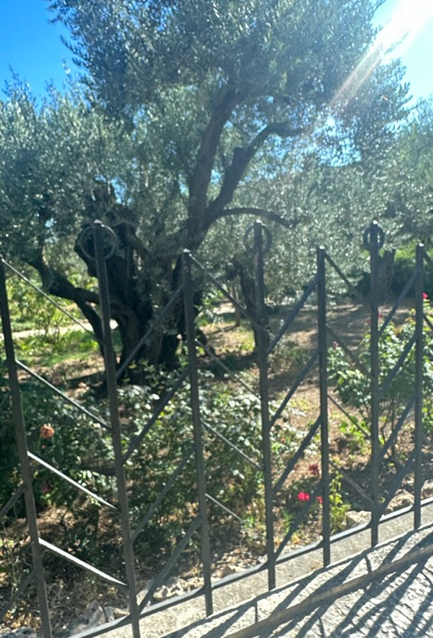
As someone who isn’t religious, but raised in a Christian family, visiting the Holy Land was about connecting stories from the Bible to a physical place and putting them into context. Sitting in the peace of the Garden of Gethsemane, surrounded by ancient olive trees, made me feel connected to the past and the reality of those stories, This Triggered a deep thinking about my own faith.
Nikki

Slide 17
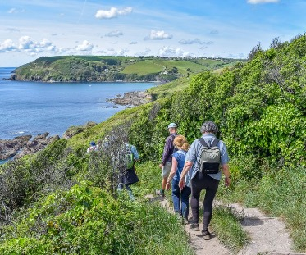
Making links to spiritual development
‘Spirituality is ‘relational consciousness’ whereby individuals relate to self, others, the world around them and to a divine other’
Rebecca Nye
Notes:
Rebecca Nye talks about the links that we make to the world around us, on pilgrimage, pilgrims will have opportunities to link to all these areas of fevelopment, By teaching about it and sharing lived experience of pilgrims, we are giving children the opportunity to consider their own encounter, lived experience and possible reflexivity.

Slide 18
Pilgrimage – do we always know that we are doing it?
Encounter
Self Knowledge
Dialogue
Experience
Notes:
When does a holiday turn into pilgrimage?
Who do we ‘do pilgrimage with?
When does it become life changing?

