Slide 1
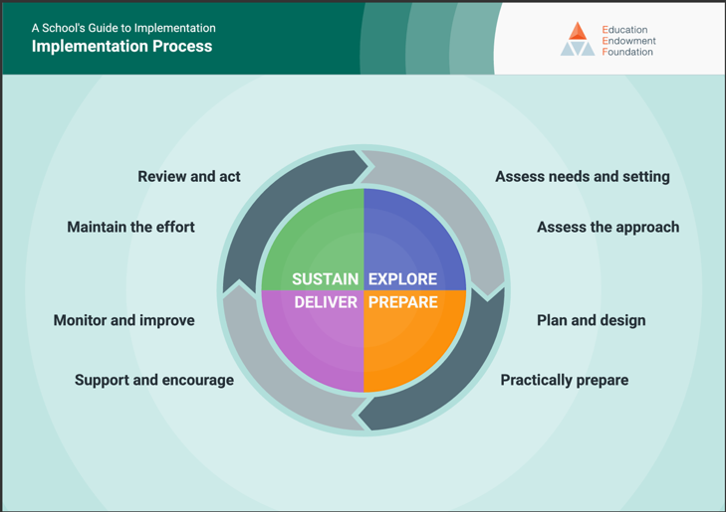
Sky – Deliver, monitor and improve, maintain the effort, review and act at Okehampton College.
Sky – Sustain model in ensuring that BV ambassadors continue at Okehampton College.

Slide 2
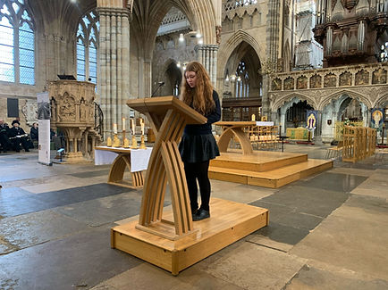
What have we done to improve, support and encourage process…
What our 2024-2025 look like
Enthronement of Bishop Mike Harrison
Display for Interfaith
HMD, speaking and lighting candles at Exeter Cathedral
Students ran assemblies on HMD, using the HMD memorial trust resources
Hosted an Iftar for Muslim communities
Went to Parliament and sat at the round table, speaking with MPs on Religious Education in schools.
Taken on more leadership roles, setting up clubs during the school day, debate and politics club, Christian Union Club, Pride alliance.
Brought Mel Stride MP into the school and spoke with him regarding Education and RE within Okehampton College

Slide 3
What have we done to improve, support and encourage process…
Enthronement of Bishop Mike Harrison
Display for Interfaith
HMD, speaking and lighting candles at Exeter Cathedral
Students ran assemblies on HMD, using the HMD memorial trust resources
Hosted an Iftar for Muslim communities
Went to Parliament and sat at the round table, speaking with MPs on Religious Education in schools.
Taken on more leadership roles, setting up clubs during the school day, debate and politics club, Christian Union Club, Pride alliance.
Brought Mel Stride MP into the school and spoke with him regarding Education and RE within Okehampton College
With a group already formed and well known – SLT can call on them, responded to invites. We were lucky enough to be able to speak at the Enthronement, and when Mel Stride MP came in as a result from the Parliament trip, SLT were able to invite them to speak with him at school.

Slide 4
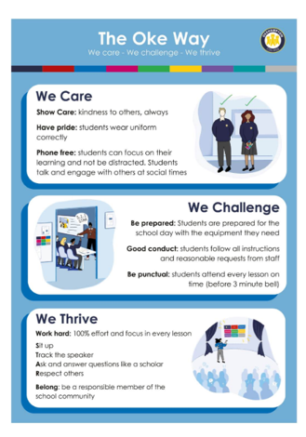
Every Friday during Break 2, we come together to brainstorm ideas, develop plans, and explore ways to tackle key issues. Clear vision guides our work. As a College, our mission is to strengthen the connection between school and community.
Our shared ambition is for all students to be caring people who embrace challenge and thrive in our society
With the ambition being central, we discuss ways that bring people together, showing care, belonging, support and community focus.

Slide 5
What is an Iftar…
An iftar is the evening meal that Muslims eat to break their daily fast at sunset during the holy month of Ramadan. It is a special, often communal, event that follows the day's fast and is typically preceded by breaking the fast with dates and water.

Slide 6
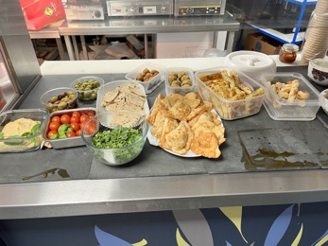
How We Hosted Our School Iftar
Making Connections - We reached out to Neomi Alam at Exeter Mosque, building on connections made during our visit for Holocaust Memorial Day. Establishing relationships with local Muslim communities is key to ensuring cultural sensitivity and support.
Planning the Date - The last two weeks of Ramadan are especially sacred, so we chose to host our Iftar in the first two weeks to avoid conflicts.
We checked the school calendar to avoid clashes with other events.
Timing the Iftar - Iftar happens at sunset, so we confirmed the exact time with the Mosque.
As it’s an after-school event, we made sure staff and site teams were informed and available.
Venue & Logistics - We cooked in the DT rooms and transported food to the hot canteen using trolleys.
Coordinated with the site team for locking up after the event.
Invitations - Sent a whole-school letter with a Microsoft form to track attendance. Families were warmly invited to join, fostering community spirit. We also added this to our school bulletin and Social Media.
Food & Essentials - We kept the menu simple and inclusive:
  Vegetarian curry (Halal-friendly)
  Salad and breads
  Dates (3 per person)
  Water bottles
Shared food from different cultures to promote belonging and connection.
Don’t forget Tea and Coffee!
Budgeting - Essential items to budget for:
  Water bottles
  Dates
  Ingredients for the main meal
  Serving supplies

Slide 7
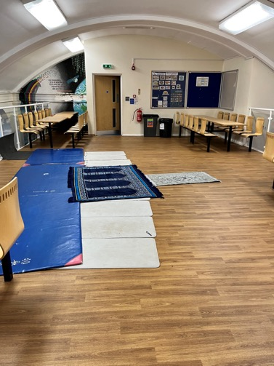
Prayer
Breaking the fast traditionally takes place after the Maghrib prayer, which occurs at sunset.
To support this, we prepared a quiet space for prayer—with help from the PS department, mats were laid out to offer families a comfortable area to observe Maghrib together.
Once the prayer was completed, the fast was broken with dates and water, following tradition. After that, everyone was able to enjoy the delicious food and share in the warmth of the evening.
Having an area that is quiet is best. We used the Qibla app to help with knowing where to lay our mats.

Slide 8

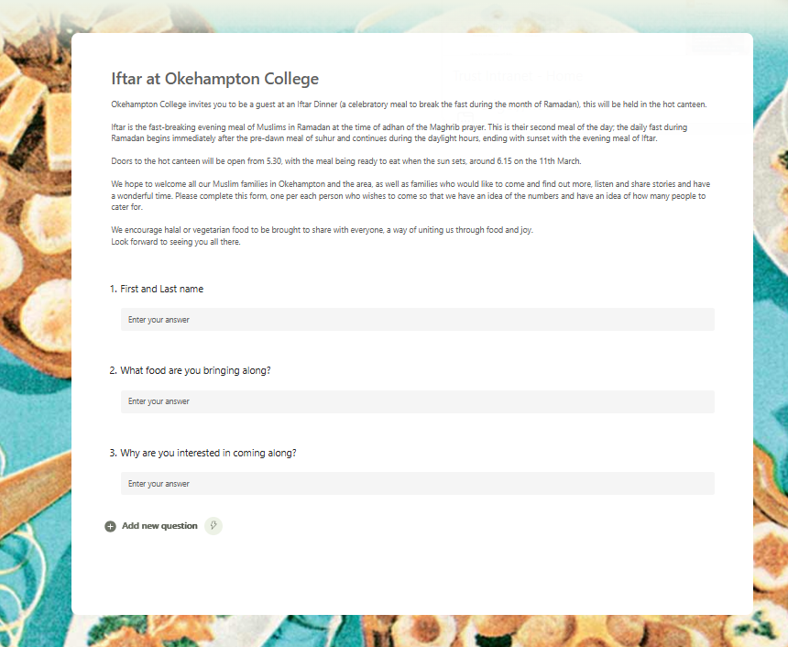
Getting the invites out for families!
We used Canva and a Microsoft form for this.

Slide 9
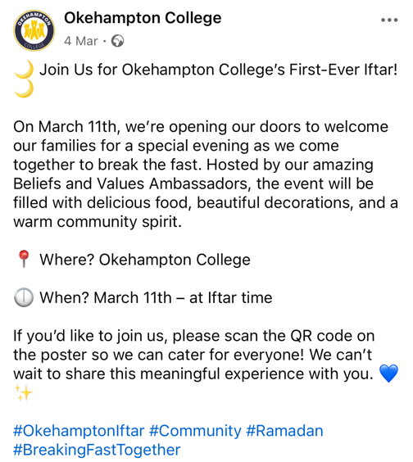
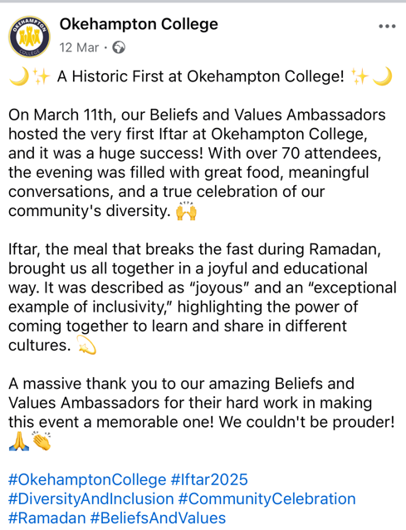
Using social media to also communicate home.
Don’t forget the follow up post.

Slide 10
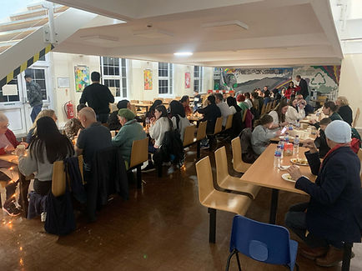
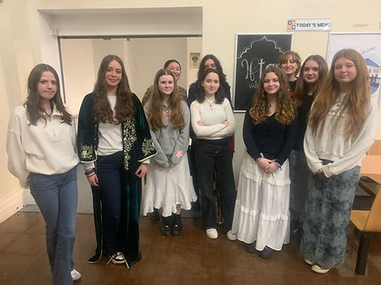
“In the two years that I have been living in Okehampton, this is the first time I have felt like I am a part of the community” Member of our Afghan community

Slide 11
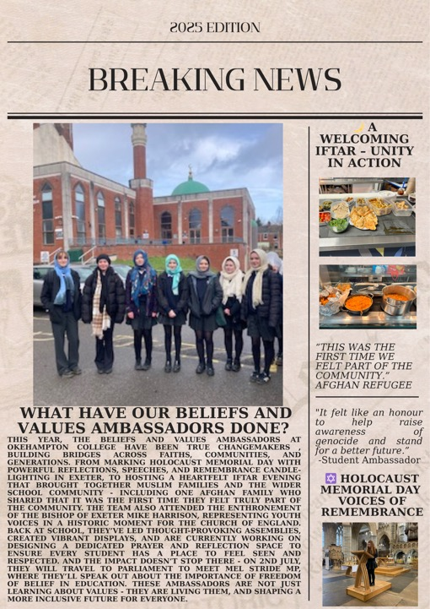
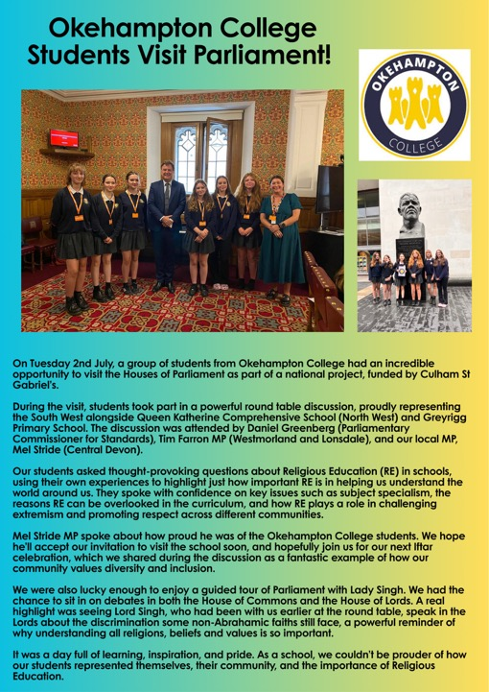
School bulletin’s, social media, Newsletter.

Slide 12
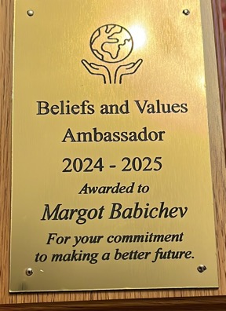
Celebrating our BV ambassadors.
At the end of the academic year, it was important for me to have these students recognised for their hard work that they have done that year.
Getting the principle to say a few words and getting them a trophy/certificate is a simple way of showing this, support the sustainment of the group.

Slide 13

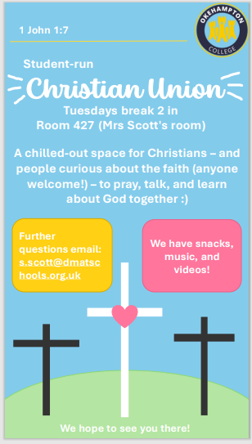
What next… Our BV ambassadors have taken on more leadership roles
BV Ambassadors have taken more leadership roles within the school. Being a part of the student leadership team and organise clubs for students across all Key stages. 5 of the 8 students with teacher support have set up clubs.

Slide 14
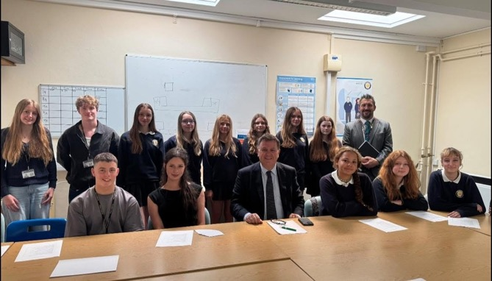
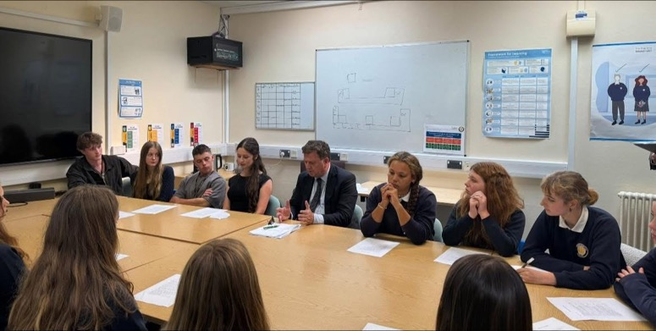
When our Student leadership team and BV Ambassadors met with Mel Stride MP

Slide 15
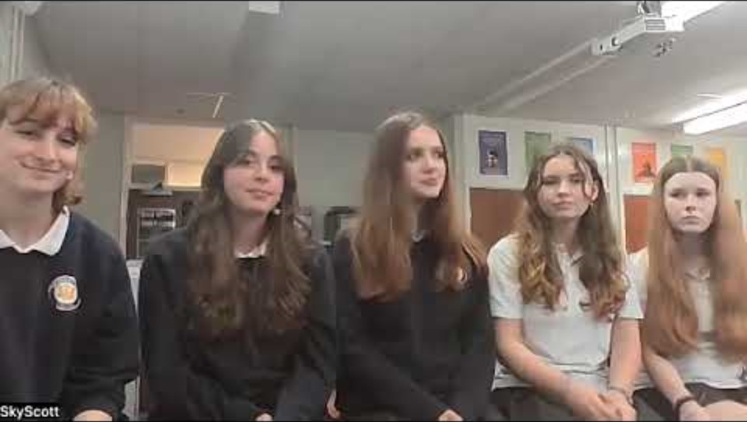
Empowering our Young Ambassadors…

Slide 16
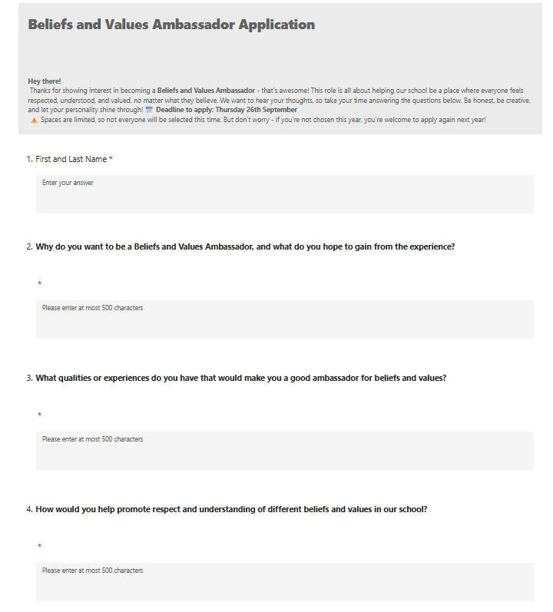
What's next… Sustain
As part of our recent ‘sign-on’ day at the start of the academic year, students had the opportunity to register their interest in various clubs and initiatives. Following last year’s success, eight students expressed interest in becoming BV Ambassadors.
To better understand their motivations, we sent each student a short questionnaire with four reflective questions. This helped us select a committed group who now meet every Friday during Break 2 to plan activities and initiatives for the academic year.

Slide 17
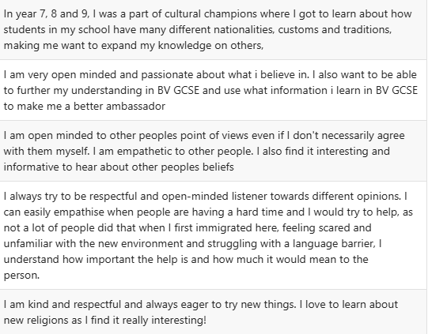
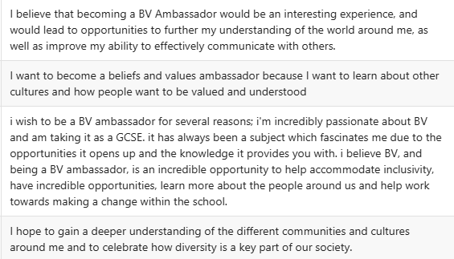
What are some of the responses on the BV application forms:

Slide 18
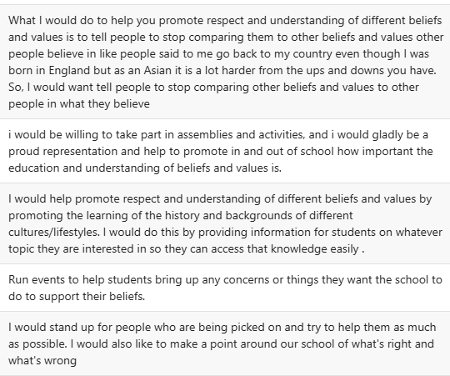

Slide 19
Benefits…
Promotes RS across the school and this can help boost numbers at GCSE and A 'Level – We have resurrected RE at Okehampton College!
Empowers young people and gives them great opportunities.
Used for UCAS applications.
All pupils learn the importance of understanding the Beliefs and Values of others.
Creates a sense of belonging.

