Slide 1

Telling the Sacred Story: Creative Storytelling in Religious Education

Slide 2
Workshop Objectives
By the end of this session, you will:
• Understand why storytelling is vital in RE.
• Explore how stories shape understanding of faith and values.
• Experience creative ways to tell Bible stories.
• Plan how to integrate storytelling into RE lessons.

Slide 3

Why Storytelling Matters in RE
• The Bible is a collection of stories about God and humanity.
• Children make sense of the world through story.
• Stories build empathy and imagination.
• In RE, stories help connect belief with lived experience.
“Tell me the facts and I’ll learn. Tell me the truth and I’ll believe. Tell me a story and it will live in my heart forever.”

Slide 4
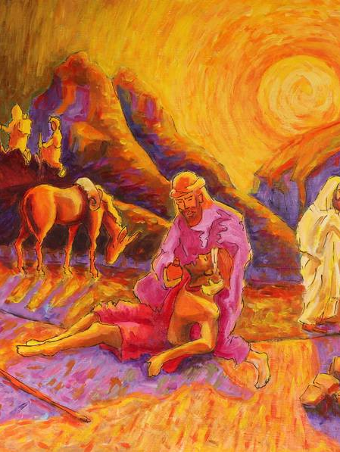
Creative Storytelling Techniques
• Drama & Role-play – e.g. The Good Samaritan (freeze frames, conscience alley)

Slide 5
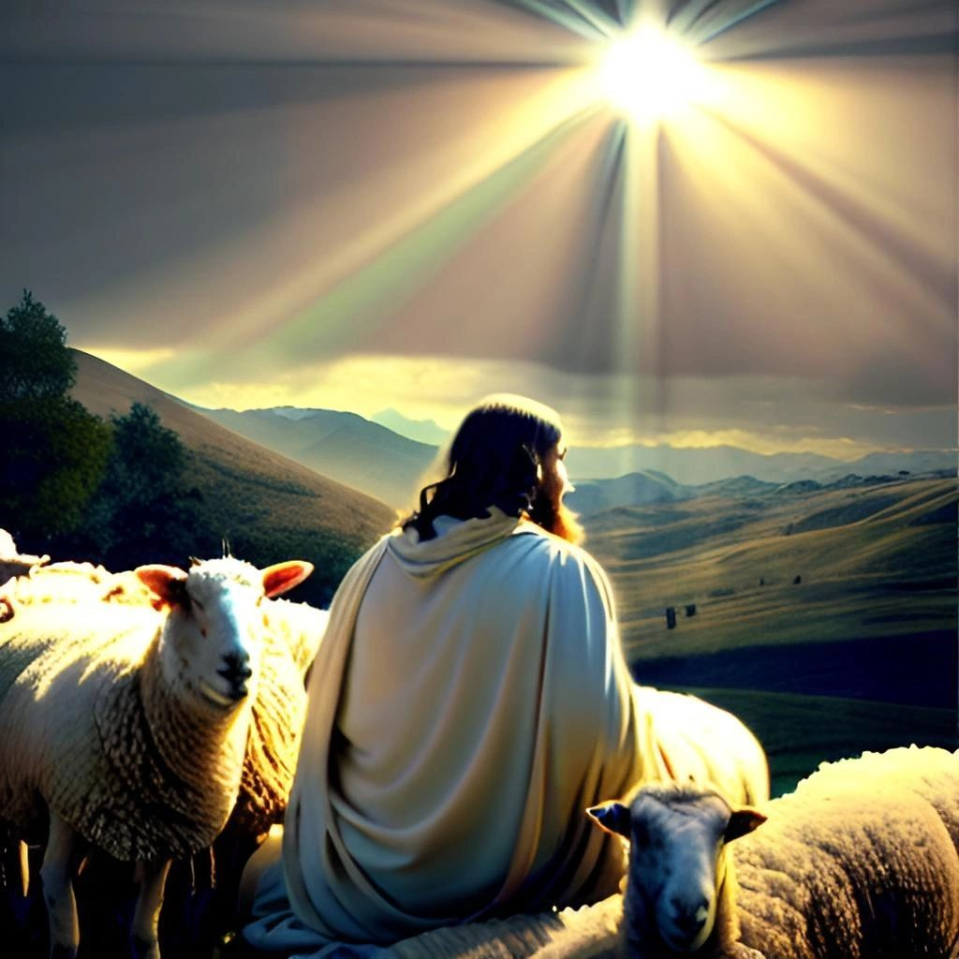
Creative Storytelling Techniques
• Godly Play – gentle, reflective storytelling (The Good Shepherd)

Slide 6
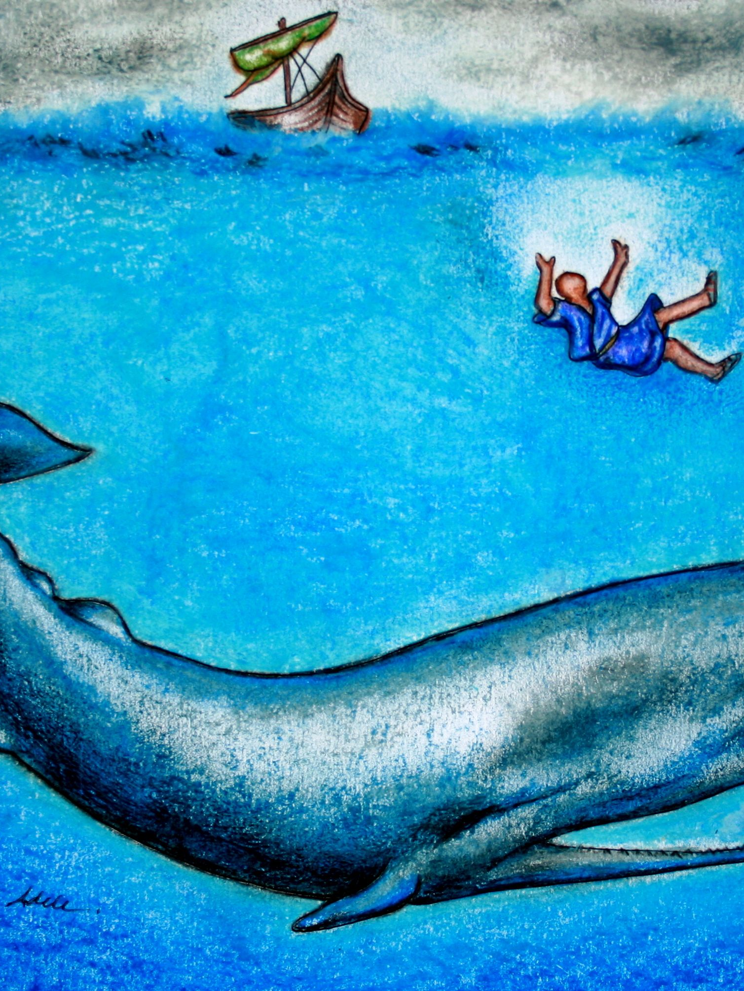
Creative Storytelling Techniques
• Story Bags – tactile props (Jonah and the Whale)

Slide 7
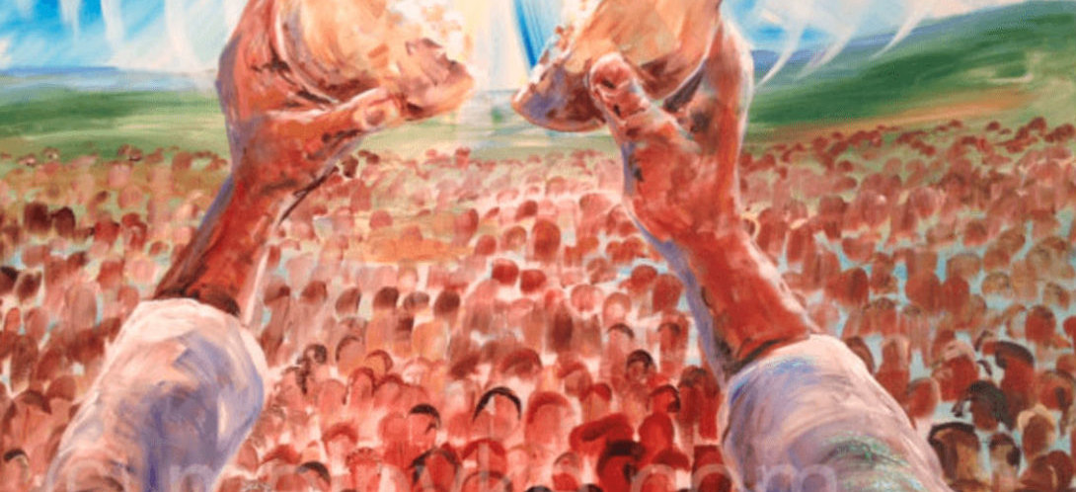
Creative Storytelling Techniques
• Art & Visuals – storyboards, comic strips (Feeding of the 5,000)

Slide 8
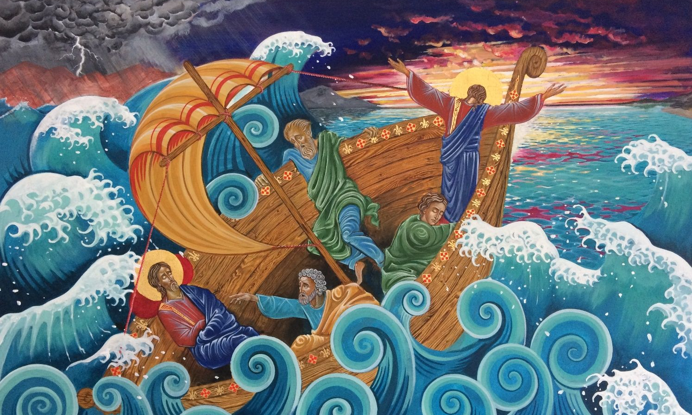
Creative Storytelling Techniques
• Music & Soundscapes – build atmosphere (Jesus calms the storm)

Slide 9
Group Activity
In small groups:
• Choose a Bible story (e.g. The Lost Sheep, David & Goliath, Jonah and the Whale).
• Retell it creatively using one method.
• Present briefly to the group.

Slide 10

Reflection…
What worked well?
How might this deepen pupils’ understanding of faith?

Slide 11
Linking to the RE Curriculum
• Storytelling supports aims of the Church of England RE Statement of Entitlement:
– Enables pupils to explore Christian beliefs and values.
– Encourages reflection and personal response.
• Use ‘I wonder…’ questions to deepen thinking:
– I wonder what this story tells us about God?
– I wonder how this story connects with our lives today?

Slide 12

Closing Reflection
Which Bible story will you tell differently this week?

