Slide 1


Bristol and South Glos SACRE Conference
Engineers’ House, Bristol
Friday 6th Feb 2026
Exploring the rich diversity within and across religious and non-religious traditions
Find the resources at
https://ltlre.org/resources/

Slide 2
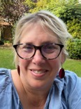
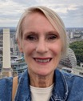

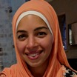

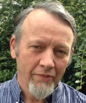
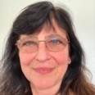
Keynote and Panel Speakers
Fiona Moss is the Education and Programmes Manager for Culham St Gabriel’s Trust. Previously, Fiona was a successful primary teacher of RE before becoming an Adviser with RE Today and NATRE CEO.
Julia Beckett is a Humanist, an experienced school speaker and member of the BANES SACRE. Her working life has been dedicated to 14 - 19 education
Revd Anjali Kanagaratnam is Priest in Charge, South Severnside, and Racial Justice Co-Ordinator in the Diocese of Bristol. She is a former RE teacher
Kate Neill is a Humanist, and has recently joined Bristol SACRE as their rep for Humanists UK
Dr Norah El-Gohary is a lecturer in the Department of Psychology at Bath Spa University. She is a former RE teacher and a member of the Islamic community
Iris Segall is a member of The Bristol and West Progressive Jewish Congregation, and a member of South Glos and BANES SACREs
Bhadra is a member of the Triratna Buddhist community and a lead figure at the Bristol Buddhist Centre

Slide 3

Programme for the Day
 | Activity | Facilitator/Room
9.00 - 9.30 | Arrival, registration and ‘breakfast’ refreshments
9.30 - 9.40 | Welcome and Introductions | Laura Harris and Ed Pawson Clifton Suite
9.40 - 10.40 | Keynote presentation Exploring how we can teach about the rich traditions within and across religious and non-religious communities | Fiona Moss, Culham St Gabriel’s Clifton Suite
10.40 - 11.00 | Refreshment break
11.00-12.00 | Group and panel discussions: Exploring diversity of perspectives Interviewing and dialoguing with Christian, Buddhist, Muslim, Hindu, Jewish and Humanist voices | Rm 1: Norah El-Gohary (Muslim) Rm 2 Iris Segall (Jewish), Anjali Kanagaratnam (Christian) Rm 3: Bhadra (Buddhist), Julia Beckett (Humanist), Kate Neill (Humanist)
12.00 - 12.50 | Lunch
12.50 – 13.10 | Local updates and Hub networking | Laura Harris, Ed Pawson and LTLRE Hub leads Clifton Suite
13.10 - 14.05 | Workshop 1
14.05 – 15.00 | Workshop 2
15.00 | Close

Slide 4
13.10 – 14.05 Workshop 1
Workshop | Leader | KS | Notes | Room
Lived Examples of religion and beliefs and how to use them in the Classroom | Paul Marvin and Rachel Mills | 1, 2 | In this workshop we will look at how to go about finding lived examples of religious and non-religious worldviews and the different ways of capturing people's thoughts and beliefs. We will also look at how these lived examples could be used in the classroom, what has worked well and any barriers to overcome. | Main
The importance of local learning in RE | Rebekah Guy | 2, 3 | This session will focus on how locality units can help build an understanding of diversity and lived experience within RE. It will explore how working with local people and places helps to bring RE to life and create high-quality, meaningful experiences for pupils. | Blue
Religion and Worldviews resources for KS3 and 4 | Adam Robertson | 3, 4 | This session will explore ways the new Oak Academy resources for RE can support the planning and teaching of a diverse and pupil-friendly KS3 and 4 Religion and Worldviews programme. | Green
14.10- 15.00 Workshop 2
Great RE for Early Years and KS1 | Emma Batcup | FS, 1 | This session will explore multisensory ways RE can be covered in FS/KS1 looking particularly at aspects of belonging, special places, special times, special stories and special people. | Green
Christianity as a Global Faith | Laura Harris | 2, 3 | This session will explore on the why it is so important to represent a diversity of expressions of the Christian faith, and how this can be achieved in the classroom. | Main
Critical, complex secondary RE | Merryn Evans | 3, 4 | Merryn will be sharing a set of carefully curated case studies which she has designed to enable students to critically engage with complex realities in the classroom. This will showcase work from the recent Freedom Declared project, focusing on Freedom of Religion or Belief. | Blue

Slide 5
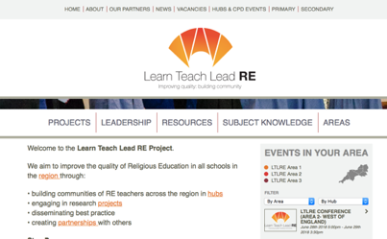
LTLRE on social media
LTLRE website: https://www.ltlre.org
Facebook: https://www.facebook.com/groups/120605851735865
Twitter: @ltlre
LTLRE hubs:
Somerset
Bath
Bristol
North Somerset
Swindon
North Wilts
South Glos

Slide 6

RE Hubs: connecting teachers of RE to the resources they need
https://www.re-hubs.uk/

Slide 7

Finding Bristol and S Glos SACRE Conference Resources
https://ltlre.org/resources/

Slide 8
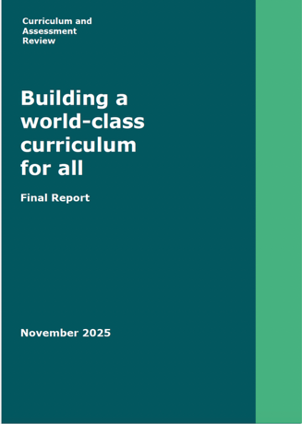
Curriculum and Assessment review
The Curriculum and Assessment Review (DfE)
Final Report
November 2025
https://assets.publishing.service.gov.uk/media/6908f7a3c0dc8f12484175e5/Curriculum_and_Assessment_Review_final_report_-_Building_a_world-class_curriculum_for_all.pdf

Slide 9

RE should be moved to the national curriculum
The Review believes that RE should be moved to the national curriculum to improve access to high-quality provision and to prevent further diminishment. (109)
The Review ultimately wishes to see RE in the national curriculum, but it recognises that it is unrealistic for this to be achieved immediately. We therefore believe that a staged approach to reform is the most appropriate way forward.
To this end, we recommend that the Government invites the sector to establish an independent task and finish group made up of representatives from faith bodies, secular groups and experts from the teaching and wider education sector, to develop a draft RE curriculum. (109)

Slide 10
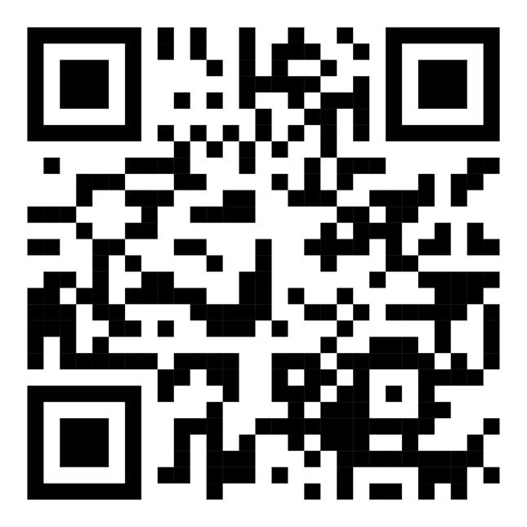
Conference Evaluation

