Slide 1
Identity, inclusion, cohesion and religion
Dr Joyce Miller

Slide 2
Young people have told us that not seeing themselves in the curriculum can be disempowering and demotivating
CaAR, 2025,33

Slide 3
Key themes
Identity
Inclusion - with a focus on the ‘nones’, working class and MSD pupils - the majority.
Social cohesion
Community cohesion

Slide 4
Where does RE fit?
We’ve contributed to cross-curricular requirements to promote equality and anti-racism
We’ve developed ‘positive pluralism’ and ‘intercultural navigation’ to promote community cohesion
Is it working?

Slide 5
A trajectory
Anti-racism
Community cohesion
Prevent
Social cohesion

Slide 6
Inclusion and cohesion
Inclusion can be seen in relation to individual pupil’s socio-economic background and worldview
Cohesion can be seen in relation to their role in society

Slide 7
RE’s role?
Do we inadvertently present middle-class images of religion and worldviews?
Do we inadvertently promote stereotyping by focusing on an individual’s religious identity?
Are raising attainment and promoting social mobility the answer?
What is RE’s role in increasing social capital?

Slide 8

Bonding is exclusive and provides support - it’s superglue
Bridging is inclusive and provides reciprocity - it’s WD40

Slide 9

Four areas of investigation:
Economics
Politics
Society
Culture

Slide 10
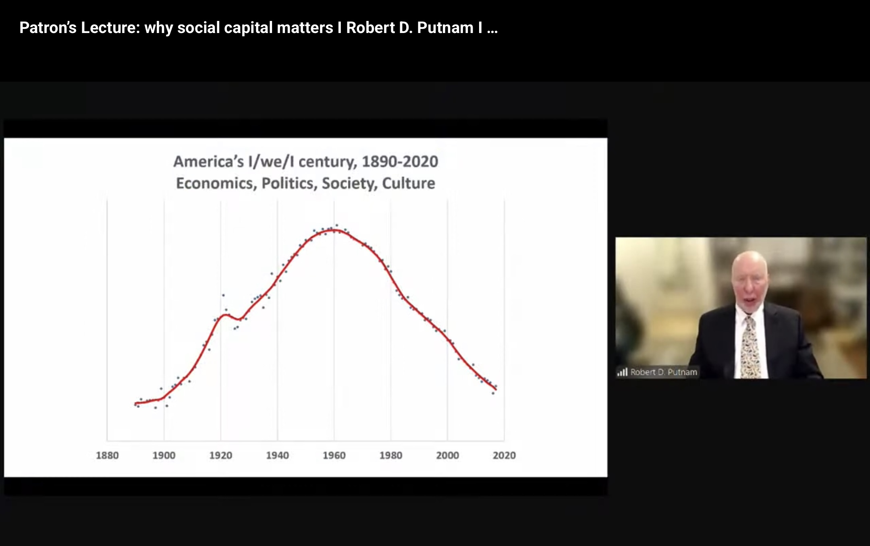

Slide 11
‘We’ needs to be much more inclusive
The young need to lead
Innovation must be from the grassroots up
We need a moral and cultural shift
We must never compromise on equality

Slide 12

Iain McGilchrist
Do we have a left-hemisphere approach to education?

Slide 13


Slide 14
Left hemisphere dominance in education:
  Focus on knowledge
  Focus on what is measurable and comparable
  An example…

Slide 15
‘For Buddhists, it is easy to follow the Five Moral Precepts’
Evaluate this statement. In your answer you should:
Refer to Buddhist teaching
Give reasoned arguments to support this statement
Give reasoned arguments to support a different point of view
Reach a justified conclusion (12 marks)

Slide 16

Overarching concepts
Religion
Worldviews
Spirituality
Secularity

Slide 17

Ways forward for RE
Not sufficient to include non-religious worldviews. Rather:
What affects us all living in the western world
What affects us and our communities
What affects us as human beings

Slide 18
What affects all of us living in the west:
  Religion and worldviews in a secular society
  Religion in public life
  Religion as a political identity
  Media treatment of religion and worldviews
  In short: the socio-political dimensions we’ve neglected

Slide 19
What affects us and our communities
  Our local area: develop social science research skills to explore demographics and change over time
  Messy and complex nature of people’s beliefs and values

Slide 20
What affects us as human beings:
  Spirituality
  Ultimate questions and human experience
  Ethical questions, recognising that ‘empathy is intrinsic to morality’
  That which transcends rationality

Slide 21
The ‘Nones’ are ‘motivated by an ethics focused on equality, compassion and social justice values’ (Strhan & Shillitoe)
They need to know that their worldview is respected and that they are in a safe space (Peacock et al)

Slide 22
Personal knowledge
Personal worldviews reflexivity: reflect on worldviews and make scholarly judgements
Personal worldviews impact: how worldviews affect learning

Slide 23
We need to move away from body/mind binary
Knowledge is ‘felt’ and not merely cognitive
Cannot limit knowledge to what is empirical, logical and rational
Understanding ourselves and understanding others are not sequential but integral to each other. We are social beings.

Slide 24
Knowing and not knowing
    The need to legitimise pupils’ not knowing
Knowing and unknowing
    The place of depth, transcendence and mystery in religion and worldviews

Slide 25
‘Whereof one cannot speak, thereof one must remain silent’

Slide 26
Key references
DFE (2025) Curriculum and Assessment Review, Final Report
McGilchrist, I (2019) The Master and his Emissary
Putnam, R D (2000) Bowling Alone: the collapse and revival of American community
Putnam, R D (2020) The Upswing.
Strhan, A & Shillitoe, R (2025) Growing up Godless: Non-religious childhoods in contemporary England.

