Slide 1

Learn Teach Lead RE (Southwest Peninsular) Conference
St Mellion
Friday 2nd October 2026
Knowledge-Rich and Socially Connected RE
Find the resources at
https://ltlre.org/resources/ltlre-area-1-conference/

Slide 2
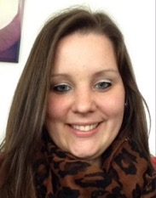
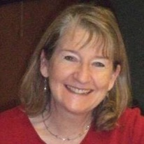
Keynote Speakers
Katie Freeman
RE lead at Bickleigh Down CofE Primary School, Plymouth
Chair of NATRE (The National Association of Teachers of RE)
Katie leads the LTLRE Plymouth hub and is the author of extensive primary RE resources
Dr Joyce Miller
These are a few of the many roles Joyce has held over many years:
Secondary RE teacher in Coventry and Northumberland
Senior Lecturer in Religious Studies at the University of Wolverhampton
Head of Diversity and Cohesion in Bradford
Chair of the RE Council of England and Wales
Associate Fellow in the Religions and Education Research Unit (University of Warwick)
One of the 14 Commissioners for RE on the CoRE report

Slide 3
Programme
Timings | Details | Rooms
9.00 - 9.30 | Arrival and welcome
9.30 - 9.35 | Introduction to the conference | St Mellion A
9.35 - 10.20 | Keynote 1: Katie Freeman Curriculum Architecture - what is the place of RE in an ever-changing world? | St Mellion A
10.20 – 11.00 | Keynote 2: Joyce Miller Identity, Inclusion, Cohesion and RE | St Mellion A
11.00 – 11.15 | Refreshment break
11.15 – 12.10 | Workshop 1 (4 parallel sessions)
12.10 - 13.05 | Lunch break
13.05 - 13.25 | RE and LTLRE hub updates | St Mellion A
13.25 - 14.20 | Workshop 2 (4 parallel sessions)
14.20 - 14.25 | Cake and Tea
14.25 – 15.25 | Panel discussion: Exploring diverse perspectives Question: are people’s beliefs and worldviews set for life, or do they change and develop? | St Mellion A
15.25 – 15.30 | Evaluations and Close

Slide 4
11.15 – 12.10 Workshop 1
Workshop | Leader | KS | Notes | Room
Updating the RE syllabus with Oak resources | Adam Robertson | 1, 2 | Adam will be introducing a new free mapping document and showing how it enables teachers to use Oak's resources to help sequence and teach the Devon, Torbay, Plymouth and Cornwall syllabus. | St Mellion A
RE and SIAMS in CofE schools | Jo Hunter, Corrine Guntrip | 1, 2 | This session will explore how to teach good RE in CofE schools, with insights into how to understand the expectations of a SIAMS inspection | St Mellion B
My journey into Islam - the story of a white British revert | Sharon Luck, Kate Vernon, Ed Pawson | 2, 3 | Sharon will be joining via Zoom to explain how she became a Muslim, why she wears a hijab, but hasn’t taken on an Islamic name. She will be sharing valuable insights into how to teach about Islam in the classroom | St Cleer
Teaching outstanding RE at secondary | Greg Parekh, Rachel Willcocks, Kelly Keatley | 3, 4 | This session, led by experienced secondary RE leaders, will explore a variety of current issues at KS3 and 4, with QandA time for an interactive discussion | Nicklaus Boardroom

Slide 5
13.25- 14.20 Workshop 2
Workshop | Leader | KS | Notes | Room
Adaptive teaching for inclusive RE | Hannah Down, Rebecca Parkinson | 1, 2 | Hannah and Rebecca will offer some valuable techniques for adaptive teaching and inclusion in primary RE - bring and share ideas | St Mellion A
Leading RE in a primary school and across a MAT | Nicki Bonell, Rachel Earley | 1, 2 | In this session Nicki will be showcasing resources and support pathways for new and existing RE leads in primary schools. Rachel heads up RE across a MAT and she will be outlining some of the key features of trust-wide RE leadership. | St Mellion B
Sacred Questions, Digital Answers | Steve Gibson | 1, 2, 3, 4 | This session will investigate the ethics and use of AI in the classroom, looking at a wide range of resources both good and bad, equipping ourselves to make the most of the opportunities new technology provides while also protecting against the potential pitfalls | St Cleer
Understanding Zoroastrianism | Shiruy Bilimoria | 3, 4 | Shiruy was brought up in a Parsee family in Bombay, India. In this session he will give an introduction to Zoroastrian worldviews and explore the way this tradition sits at the root of the Abrahamic traditions | Nicklaus Boardroom

Slide 6
14.25 – 15.25 Panel discussion: Exploring diverse perspectives
Question: are people’s beliefs and worldviews set for life, or do they change and develop?
Faith and Belief panel members:
Shiruy Billimoria (Zoroastrian)
Arezoo Farazhad (Baha’i)
Steve Gibson (Christian)
Sharon Luck (Muslim)
Rania Osman (Muslim)
Joyce Miller (Buddhist)
Tim Purches (Humanist)

Slide 7

LTLRE on social media
LTLRE website: https://www.ltlre.org
Facebook: https://www.facebook.com/groups/120605851735865
School speakers: https://ltlre.org/resources/list-of-faith-and-belief-visitors-for-devon-schools/
LTLRE hubs:
West Cornwall
Mid Cornwall
East Cornwall
Plymouth
South Devon/Torbay
Exeter
East Devon
North Devon
Mid Devon
Special School

Slide 8
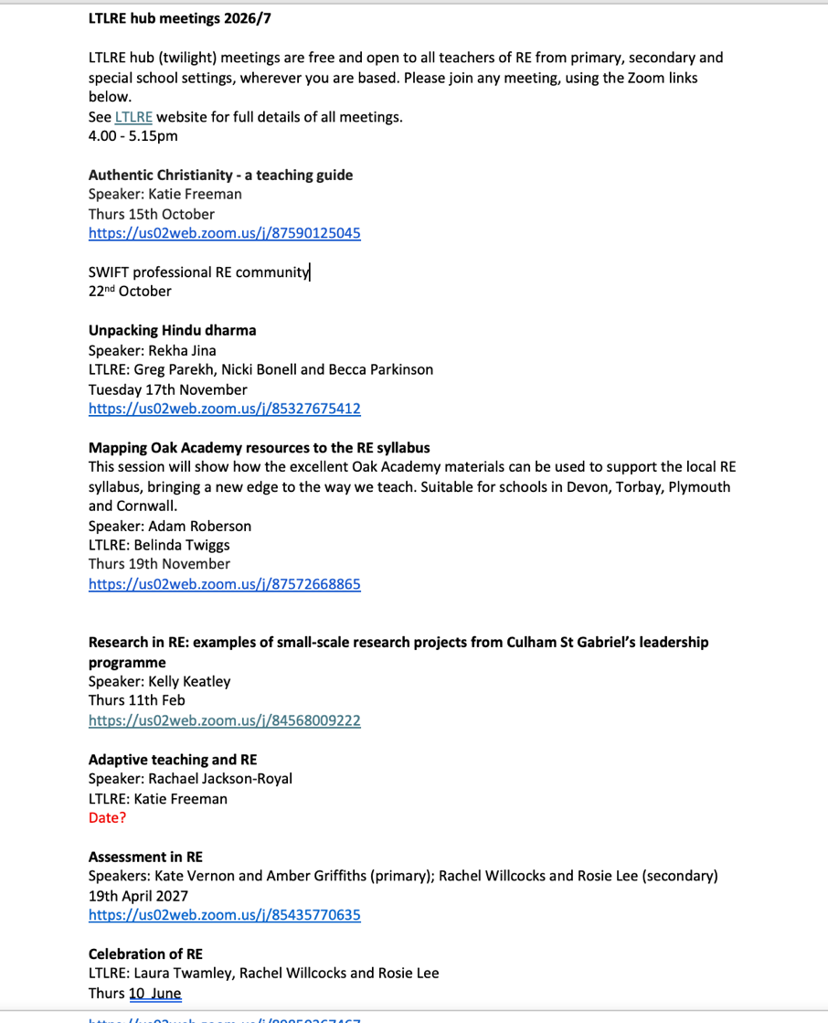

Slide 9
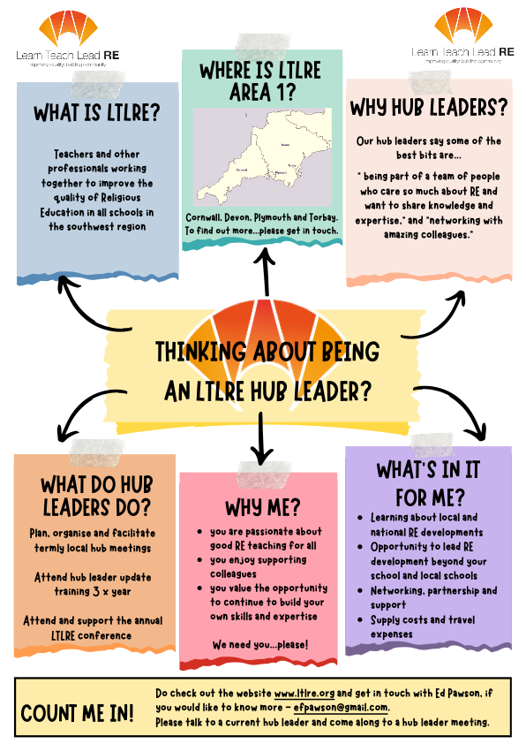
Link

Slide 10

RE Hubs: connecting teachers of RE to the resources they need
How are you using RE Hubs?
Link

Slide 11

Plymouth Centre for Faiths & Cultural Diversity (PCFCD)
Educational Charity based in Plymouth since 2001
Supports schools across Devon & Cornwall in the delivery of high-quality RE.
Offers Faith & Cultural Speakers & Interactive Workshops, (both face-to-face & online) - all major faiths/beliefs
Speaker-led visits to Places of Worship (Plymouth Synagogue, PIETy Islamic Centre, Minster Church of St Andrew & more)
Subscription & Pay-As-You-Use packages available
Go and chat to them today!

Slide 12
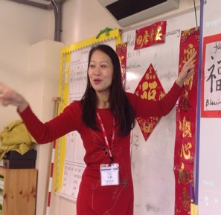
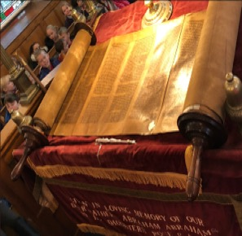
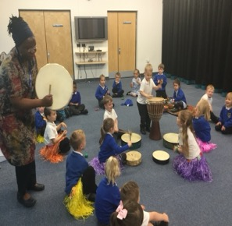
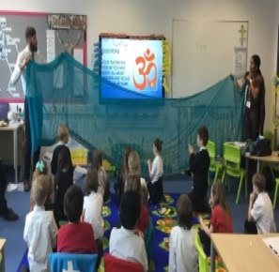
Experiencing diversity first hand allows children to encounter the reality of religion and culture as a way of life and the values that religions and traditions teach
Our speakers & visits to places of worship help schools to address the statutory requirements of their agreed syllabus for Religious Education, through lively and creative learning.
Our work also enables schools develop mutual respect and tolerance of those with different faiths and beliefs, a key aspect of British Values.

Slide 13
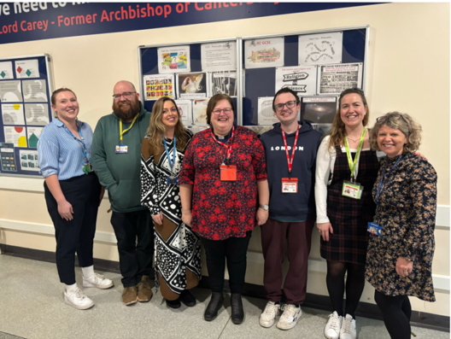
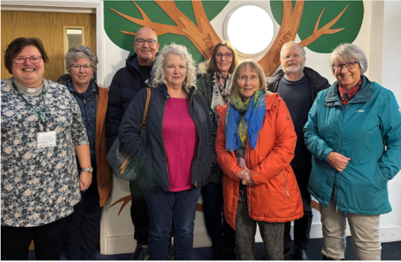

Hazel Briton
Project Leader
East Devon Hub Leader
Schools Facilitator
Christianity based RE Enrichment
In Devon Secondary schools and beyond
Part of the team for Year 7 RE Lessons Big Questions, with visitors answering questions from students throughout the lessons and Year 9 ‘Christian Practices’ where speakers are invited to give a short, interactive presentation of church practices.

Slide 14

Oak Academy Resources – mapping onto the local syllabus units
Adam Robertson has created a new free mapping document to enable teachers to use Oak's resources to help sequence and teach the Devon, Torbay, Plymouth and Cornwall syllabus.
https://www.devon.gov.uk/support-schools-settings/school-effectiveness/teaching-and-learning/curriculum/religious-education/

Slide 15
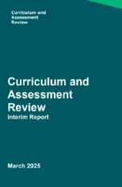
DfE’s Curriculum and Assessment Review
Update on the path to RE possibly becoming a National Curriculum subject

Slide 16

NATRE primary subject leader page (free access)
https://natre.org.uk/primary-re-curriculum/primary-subject-leader/

Slide 17

https://natre.org.uk/secondary-subject-leader/

Slide 18
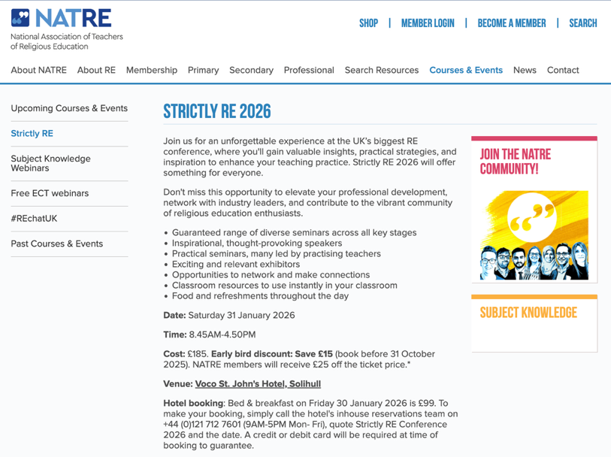
Strictly RE Conference 2026
Saturday 31st January 2026
Strictly RE is NATRE’s annual conference. It’s a great place for RE professionals to come together to share ideas, gain new knowledge and further boost your confidence when teaching RE
https://www.natre.org.uk/courses-events/strictly-re/

Slide 19
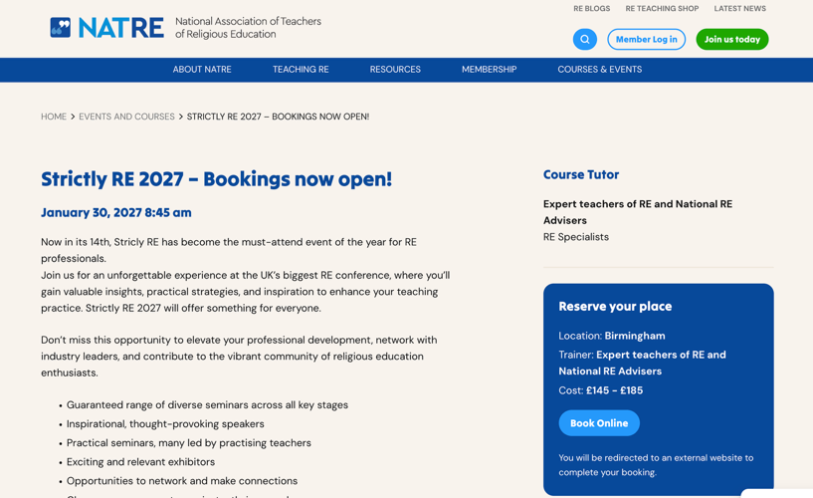
Strictly RE Conference 2026
Saturday 30th January 2027
Strictly RE is NATRE’s annual conference. It’s a great place for RE professionals to come together to share ideas, gain new knowledge and further boost your confidence when teaching RE
https://natre.org.uk/events-courses/strictly-re/

Slide 20

Applications are open.
Closing date is at the end of January 2027
https://farmington.ac.uk/farmington-institute-scholarship/

Slide 21

The 2026 theme "Lighting the Way for a Shared Future” is a celebration of hope. Inspired by the symbolism of light across faiths and traditions, including the spirit of Diwali, the theme reflects a shared belief that even in challenging times, communities can come together to build understanding, trust and friendships.
Find resources for Interfaith Week in schools here:
Link 1 Link 2 Link 3 Link 4

Slide 22
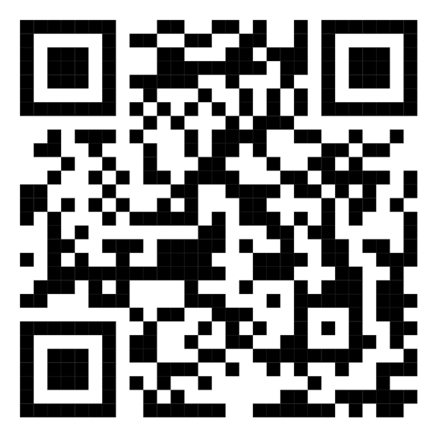
Conference Evaluations

