Slide 1

Religious Education in Church of England schools and SIAMS
Jo Hunter and Corrine Guntrip
jo.hunter@exeter.anglican.org
cguntrip@lapsw.org

Slide 2

Vision:

Slide 3

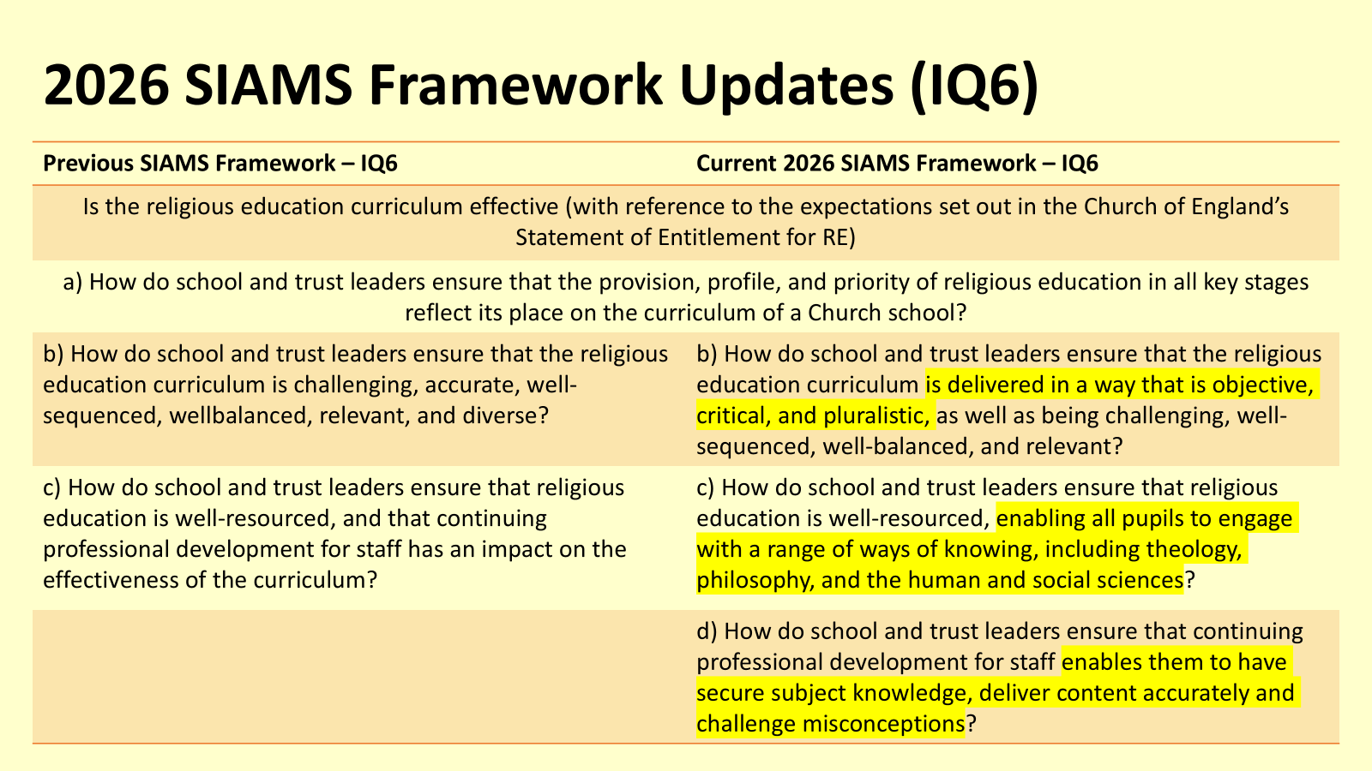
Reflection
Take a moment to consider the vision for RE within your school.
Is there a vision in place for this subject?
Where did it ‘come from’?
Is it relevant to the school, context and community?
Are all staff aware?
How might the children describe this?
Where do you see this in action?

Slide 4
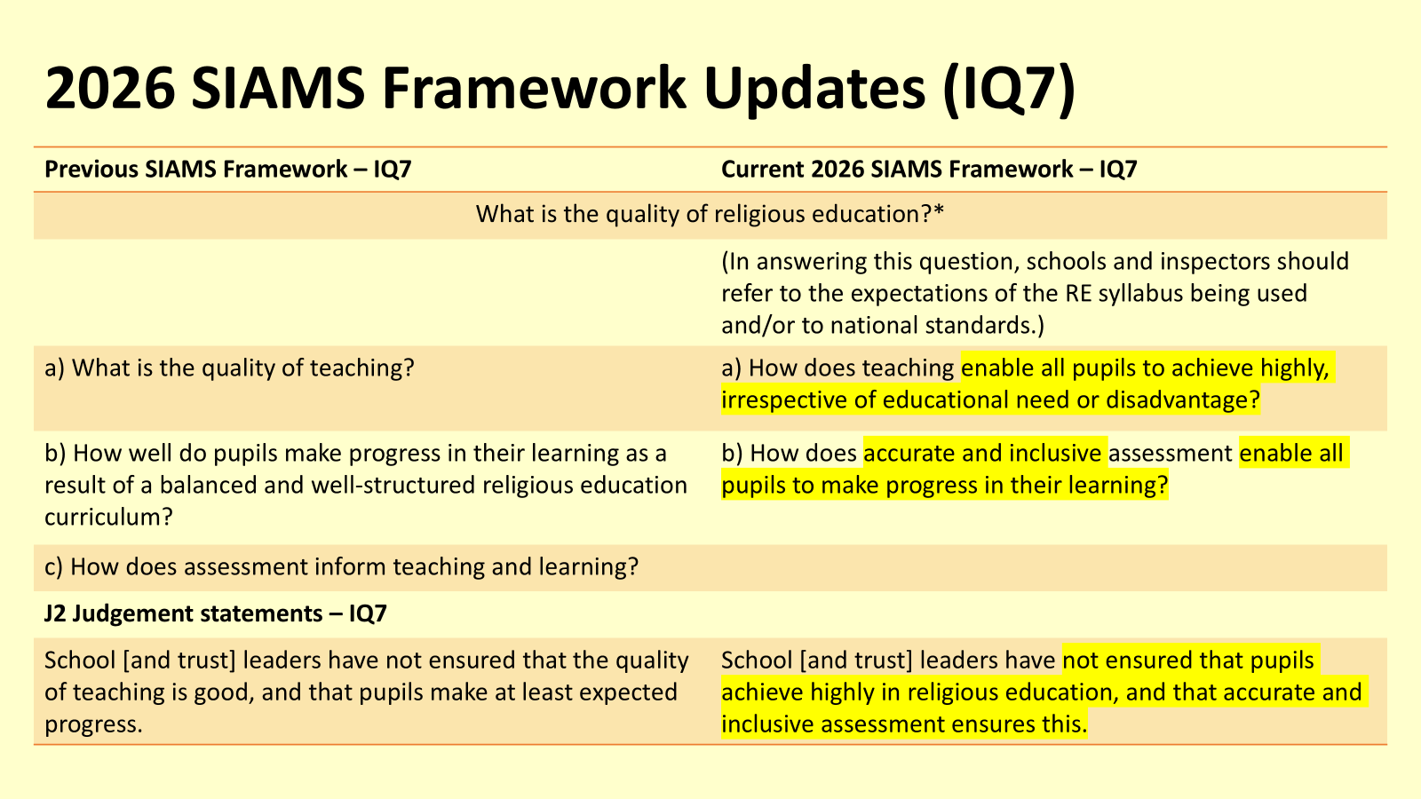
Reflection
Take a moment to consider the vision for RE within your school.
Is there a vision in place for this subject?
Where did it ‘come from’?
Is it relevant to the school, context and community?
Are all staff aware?
How might the children describe this?
Where do you see this in action?

Slide 5
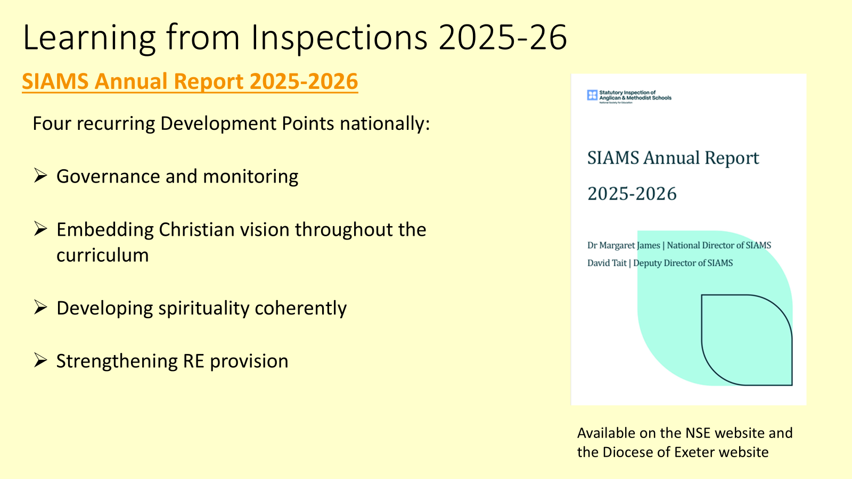
The Statement of Entitlement details the expectations for religious education in Church of England schools. It is designed to help stakeholders place RE at the heart of a flourishing school.
This Statement of Entitlement (September 2026) is the document referred to as part of the SIAMS inspection process, under IQ6 and IQ7.
This is now in place (September 2026).
✅ curriculum coverage ✅ assessment
✅ progression ✅ KS5 compliance
✅ teacher subject knowledge ✅ governor oversight
Curriculum: religious education — National Society for Education

Slide 6
Key elements of the Statement of Entitlement are:
RE’s high priority within the curriculum and status as an academic subject are clearly articulated.
• The RE entitlement is entirely separate from collective worship.
• The RE curriculum is well-balanced, well-sequenced and reflects the school’s specific context.
• Sufficient dedicated curriculum time, meeting explicitly RE objectives, is committed to the delivery of RE. This should aim to be close to 10% but must be no less than 5% in key stages (KS) 1-4.
• All teaching staff and those responsible for governance understand the distinctive role and purpose of RE within a Church school.
• Priority is given to building up staff expertise through professional development and resourcing, particularly where teachers with specialisms in other areas are delivering RE.
• They engage with their diocese when developing the school’s RE curriculum and adapting schemes and frameworks, such as a locally agreed syllabus, to the school’s context.
• All pupils follow a course which leads to a recognised and appropriate qualification in RE or Religious Studies at KS4. This includes pupils who have SEND. The study of Christianity will be a significant part of any Religious Studies qualification offered.
Additional KS4/5 information in the full document.

Slide 7
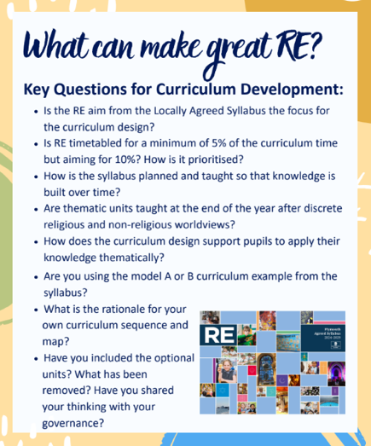

Curriculum overview – Broad and balanced?
download.asp
‘To grow and Flourish wherever you are planted.’

Slide 8


Diversity within Religion and Worldviews

Slide 9


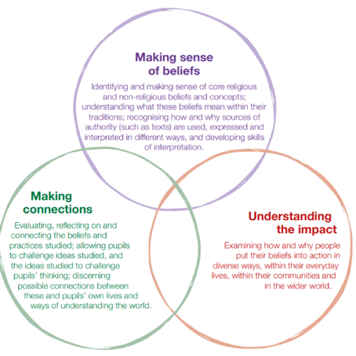

Curriculum

Slide 10
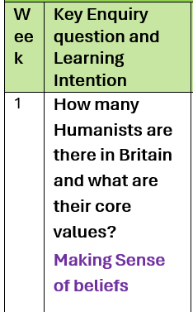


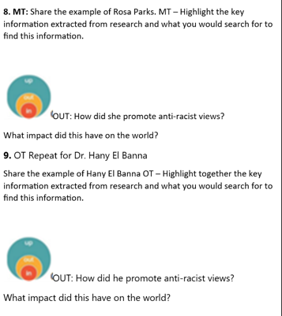
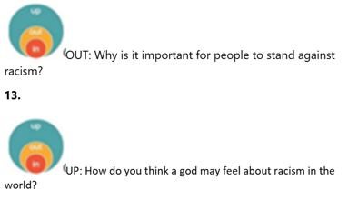
Spirited Arts – NATRE

Slide 11

Example of adding depth of thought and reflection
''To grow and flourish wherever you are planted.''
We grow as people.
We respect our world.
We ask questions.

Slide 12

Jo- could you talk about Global Christianity here? I haven’t had the training yet…

Slide 13
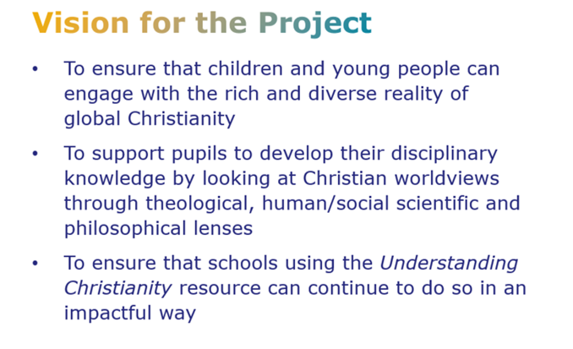

Dates for upcoming training are:
Monday 23 November 10.00am – 3.30pm, Old Deanery

Slide 14
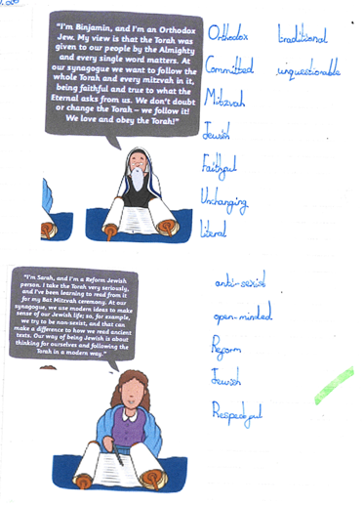
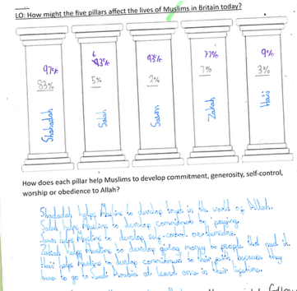
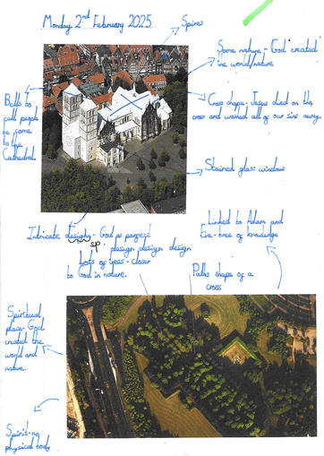
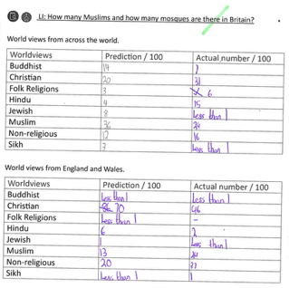

Slide 15










Resources and CPD

Slide 16
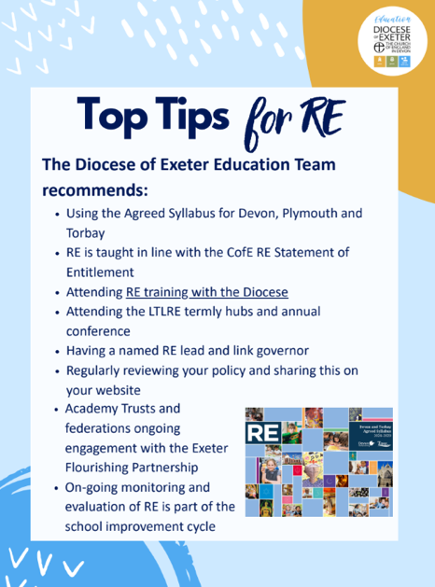
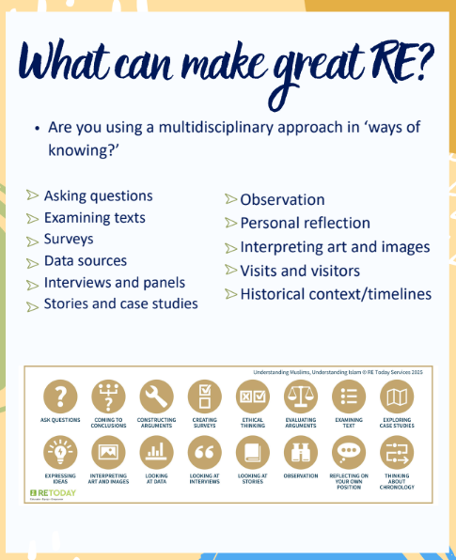

Slide 17

Any Questions or Comments
Religious Education in Church of England schools and SIAMS

