Slide 1



Support for new RE Leads

Slide 2

The position of RE/RW in the curriculum/ Legal Requirements
Although there is not a National Curriculum for RE, all maintained schools must follow the National Curriculum requirements to teach a broad and balanced curriculum, which includes RE. All maintained schools therefore have a statutory duty to teach RW.
Under the terms of their funding agreement with the Secretary of State for Education, all academies have to provide RE for all their pupils. Schools with Religious Character and Academies are free to choose their own syllabus. Parents have the right to withdraw their child from all or part of RW
SACRE stands for “Standing Advisory Council on Religious Education.” Following the 1988 Education Act, when Religious Education was confirmed as a compulsory part of the curriculum, it became a statutory requirement for every Local Education Authority to appoint a SACRE. Their main role is to oversee the provision of Religious Education and Collective Worship in schools.

Slide 3


Cornwall and Devon and Torbay’s Agreed Syllabus
Cornwall and Devon SACRE’s have adopted the RE Today syllabus to promote in their schools.

Slide 4

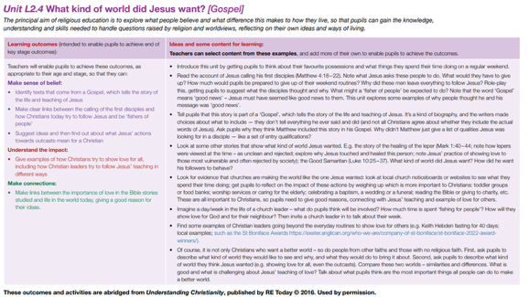









The Fall
Incarnation
Salvation
God/
Creation
People of God
Gospel
Kingdom of God

Slide 5
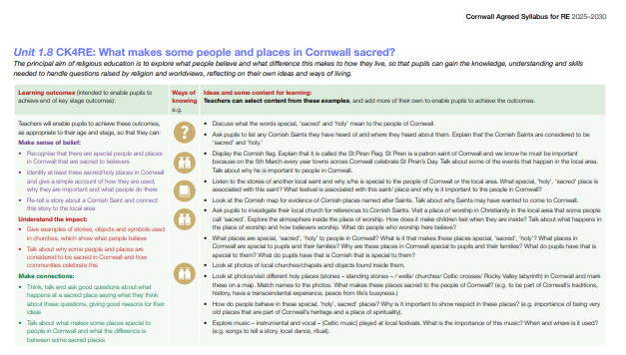


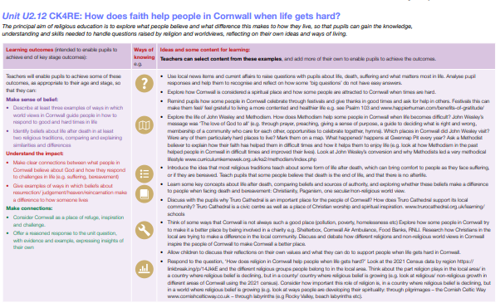
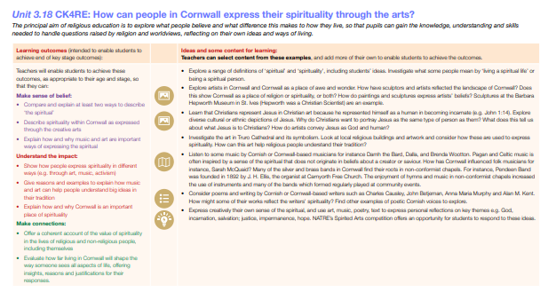

Cornwall Units of Work
Curriculum Kernewek

Slide 6

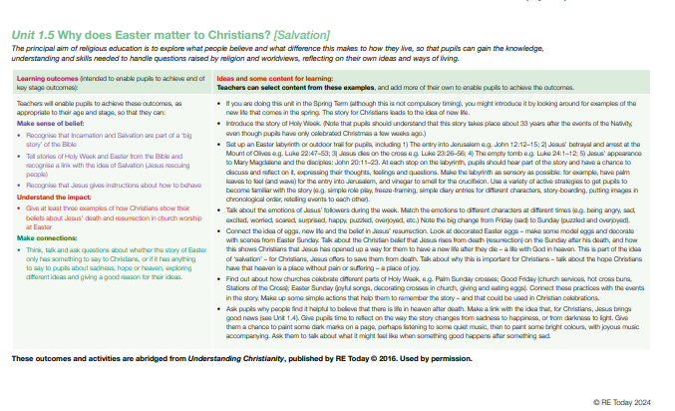
The Teaching Pedagogy behind the Agreed Syllabus

Slide 7











The Diverse RE Landscape

Slide 8














Notes:
RE Facebook page

Slide 9



Making RW easier!
Explore RE in your area

Slide 10

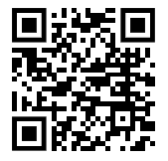
NATRE membership
Up to date information
Lobbying for you
Classroom ready ppts
Many resources to search
Termly curriculum books and Termly RE today magazine- up to date with current thinking
Professional Reflection
ECT support
Strictly RE
Primary Subject leader toolkit
Money off resources/ training
New website incoming
Resources from NATRE executive members
#REchatUK
www.natre.org.uk

Slide 11
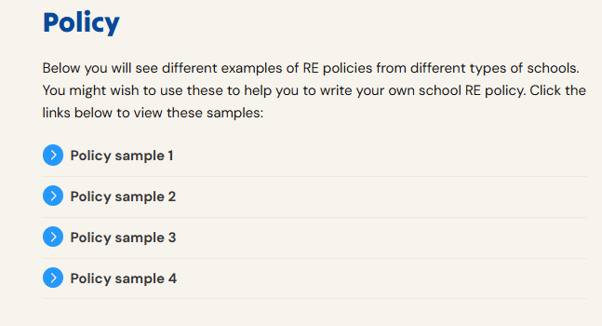
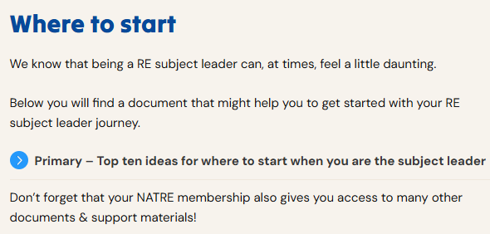

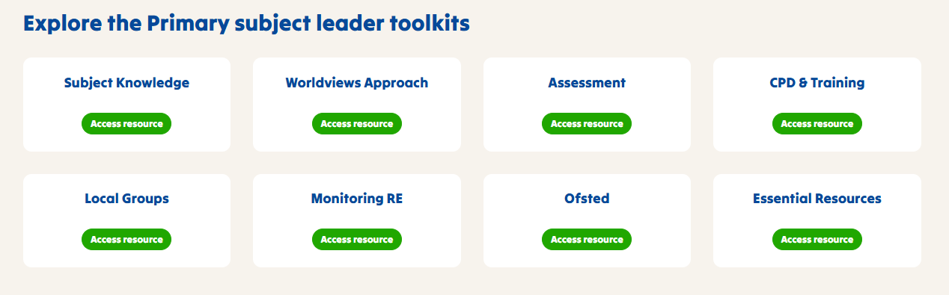
Free RE Subject leader Toolkit
NATRE Primary Subject Leader - Leading RE in Primary Schools

Slide 12

Free Termly CPD
Improving quality, building communities | Learn, Teach, Lead RE
North Devon | Debs Spelman | dspelman@ilfracombe-jun.devon.sch.uk
Mid Devon | Shana Bartram-Owen | rosie.lee@qe.devon.sch.uk
Exeter | Frankie Rowsell | frankie.rowsell@stcmat.org
East Devon | Kate Vernon | kvernon@woodbury.devon.sch.uk
Torbay/South Devon | Belinda Twiggs Laura Twamley | belinda.twiggs@stmichaels.education ltwamley@kingskerswell.devon.sch.uk
Plymouth | Katie Freeman | kfreeman@bickleighdown.devon.sch.uk
Cornwall | Nicki Bonell Sophie Greenaway | nbonell@st-marys-ce-pz.cornwall.sch.uk Sophie.Greenaway@crowanschool.org

Slide 13

Strictly RE Conference 2027
Saturday 30th January 2027
Strictly RE is NATRE’s annual conference. It’s a great place for RE professionals to come together to share ideas, gain new knowledge and further boost your confidence when teaching RE
https://natre.org.uk/events-courses/strictly-re/

Slide 14



Increasing the Profile

Slide 15

Applications are not yet open.
Closing date is at the end of January 2027
https://farmington.ac.uk/farmington-institute-scholarship/

Slide 16


Leadership Scholarship Programme
Programme Aims
This programme aims to provide opportunities for emerging Religion and Worldviews leaders to expand and deepen their reflections on educational leadership in the subject, through receiving mentoring, structured challenges, research insights, inspirational networking events, and experience of professional development delivery.
Programme Outline
The funded programme aims to develop leaders in the following four areas.
Applications for the programme 2027-29 open Jan 2027

Slide 17
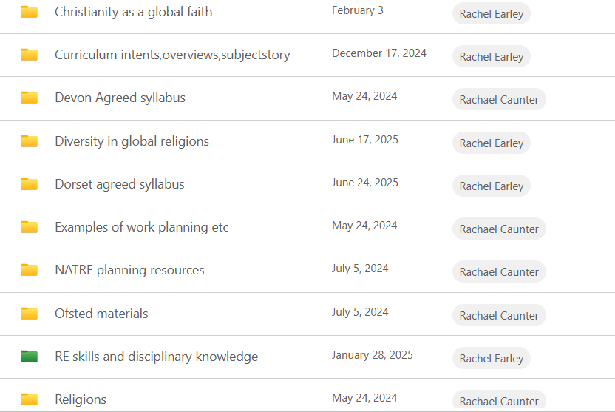
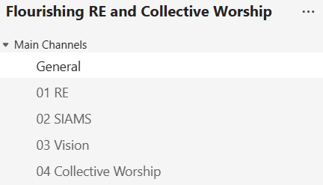
Leadership across a MAT
Organised and shared resources

Slide 18
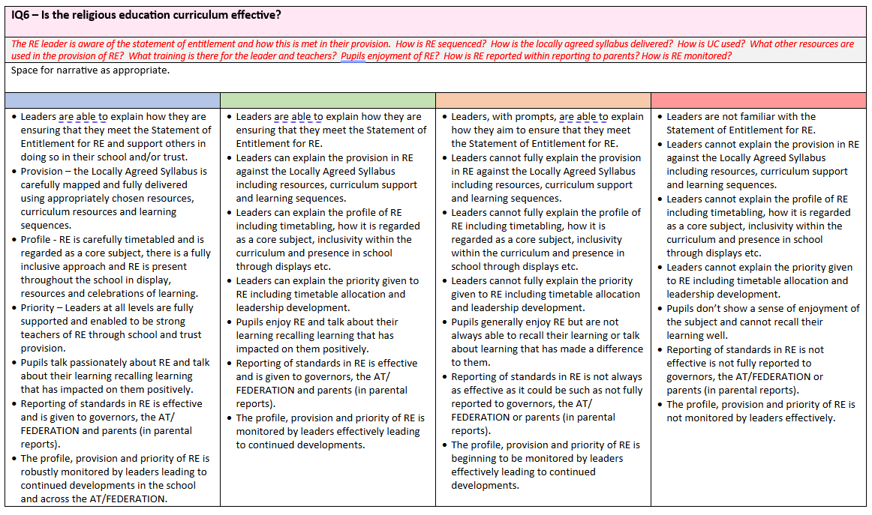
Flourishing trails and monitoring RE effectively to share with all stakeholders

Slide 19
