Slide 1
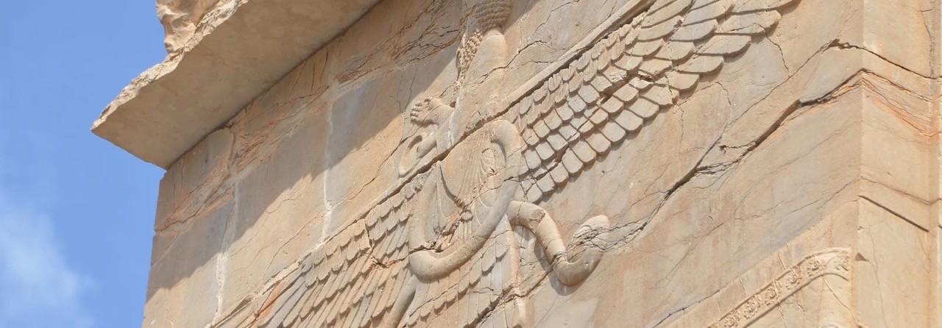
Zoroastrianism
History, Influence, and Legacy
Presented by Shiruy Billimoria, PhD candidate at School of Oriental and African Studies, University of London.
Origins & Beliefs
Empire & Antiquity
Abrahamic Influence
India & the Parsis
Britain Today
Shiruy Billimoria, PhD candidate
SOAS, London

Slide 2
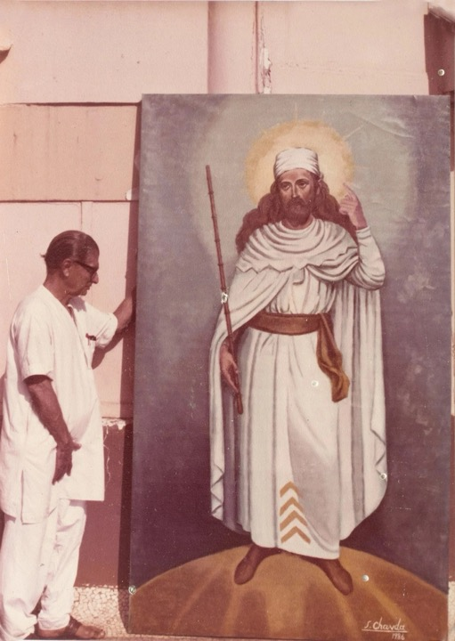
Zoroastrianism
Core Religious Principles
One of the oldest monotheistic religions still practised today — belief in One God, Ahura Mazda, “The Wise Lord”.
A Revealed Religion
Ahura Mazda's revelation is preserved in the Avesta scriptures.
Zarathushtra, the Prophet
His hymns, the Gathas, teach good thoughts, words and deeds.
A traditional depiction of the prophet Zarathushtra
Zoroastrianism: History & Legacy
SOAS, London

Slide 3
Reading Age from Language
Dating Zoroastrianism
The faith's age is read from the language of its scripture.
01
02
03
04
Old Avestan
→
Rig Vedic Sanskrit
→
Close Similarities
→
Bronze Age Origin
Language of the Gathas, the earliest layer of the Avesta
Language of the Rig Veda, Old Avestan's close sister language
Similarities between the two languages are the basis for dating
Established in the second half of the second millennium BCE
The Gathas' language ties Zoroastrianism to the same Bronze Age world as the Rig Veda.
Zoroastrianism: History & Legacy
SOAS, London

Slide 4

The Iranian Plateau
Geographical Location
Founded, according to tradition, in the Iranian Plateau, now spanning Afghanistan, Azerbaijan, Iran, Iraq, Pakistan and Turkmenistan.
Mountain Frontiers
Zagros (west), Kopet Dag (north), Sulaiman Mountains (east)
Water Frontiers
Caspian Sea (north); Persian Gulf, Strait of Hormuz (south)
Eastern Lowlands
The Indus River plain bounds the plateau to the east
The Iranian Plateau, the faith's traditional homeland
Zoroastrianism: History & Legacy
SOAS, London

Slide 5
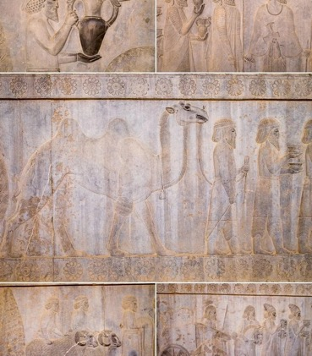
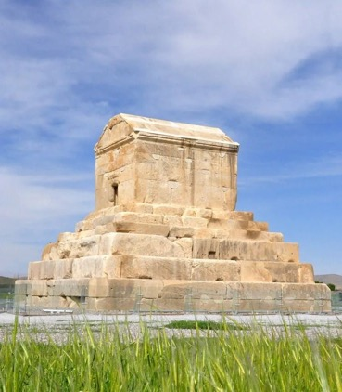

State religion of three empires: Achaemenid (550–330 BCE), Parthian (247 BCE–224 CE), Sasanian (224–651 CE)
Faith of Persia's Rulers
Imperial Religion
Achaemenid Rock Reliefs
Tomb of Cyrus the Great
Sasanian Flag
The empires ruled vast parts of Eurasia, from Turkey to the Indus
At Pasargadae, an enduring monument of Achaemenid rule
Zoroastrianism permeated these lands, influencing many belief practices
Zoroastrianism: History & Legacy
SOAS, London

Slide 6
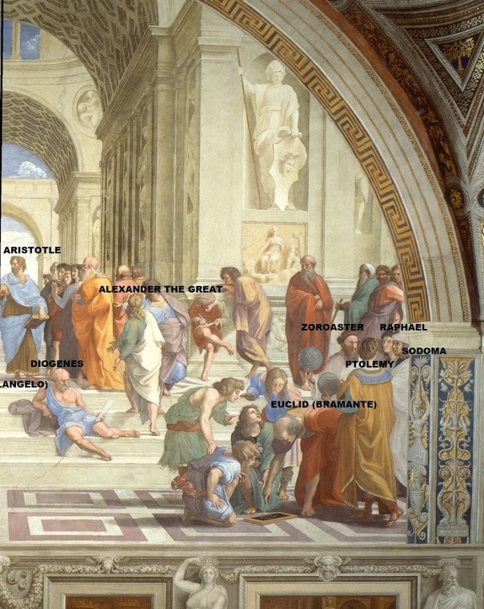
Through Classical Eyes
Greek and Roman Perception
Greeks called Zarathushtra 'Zoroaster' and regarded him as a great moral philosopher, lawgiver and astronomer.
Magi: Zoroastrian Priests
Credited with originating the natural sciences and philosophy
Pliny the Elder
Named Zoroaster inventor of Magic, a word derived from 'Magi'
Zoroaster as depicted in Raphael's The School of Athens
Zoroastrianism
SOAS London

Slide 7
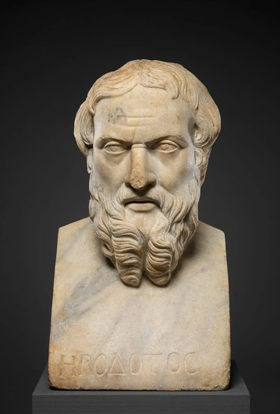
Classical Sources
Greek Works Describing Zoroastrianism
5
The Transmitters
Herodotus, Strabo, Plutarch, Diogenes Laertius, Agathias all wrote on it.
Greco-Roman authors who transmitted the faith
A Philosophical Lens
Classical writers cast Zoroaster as a sage of ethics and nature, not a religious prophet.
They read the faith as moral philosophy, ethics and the laws of nature.
Zoroastrianism
SOAS

Slide 8
A Contested Question
Where evidence ends and polemic begins
Influence of Zoroastrianism on Abrahamic Traditions
Debate on Zoroastrian influence over other monotheisms began in the early 19th century, when scholars noted shared ideas: a final judgment, bodily resurrection, angels and demons, and a coming saviour.
Claims Beyond the Evidence
Maximalists see heaven, hell and Satan as direct loans from Persian dualism
Wholesale Dismissal
Minimalists trace the same ideas to internal Jewish growth, denying any Persian role
Zoroastrianism
SOAS London

Slide 9
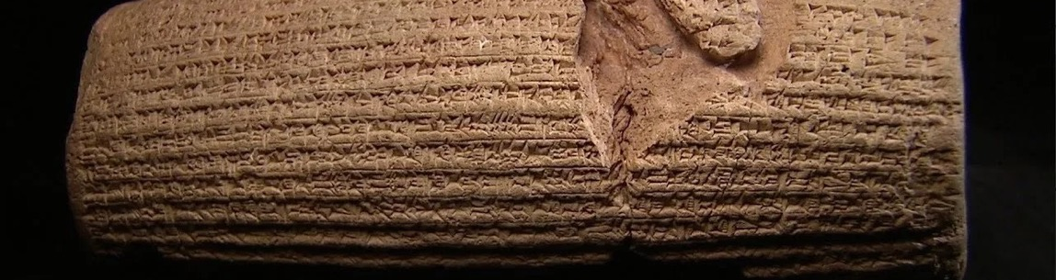




The Cyrus Cylinder
The First Interaction: Zoroastrian Persians and the Jews
539 BCE
Jerusalem
Royal Treasury
Positive
First contact: Cyrus the Great conquers Babylon
Jews liberated from Babylonian captivity and allowed to return
First recorded encounter shapes a noble impression of Persians
Pays for the Jews to rebuild their temple (Edict of Ecbatana)
Zoroastrianism
SOAS London

Slide 10
Under Achaemenid Rule
Zoroastrian Influence on Judaism (Part 1)
Political, social and linguistic ties set the stage for ideas to travel
The Kingdom of Israel remained a vassal state under the Achaemenids
2
A Vassal Kingdom
Centuries under Persia
A Favourable Perception
Marked by the absence of anti-Persian literature in Jewish texts
Aramaic as Lingua Franca
A shared language enabled frequent interpersonal contact
First evidence of Zoroastrian influence on Judaism appears
2nd c. BCE
Influence Becomes Visible
Earliest attestation
Zoroastrianism
SOAS London

Slide 11

Eschatology
Zoroastrian Influence on Judaism (Part 2)
Pre-Exile
Post-Exile
Strictly this-worldly eschatology
Transcendent, cosmic, universal
Four shared elements: Evil's defeat, resurrection, judgement, blissful era
Lacked judgement, heaven and hell
II Isaiah prophesies Cyrus as Yahweh's “anointed” (māšiaḥ)
No resurrection and no perfector figure
Isaiah's vocabulary parallels the Zoroastrian Yasna 44
Eschatology was Zoroastrianism's most significant influence on Judaism
Zoroastrianism
SOAS

Slide 12
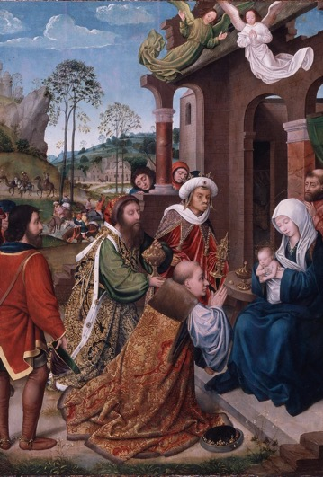
Abrahamic Traditions
Zoroastrianism and Christianity
5
Core Christian Principles
One God, life after death, resurrection, eschatological rewards & punishments
centuries of contact with Zoroastrianism enriched Judaism
Wise Men from the East
Matthew's Magi brought gold, frankincense and myrrh to the baby Jesus
Mary Boyce: Christianity arose from this Zoroastrian-enriched Judaism
Zoroastrianism
SOAS

Slide 13
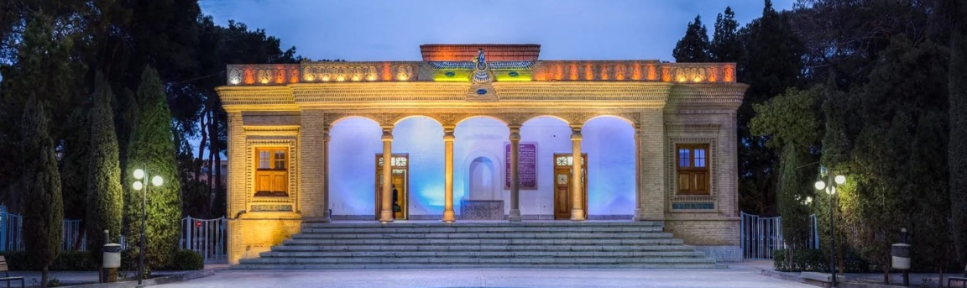




Abrahamic Traditions
Zoroastrianism and Islam
651 CE
Ahl al-kitab
Two-way
Blurred
Arab defeat of Sasanians ends state-religion status
Zoroastrians recognised as a 'people of the book'
Zoroastrian ideas shaped Islam, and influence flowed back
Direct vs. indirect influence via Judaism and Christianity
Zoroastrianism
SOAS

Slide 14

Shared Roots, New Home
Zoroastrianism and India
Linguistic
3rd millennium BCE
Sister Languages
Proto-Indo-Iranians
Avestan and Vedic Sanskrit are sister languages within the Indo-European family
Pastoral nomads who split in the third millennium BCE
8th–9th c. CE
Terms of refuge
Qissa-e-Sanjan
Five Conditions of Refuge
The most important interaction: the story of Zoroastrian arrival in India
Jadi Rana's terms: adopt Gujarati, women wear saris, no weapons, evening weddings, explain the faith
Kinship in language long preceded the refuge that made India home
Zoroastrianism
SOAS

Slide 15
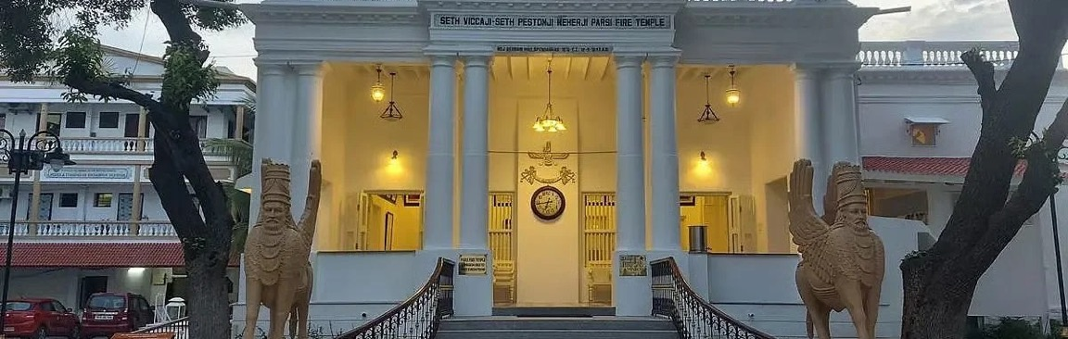


Before the Europeans
Zoroastrians on the Eve of European Arrival in India
Unharassed
Agriculturalists
Southern Gujarat
Settled in India and mostly left undisturbed
Or tradesmen: carpenters and weavers
Self-sufficient, with little influence among ruling elites
Zoroastrianism
SOAS

Slide 16
First to Adapt
Zoroastrian Interaction with Europeans
01
02
03
Europeans Arrive
→
Open Boundaries
→
Trusted Middlemen
Late 15th century CE; Zoroastrians were among the first to adapt
No strict boundary maintenance customs, so they interacted freely
Acted as middlemen between European companies and Indians
Early openness turned Zoroastrians into the bridge between Europe and India
Zoroastrianism: History & Legacy
SOAS London

Slide 17
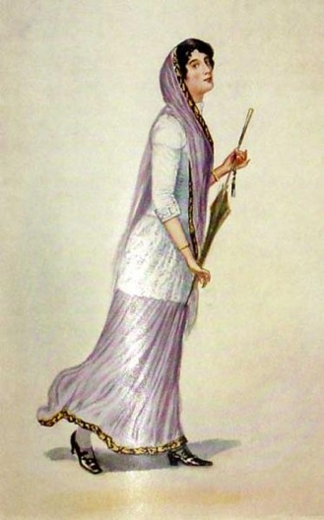
Early 19th Century
Adopting Western Sensibilities & Education
First
Widespread Literacy
Highly literate as a community by the end of the 19th century
Community to actively engage with Western education
Doors Opened
Schooling turned early openness into careers across colonial professions
Colonial administration, law, medicine, education, trade and industry
Zoroastrianism: History & Legacy
SOAS London

Slide 18
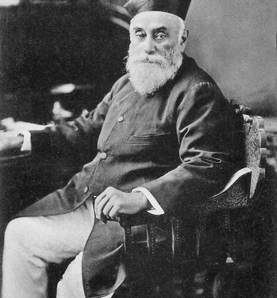

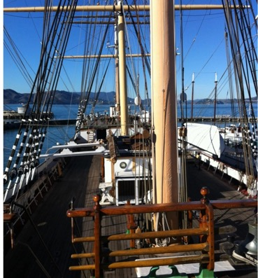
Parsi Enterprise in India
The Zoroastrian Community Becomes Industrious
From agriculturalists and tradesmen to successful merchants and pioneers of industry
Jamsetji N. Tata
Ardeshir Godrej
The Wadia Shipbuilders
Founded the Tata Group in 1868; seeded Indian steel and hydropower
Co-founded Godrej & Boyce in 1897, starting with a springless lock
Bombay dockyard built ships for the East India Company and Royal Navy
Zoroastrianism: History & Legacy
SOAS London

Slide 19
19th Century Onward
Pride & Prestige of the Zoroastrian Community
A public ideal: enterprise joined to 'good deeds'
Exceptional Prestige
Earned in Bombay and beyond, from the 19th century onward
Municipal Engagement
Civic institutions and municipal life, beside commerce
Philanthropy
Wealth channelled into trusts, hospitals, schools, housing
Enterprise & Ethics
Industrial success paired with distinctive business ethics
Prestige rested on enterprise and giving together, not on wealth alone
Zoroastrianism: History & Legacy
SOAS London

Slide 20

Growing Up in India
In Bombay, this pride and prestige shaped my identity as a Zoroastrian
A personal reflection by Shiruy Billimoria, Mumbai, India

Slide 21
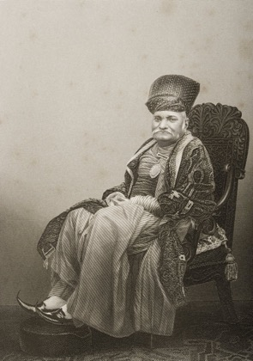
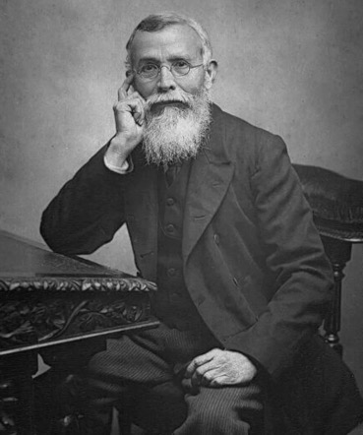
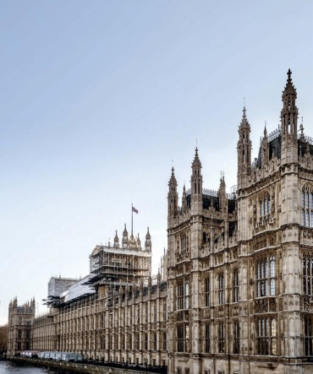
Firsts in British Public Life
Zoroastrians' Perception of Britain
Favourable view of the British, owing to the opportunities their rule brought
Sir Jamsetjee Jejeebhoy
Dadabhai Naoroji
Later Parsi MPs
First Indian knighted (1842); created first Indian baronet (1857)
First Indian elected to the British Parliament, in 1892
Sir Mancherjee Bhownaggree and Shapurji Saklatvala followed Naoroji
Zoroastrianism: History & Legacy
SOAS

Slide 22



Legacy in the Present
Being a Zoroastrian in Britain Today
Carrying Forward the Legacy
Contributing to Public Life
From Bombay to SOAS
Raised in Bombay (Mumbai)
Enterprise joined to good deeds
Heirs to a tradition of firsts
Identity shaped by community pride and prestige
Wealth channelled into trusts, schools, hospitals
Building on Parsi pioneers in British public life
Distinctive business ethics
Contributing constructively
PhD candidate at SOAS
The ideal behind the community's industrial success
Continuing to serve British public life today
Indo-European linguistics, University of London
Zoroastrianism: History & Legacy
SOAS

Slide 23
Questions Welcome
Thank You
An ancient faith of the Iranian Plateau, still carried forward in Britain today
Ideas That Travelled
A Community That Adapts
A Legacy Carried Forward
Through empires, the Magi and the Exile, Zoroastrian ideas of judgement and resurrection shaped Judaism, Christianity and Islam.
From refuge in Gujarat to colonial Bombay and modern Britain, each new home brought adaptation and fresh contribution.
Prosperity put to public good remains the inheritance Zoroastrians bring to British life today.
Shiruy Billimoria
PhD candidate, School of Oriental and African Studies
University of London
Zoroastrianism: History & Legacy
SOAS

